Slide 1
Slides that can be used to supplement a power point on obesity

Slide 2
Notes:
Taken from “Obesity in the Pacific to Big to Ignore.”
http://www.wpro.who.int/publications/docs/obesityinthepacific.pdf

Slide 3
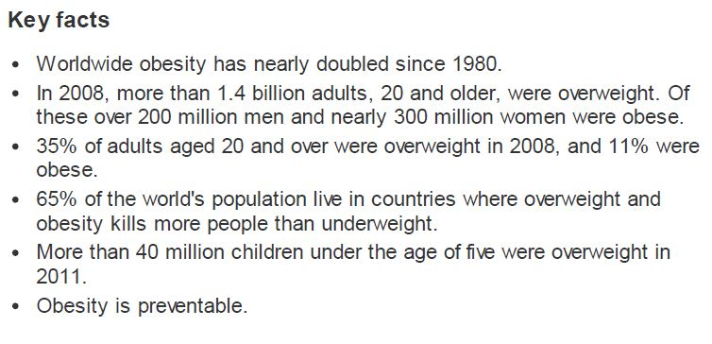
Notes:
Taken from the WHO Obesity and overweight fact sheet March 2013.

Slide 4
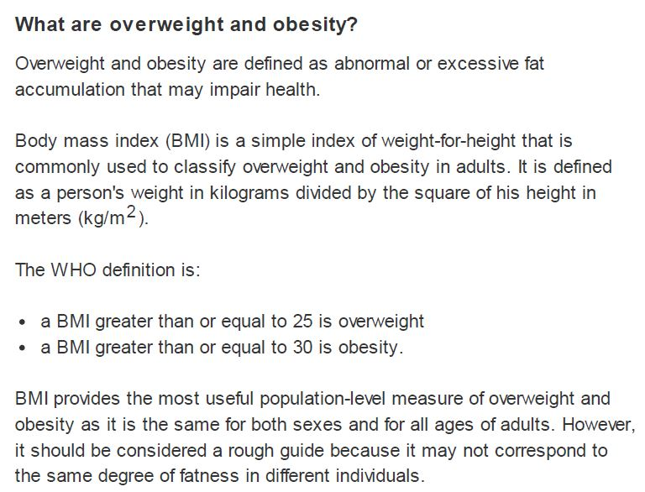
Notes:
Taken from the WHO Obesity and overweight fact sheet March 2013.

Slide 5
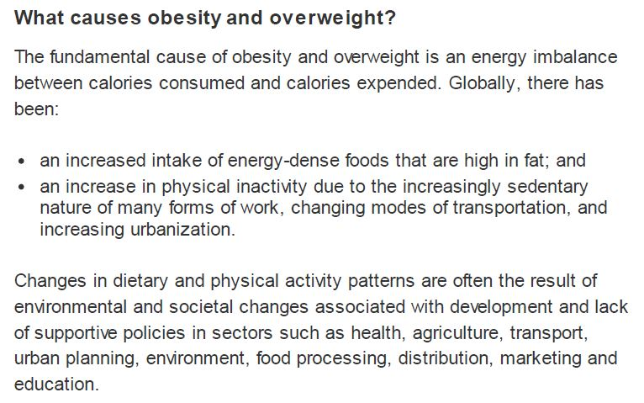
Notes:
Taken from the WHO Obesity and overweight fact sheet March 2013.

Slide 6
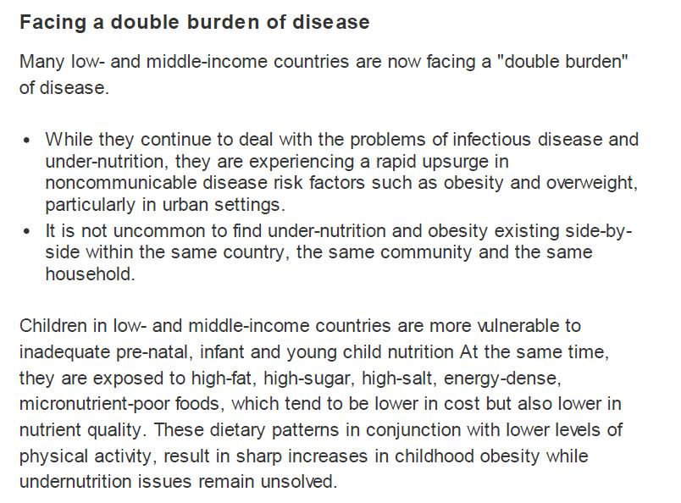
Notes:
Taken from the WHO Obesity and overweight fact sheet March 2013.

Slide 7
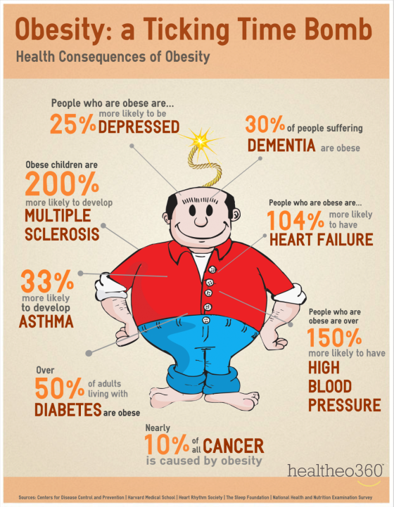
Notes:
Obesity Vs. Smoking
Obesity Costs Employers 45% more in Medical Costs!
While smoking has been an “easy target” for thousands of health and wellness initiatives over the years, many recent studies have pointed to obesity as a higher risk and cost for health insurance plans.
http://www.healtheo360.com/blog/729/obesity-a-ticking-time-bomb/#.Ul8nnRCabug

Slide 8
Overweight at young ages Source: Global School Based Health Survey 2012
Notes:
Incidence of NCD increasing and starts at younger age. More than 50% surveyed students 13-15 in Tonga, Cook and Niue were over weight.
Slide was taken from the “Economic Costs of NCD” power point from the 5th Pacific NCD Forum Political Commitment to Resiliant Actions. Auckland, New Zealand 9/23 – 9/26/13.

Slide 9
Childhood Obesity
An increasing problem in the Pacific with some coexistence of micronutrient deficiency
Definite risk factor for Adult Obesity & Diabetes
Increasing prevalence of Type 2 or adult-onset diabetes in children (11yrs)
The pacific is raising the most obese generation ever in its human history ….. (PPAC 2011)
Notes:
Slide was taken from the “NEW NCD ADVOCACY FROM BROWN TO GREEN ECONOMY IN A BLUE CONTINENT” power point from the 5th Pacific NCD Forum Political Commitment to Resiliant Actions. Auckland, New Zealand 9/23 – 9/26/13.

Slide 10
Policies to reduce the impact on children of marketing of foods and non-alcoholic beverages high in fat, free sugars, or salt
Country / Area | Policy? | Voluntary or enforced? | Targeted to:
 |  |  | Schools | Broadcast media (TV/ Radio) | Print-based media (e.g. billboards, magazines) | Web-based social media | Sporting events
Fiji | Yes | Voluntary | Yes | Yes | Yes | Yes | Yes
Kiribati | Yes | Voluntary | Yes | No | Yes | No | No
New Caledonia | Yes | Voluntary | Yes | Yes | Yes | Yes | Yes
Northern Mariana Islands | Yes | Voluntary | Yes | Yes | Yes | Yes | Yes
Palau | Yes | Voluntary | Yes | No | Yes | No | Yes
Samoa | Yes |  | Yes | No | No | No | No
Solomon Islands | Yes | Enforced | Yes | Yes | No | No | Yes
Tokelau | Yes | Voluntary | Yes | No | No | No | No
Tuvalu | Yes | Enforced | Yes | Yes | Yes | DK | DK
Vanuatu | Yes | Voluntary | Yes | No | No | No | No
Source: WHO NCD Country Capacity Survey 2013
Notes:
Slide was taken from the “NEW NCD ADVOCACY FROM BROWN TO GREEN ECONOMY IN A BLUE CONTINENT” power point from the 5th Pacific NCD Forum Political Commitment to Resiliant Actions. Auckland, New Zealand 9/23 – 9/26/13.

Slide 11
Unhealthy diet contributes to all major NCDs and intermediate risk factors
NCDs | Unhealthy diet | Smoking | Alcohol | Physical activity
Cancer | ✓ | ✓ | ✓ | ✓
Cardiovascular disease* | ✓ | ✓ | ✓ | ✓
Type 2 diabetes | ✓ | ✓ |  | ✓
Respiratory conditions** | ✓ | ✓
Risk factors
Obesity | ✓ |  |  | ✓
⇧ blood pressure | ✓ | ✓ | ✓ | ✓
⇧ blood glucose | ✓ |  | ✓ | ✓
⇧ blood lipids | ✓ | ✓ | ✓ | ✓
Abnormal lung function | ✓ | ✓ |  | ✓
* Includes heart disease, stroke, hypertension ** Including chronic obstructive pulmonary disease & asthma
Notes:
Slide was taken from the “Unhealthy diet and physical Activity Monitoring and Surveillance -towards the 2025 global targets.” power point from the 5th Pacific NCD Forum Political Commitment to Resiliant Actions. Auckland, New Zealand 9/23 – 9/26/13. Dr Colin Bell, WHO Suva.
11

Slide 12
Prevalence of Obesity (aged 20+)
BMI 30 ≥ kg/m²
Age-standardized adjusted estimates. Global Status Report
Notes:
Slide was taken from the “Unhealthy diet and physical Activity Monitoring and Surveillance -towards the 2025 global targets.” power point from the 5th Pacific NCD Forum Political Commitment to Resiliant Actions. Auckland, New Zealand 9/23 – 9/26/13. Dr Colin Bell, WHO Suva.

Slide 13
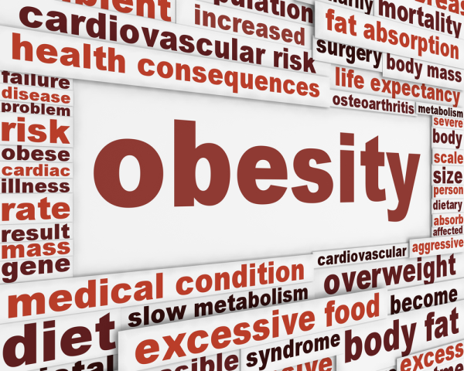
Notes:
Establishing the links between obesity and chronic health problems
Obesity is more than just a matter of size - the scope of the condition can have long-term consequences for a person's health, particularly for young people.
http://blog.cybexintl.com/blog/bid/113360/Establishing-the-links-between-obesity-and-chronic-health-problems

Slide 14
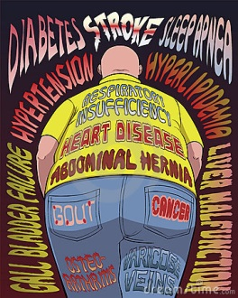
Notes:
Health Risks of Obesity
http://www.dreamstime.com/royalty-free-stock-image-health-risks-obesity-image19318676

Slide 15
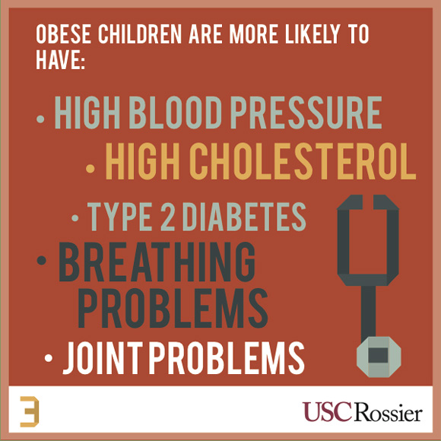
Notes:
Did you know that obese children are more likely to have high blood pressure, high cholesterol, type 2 diabetes, breathing problems and joint problems?
http://rossieronline.usc.edu/understanding-childhood-obesity/understanding-childhood-obesity-3/

Slide 16
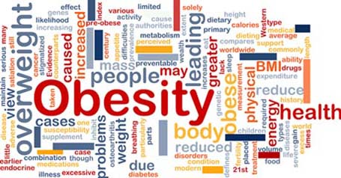
Notes:
Apart from tobacco, there is perhaps no greater harm to the collective health in the U.S. than obesity. Worldwide, too, obesity’s health effects are deep and vast—and they have a real and lasting impact on communities, on nations, and most importantly, on individuals, today and across future generations
http://www.hsph.harvard.edu/obesity-prevention-source/obesity-consequences/

Slide 17
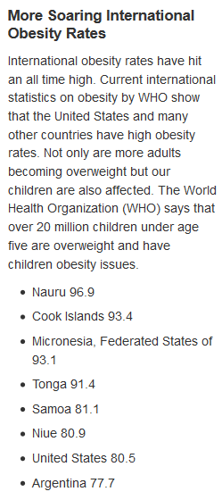
Notes:
http://mecheshier.hubpages.com/hub/International-Obesity-Facts-Highest-vs-Lowest-Worldwide-Obesity-Rates

Slide 18
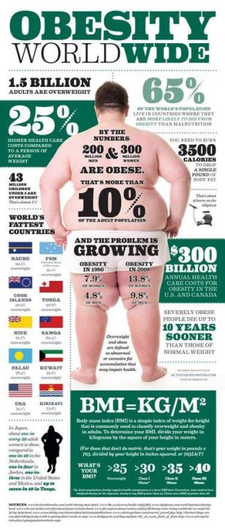
Notes:
With fast food available on every corner in some of the United States’ most urban cities, it’s no wonder we’re among the top 10 most obese countries in the world.
http://nutribulletblog.com/obesity-worldwide-infographic/

Slide 19
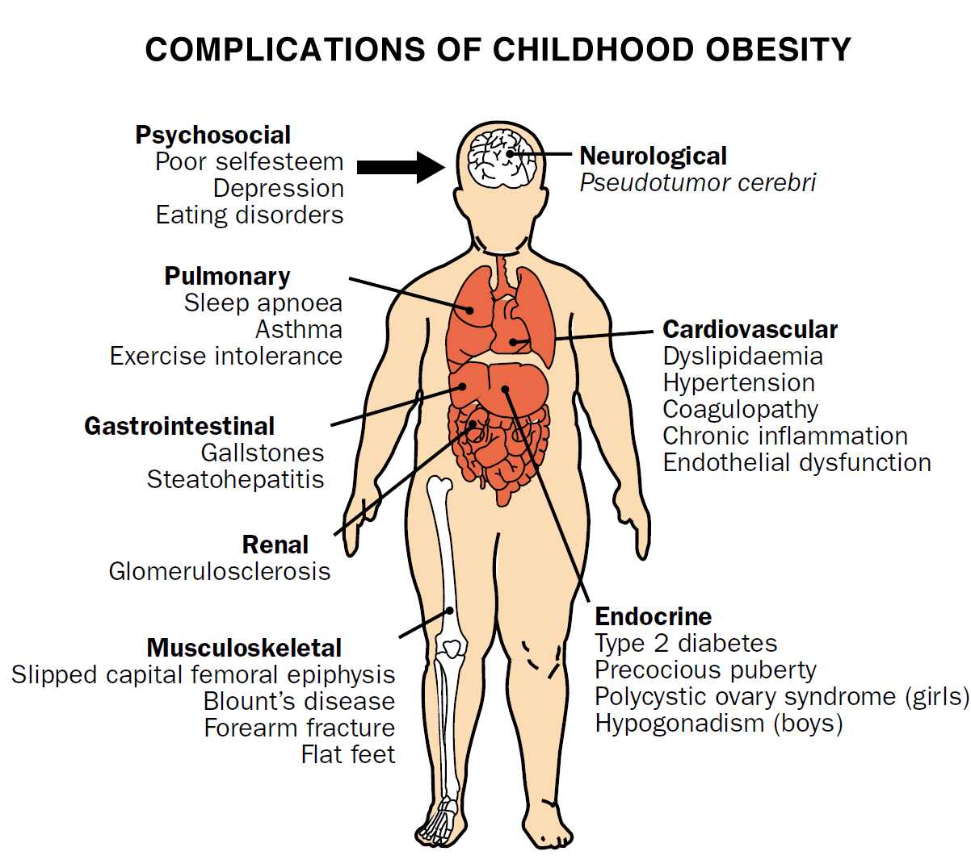
Notes:
Obesity is a chronic and progressive disease that can affect multiple organs in the body. People with clinically severe obesity are at medical risk of disability or premature death. The estimated number of deaths attributable to obesity among U.S. adults is approximately 280,0001 each year. At the top of the list of obesity-related comorbidities are adult onset diabetes and high blood pressure. High blood pressure caused by clinically severe obesity can contribute to heart attacks, congestive heart failure and stroke. http://www.patient-help.com/9650/understanding-the-impact-of-obesity#axzz2hvTX3Ud5

Slide 20
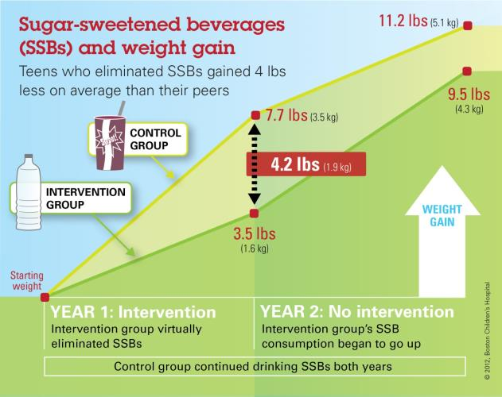
Notes:
Non-caloric beverages can help teens avoid excessive weight gain, study shows
A new study published today in the New England Journal of Medicine shows that adolescents who eliminated sugar-sweetened beverages for one year gained less weight than those who didn't, shedding light on an effective intervention to help combat adolescent obesity.
http://medicalxpress.com/news/2012-09-non-caloric-beverages-teens-excessive-weight.html

Slide 21
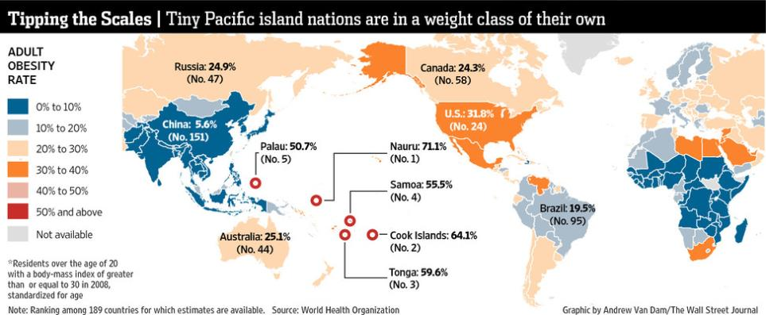

Slide 22
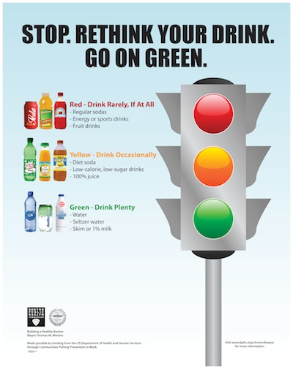
Notes:
The City of Boston has banned sugary beverages from city-owned property and city-managed food and beverage programs. Only healthier drinks, such as low-calorie beverages, 100 percent juices, water and seltzers will be allowed.
http://behealthy.baystatebanner.com/issues/2011/09-2011/StopRethinkYourDrink.html

Slide 24
Notes:
Raised body mass index (overweight and obesity) is an important cause of chronic disease.
http://www.who.int/chp/chronic_disease_report/samoa.pdf

Slide 25
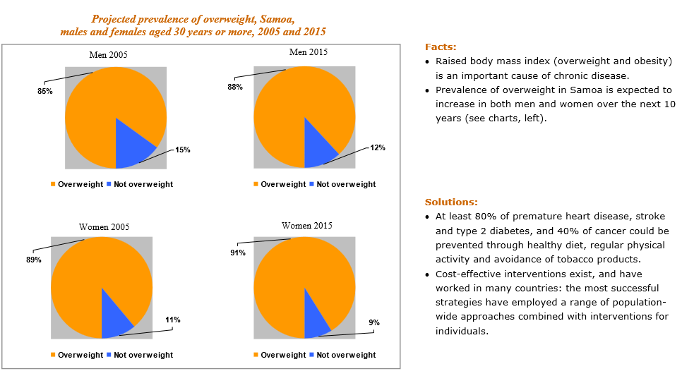
Notes:
http://www.who.int/chp/chronic_disease_report/samoa.pdf

Slide 26
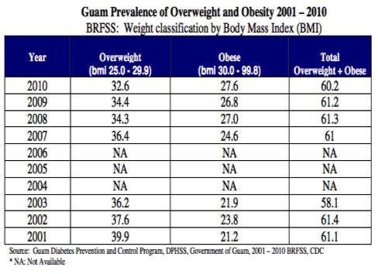
Notes:
Children in particular have fallen victim to the spread of poor dietary habits in Guam, with even worse statistics than in America. A study was carried out in a middle school and high school and found that, alarmingly, 26% of middle school children in Guam eat fast food at least three times a week, 53.3% of students drink at least two cans of soda a day, and the most shocking: 75.3% of students have consumed less than one fruit or vegetable serving per day.
http://blogs.scientificamerican.com/expeditions/2013/06/13/a-persistent-case-of-diabetes-mellitus-in-guam/

Slide 27
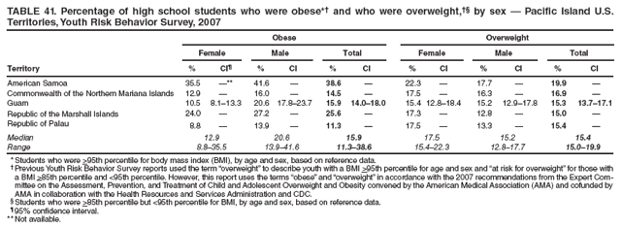
Notes:
Obese
Across surveys, the overall percentage of students who were obese ranged from 11.3% to 38.6% (median: 15.9%). Prevalence among female students ranged from 8.8% to 35.5% (median: 12.9%), and prevalence among male students ranged from 13.9% to 41.6% (median: 20.6%) (Table 41).
Overweight
Across surveys, the overall percentage of students who were overweight ranged from 15.0% to 19.9% (median: 15.4%). Prevalence among female students ranged from 15.4% to 22.3% (median: 17.5%), and prevalence among male students ranged from 12.8% to 17.7% (median: 15.2%)
http://www.cdc.gov/mmwr/preview/mmwrhtml/ss5712a2.htm

Slide 28
Battling American Samoa's 75-percent obesity rate
http://www.cbsnews.com/8301-18563_162-57592578/battling-american-samoas-75-percent-obesity-rate/

Slide 29
'Big boys' complete Round the Bays
http://www.3news.co.nz/Big-boys-complete-Round-the-Bays/tabid/423/articleID/289698/Default.aspx

Slide 30
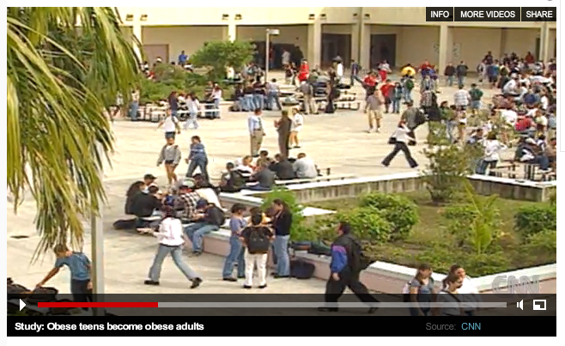
Obese teens become obese adults
http://www.cnn.com/2010/OPINION/12/06/frum.obesity.military/index.html

Slide 31
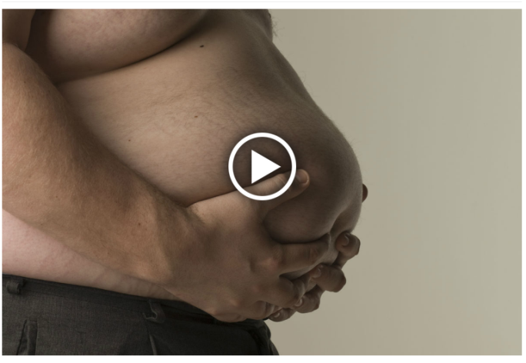
More New Zealanders dying of obesity - study
http://www.3news.co.nz/More-New-Zealanders-dying-of-obesity--study/tabid/1807/articleID/280531/Default.aspx

Slide 32
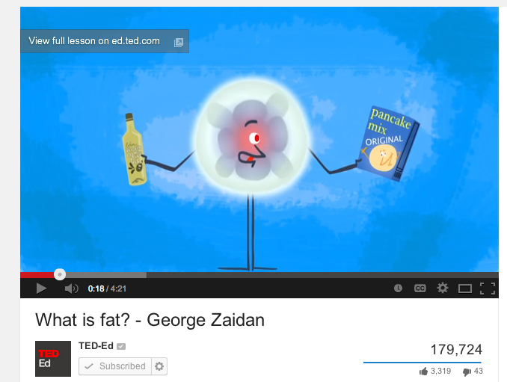
Video
http://youtu.be/QhUrc4BnPgg

