Slide 1
Slides that can be used to supplement a power point on the cost of obesity

Slide 2
Notes:
Taken from “Obesity in the Pacific to Big to Ignore.”
http://www.wpro.who.int/publications/docs/obesityinthepacific.pdf

Slide 3
At least 70% all deaths are from NCDs Source: WHO (2011) Noncommunicable Diseases Country Profiles
NCD and other, proportion of total deaths all ages, 2008 | Samoa | Tonga | Vanuatu
NCD
Cardiovascular disease | 37% | 38% | 36%
Chronic Respiratory Diseases | 7% | 7% | 6%
Cancers | 6% | 9% | 12%
Diabetes | 5% | 5% | 4%
Other NCDs | 15% | 15% | 13%
Total NCDS | 70% | 74% | 70%
Communicable, maternal, perinatal and nutritional conditions | 25% | 22% | 24%
Injuries | 5% | 4% | 5%
Notes:
Slide was taken from the “Economic Costs of NCD” power point from the 5th Pacific NCD Forum Political Commitment to Resiliant Actions. Auckland, New Zealand 9/23 – 9/26/13.

Slide 4
Multiple risk factors are feeding a large pipeline of future NCDs in other countries of Pacific too (Source WHO 2012)
Notes:
Pacific has some of the highest rate of Obesity and Diabetes in the world. Close association with stroke, amputation lead to permanent disability, very costly.
Slide was taken from the “Economic Costs of NCD” power point from the 5th Pacific NCD Forum Political Commitment to Resiliant Actions. Auckland, New Zealand 9/23 – 9/26/13.

Slide 5
Economic Burden
NCDs undermines the four main factors of economic growth:
Labour supply
Productivity
Investment
Education
Unaddressed NCDs will negatively impact economic development
World Economic Forum ranks NCD as one of the top global threats to economic development
Notes:
Slide was taken from the “NEW NCD ADVOCACY FROM BROWN TO GREEN ECONOMY IN A BLUE CONTINENT” power point from the 5th Pacific NCD Forum Political Commitment to Resiliant Actions. Auckland, New Zealand 9/23 – 9/26/13.

Slide 6
Health Costs
Consume health budgets
57.8% of Tonga health budget for treatment of NCD (2002)
40% of Fiji health expenditure (1998) for treatment of NCDs
55% of Palau health budget (2010)
Estimate economic loss in Nauru (2005) – approx. AUD$5.5 million
# Andrew Dalton et al 2002, Burden of Illness study
Notes:
{ TABLE “Costs of Treating NCDs in some Pacific countries compared to other diseases” } Obesity and related NCD impose a heavy burden on the health care systems and the economies of countries, as well as the quality of life of the people.
The cost of managing NCD is responsible for about half of health expenditure in some Pacific countries.
Slide was taken from the “NEW NCD ADVOCACY FROM BROWN TO GREEN ECONOMY IN A BLUE CONTINENT” power point from the 5th Pacific NCD Forum Political Commitment to Resiliant Actions. Auckland, New Zealand 9/23 – 9/26/13.

Slide 7
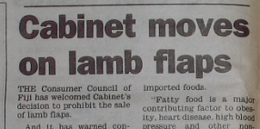
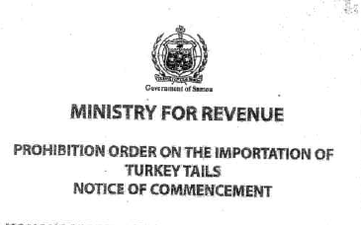
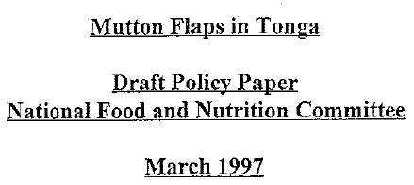
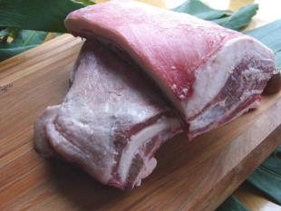
Fiji, Samoa and Tonga move to ban imported fatty meats
Thow AM, Swinburn B, Colagiuri S, Diligolevu M, Quested C, Vivili P and Leeder S 2010. Trade and food policy: case studies from three Pacific Island Countries. Food Policy, 35:556-564.
Notes:
Fiji lamb flap ban
Samoa turkey tail ban
Tonga proposal to ban mutton flaps – didn’t go anywhere
Slide was taken from the “NEW NCD ADVOCACY FROM BROWN TO GREEN ECONOMY IN A BLUE CONTINENT” power point from the 5th Pacific NCD Forum Political Commitment to Resiliant Actions. Auckland, New Zealand 9/23 – 9/26/13.

Slide 8
Notes:
The Cost of Cooking vs Fast Food

Slide 9
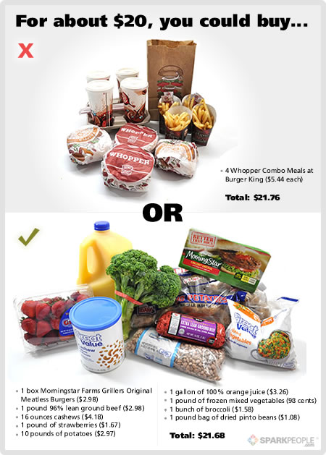
Notes:
The Cost of Cooking vs Fast Food
An example of two options you could purchase for a family of four.

Slide 10
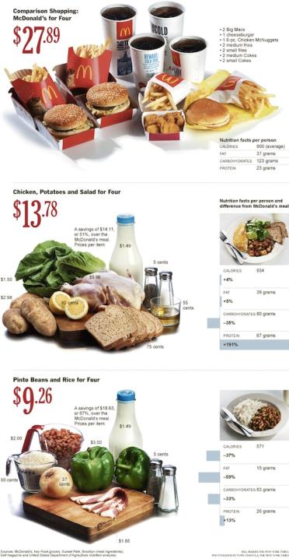
Notes:
The Cost of Cooking vs Fast Food
This graphic shows the cost and nutrition of a meal for four at McDonald’s versus two different home cooked options.

Slide 11
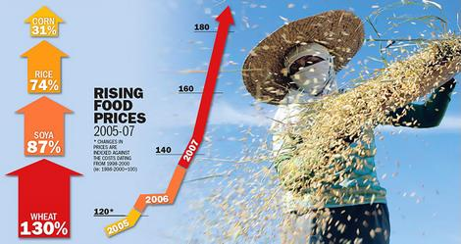
Notes:
Over the past decade the world has witnessed a drastic rise in food prices. According to the World Bank, over the past three years alone, global food prices have increased over 80%^{[2]} These dramatic increases can be attributed to the convergence of factors that has created the perfect storm for food prices. Prime among these factors is a world that is growing both more populous and prosperous. New wealth in rapidly developing nations such as China, India, Brazil and Vietnam is allowing billions of people to increase their caloric intake, increasing global demand and straining supplies. Similarly in response to a more prosperous and populous world, global energy prices have skyrocketed, increasing input prices for food production. High energy prices, in turn, have triggered a shift toward ethanol and biodiesels which further increases the demand for crops such as corn and soybeans. Finally, an increase in crop shortages caused by "freak" weather occurrences such as a 10 year drought in Australia and floods in south Asian as well as pest outbreaks.
http://www.wikinvest.com/industry/Food_%26_Beverage

Slide 12
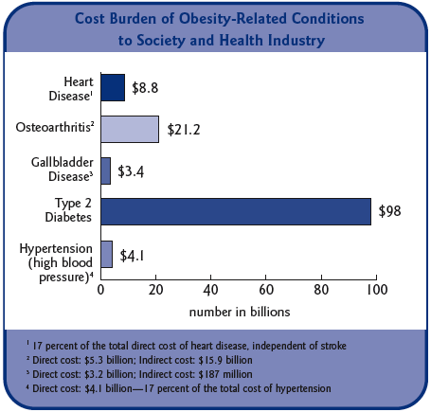
Notes:
Economic Consequences of Obesity in America Overweight and obesity and their associated health problems have a significant economic impact on the U.S. health care system (USDHHS, 2001). Medical costs associated with overweight and obesity may involve direct and indirect costs (Wolf and Colditz, 1998; Wolf, 1998). Direct medical costs may include preventive, diagnostic, and treatment services related to obesity. Indirect costs relate to morbidity and mortality costs. Morbidity costs are defined as the value of income lost from decreased productivity, restricted activity, absenteeism, and bed days. Mortality costs are the value of future income lost by premature death.
http://www.getamericafit.org/statistics-obesity-in-america.html

Slide 13
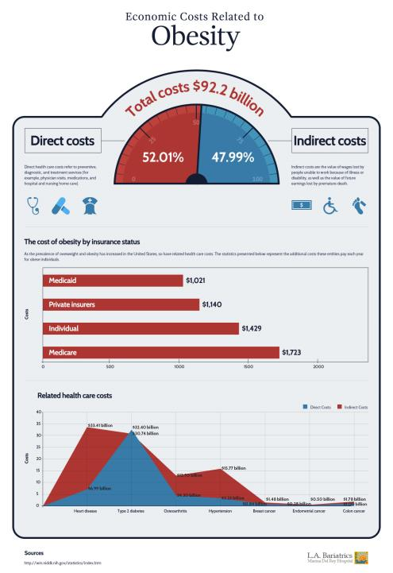
Notes:
Obesity not just affects our health but our pockets as well. The costs related to obesity totals in an enormous sum.
http://visual.ly/economic-costs-obesity

Slide 14
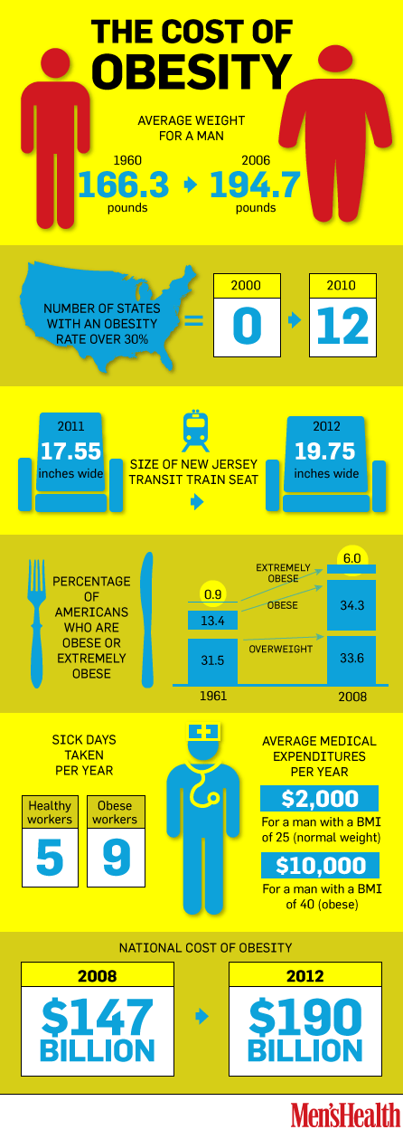
Notes:
While the health effects of obesity are well documented, the economic and social effects are just coming into play, a new report published by Campaign to End Obesity says. The national cost of obesity is now estimated at $190 billion, or $607.77 per person.
http://news.menshealth.com/cost-of-obesity/2012/05/09/

Slide 15
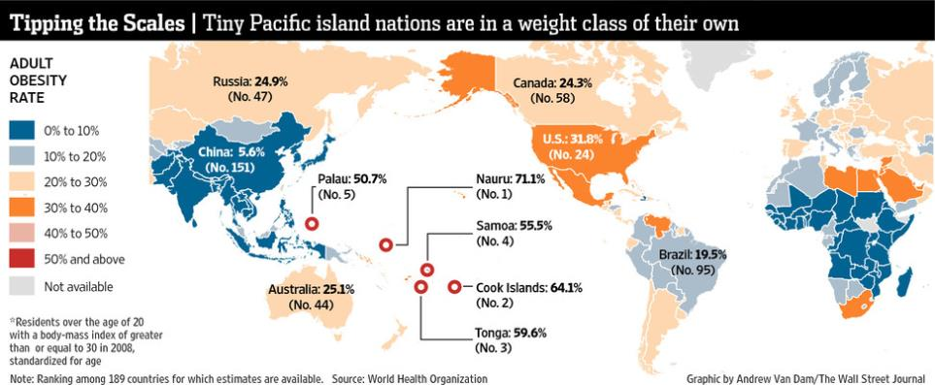

Slide 16
Samoa Air defends weighty fares
Notes:
"A kilo is a kilo is a kilo."
That's the approach of Samoa Air's chief executive to his airline's pay-by-weight fares, which have sparked hefty debates around the world.
http://www.3news.co.nz/Samoa-Air-defends-weighty-fares/tabid/1807/articleID/292855/Default.aspx

Slide 17
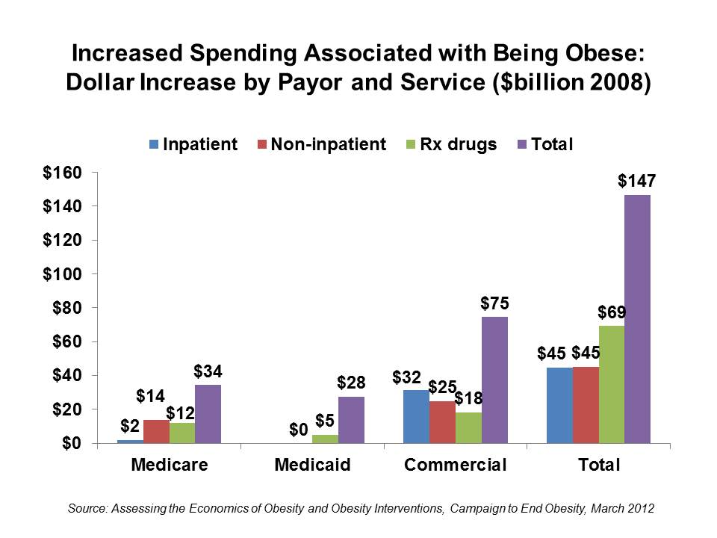
Notes:
The newest aspect of health spending driver is obesity: the U.S. wins the global obesity contest:
US: 34% score a BMI over 30.
New Zealand (the next most-obese nation): 26.5%.
Australia: 24.8%.
Canada: 24.2%.
UK: 23%
Other countries studied: fewer than 20%.
The leanest live in Switzerland and Japan, according to the latest OECD health database.
http://stevensonfinancialmarketing.wordpress.com/category/healthcare-reform/page/3/

Slide 18
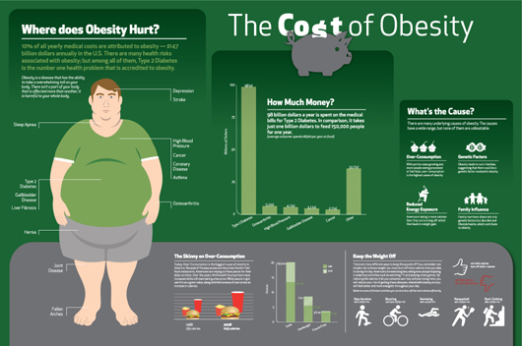

Slide 19
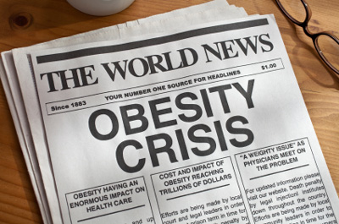
Notes:
http://www.upmcmyhealthmatters.com/2013/01/07/carrying-around-more-weight-than-whats-ideal/

Slide 20
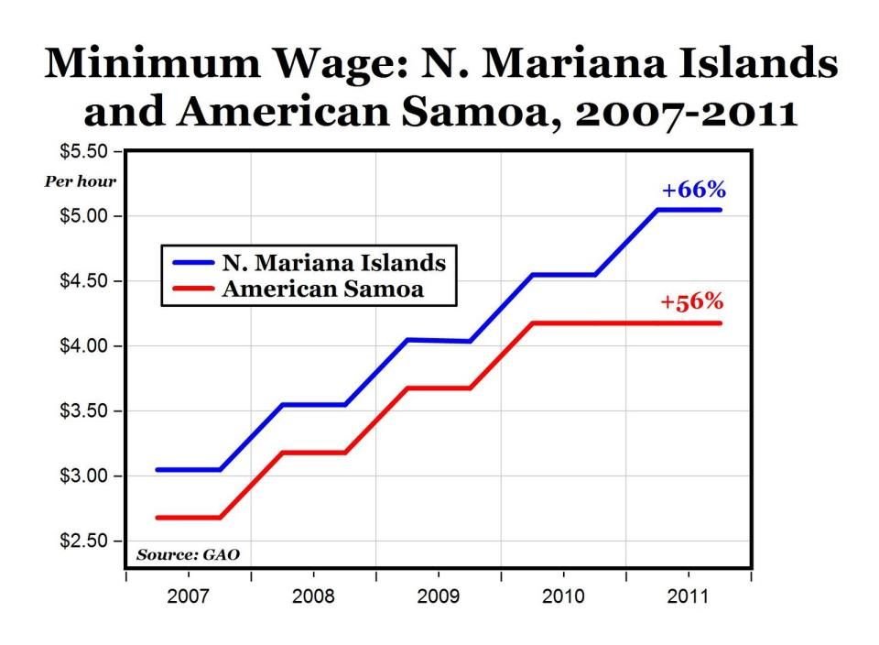
Notes:
http://mjperry.blogspot.com/2011/07/amazing-discovery-by-gao-in-american.html
http://www.gao.gov/new.items/d11427.pdf

Slide 22
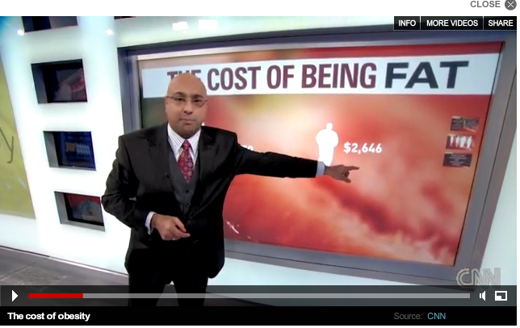
The Cost of Being FAT
http://www.cnn.com/2010/OPINION/12/06/frum.obesity.military/index.html
Notes:
http://www.cnn.com/2010/OPINION/12/06/frum.obesity.military/index.html

