Slide 1
Slides that can be used to supplement a power point on breastfeeding

Slide 2
How long should a mother breastfeed?
The American Academy of Pediatrics (AAP) recommends that breastfeeding continue for at least 12 months, and thereafter for as long as mother and baby desire. The World Health Organization recommends continued breastfeeding up to 2 years of age or beyond.
Notes:
Taken from http://www.cdc.gov/breastfeeding/faq/index.htm

Slide 3
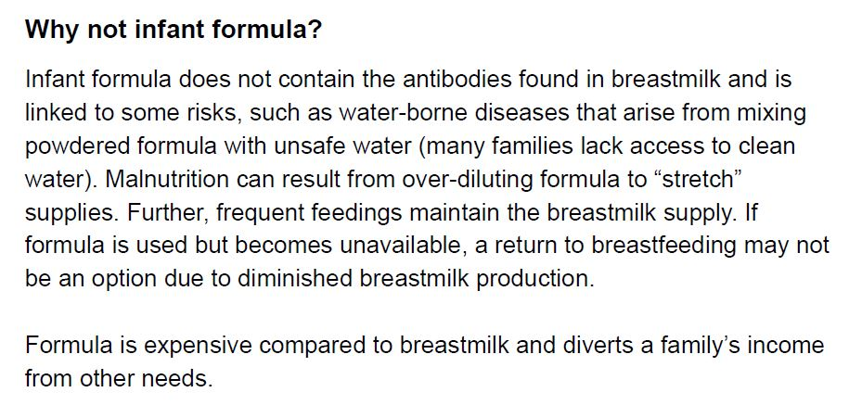
Notes:
Taken from the WHO Breastfeeding Fact sheet 17 March 2012

Slide 4
Notes:
Taken from the WHO Breastfeeding Fact sheet 17 March 2012

Slide 5
Notes:
Taken from http://mededppd.org/presentations/bolger03/html/index.html

Slide 6
Where can I find answers to my other questions about breastfeeding?
To find additional resources on breastfeeding:
National Women's Health Information Center
American Academy of Pediatrics' Children's Health Topics: Breastfeeding
To locate someone who can help you with practical breastfeeding concerns, begin by talking to your pediatrician. In addition, you may wish to contact your State or County Health Department, your local Special Supplemental Nutrition Program for Women, Infants, and Children (WIC) clinic, or one of the local La Leche League affiliates. To locate a Board Certified Lactation Consultant (IBCLC), visit The International Lactation Consultant Association.
Notes:
Taken from http://www.cdc.gov/breastfeeding/faq/index.htm

Slide 7
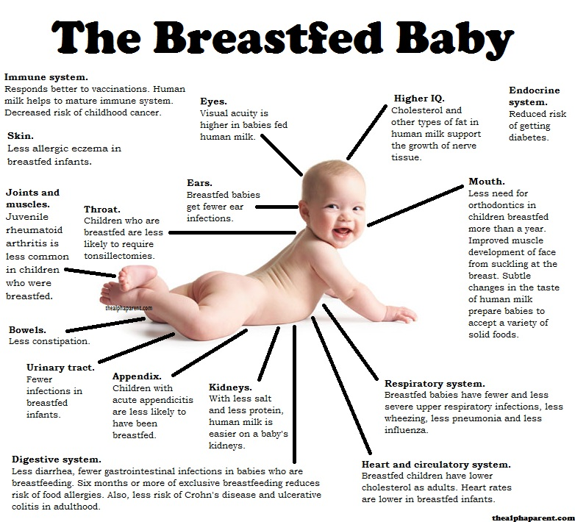
Notes:
Taken from http://www.thealphaparent.com/2011/12/diagram-of-breastfed-baby.html

Slide 8
Key Messages
Increase food intake: “an additional meal, more food than usual, and a varied diet”.
Take vitamin A at delivery or within 6 weeks after delivery.
Eat foods rich in vitamin A (papaya, mangoes, carrots, pumpkins, liver.”
Continue iron/folic acid supplementation to complete 6 months in total (during pregnancy and/or lactation).
Notes:
Taken from: Key and Supporting Messages. Counselling Cards. CARE. University Research CO. Center for Human Services.

Slide 9
Key Messages
Breastfeeding makes your baby grow strong and healthy and helps to prevent diarrhoea and respiratory infections.
Breastmilk is the best food and it is all that your baby needs for the first 6 months.
Giving other feeds can make your baby ill.
Do not give anything else to your baby before 6 months, NOT ecen water (tea, sugar water, gripe water, other animals milks, infant formula or porridge.)
Notes:
Taken from: Key and Supporting Messages. Counselling Cards. CARE. University Research CO. Center for Human Services.

Slide 10
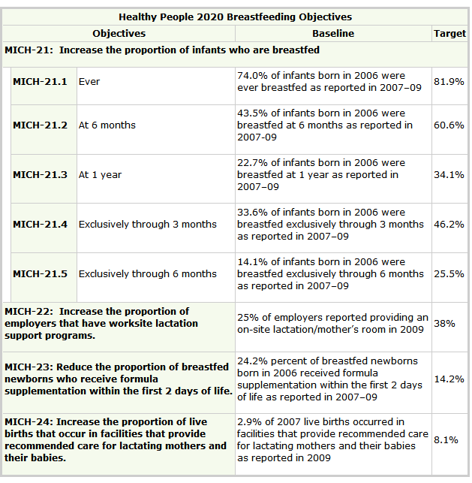
Notes:
Taken from http://www.cdc.gov/breastfeeding/policy/hp2010.htm?topicId=26
Healthy People 2020 Objectives for the Nation
Healthy People is a national health promotion and disease prevention initiative that brings together national, state, and local government agencies; nonprofit, voluntary, and professional organizations, businesses, communities; and individuals to address major public health issues. The report Healthy People 2020, released by the Department of Health and Human Services in December 2, 2010, is the latest science-based, 10-year national objective plan developed that serves as a roadmap for improving the nation's health.
There are four objectives and five sub-objectives related to breastfeeding found under the Maternal, Infant and Child Health topic section.

Slide 11
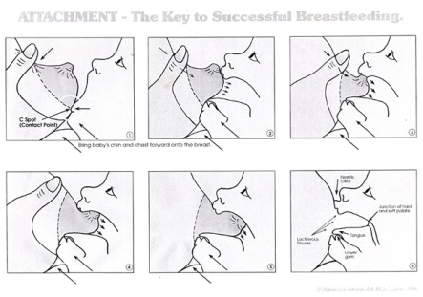
Notes:
Taken from http://quickening.id.au/qss/articles/breastfeeding-diagram.html

Slide 12
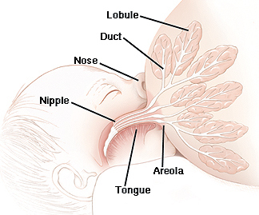
Notes:
Taken from http://drewstarr.wordpress.com/pictures/attachment/68994/

Slide 13
Notes:
http://fortunatechance.blogspot.com

Slide 14
Notes:
http://www.acf.hhs.gov/programs/ohsepr/infant-feeding-during-disasters

Slide 15
Notes:
http://www.who.int/mediacentre/events/meetings/2013/world_breastfeeding_week/en/

Slide 19
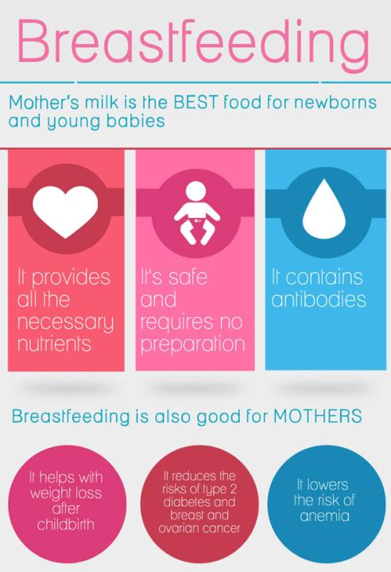
Notes:
http://www.thebahamasweekly.com/publish/caribbean-news/PAHO_WHO_urges_support_for_nursing_mothers_to_ensure_exclusive_breastfeeding_up_to_six_months29790.shtml

Slide 20
Notes:
http://www.ucollectphotos.com/breastfeeding-vs-formula-whats-best-for-baby/

Slide 21
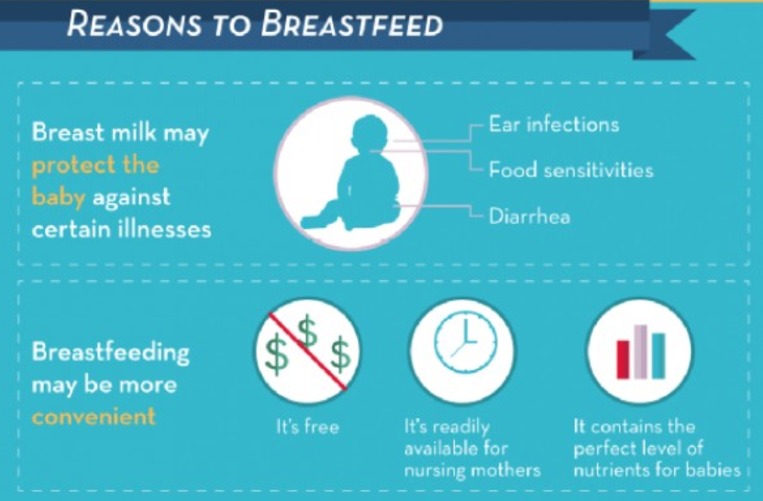

Slide 22
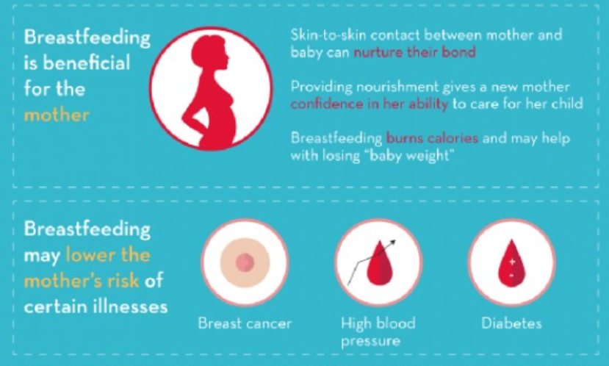

Slide 23
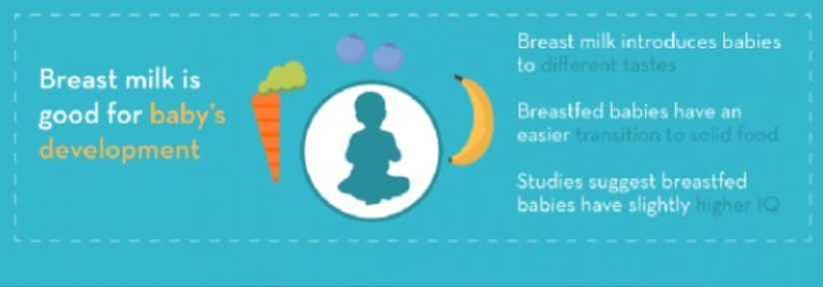

Slide 24
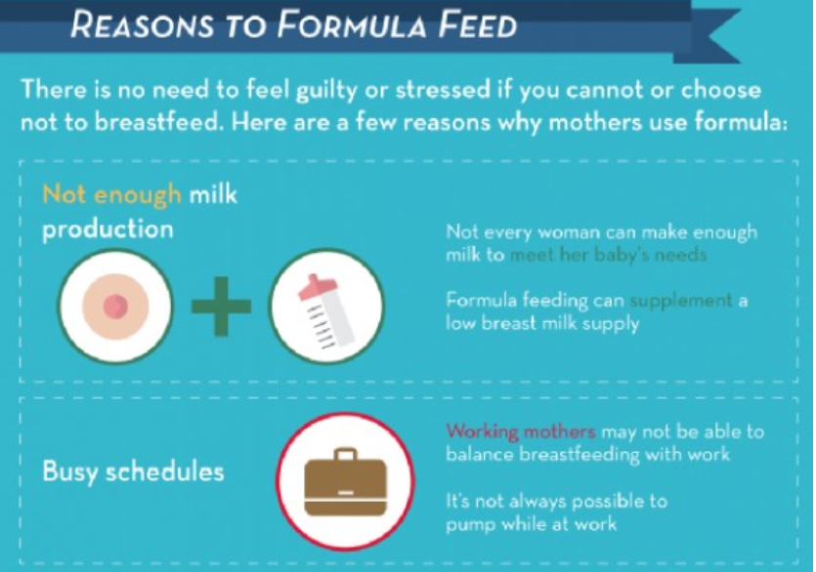

Slide 25
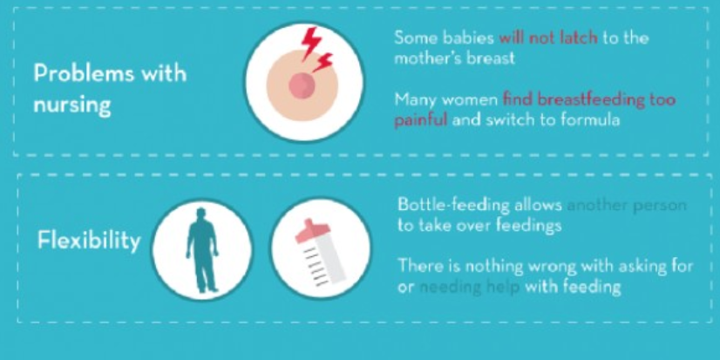
Notes:
www.pediatriciansleessummit.net

