Slide 1
Supplemental slides to Implement Policies that Promote the Production and Consumption of Local Foods

Slide 2
Economy
By purchasing local foods the money stays in the country and supports the grower’s family and the national economy. By growing local foods people are less reliant on the cash economy for survival and can obtain nutrient-rich sustenance with very little input. Surplus can also be sold or preserved, with opportunities for entrepreneurial food processing initiatives existing.
Notes:
Taken from http://www.islandfood.org/

Slide 3
Local food systems
A local food system is one where food production and distribution is geographically localized rather than globally sourced, processed and transported.
This has many benefits for environmental sustainability, for ourselves through the freshness and local varieties of products, the health of our community, culture and the local economy.
Notes:
Taken from http://www.islandfood.org/

Slide 4
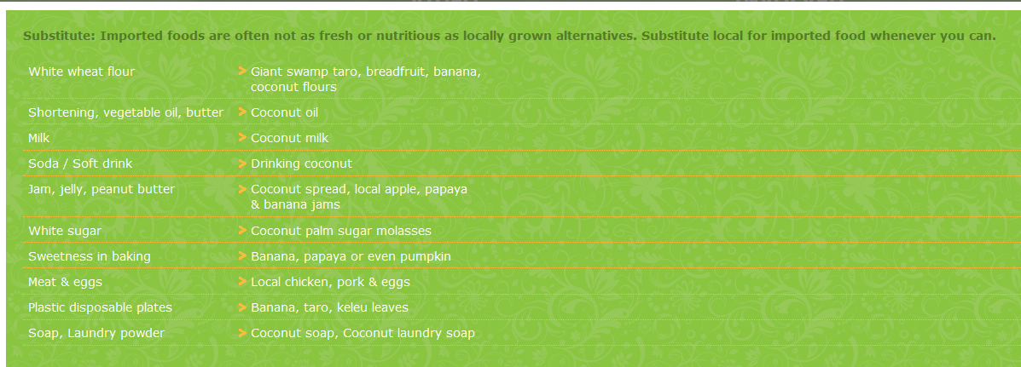
Notes:
Taken from http://www.islandfood.org/involved.html

Slide 5
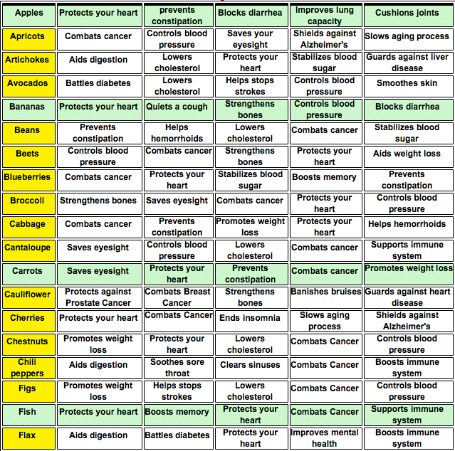
Notes:
Taken from http://www.escapepress.com/foodBenefits.html

Slide 6
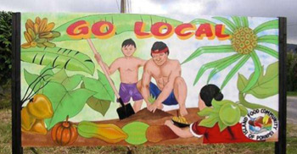
Notes:
http://www.usda.gov/wps/portal/usda/usdahome?contentidonly=true&contentid=KYF_Compass_Case_Studies_Pohnpei.html
The Island of Pohnpei Rediscovers its Agroforestry Roots
Since the 1970s, the people of Pohnpei, an island in the Federated States of Micronesia, have seen their diets shift from traditional local foods such as taro and bananas to imported foods, including refined grains, sugar, and fatty meats. The dietary shift and other lifestyle changes in the population have led to serious health problems, including a rise in diabetes and vitamin deficiencies. But, ironically, on Pohnpei and many Pacific Islands, traditional agroforestry systems - based on thousands of years of indigenous knowledge - are part of the solution because they provide traditional local food that is healthier and was once a staple of their diets.

Slide 7
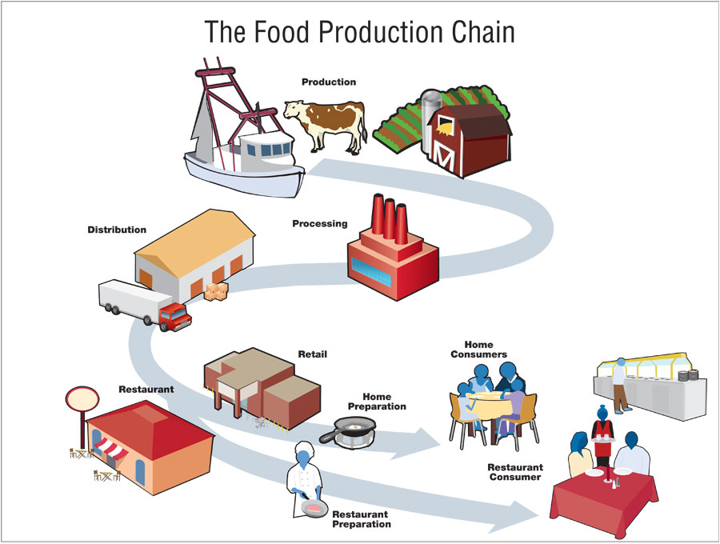
Notes:
Taken from http://www.cdc.gov/outbreaknet/investigations/figure_food_production.html

Slide 8
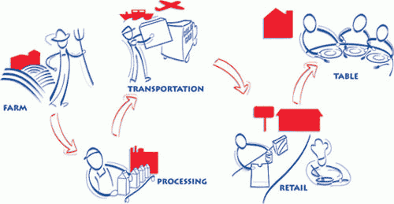
Notes:
Taken from http://www.fda.gov/Food/FoodScienceResearch/ToolsMaterials/ucm216920.htm
A multi-step journey that food travels before it is consumed.

Slide 9
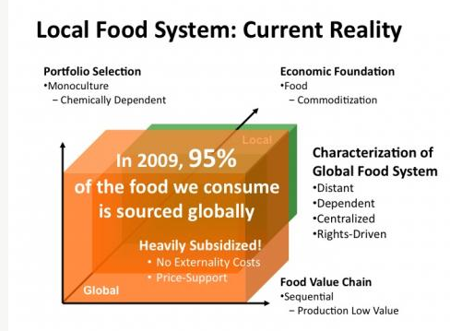
Notes:
Taken from http://localfoodsystems.org/greeneracres/economics-local-food-system

Slide 10
Notes:
Taken from http://localfoodsystems.org/greeneracres/economics-local-food-system

Slide 11
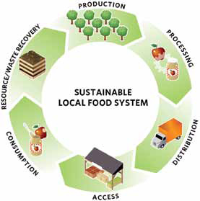
Notes:
Taken from http://www.chathamjournal.com/weekly/news/agriculture/local-food-policy-meeting-130819.shtml

Slide 12
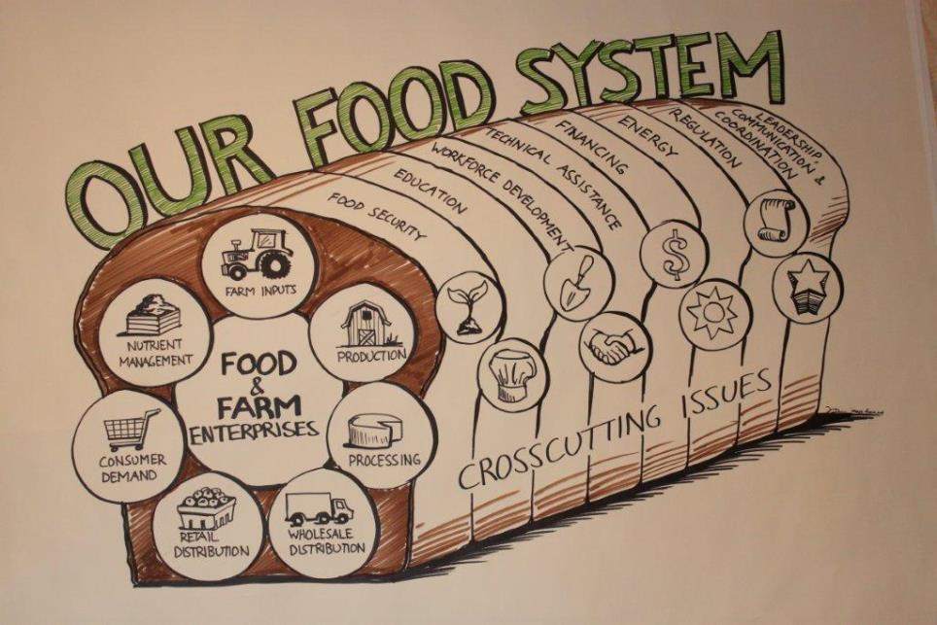
Notes:
Taken from http://www.vsjf.org/news/66/farm-to-plate-annual-gathering-taking-stock-and-moving-ahead

Slide 13
Notes:
Taken from http://hfhpcoalition.org/policy-research-and-analysis/

Slide 14
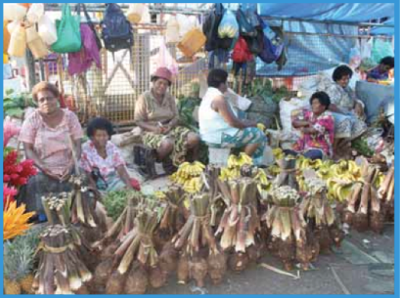
Traditionally, the Pacific achieved food security through
sustainable agriculture and fishing practices and a reliance
on local staples including:
-Roots
-Tubers
-Bananas
-Breadfruits
Notes:
http://projects.nri.org/tropicalroots/photos.html
http://www.wpro.who.int/nutrition/documents/Pacific_Food_Summit_Report/en/index.html

Slide 15
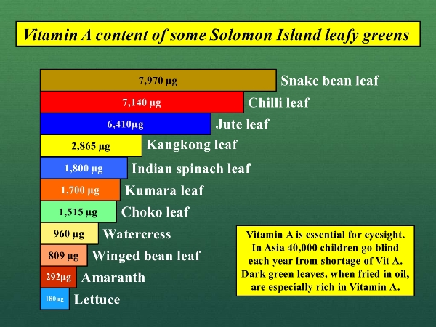
Notes:
Taken from http://learngrow.org/about-fps/the-advantages/
Food Plant Solutions empowers people in developing countries to harness local food plant resources to feed themselves and their families. No costly equipment or structural improvements are required to get people switched onto the advantages of growing local food plants including: • greater production • better adaptation to local conditions – soil type, rainfall, temperature • better resistance to pests and diseases, hence lower costs for pesticides • simpler growing requirements, no need for extensive areas cleared for monoculture cultivation • better nutritional quality of local food plants Bruce French has documented that local food crops are frequently nutritionally superior to exotic food crops. Nutrient levels in local food crops can be dramatically better than in exotic food plants.

Slide 16
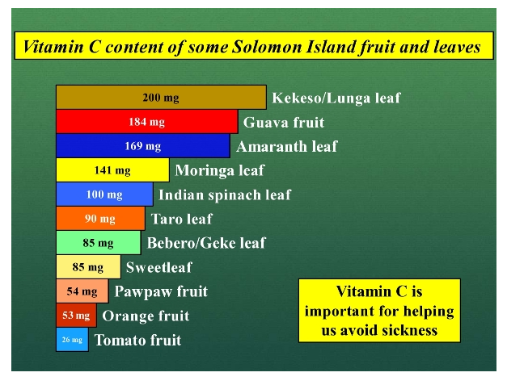
Notes:
Taken from http://learngrow.org/about-fps/the-advantages/
The main obstacle to local people taking advantage of local food plants is a lack of knowledge about their identification, nutritional benefits and production methods. Food Plant Solutions is focussed on imparting this knowledge to people in developing countries. At a national economy level in developing countries, switching over to growing local food crops, instead of growing exotic food crops or importing foodstuffs, can insulate the national economy from the shocks of rising world food prices or oil based products e.g. fertilisers and pesticides. Rising prices for imported foodstuffs (e.g. rice) means less money for essential services like health and education. Indirect costs, like the costs of shipping, can also push up the price of imported foodstuffs.

Slide 17
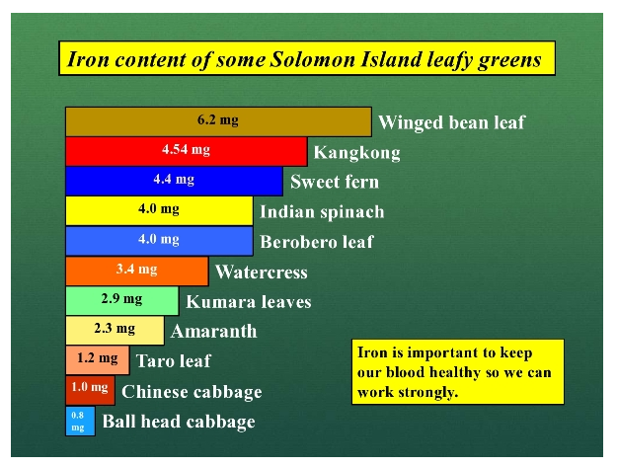
Notes:
Taken from http://learngrow.org/about-fps/the-advantages/
The main obstacle to local people taking advantage of local food plants is a lack of knowledge about their identification, nutritional benefits and production methods. Food Plant Solutions is focussed on imparting this knowledge to people in developing countries. At a national economy level in developing countries, switching over to growing local food crops, instead of growing exotic food crops or importing foodstuffs, can insulate the national economy from the shocks of rising world food prices or oil based products e.g. fertilisers and pesticides. Rising prices for imported foodstuffs (e.g. rice) means less money for essential services like health and education. Indirect costs, like the costs of shipping, can also push up the price of imported foodstuffs.

Slide 18
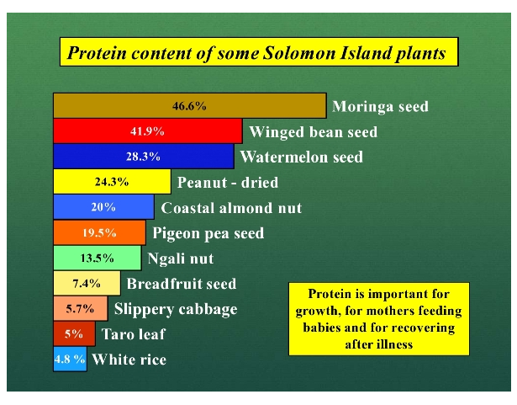
Notes:
Taken from http://learngrow.org/about-fps/the-advantages/

Slide 19
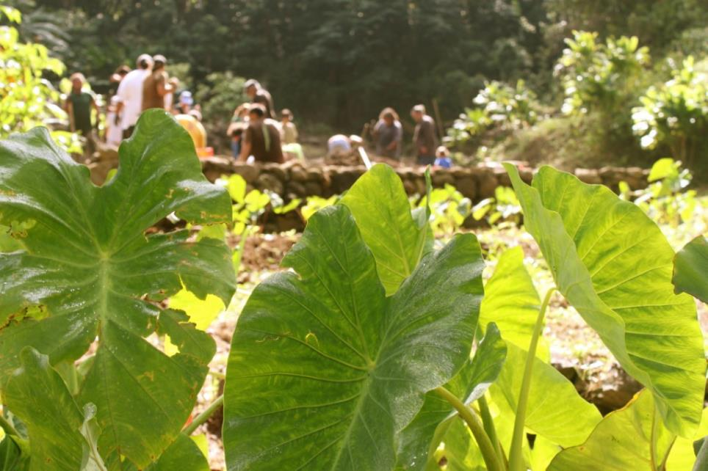
Notes:
http://kaohana.windward.hawaii.edu/?p=3366
http://www.kkv.net
Kokua Kalihi Valley (KKV)
The mission of KKV is to “be agents of healing and reconciliation for the people of Kalihi valley,” according to KKV’s co-executive director David Derauf.
“We grow kalo, vegetables and fruits. But more importantly, we grow farmers,” said group leader Nathan Kamaka as he led his volunteers to the area where they would be working.

Slide 20
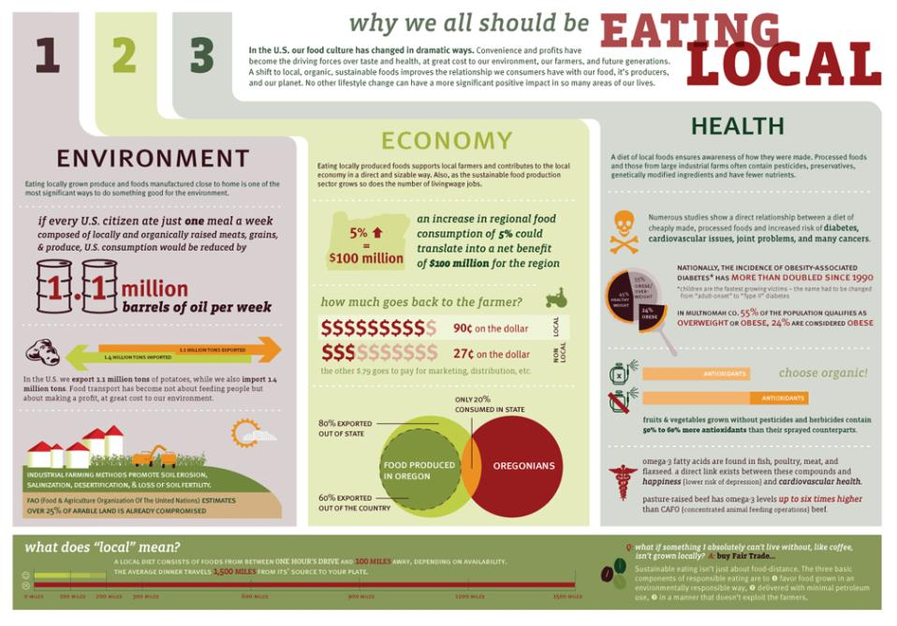
Notes:
http://www.jen-drivenbydesign.com/?p=389

Slide 22
Notes:
http://www.foodtechconnect.com/2011/05/11/infographic-making-the-case-for-buying-local/

Slide 23
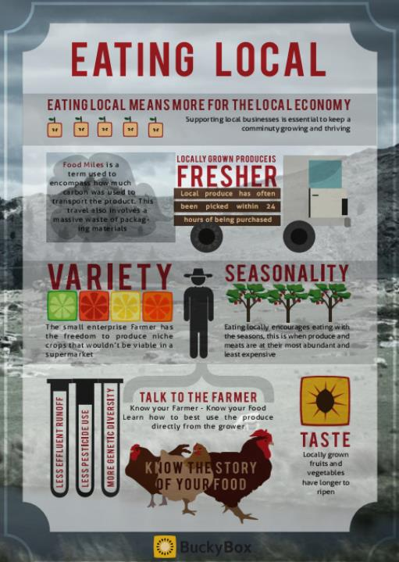
Notes:
http://visual.ly/eating-local

Slide 24
Notes:
http://rachels-table.com/2012/05/05/861/

Slide 25
Notes:
http://rachels-table.com/2012/05/05/861/

Slide 26
Notes:
Taken from: http://www.wpro.who.int/nutrition/documents/docs/PacificFoodSummitReport.pdf
The Pacific Food Summit, 21-23 April, Port Vila, Vanuatu, has brought together leaders from across the Pacific: from governments, industry, NGOs, development agencies, the media and community groups, in recognition that a radical rethink is necessary in order to improve food security for the Pacific.

