Slide 1
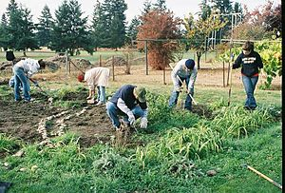
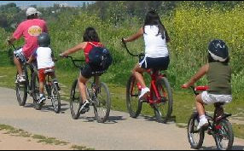
Built Environment to Promote Physical Activity: Supplemental Slides

Slide 3
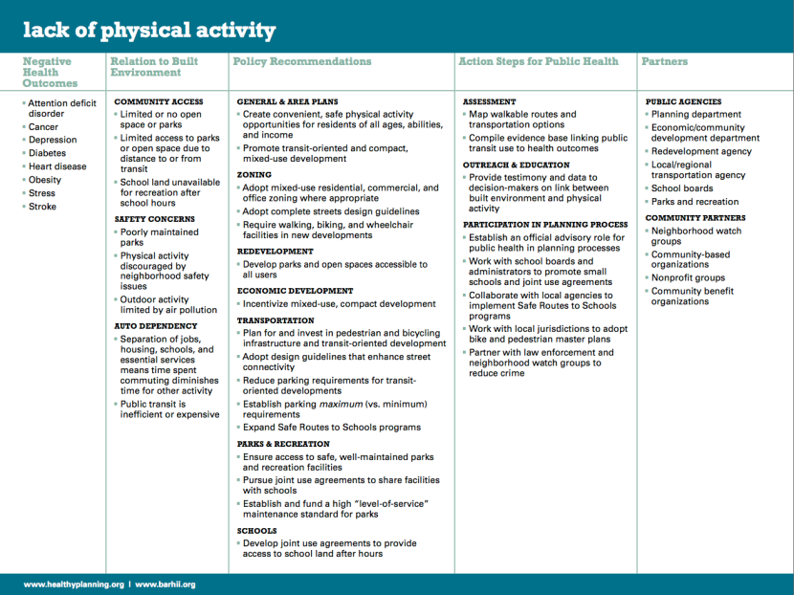
Notes:
http://www.barhii.org/resources/downloads/barhii_healthy_planning_guide.pdf

Slide 4
Classification of Weekly Amounts of Aerobic Physical Activity
Notes:
US Department of Health and Human Services. 2008 physical activity guidelines for Americans. 2008. http://www.health.gov/PAGuidelines. Accessed January 14, 2014.

Slide 5
Health Benefits of Physical Activity
Notes:
US Department of Health and Human Services. 2008 physical activity guidelines for Americans. 2008. http://www.health.gov/PAGuidelines. Accessed January 14, 2014.

Slide 6
Notes:
US Department of Health and Human Services. 2008 physical activity guidelines for Americans. 2008. http://www.health.gov/PAGuidelines. Accessed January 14, 2014.

Slide 7
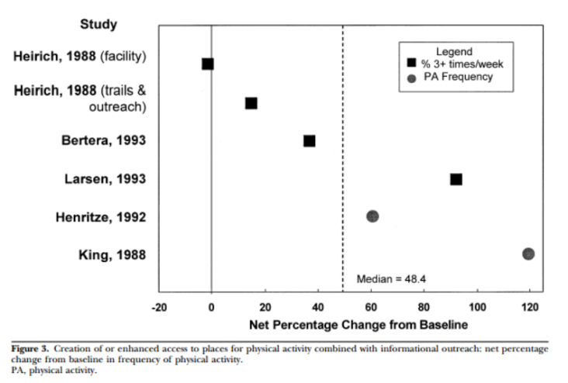
Change in physical activity after increasing access to places of physical activity
Notes:
Kahn EB, Ramsey LT, Brownson RC, et al. The effectiveness of interventions to increase physical activity: a systematic review. AM J Prev Med. 2002; 22 (4 Suppl): 73-107

Slide 8
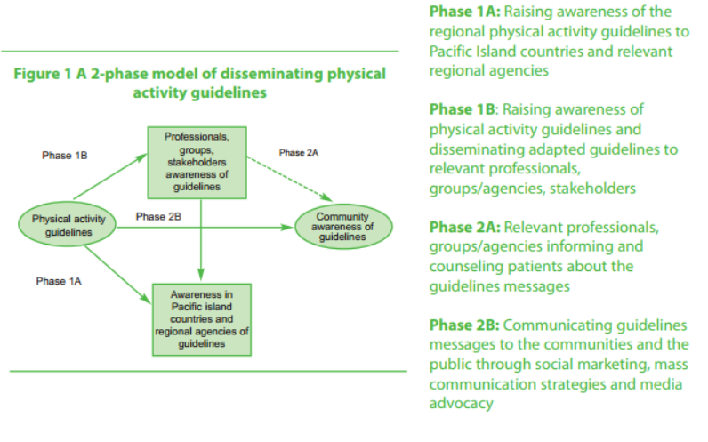
Disseminating physical activity guidelines
Notes:
WHO (World Health Organization). (2008). Pacific Physical Activity Guidelines for Adults: Framework for accelerating the communication of physical activity guidelines. World Health Organization Western Pacific Region. Retrieved January 16, 2014 from: http://www.who.int/dietphysicalactivity/publications/pacific_pa_guidelines.pdf

Slide 9
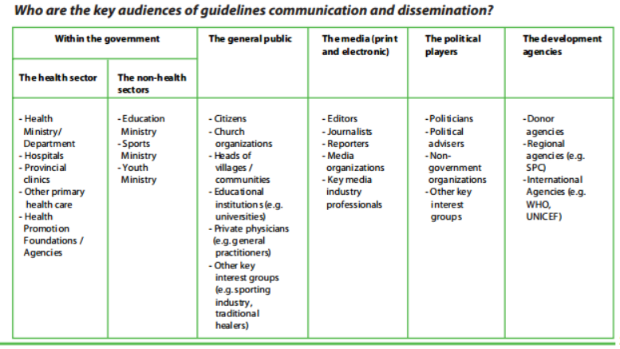
Key audiences of guidelines communication and dissemination
Notes:
WHO (World Health Organization). (2008). Pacific Physical Activity Guidelines for Adults: Framework for accelerating the communication of physical activity guidelines. World Health Organization Western Pacific Region. Retrieved January 16, 2014 from: http://www.who.int/dietphysicalactivity/publications/pacific_pa_guidelines.pdf

Slide 10
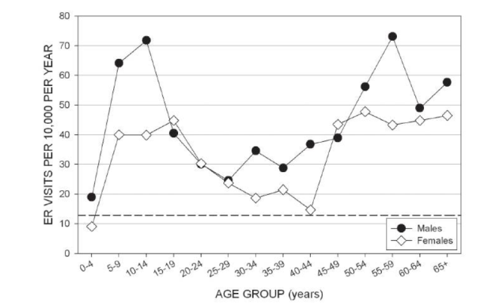
Incidence of Dog Bite injuries presented at the LBJ Tropical Medical Center in American Samoa (2004-2010)
Notes:
Incidences of dog bite-related injuries treated at the LBJ Tropical Medical Center ER based on 1,873 visits from 2004 through 2010, by sex and age group. Incidence is the average yearly number of ER visits per 10,000 individuals in each age group for each sex based on population estimates for 2005. The dashed line at 12.9 ER visits per 10,000 is the average incidence of annual dog bite-related injury visits to emergency departments in the United States from 1992 to 1994
Vargo D, DePasquale JM, Vargo AM. Incidence of Dog Bite Injuries in American Samoa and Their Impact on Society. Hawaii J Med Public Health. 2012;7:6–12.

Slide 11
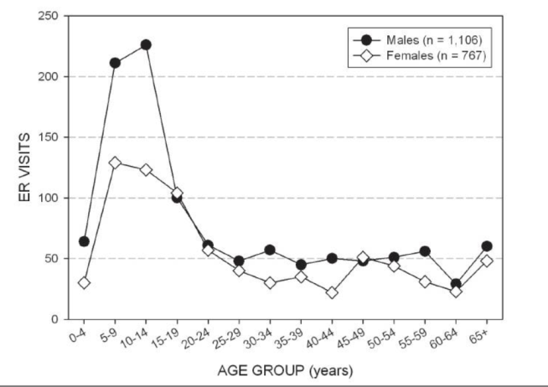
Distribution of dog bite injuries by sex and age group in American Samoa (2004-2010)
Notes:
Vargo D, DePasquale JM, Vargo AM. Incidence of Dog Bite Injuries in American Samoa and Their Impact on Society. Hawaii J Med Public Health. 2012;7:6–12.

Slide 12
Notes:
http://www.nourishinteractive.com/system/assets/general/blog/2012/ALR_Infographic_Communities_June2012.gif

Slide 13
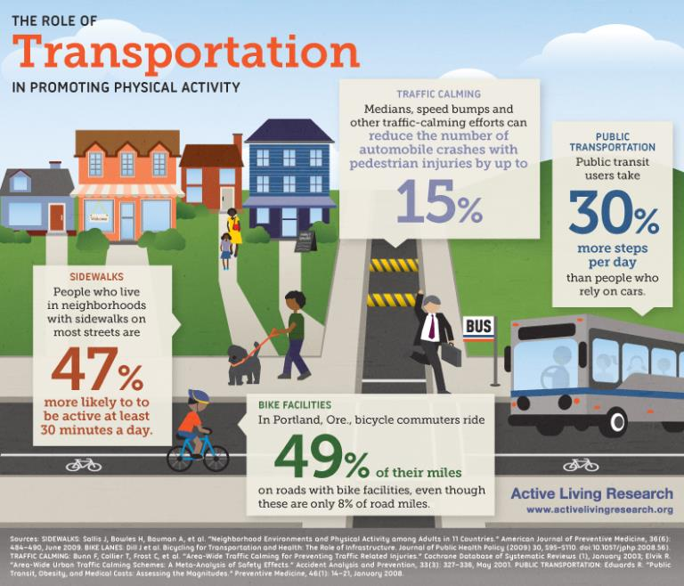
Notes:
http://urbanhs.com/wp-content/uploads/2012/07/ALR_Infographic_Transportation_July2012.jpg

Slide 14
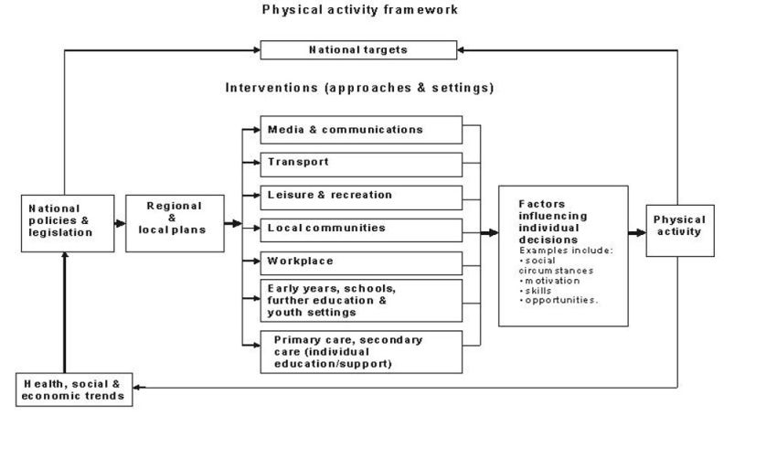
The types of interventions that can increase physical activity
Notes:
Figure 1 shows the links between national policy, local plans and the types of intervention that can increase levels of physical activity. This comprehensive framework was used to develop the recommendations.
http://publications.nice.org.uk/physical-activity-and-the-environment-ph8/public-health-need-and-practice

Slide 15
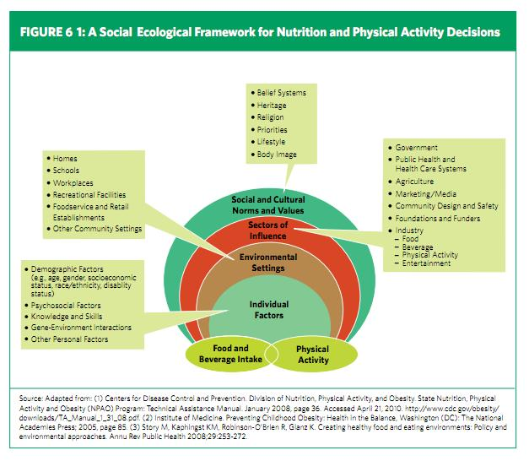

Slide 16
Obesity in the Pacific
Notes:
Obesity is a major risk factor for hypertension and diabetes and is prevalent in all Pacific Island countries, especially in Polynesia. More than 70% of the adult population are obese in American Samoa. More women than men are obese.
NCD Statistics for the Pacific Islands Countries and Territories, Healthy Pacific Lifestyle Section (2010). Public Health Division, Secretariat of the Pacific Community. http://www.spc.int/hpl/index.php?option=com_content&task=blogcategory&id=20&Itemid=45. Accessed 1/20/14.

Slide 17
The effects of physical activity
Notes:
Promoting Physical Activity in Pacific Island Communities. Secretariat of the Pacific Community and Russell Consulting International, 2010. Web. 20 Jan. 2014.

Slide 18
Notes:
Promoting Physical Activity in Pacific Island Communities. Secretariat of the Pacific Community and Russell Consulting International, 2010. Web. 20 Jan. 2014.

Slide 19
Prevalence of Behavioral Risk Factors for Non-Communicable Diseases
Notes:
NCD Statistics for the Pacific Islands Countries and Territories, Healthy Pacific Lifestyle Section (2010). Public Health Division, Secretariat of the Pacific Community. http://www.spc.int/hpl/index.php?option=com_content&task=blogcategory&id=20&Itemid=45. Accessed 1/20/14.

Slide 20
Notes:
http://2.bp.blogspot.com/-T_f1qgslIYY/TpKski8JZhI/AAAAAAAAAGU/6GXxRjNZSek/s1600/Framework.jpg

Slide 21
Discussion Question
What challenges does your jurisdiction face with building a better environment that promotes physical activity?

Slide 22
Discussion Question
Identify at least four stakeholders or partners you could work with on building environments that will promote physical activity

