Slide 1
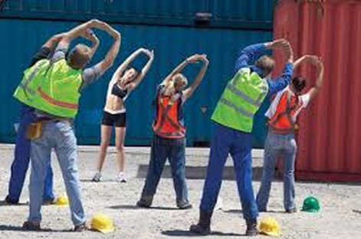
Promote Physical Activity at the Workplace: Supplemental Slides

Slide 2
Classification of Weekly Amounts of Aerobic Physical Activity
Notes:
US Department of Health and Human Services. 2008 physical activity guidelines for Americans. 2008. http://www.health.gov/PAGuidelines. Accessed January 14, 2014.

Slide 3
Health Benefits of Physical Activity
Notes:
US Department of Health and Human Services. 2008 physical activity guidelines for Americans. 2008. http://www.health.gov/PAGuidelines. Accessed January 14, 2014.

Slide 4
Notes:
US Department of Health and Human Services. 2008 physical activity guidelines for Americans. 2008. http://www.health.gov/PAGuidelines. Accessed January 14, 2014.

Slide 5
Key Physical Activity Guidelines for Adults
Notes:
US Department of Health and Human Services. 2008 physical activity guidelines for Americans. 2008. http://www.health.gov/PAGuidelines. Accessed January 14, 2014.

Slide 6
Notes:
US Department of Health and Human Services. 2008 physical activity guidelines for Americans. 2008. http://www.health.gov/PAGuidelines. Accessed January 14, 2014.

Slide 7
Notes:
US Department of Health and Human Services. 2008 physical activity guidelines for Americans. 2008. http://www.health.gov/PAGuidelines. Accessed January 14, 2014.

Slide 8
Notes:
US Department of Health and Human Services. 2008 physical activity guidelines for Americans. 2008. http://www.health.gov/PAGuidelines. Accessed January 14, 2014.

Slide 9
Notes:
http://www.medicalbillingandcoding.org/sitting-kills/

Slide 10
Notes:
http://www.medicalbillingandcoding.org/sitting-kills/

Slide 11
Notes:
http://www.medicalbillingandcoding.org/sitting-kills/

Slide 12
Notes:
http://www.medicalbillingandcoding.org/sitting-kills/

Slide 13
Notes:
http://www.medicalbillingandcoding.org/sitting-kills/

Slide 14
Notes:
http://www.medicalbillingandcoding.org/sitting-kills/

Slide 18
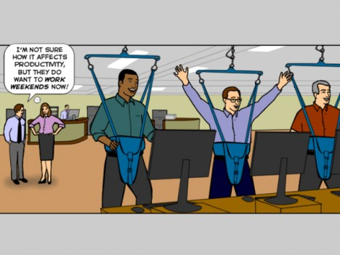
Notes:
http://www.deskmag.com/en/how-to-strike-a-balance-between-activity-and-productivity-682

Slide 19
Notes:
The model below outlines how personal and work related factors influence worker health and wellbeing and the performance of the business.
http://www.deir.qld.gov.au/workplace/workers/healthy-workers/impact/index.htm#.Ut47gpWqlmM

