Slide 1
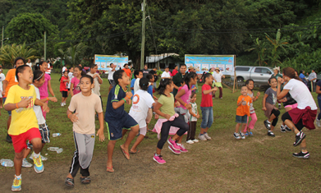
Promote Physical Activity at the School: Supplemental Slides
Notes:
Picture 1 from:
http://www.chl-pacific.org/chl-news-vol-3-issue-4-oct-dec-2013
Picture 2 from: http://www.jmir.org/2014/1

Slide 2
Classification of Weekly Amounts of Aerobic Physical Activity
Notes:
US Department of Health and Human Services. 2008 physical activity guidelines for Americans. 2008. http://www.health.gov/PAGuidelines. Accessed January 14, 2014.

Slide 3
Health Benefits of Physical Activity
Notes:
US Department of Health and Human Services. 2008 physical activity guidelines for Americans. 2008. http://www.health.gov/PAGuidelines. Accessed January 14, 2014.

Slide 4
Notes:
US Department of Health and Human Services. 2008 physical activity guidelines for Americans. 2008. http://www.health.gov/PAGuidelines. Accessed January 14, 2014.

Slide 5
Physical Activity Guidelines for Children and Adolescents
Notes:
US Department of Health and Human Services. 2008 physical activity guidelines for Americans. 2008. http://www.health.gov/PAGuidelines. Accessed January 14, 2014.

Slide 6
Notes:
US Department of Health and Human Services. 2008 physical activity guidelines for Americans. 2008. http://www.health.gov/PAGuidelines. Accessed January 14, 2014.

Slide 7
Barriers to Physical Activity (Apia, Samoa)

Slide 8
Who is most influential for youth to be physically active? (Apia, Samoa)

Slide 9
Percentage of high school students who were obese or overweight
Notes:
http://www.cdc.gov/mmwr/preview/mmwrhtml/ss5712a2.htm

Slide 10
Notes:
http://www.cdc.gov/mmwr/preview/mmwrhtml/ss5712a2.htm

Slide 11
Notes:
http://www.cdc.gov/mmwr/preview/mmwrhtml/ss5712a2.htm

Slide 12
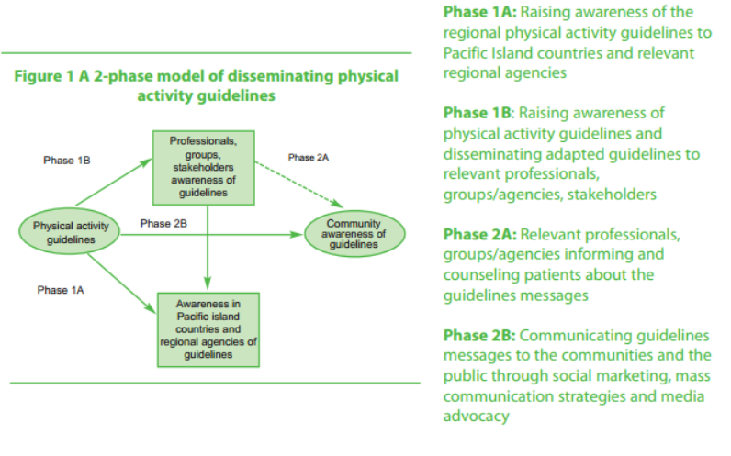
Disseminating physical activity guidelines
Notes:
WHO (World Health Organization). (2008). Pacific Physical Activity Guidelines for Adults: Framework for accelerating the communication of physical activity guidelines. World Health Organization Western Pacific Region. Retrieved January 16, 2014 from: http://www.who.int/dietphysicalactivity/publications/pacific_pa_guidelines.pdf

Slide 13
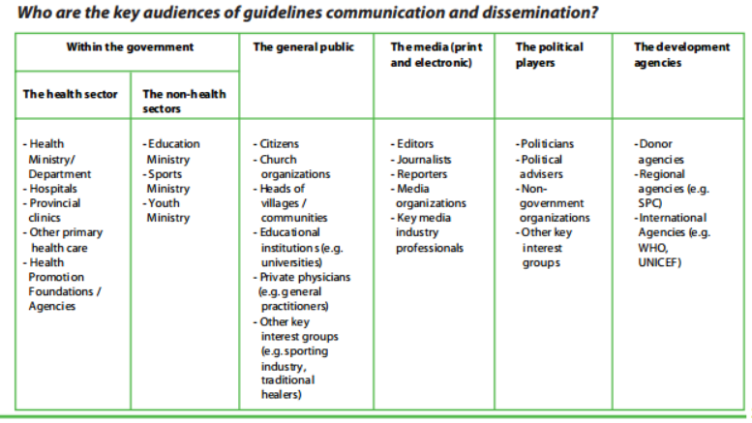
Key audiences of guidelines communication and dissemination
Notes:
WHO (World Health Organization). (2008). Pacific Physical Activity Guidelines for Adults: Framework for accelerating the communication of physical activity guidelines. World Health Organization Western Pacific Region. Retrieved January 16, 2014 from: http://www.who.int/dietphysicalactivity/publications/pacific_pa_guidelines.pdf

Slide 14
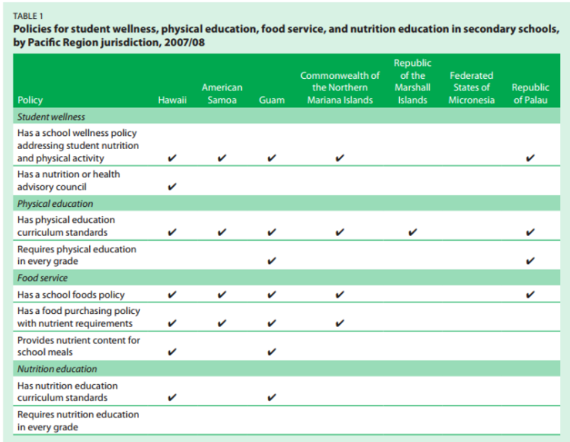
Notes:
Wilson, M., Linke, L, Bellhouse-King, M, and Singh, M. (2011). Nutrition and
physical education policy and practice in Pa- cific Region secondary schools. (Issues & Answers Report, REL
2012–No. 117). Washington, DC: U.S. Department of Educa- tion, Institute of Education Sciences, National Center for
Education Evaluation and Regional Assistance, Regional Educa- tional Laboratory Pacific. Retrieved from
http://ies.ed.gov/ncee/edlabs

Slide 15
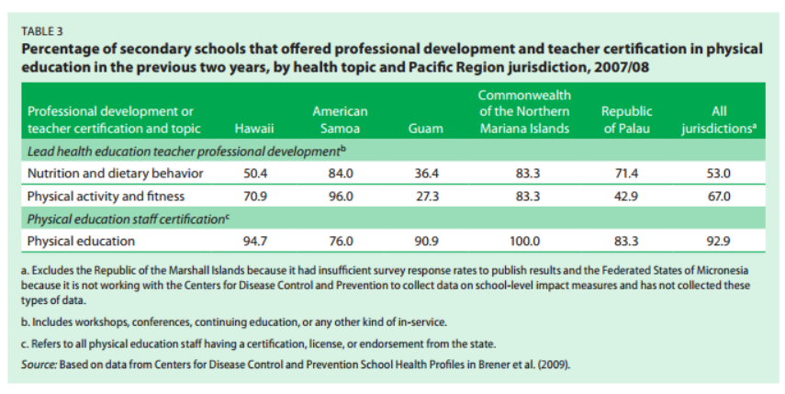
Percentage of secondary schools offering teacher certification in PE
Notes:
Wilson, M., Linke, L, Bellhouse-King, M, and Singh, M. (2011). Nutrition and
physical education policy and practice in Pa- cific Region secondary schools. (Issues & Answers Report, REL
2012–No. 117). Washington, DC: U.S. Department of Educa- tion, Institute of Education Sciences, National Center for
Education Evaluation and Regional Assistance, Regional Educa- tional Laboratory Pacific. Retrieved from
http://ies.ed.gov/ncee/edlabs

Slide 16
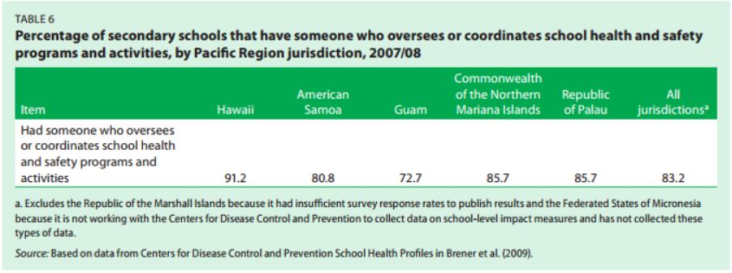
Percentage of secondary schools that have someone to coordinate health programs and activities
Notes:
Wilson, M., Linke, L, Bellhouse-King, M, and Singh, M. (2011). Nutrition and
physical education policy and practice in Pa- cific Region secondary schools. (Issues & Answers Report, REL
2012–No. 117). Washington, DC: U.S. Department of Educa- tion, Institute of Education Sciences, National Center for
Education Evaluation and Regional Assistance, Regional Educa- tional Laboratory Pacific. Retrieved from
http://ies.ed.gov/ncee/edlabs

Slide 17
Percentage of schools whose principal has a copy of the district wellness policy
Notes:
Wilson, M., Linke, L, Bellhouse-King, M, and Singh, M. (2011). Nutrition and
physical education policy and practice in Pa- cific Region secondary schools. (Issues & Answers Report, REL
2012–No. 117). Washington, DC: U.S. Department of Educa- tion, Institute of Education Sciences, National Center for
Education Evaluation and Regional Assistance, Regional Educa- tional Laboratory Pacific. Retrieved from
http://ies.ed.gov/ncee/edlabs

Slide 18
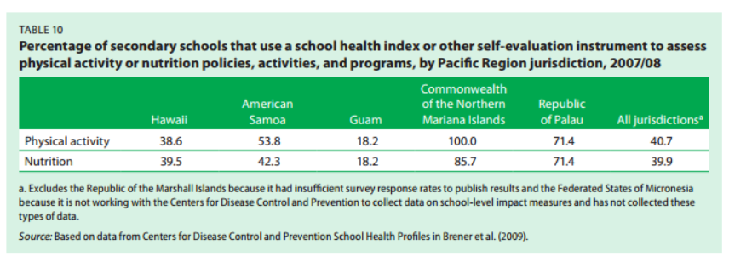
Percentage of schools with an evaluation instrument to assess physical activity policy and programs
Notes:
Wilson, M., Linke, L, Bellhouse-King, M, and Singh, M. (2011). Nutrition and
physical education policy and practice in Pa- cific Region secondary schools. (Issues & Answers Report, REL
2012–No. 117). Washington, DC: U.S. Department of Educa- tion, Institute of Education Sciences, National Center for
Education Evaluation and Regional Assistance, Regional Educa- tional Laboratory Pacific. Retrieved from
http://ies.ed.gov/ncee/edlabs

Slide 21
Notes:
http://www.onlinecollegecourses.com/2012/08/27/exercise-makes-you-smarter/

Slide 22
Notes:
http://www.onlinecollegecourses.com/2012/08/27/exercise-makes-you-smarter/

Slide 23
Notes:
http://www.onlinecollegecourses.com/2012/08/27/exercise-makes-you-smarter/

Slide 24
Notes:
http://www.onlinecollegecourses.com/2012/08/27/exercise-makes-you-smarter/

Slide 25
Notes:
http://www.onlinecollegecourses.com/2012/08/27/exercise-makes-you-smarter/

Slide 26
Notes:
Center for Disease Control
2010 National Youth and Physical Activity Study
Healthypeople.gov

Slide 27
Notes:
Center for Disease Control
2010 National Youth and Physical Activity Study
Healthypeople.gov

