Slide 1
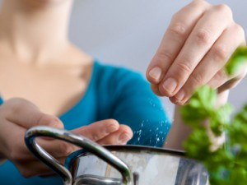
Salt Intake Reduction: Supplementary Slides
Notes:
http://arch1design.com/blog/latest_environmental_health_news/salt-content-of-common-foods/

Slide 2
Why is sodium added to processed food?
To enhance flavor
Adds a salty taste
Boosts flavor balance and can enhance the sweetness of sugary items
Masks bitterness
Makes some types of processed foods more palatable
To preserve freshness
Increases shelf life
Helps prevent growth of bacteria and other disease-causing agents
To improve texture and appearance
Makes the product seem thicker or fuller
Enhances color and hue
Helps retain moisture in processed meat products
Stabilizes texture, allowing bread to rise and cheese to stick together
Prevents unwanted chemical changes to other ingredients in many baked items
Notes:
Source: http://www.cdc.gov/salt/pdfs/role_of_sodium.pdf

Slide 3
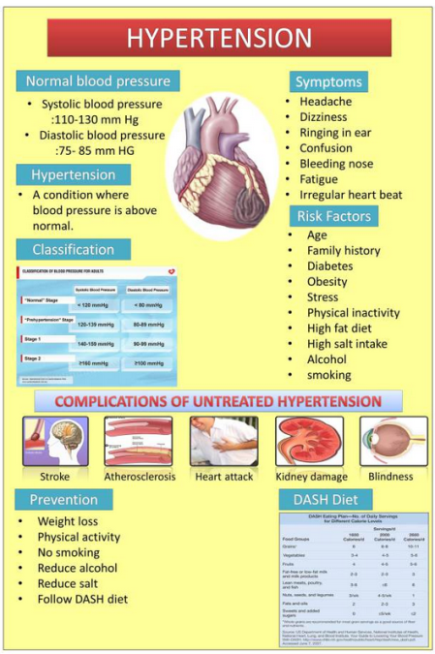
Notes:
Source: http://mithunjhc.wordpress.com/2013/01/31/do-you-know-about-hypertension/

Slide 4
Notes:
Too much sodium increases your risk for high blood pressure, and high blood pressure is the leading cause of heart attack and stroke.
-By taking the right steps to reduce your sodium intake, your blood pressure can begin decreasing within weeks.
Tips you can use to Reduce Sodium:
-Choose Fresh, frozen (no sauce), or no salt added canned vegetables.
-Know terms that commonly indicate sodium content: pickled, cured, brined, and broth
-follow the dietary approaches to stop hypertension (DASH) eating plan: http://go.usa.gov/p3C
http://www.cdc.gov/salt/infographic.htm

Slide 6
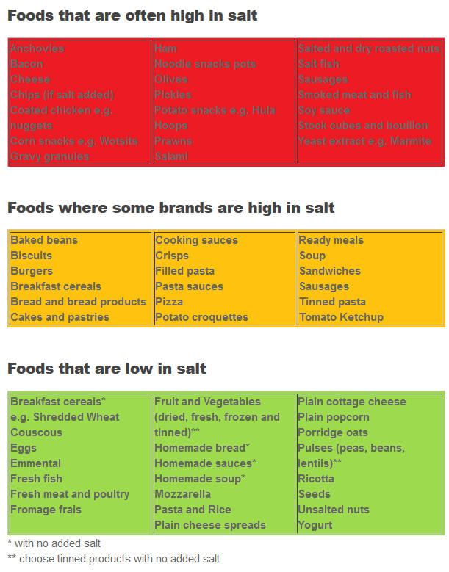
Notes:
Source: http://www.worldactiononsalt.com/less/how/whichfoods/index.html

Slide 7
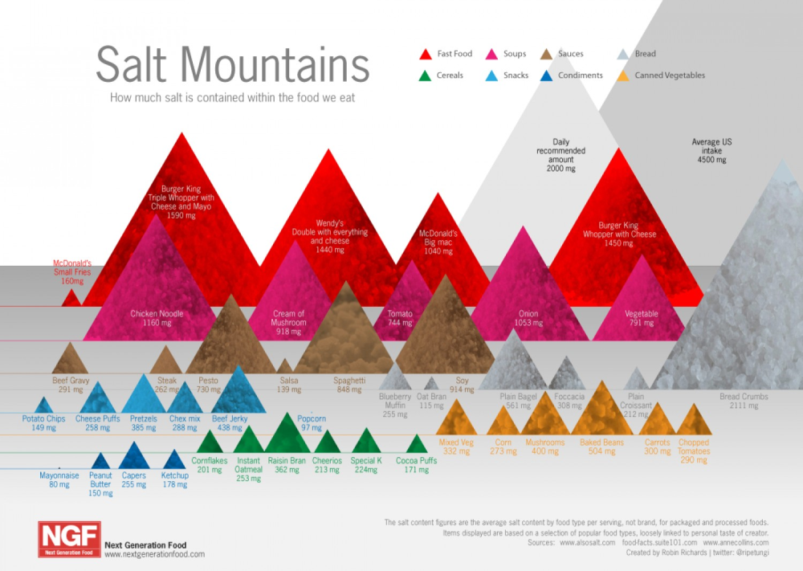
Notes:
Check to see the mountains of salt found in processed food.
http://www.fastcompany.com/1616950/infographic-day-mountains-salt-processed-food

Slide 8
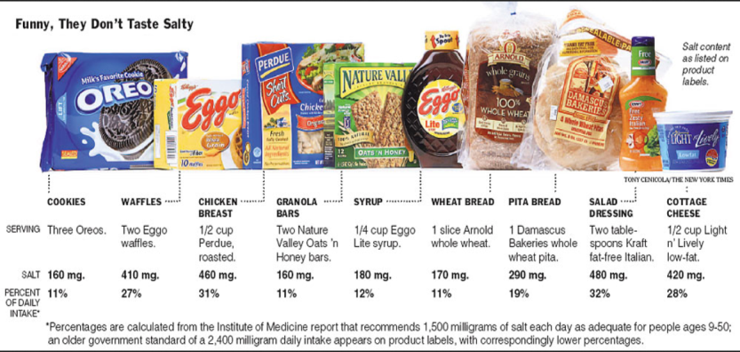
Notes:
http://www.foodpolitics.com/wp-content/uploads/Times_Salt.jpg

Slide 9
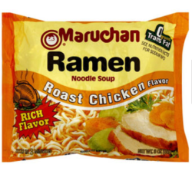
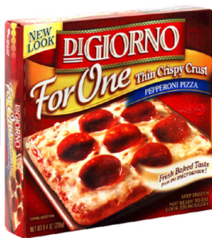
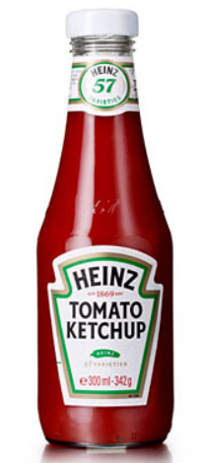
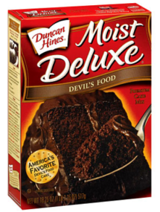
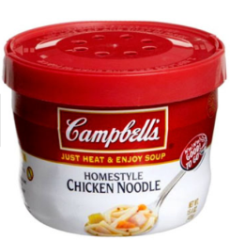
790 mg for ½ package
1170mg for 1 pizza
190 mg per tbsp
380mg for 1/12 cake
940mg for ½ cup

Slide 10
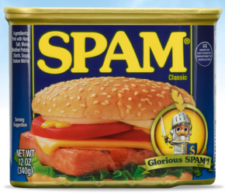
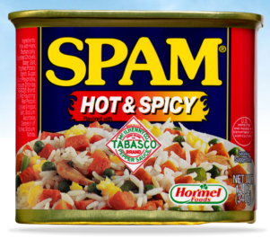
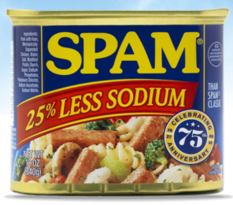
SPAM Classic
790mg for 1 slice (1/6)
SPAM Hot & Spicy
600mg for 1 slice (1/6)
SPAM Less Sodium
580mg for 1 slice (1/6)

Slide 11
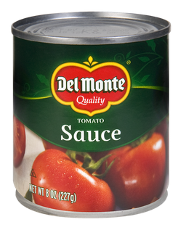
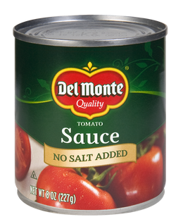
With Salt
340mg for ¼ cup
No Salt
20mg for ¼ cup

Slide 12
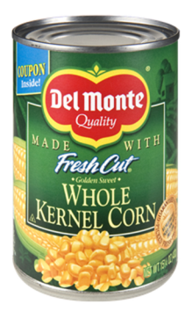
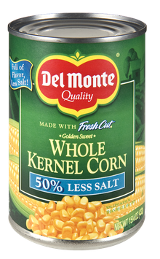
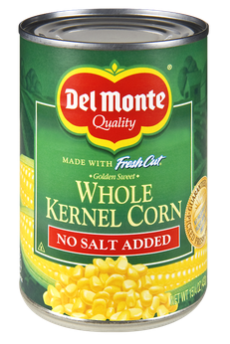
With Salt
360mg for ½ cup
With Less Salt
180mg for ½ cup
No Salt
10mg for ½ cup

Slide 13
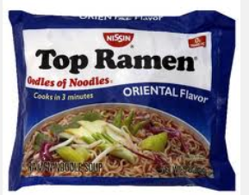
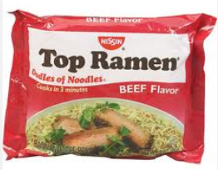

Slide 14
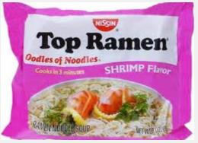
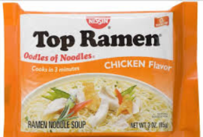

Slide 15
Notes:
http://eatdrinkbetter.com/2013/04/06/sodium-intake-infographics/

Slide 16
Notes:
http://yourethecure.org/aha/advocacy/issuedetails.aspx?IssueId=CVD%20Prevention

Slide 17
Notes:
http://www.heart.org/HEARTORG/GettingHealthy/NutritionCenter/HealthyDietGoals/Sodium-Infographics_UCM_454726_Article.jsp

Slide 18
Notes:
http://www.heart.org/HEARTORG/GettingHealthy/NutritionCenter/HealthyDietGoals/Sodium-Infographics_UCM_454726_Article.jsp

Slide 19
Notes:
http://www.heart.org/HEARTORG/GettingHealthy/NutritionCenter/HealthyDietGoals/Sodium-Infographics_UCM_454726_Article.jsp

Slide 20
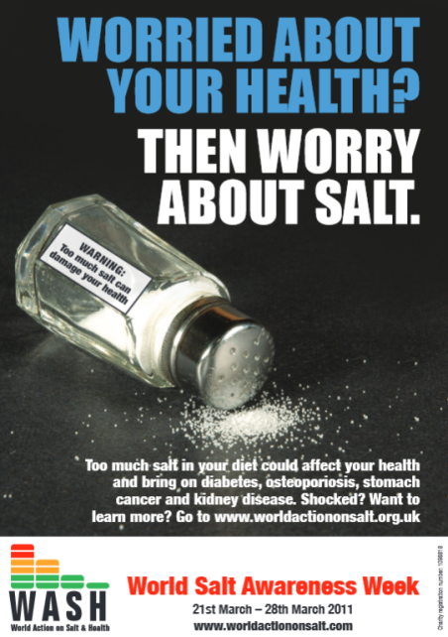
World Action on Salt and Health (WASH) was established in 2005 and is a global group with the mission to improve the health of populations through the world by achieving a gradual reduction in salt intake. WASH will encourage multi-national food companies to reduce salt in their products and will work with Governments in different countries highlighting the need for a population salt reduction strategy.
Notes:
http://www.worldactiononsalt.com/awarenessweek/index.html
There is a video of their “Salt Reduction Journey” at http://www.worldactiononsalt.com/ (bottom right box)

Slide 21
Nestle Pledges Salt Reduction
Nestle Article in November 2013
Nestle has pledged to accelerate the reduction of salt across all its food brands worldwide.
Soups, noodles, frozen meals, pizzas
DiGiorno, Buitoni, Stouffer’s, Maggi
To meet WHO salt target of no more than 5g of salt per person, per day, by 2025
Notes:
Resource: http://www.nestle.com/media/newsandfeatures/salt-reduction-at-nestle

Slide 22
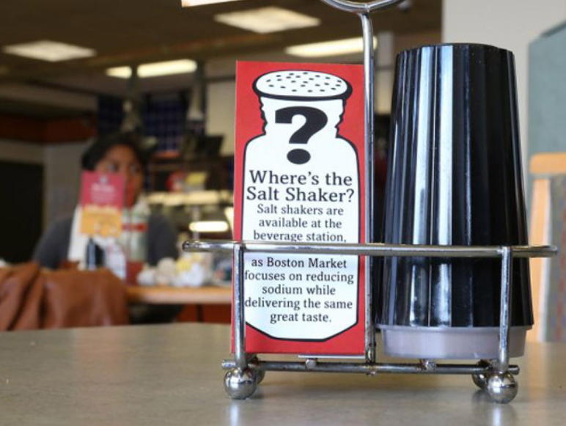
Notes:
http://news.nationalpost.com/2013/09/22/little-evidence-sharp-reductions-in-salt-consumption-will-improve-health-heart-researcher-says/

Slide 23
Tips for Reducing Sodium
Buy fresh, plain frozen, or canned "with no salt added" vegetables.
Use fresh poultry, fish, and lean meat, rather than canned or processed types.
Use herbs, spices, and salt-free seasoning blends in cooking and at the table.
Cut back on instant or flavored rice, pasta, and cereal mixes, which usually have added salt.
Choose "convenience" foods that are lower in sodium. Cut back on frozen dinners, pizza, packaged mixes, canned soups or broths, and salad dressings — these often have a lot of sodium.
Rinse canned foods, such as tuna, to remove some sodium
When available, buy low- or reduced-sodium, or no-salt-added versions of foods
Choose ready-to-eat breakfast cereals that are lower in sodium.
Notes:
Resource: https://www.nhlbi.nih.gov/hbp/prevent/sodium/tips.htm

