Slide 1
Reduce Sugar Intake: Supplemental Slides
Notes:
http://www.drfranklipman.com/20-ways-to-get-sugar-out-of-your-life/

Slide 2
Define sugar-sweetened beverages
Contain added caloric sweeteners
Soda
Fruit drink
Sport dink
Sweetened tea
Rice drinks

Slide 3
Notes:
http://foododdity.com/theres-how-much-sugar-in-soda-infographic/

Slide 8
Notes:
http://www.candyusa.com/files/IFIC-SugarFacts.pdf

Slide 9
Notes:
http://www.candyusa.com/files/IFIC-SugarFacts.pdf

Slide 12
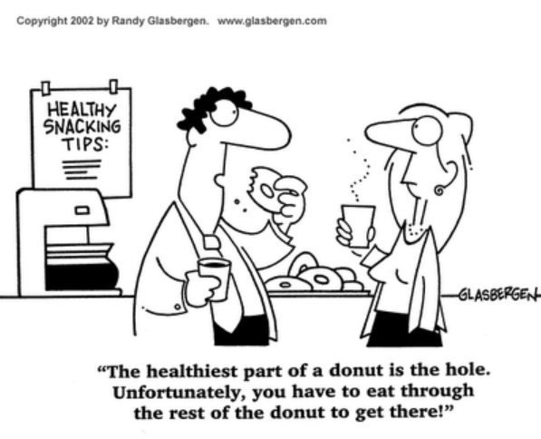
Notes:
Source: www.glasbergen.com

Slide 13
Notes:
http://www.loveinfographics.com/categories/food-and-drink-infographics/facts-about-sugar-infographic

Slide 14
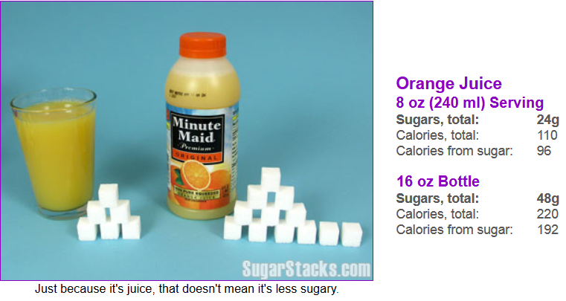
Notes:
Source: http://www.sugarstacks.com/beverages.htm

Slide 15
Water
8 oz serving
Sugars, total: 0g
Calories: 0g

Slide 16
Diseases Associated with High Sugar Intake
Obesity
Anaemia
General morbidity
Diabetes
Cancer
Kwashiorkor
Dental disease
Hypertension
Cardiovascular Disease
Notes:
http://www.pacifichealthdialog.org.fj/Volume%2010/No1%20Oral%20Health%20In%20The%20Pacific/Oral%20Health/Reprint%20Papers'/Consumerism%20the%20media%20and%20malnutrition%20in%20the%20Pacific%20Islands.pdf

Slide 17
Videos
How Sugar Affects the Brain by Nicole Avena
Ted Ed’s Original Videos
5 minutes long
http://youtu.be/lEXBxijQREo

Slide 18
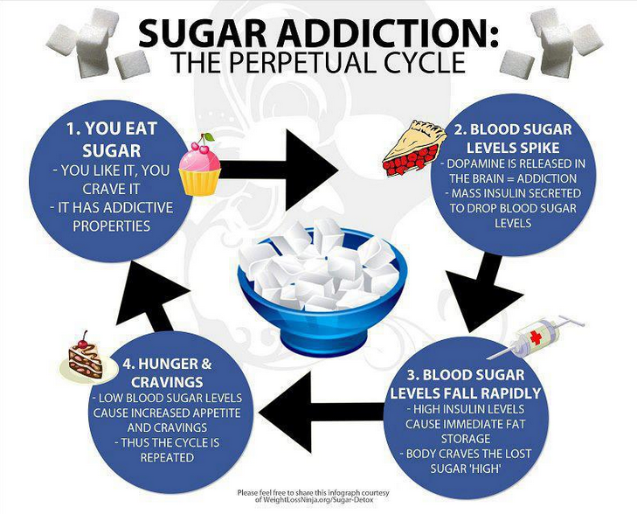
Notes:
Source: http://www.skepticaleye.com/2013/02/sugar-addiction.html

Slide 19
Notes:
Source: http://smexchange.ogilvypr.com/wp-content/uploads/2012/01/Pages-from-portion-campaign-ads.jpg

Slide 20
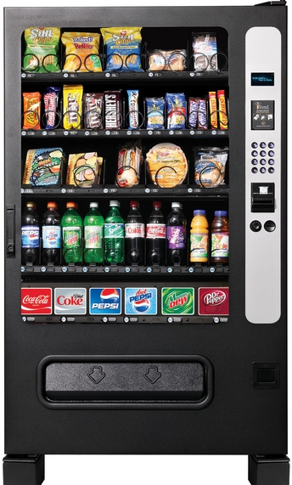
Notes:
Source: http://bunow.com/24786-shippensburg-vending-machines-serve-more-than-snacks
Source: http://crossfitthepoint.com/crossfit-the-point-weight-loss-competition/sugary-foods/

Slide 21
Best Picks for Vending Machines
Small bags of pretzels, peanuts, almonds, or trail mix
Fat-free or reduced fat popcorn
Whole-wheat crackers with peanut butter or cheese
Whole grain granola or cereal bars
Graham or animal crackers
100% fruit or vegetable juice
Dried fruit such as raisins, cranberries, apricots
Notes:
Source: http://www.eatright.org/kids/tip.aspx?id=6442466933

Slide 22
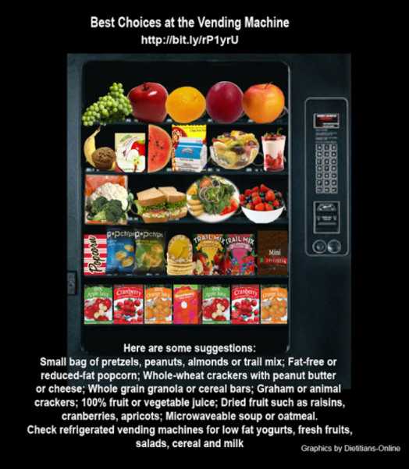
Notes:
Source: http://weighing-success.blogspot.com/2012/12/best-choices-at-vending-machine.html

Slide 23
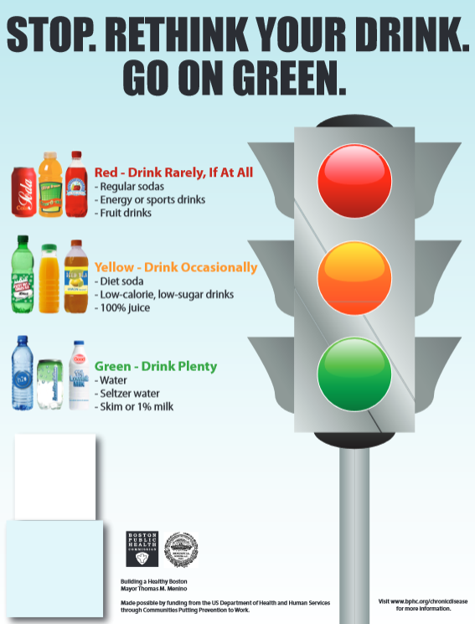
Notes:
Source: http://www.cityofboston.gov/news/uploads/43367_33_7_52.pdf

Slide 24
Notes:
Source: http://www.coolstuffdirectory.com/2013/03/8-tips-to-relieve-cough.html

Slide 25
Notes:
Source: http://www.burlesonisd.net/home/?q=bisd/bisd/parents/lunch

Slide 26
Notes:
Source: http://www.fitbie.com/eat-right/state-school-lunch

Slide 27
Notes:
Source: http://www.earthday.org/national-school-lunch-campaign

Slide 28
www.pinterest.com/pin/68468856807538107/
Notes:
Source: http://www.pinterest.com/pin/68468856807538107/

Slide 29
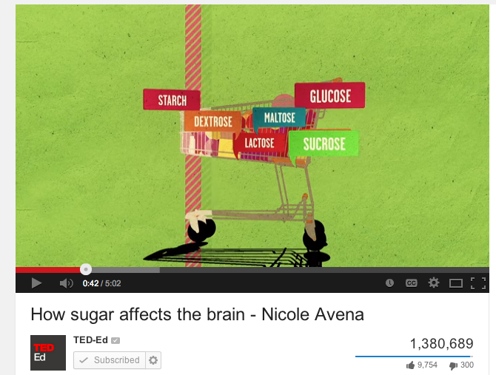
Click: http://www.fda.gov/forconsumers/consumerupdates/ucm327369.htm

