Slide 1
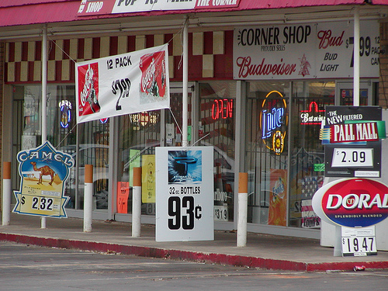
Banning Forms of Alcohol Advertising
Notes:
Image courtesy of Prevention Wins, May 2012, http://preventionworksinseattle.blogspot.com/2012_05_01_archive.html

Slide 2
Background
Misuse and abuse of alcohol can lead to:
  Injuries
  Liver diseases
  Cancers
  Heart diseases
  Premature deaths
  Poverty
  Family and partner violence
  Poor social acceptance
  Violence
  Crime
  Traffic accidents
  Abuse
  Loss of work

Slide 3
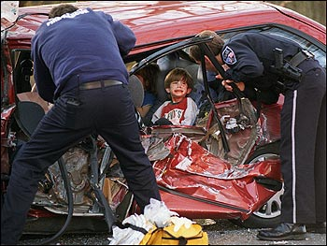
Did you know?
Harmful alcohol use kills 2.5 million people in the world each year.
Notes:
Image courtesy of Byer Media http://byermedia.com/life/5/safety/traffic-fatalitie-alcohol/traffic-fatalitie-alcohol.html

Slide 4
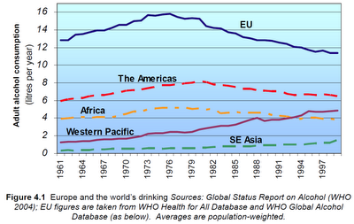
Did you know?
Alcohol is the leading risk factor for disease in the Western Pacific.
Notes:
Figure courtesy of Youth Risk Behavior Surveillance -- Pacific Island United States Territories 2007, CDC, November 2008
http://www.cdc.gov/mmwr/preview/mmwrhtml/ss5712a2.htm
The chart shows that in the Western Pacific, alcohol consumption has increased over the years.

Slide 5
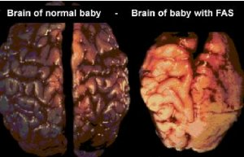
Did you know?
Alcohol drinking by pregnant mothers is harmful to the health of developing babies.
Notes:
Image courtesy of Tucson Citizen, “The Face of FAS,” November 2001
http://www.fasarizona.com/CitizenNov2001.htm

Slide 6
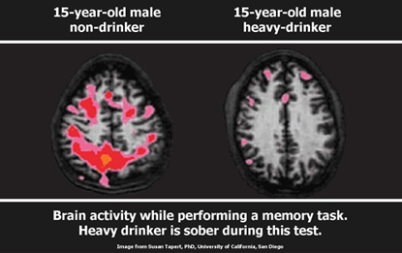
Alcohol affects our youth!
Alcohol use may affect brain development during adolescence.
Notes:
Significant changes occur in the body during adolescence.

Slide 7
Fact
A ban on alcohol ads would lower harmful drinking among young people and lead to fewer deaths from drinking. Banning alcohol ads could lower harmful drinking by almost 1 out of 10.

Slide 8
Alcohol affects our youth!
Alcohol use is linked to youth deaths by drowning, suicide and homicide.
Notes:
Significant changes occur in the body during adolescence.
8

Slide 9
Fact
Almost 1 out of 10 of all deaths for young adults ages 19-29 are due to alcohol related causes. This amounts to up to 320,000 deaths in this age group.

Slide 10
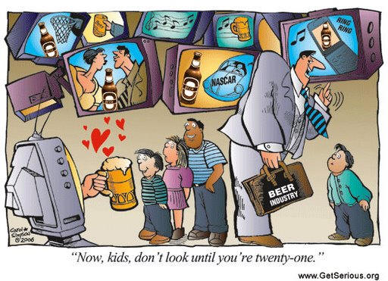
We must protect our youth!

Slide 11
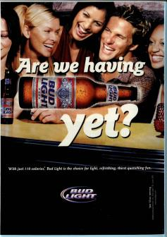
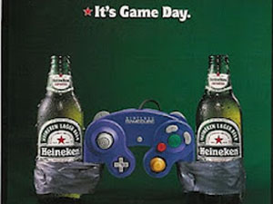
We must protect our youth!
Young people 15-20 years old, especially teenagers, are most affected by alcohol ads. Studies have shown that alcohol companies make ads using sexy and fun pictures to get young people to want to drink and buy alcohol.

Slide 12
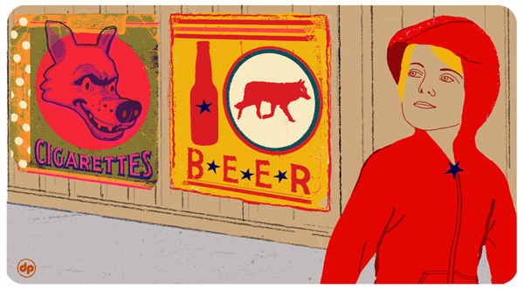
We must protect our youth!
The more alcohol ads young people see, the more likely they are to start drinking at a younger age.
  7th grade middle school students that had seen more alcohol ads were more likely to drink when they reached 9th grade.
Notes:
Image courtesy of David Pohl (NY Times), May 2007
http://www.nytimes.com/2007/05/22/health/22teen.html?ex=1180411200&en=bfd0e547e3f64434&ei=5123&partner=BREITBART&_r=0

Slide 13
We must protect our youth!
If young people like the images, they tend to have good feelings about drinking alcohol and are more likely to drink. Teens who begin drinking at age 15 are four times more likely to have a future alcohol problem.

Slide 14
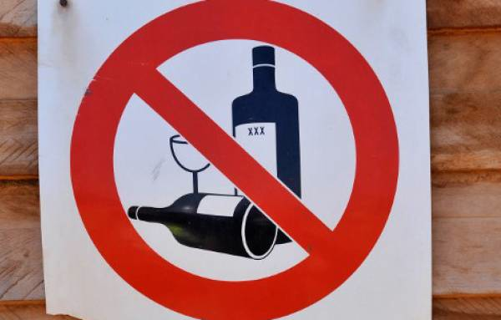
This is OUR community!
Banning alcohol advertising sends a message to youth in the community that early alcohol use is not accepted.

Slide 15
What should we ban?
Restrict promotion, marketing, or merchandising of alcohol nearby
Public celebrations
Concerts
Fairs
Schools
Churches
Playgrounds
Events
Notes:
Form of a local ordinance or state law, or can be implemented voluntarily by a business, event or organization.
15

Slide 16
What can I do?
      Talk to people that are interested in taking action in your community
      Reach out to people in the public health sector or local government to address this concern
      Put together a project with a team/working group to help you speak at community meetings and with local government to help ban alcohol ads
      Talk to businesses to take down alcohol ads in their windows or store fronts take them out of in store displays.

Slide 17
What can churches do?
    Encourage youth to involve themselves in church activities
    Educate your community about the harmful effects of alcohol and the problems it can have on family
    Support those who are struggling with alcohol problems
    Rally together to ask those businesses near your church that are advertising alcohol in their windows to take them down and replace them with other ads!
Notes:
17

Slide 18
What can schools do?
      Educate youth about the harmful effects of alcohol
      Enforce rules about drinking at school and prohibit underage drinking
      Promote activities or a week of awareness to discuss the problems and harmful effects of drinking
      Ban alcohol sponsorship from school events and other school activities
      Talk to businesses near your school to take down alcohol ads in their windows or store fronts
Notes:
18

Slide 19
What can communities do?
      Talk to businesses in your community about limiting the number of alcohol ads in their windows
      Strictly enforce drinking policies
      Initiate alcohol free events and ban alcohol at community gatherings and activities
      Investigate alcohol harms in your community and collect information
      Call a community meeting with people in your community who can help reduce alcohol harms
      Work together and contact local government to ask them to help enforce policies to that will ban alcohol ads in your jurisdiction.
Notes:
19

Slide 20
Who can I contact?
Jeanie McKenzie
NCD Advisor, Tobacco and Alcohol Secretariat of the Pacific Community
Email: JeanieM@spc.int
Notes:
20

