Slide 1
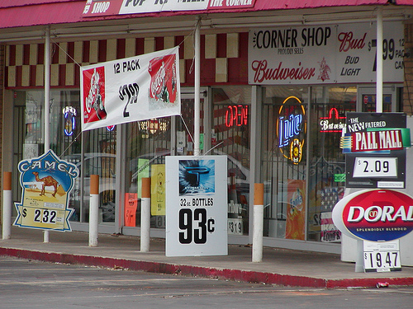
Banning Forms of Alcohol Advertising
Notes:
Image courtesy of Prevention Wins, May 2012, http://preventionworksinseattle.blogspot.com/2012_05_01_archive.html

Slide 2
Background
Misuse and abuse of alcohol can lead to:
  Injuries
  Liver diseases
  Cancers
  Heart diseases
  Premature deaths
  Poverty
  Family and partner violence
  Poor social acceptance
  Violence
  Crime
  Traffic accidents
  Abuse
  Loss of work

Slide 3
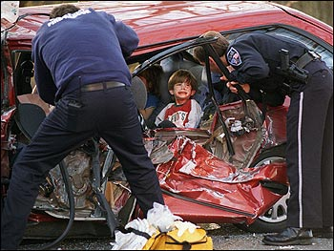
Did you know?
Harmful alcohol use kills 2.5 million people in the world each year.
Notes:
Citation: World Health Organization, Alcohol Factsheet, February 2011
Image courtesy of Byer Media http://byermedia.com/life/5/safety/traffic-fatalitie-alcohol/traffic-fatalitie-alcohol.html

Slide 4
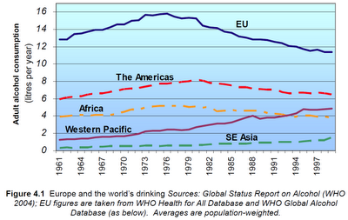
Did you know?
Alcohol is the leading risk factor for disease in the Western Pacific.
Notes:
Figure courtesy of Youth Risk Behavior Surveillance -- Pacific Island United States Territories 2007, CDC, November 2008
http://www.cdc.gov/mmwr/preview/mmwrhtml/ss5712a2.htm
The chart shows that in the Western Pacific, alcohol consumption has increased over the years.

Slide 5
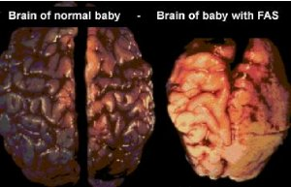
Did you know?
Alcohol drinking by pregnant mothers is harmful to the health of developing babies.
Notes:
Citation: World Health Organization, Alcohol Factsheet, February 2011
Image courtesy of Tucson Citizen, “The Face of FAS,” November 2001
http://www.fasarizona.com/CitizenNov2001.htm

Slide 6
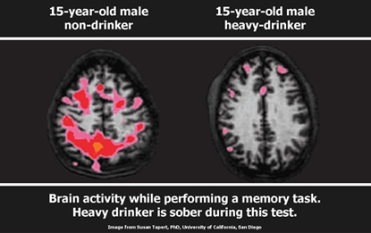
Alcohol affects our youth!
Alcohol use may affect brain development during adolescence.
Notes:
Citation: National Institute of Alcohol Abuse and Alcoholism, The Fact about Youth and Alcohol, date unknown
Significant changes occur in the body during adolescence.

Slide 7
Fact
Alcohol advertising can reduce the promotion of underage drinking and decrease alcohol use. Research projects a 5-8% decrease in alcohol consumption through increasing bans
Notes:
Citation: Saffer, H. (1996). Studying the effects of alcohol advertising on consumption. Alcohol Health & Research World, 20(4), 266-272.
Saffer, H., Dave, D., (2002). Alcohol consumption and alcohol advertising bans. Applied Economics, 34(11), 1325-1334.

Slide 8
Alcohol affects our youth!
Alcohol use is linked to youth deaths by drowning, suicide and homicide.
Notes:
Citation: National Institute of Alcohol Abuse and Alcoholism, The Fact about Youth and Alcohol, date unknown
Significant changes occur in the body during adolescence.
8

Slide 9
Fact
Almost 1 out of 10 of all deaths for young adults ages 19-29 are due to alcohol related causes. This amounts to up to 320,000 deaths in this age group.
Notes:
Citation: World Health Organization, Alcohol Factsheet, February 2011

Slide 10
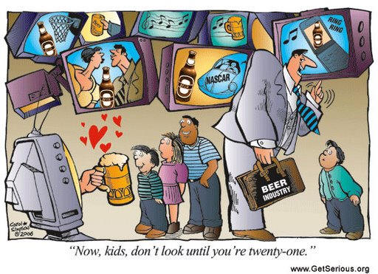
We must protect our youth!

Slide 11
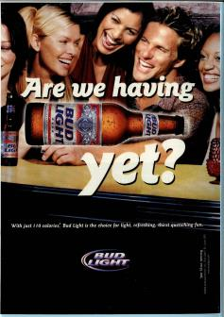
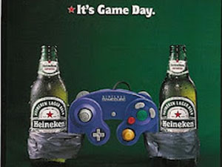
We must protect our youth!
Studies have found that youth ages 15-20 are most affected by these advertisements. If ads are found favorable to youth within this age range, they tend to have positive expectations about alcohol use and intentions to drink.
Notes:
Citation: K. Fleming, E. Thorson, et al., "Alcohol Advertising Exposure and Perceptions: Links with Alcohol Expectancies and Intentions to Drink or Drinking in Underaged Youth and Young Adults," Journal of Health Communication 9(2004): 3-29.

Slide 12
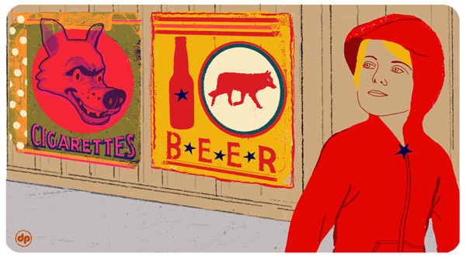
We must protect our youth!
The more alcohol ads young people see, the more likely they are to start drinking at a younger age.
Long-term studies have found that 7th grade middle school students that had a higher exposure to alcohol advertising at events and through in-store displays had a higher frequency of drinking when they reached 9th grade.
Notes:
P.L. Ellickson, R.L.Collins, K.Hambarsoomians, and D.R. McCaffrey, "Does Alcohol Advertising Promote Adolescent Drinking? Results From a Longitudinal Assessment," Addiction 100 (2005): 235-46.
Image courtesy of David Pohl (NY Times), May 2007
http://www.nytimes.com/2007/05/22/health/22teen.html?ex=1180411200&en=bfd0e547e3f64434&ei=5123&partner=BREITBART&_r=0

Slide 13
We must protect our youth!
Studies have found that youth ages 15-20 are most affected by these advertisements. If ads are found favorable to youth within this age range, they tend to have positive expectations about alcohol use and intentions to drink.
Notes:
E.W. Austin and C. Knaus, "Predicting the Potential for Risky Behavior Among Those Too Young to Drink as a Result of Appealing Advertising," Journal of Health Communications 5(2000): 13-27.
E.W. Austin, B. E. Pinkleton, et al., "The Role of Interpretation Processes and Parental Discussion in the Media's Effects on Adolescents' Use of Alcohol," Pediatrics 105(2000): 343-349.
K. Fleming, E. Thorson, et al., "Alcohol Advertising Exposure and Perceptions: Links with Alcohol Expectancies and Intentions to Drink or Drinking in Underaged Youth and Young Adults," Journal of Health Communication 9(2004): 3-29.

Slide 14
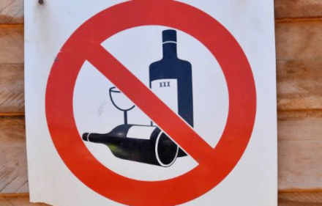
Legislation is more effective than self-regulation
Restrictions and guidelines help to ensure a strong support system. Regulations on alcohol marketing are essential to control alcohol and decrease alcohol-related harm.

Slide 15
Policy works!
An estimate on the effects of alcohol policies in the U.S. population concluded that a complete ban on alcohol advertising would be the most effective in affecting youth drinking, resulting in fewer deaths from harmful drinking and a 16.4% drop in alcohol-related life-years lost
Notes:
Citation:W. Hollingworth, B. E. Ebel, et al., "Prevention of Deaths From Harmful Drinking in the United States: The Potential Effects of Tax Increases and Advertising Bans on Young Drinkers," Journal of Studies on Alcohol 67 (2006): 300-308.

Slide 16
What should we ban?
Restrict promotion, marketing, or merchandising of alcohol nearby
Public celebrations
Concerts
Fairs
Schools
Churches
Playgrounds
Events
Notes:
Form of a local ordinance or state law, or can be implemented voluntarily by a business, event or organization.
16

Slide 17
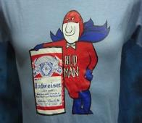
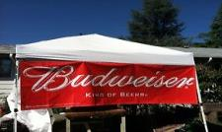
What can be banned or restricted?
Misleading alcohol ads
Ads that target children
Pictures of minors in alcohol ads
Pictures or statements that encourage drinking
Ads in electronic media
Outdoor alcohol ads in locations where children are likely to be present such as near schools, public playgrounds and churches
Ads on alcohol retail outlet windows and outside areas
Alcohol sponsorship at events
Giveaways and Contests

Slide 18
Example Policy:
Restrictions on the Promotion of Alcohol
Except as authorized by subsection (2), no person shall advertise or promote or arrange for any other person to advertise or promote alcoholic beverages.
Despite subsection (1), a person may do any of the following:
a) Place advertisements for alcoholic beverages in newspaper media other than publications intended for young people;
b) Display signs and posters inside licensed premises and inside an alcohol manufacturer’s place of business;
c) Undertake trade communications between producers, manufacturers, importers and sellers of alcoholic beverages;
d) Display the name, address and logo only of an alcohol manufacturer or distributor on the exterior of delivery vehicles for alcoholic beverages;
e) Use labeling and packaging for alcoholic products that complies with regulations under this Act; and
f) Display materials related to winemaking in museums or education establishments as well as at presentations and tastings of alcoholic beverages. Advertising for alcoholic beverages and other materials authorized by subsection (2)
Notes:
Citation: Suggested legislative example was taken from the following: World Health Organization, Addressing the Harmful Use of Alcohol: A guide to developing effective legislation (2011). http://www.wpro.who.int/publications/docs/Addressingtheharmfuluseofalcoholforupload.pdf

Slide 19
Example Policy:
Restrictions on the Promotion of Alcohol
    3. All shall be limited to describing or depicting the type, strength, origin, composition and other production characteristics of the alcohol product and the name and address of the manufacturer and agents, as well as methods of sale and consumption.
    4. All advertising for alcoholic beverages except in trade communications must carry a health message specifying that “Alcohol can be dangerous for your health.”
Notes:
Citation: Suggested legislative example was taken from the following: World Health Organization, Addressing the Harmful Use of Alcohol: A guide to developing effective legislation (2011). http://www.wpro.who.int/publications/docs/Addressingtheharmfuluseofalcoholforupload.pdf

Slide 20
Example Policy:
Alcohol Sponsorship Prohibited
1) This section applies to any event or activity if its name or any item used or associated with it or in connection with the organization, promotion, marketing or merchandising of the event or activity includes or is associated directly or indirectly with:
    a) any alcohol product; or
    b) any trade mark of an alcohol product; or
    c) a company name or any part of a company name which may be included in that alcohol product trade mark.
Notes:
Citation: Suggested legislative example was taken from the following: World Health Organization, Addressing the Harmful Use of Alcohol: A guide to developing effective legislation (2011). http://www.wpro.who.int/publications/docs/Addressingtheharmfuluseofalcoholforupload.pdf

Slide 21
Example Policy:
Alcohol Sponsorship Prohibited
2) No person shall:
a) organize or promote any such event or activity which is to take place, in whole or in part, in (name of country); or
b) make any financial contribution towards the event or activity which is to take place, or is taking place, or has taken place, in whole or in part, in (name of country); or
c) make any financial contribution to any person in respect of:
i) the organization or promotion of the event or activity by that person; or
ii) participation by the person.
Notes:
Citation: Suggested legislative example was taken from the following: World Health Organization, Addressing the Harmful Use of Alcohol: A guide to developing effective legislation (2011). http://www.wpro.who.int/publications/docs/Addressingtheharmfuluseofalcoholforupload.pdf

Slide 22
What can I do?
      Put together a project with a team/working group to help you speak at community meetings and with local government to help ban alcohol ads.
      Talk to businesses to take down alcohol ads in their windows or store fronts take them out of in store displays.

Slide 23
Who can I contact?
Jeanie McKenzie
NCD Advisor, Tobacco and Alcohol Secretariat of the Pacific Community
Email: JeanieM@spc.int
Notes:
23

