Slide 1
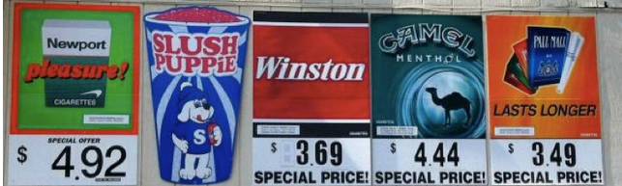
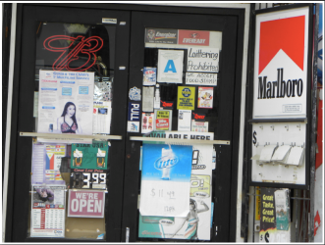
Ban Forms of Tobacco Advertising
Notes:
Top picture: http://countertobacco.org/why-retail-tobacco-control-important
Bottom picture: Assessing Tobacco Point-of-Sale Advertising in Guam (UOG U54 Pilot Program 1)

Slide 2
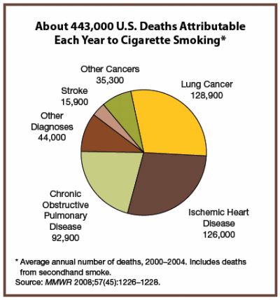
Background
Misuse and Abuse of Tobacco
Increase rates of cancer
  Lung cancer
Heart disease
Poor circulation
  asthma
High blood pressure
Notes:
Source: Morbidity and Mortality Weekly Report, November 14, 2008; 57(48): 1226-1228. http://www.cdc.gov/mmwr/PDF/wk/mm5745.pdf

Slide 3
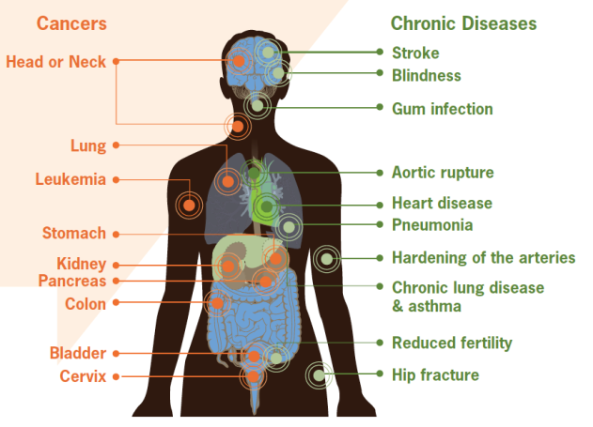
Smoking can cause damage to the body leading to various cancers and chronic diseases
Notes:
Figure: CDC vital signs, September 2010 Fact Sheet, http://www.cdc.gov/VitalSigns/pdf/2010-09-vitalsigns.pdf

Slide 4
Did you know?
Tobacco kills up to half of its users, about 6 million people each year.
  5 million of those deaths are the result of direct tobacco use
  More than 600,000 deaths are of non-smokers being exposed to second-hand smoke.
Notes:
Source: World Health Organization Fact Sheet July 2013

Slide 5
Prevalence of Daily Smoking:
25-64 years old
Notes:
Slide source: YAP Tobacco Jeannie McKenzie (2-12).ppt
Data Sources: WHO STEPs . Fiji 2005; Nauru 2007; American Samoa 2007; Tokelau 2007; Marshall Islands 2007; FSM 2008; Kiribati 2009; Solomon Islands 2010, SPC- Wallis and Futuna 2009
It is estimated that two people die each minute from tobacco-related disease in the Western Pacific.
-Source: Jha, P., Ramasundarahettige, C., Landsman, V., Rostron, B., Thun, M., Anderson, R.N., McAfee, T., & Peto, R. (2013) 21st Century Hazards of Smoking and Benefits of Cessation in the United States. New England Journal of Medicine, 368:341–50.

Slide 6
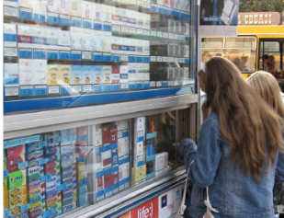
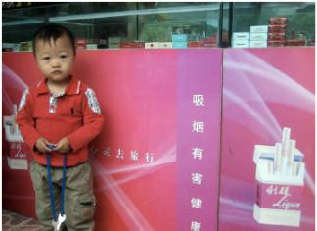
Did you know?
Tobacco companies target young people to get them to use their products
Countries that enforce bans have seen decreases in percentages of young people exposed to tobacco advertising
Notes:
Text source: http://www.who.int/mediacentre/news/releases/2013/who_ban_tobacco/en/
Images: http://global.tobaccofreekids.org/files/pdfs/en/APS_you
Youth purchasing cigarettes (Ukraine, 2007)
Tobacco Store (Beijing, China, 2007)
th_facts_en.pdf

Slide 7
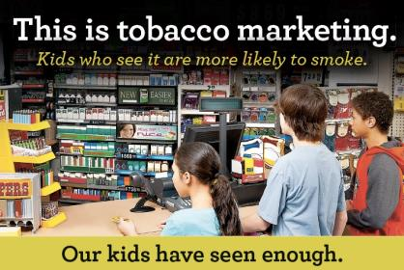
Facts
Young children and teenagers ages 11-15 who visited stores with point-of-sales tobacco advertising at least twice per week were twice as likely to start smoking compared to those who did not visit stores.
Notes:
Picture: http://www.tobaccofreeadirondacks.org/userfiles//2012%20POS%20Postcard%20Front.jpg

Slide 8
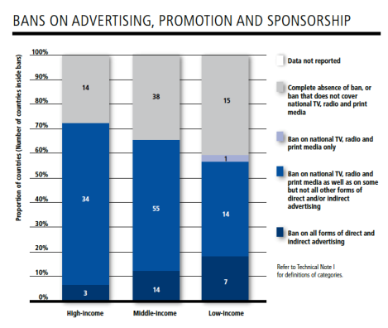
Facts
Bans on tobacco advertising, promotion, and sponsorship (TAPS) are effective BUT underused
Only 24 countries, under 10% of the world’s population, have passed complete bans on direct and indirect TAPS activities-majority of them being middle and low-income countries
Notes:
Source: WHO report on the global tobacco epidemic, 2013, http://apps.who.int/iris/bitstream/10665/85380/1/9789241505871_eng.pdf

Slide 9

List of forms of TAPS
Display of tobacco products at point-of-sales
Tobacco product vending machines
Communication through print means
Communication through audio means
Internet sales of tobacco products
Supply of free tobacco products
Sale or supply of toys or sweets that resemble tobacco products
*Detailed list found here: http://www.who.int/fctc/guidelines/article_13.pdf (Appendix)
Notes:
tobacco advertising, promotion, and sponsorship (TAPS)

Slide 10

Community Programs
What are they?
Programs to change public attitudes and behaviors about tobacco and the way tobacco products are marketed and sold
Interventions that affect policies and societal organizations to encourage individuals to stay or become tobacco-free
Coalitions or partnerships where parents, youth, business leaders, Faith leaders, and health professionals work together
Notes:
Tobacco Prevention and Control: Implementing Comprehensive Programs, 2nd edition. National Association of County and City Health Officials (NACCHO), Washington DC, 2004. http://www.naccho.org/topics/hpdp/tobacco/upload/tobacco-prevention-learners-guide.pdf

Slide 11
Community Program Examples
Using tribal, ethnic, and non-English newspapers and community presentations to educate about tobacco use and advertising methods geared toward vulnerable population
Working towards the adoption of local ordinances or other provisions restricting access to tobacco products, and other policy objectives
Conducting community programs to decrease the percentage of successful attempts by minors to buy tobacco
Notes:
Tobacco Prevention and Control: Implementing Comprehensive Programs, 2nd edition. National Association of County and City Health Officials (NACCHO), Washington DC, 2004. http://www.naccho.org/topics/hpdp/tobacco/upload/tobacco-prevention-learners-guide.pdf

Slide 12

Specific Activities at the Community Level
Support and develop effective counter marketing messaging and programs against tobacco
Identify potential partners and resources for counter marketing programs
Prevent tobacco companies to utilize brand stretch
Advocate for stronger legislation which restricts tobacco advertisement
Control the sale of tobacco products to children, preteens, and teens
Notes:
Source: Restricting advertising, promotion, and sponsorship by tobacco companies by Community Interventions for Health, An Oxford Health Alliance Programme
http://www.oxha.org/cih_manual/index.php/restricting-advertising-promotion-and-sponsorship-by-tobacco-companies,
CDC, CHW Training Manual for Preventing Heart Disease
Image:
http://www.impowerable.com/wp-content/uploads/2012/06/we-are-a-community-21pixmulecom.jpg

Slide 13
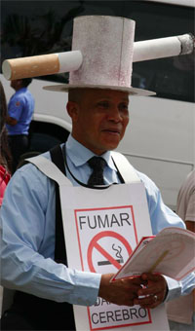
Examples of Successful Policies: Panama
2008: became 1st country in the Americas to enact complete ban on all TAPS
Restricts advertising and marketing at the point of tobacco sale-> not often included in bans
# of cigarette smoking students aged 13-15 dropped from 13.2 % in 2002 to 4.3% in 2008
Notes:
Source: http://www.who.int/features/2013/panama_ban_tobacco/en/

Slide 14
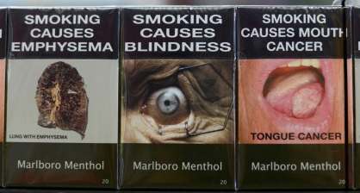
Examples of Successful Policies: Australia
December 1, 2012: Australia’s world-first laws on tobacco plain packaging came into full effect
Tobacco products must be sold in olive brown packaging with large graphic health warnings without logos, brand imagery, or promotional text
Notes:
Picture source: http://www.washingtonpost.com/business/economy/australias-plain-packaging-stubs-out-cigarette-branding-prompting-backlash/2013/10/29/317e58cc-3ccd-11e3-a94f-b58017bfee6c_story.html
Text source: http://www.who.int/features/2013/australia_tobacco_packaging/en/

Slide 15
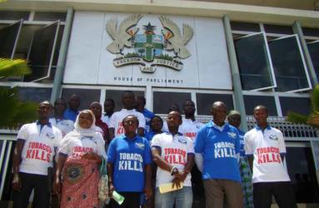
Examples of Successful Policies: Ghana
July 11,2012: Parliament passed Public Health Act, consolidation of 9 separate of tobacco control measures
Complete ban on all TAPS including:
  Limiting point of sales
  Prohibits smoking in public places
  Health warnings on tobacco packs
  Public education on effects of tobacco use
  Provision of cessation treatment
Notes:
Source: WHO report on the global tobacco epidemic, 2013, http://apps.who.int/iris/bitstream/10665/85380/1/9789241505871_eng.pdf

Slide 16
Who to contact?
James Rarick
Technical Officer, Tobacco Free Initiative
WHO Western Pacific Regional Office
Manila, Philippines
E-mail:  rarickj@wpro.who.int

