Slide 1
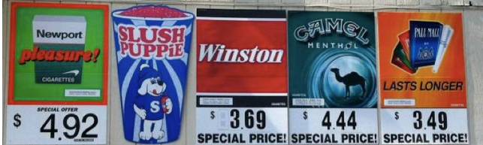
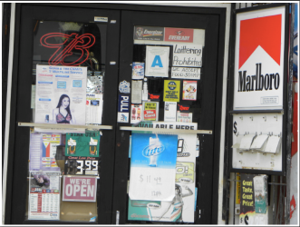
Ban Forms of Tobacco Advertising
Notes:
Top picture: http://countertobacco.org/why-retail-tobacco-control-important
Bottom picture: Assessing Tobacco Point-of-Sale Advertising in Guam (UOG U54 Pilot Program 1)

Slide 2
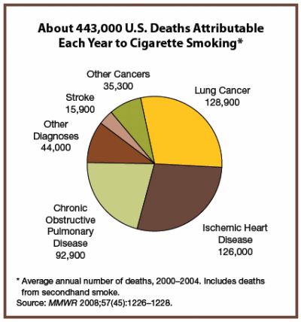
Background
Misuse and Abuse of Tobacco
Increase rates of cancer
  Lung cancer
Heart disease
Poor circulation
  asthma
High blood pressure
Notes:
Source: Morbidity and Mortality Weekly Report, November 14, 2008; 57(48): 1226-1228. http://www.cdc.gov/mmwr/PDF/wk/mm5745.pdf

Slide 3
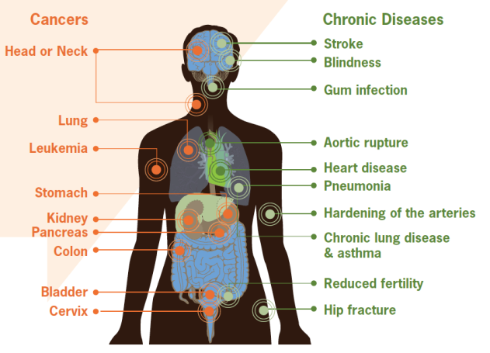
Smoking can cause damage to the body leading to various cancers and chronic diseases
Notes:
Figure: CDC vital signs, September 2010 Fact Sheet, http://www.cdc.gov/VitalSigns/pdf/2010-09-vitalsigns.pdf

Slide 4
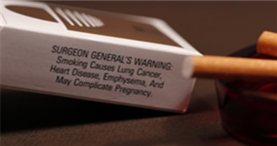
Did you know?
Tobacco kills up to half of its users, about 6 million people each year.
  5 million of those deaths are the result of direct tobacco use
  More than 600,000 deaths are the result of non-smokers being exposed to second-hand smoke.
Nearly 80% of the world’s one billion smokers live in low- and middle-income countries.
Consumption of tobacco products is increasing globally, though it is decreasing in some high-income and upper middle-income countries.
Notes:
Source: World Health Organization Fact Sheet July 2013

Slide 5
Prevalence of Daily Smoking:
25-64 years old
Notes:
Slide source: YAP Tobacco Jeannie McKenzie (2-12).ppt
Data Sources: WHO STEPs . Fiji 2005; Nauru 2007; American Samoa 2007; Tokelau 2007; Marshall Islands 2007; FSM 2008; Kiribati 2009; Solomon Islands 2010, SPC- Wallis and Futuna 2009
It is estimated that two people die each minute from tobacco-related disease in the Western Pacific.
-Source: Jha, P., Ramasundarahettige, C., Landsman, V., Rostron, B., Thun, M., Anderson, R.N., McAfee, T., & Peto, R. (2013) 21st Century Hazards of Smoking and Benefits of Cessation in the United States. New England Journal of Medicine, 368:341–50.

Slide 6

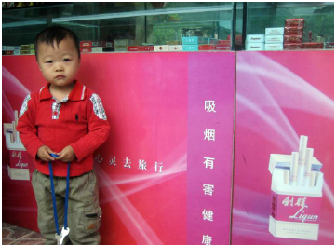
Did you know?
Tobacco companies target young people to get them to use their products
Countries that enforce bans have seen decreases in percentages of young people exposed to tobacco advertising
Notes:
Text source: http://www.who.int/mediacentre/news/releases/2013/who_ban_tobacco/en/
Images: http://global.tobaccofreekids.org/files/pdfs/en/APS_youth_facts_en.pd
Youth purchasing cigarettes (Ukraine, 2007)
Tobacco Store (Beijing, China, 2007)
f

Slide 7
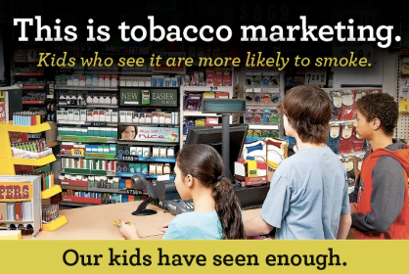
Facts
Young children and teenagers ages 11-15 who visited stores with point-of-sales tobacco advertising at least twice per week were twice as likely to start smoking compared to those who did not visit stores
Countries such as Ireland, Norway, and the UK have shown that a ban can reduce smoking initiation and ultimately lead to a decrease in cigarette sales.
Notes:
Picture: http://www.tobaccofreeadirondacks.org/userfiles//2012%20POS%20Postcard%20Front.jpg

Slide 8
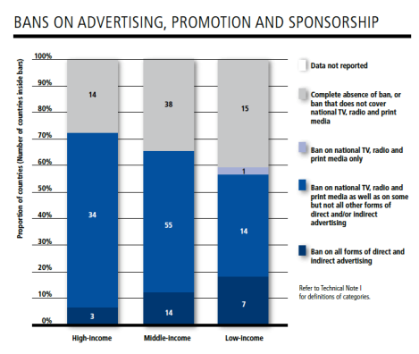
Facts
Bans on tobacco advertising, promotion, and sponsorship (TAPS) are effective BUT underused
Only 24 countries, under 10% of the world’s population, have passed complete bans on direct and indirect TAPS activities
Notes:
Source: WHO report on the global tobacco epidemic, 2013, http://apps.who.int/iris/bitstream/10665/85380/1/9789241505871_eng.pdf

Slide 9

List of forms of TAPS
Display of tobacco products at point-of-sales
Tobacco product vending machines
Communication through print means Communication through audio means
Internet sales of tobacco products
Supply of free tobacco products
Sale or supply of toys or sweets that resemble tobacco products
Sale and display of products at venues and events
*Detailed list found here: http://www.who.int/fctc/guidelines/article_13.pdf (Appendix)
Notes:
tobacco advertising, promotion, and sponsorship (TAPS)

Slide 10
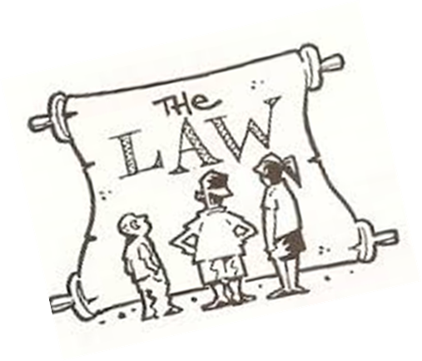
What should the policies include?
Laws regarding tobacco advertising are easy to maintain and enforce if they are well written
  Prohibitions on advertising in all types of media
  Restrictions on marketing strategies by importers and retailers
  Restrictions on promotional activities involving the sporting and entertainment industries
  Penalties for violations of marketing bans MUST be high to be effective
Notes:
Source: MPOWER A Policy Package to Reverse the Tobacco Epidemic, http://www.who.int/tobacco/mpower/mpower_english.pdf

Slide 11
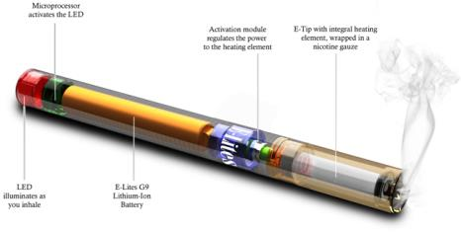
Key Steps
Obtain political will and public support
    Countering claims by the tobacco industry
    Questioning the motives of tobacco sponsorship
    Showing the impact of tobacco advertisement, promotion, and sponsorship (TAPS) activities on tobacco consumption and health
Announce bans in advance of implementation
Update comprehensive bans on TAPS to keep up with new types of tobacco products or cigarette substitutes (e.g.: electronic cigarettes)
Notes:
Source: WHO report on the global tobacco epidemic, 2013, http://apps.who.int/iris/bitstream/10665/85380/1/9789241505871_eng.pdf
Image:
http://www.encigarette.com/wp-content/uploads/2012/12/what-is-an-electronic-cigarette.jpeg

Slide 12
Key Steps Continued
Coordinating with government ministries and civil society organizations :
    Health ministry: to monitor TAPS activities and the impact of bans
    Justice ministry: enforce bans on TAPS
    Finance ministry: make reports of TAPS expenditures as required by WHO FCTC
    Commerce ministry: monitor and enforce bans on TAPS
    Communications ministry: monitor and enforce broadcast and Internet advertising bans
Notes:
Source: WHO report on the global tobacco epidemic, 2013, http://apps.who.int/iris/bitstream/10665/85380/1/9789241505871_eng.pdf

Slide 13
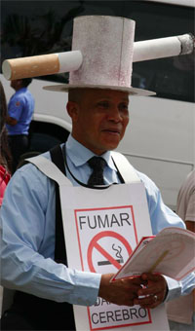
Examples of Successful Policies: Panama
2008: became 1st country in the Americas to enact complete ban on all TAPS
Restricts advertising and marketing at the point of tobacco sale
# of cigarette smoking youths aged 13-15 dropped 13.2% in 2002 to 4.3% in 2008
Notes:
Source: http://www.who.int/features/2013/panama_ban_tobacco/en/

Slide 14
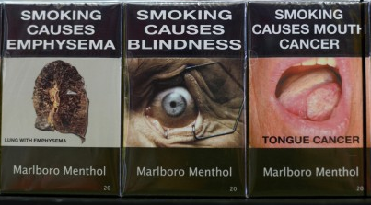
Examples of Successful Policies: Australia
December 1, 2012: Australia’s world-first laws on tobacco plain packaging came into full effect
Tobacco products must be sold in olive brown packaging with large graphic health warnings and NO tobacco industry, logos, brand imagery, or promotional text
Notes:
Picture source: http://www.washingtonpost.com/business/economy/australias-plain-packaging-stubs-out-cigarette-branding-prompting-backlash/2013/10/29/317e58cc-3ccd-11e3-a94f-b58017bfee6c_story.html
Text source: http://www.who.int/features/2013/australia_tobacco_packaging/en/

Slide 15

Examples of Successful Policies: Ghana
July 11, 2012: Parliament passed Public Health Act, consolidation of 9 laws of tobacco control measures
Complete ban on all TAPS including:
  Limiting point of sales
  Prohibits smoking in public places
  Health warnings on tobacco packs
  Public education on effects of tobacco use
  Provision of cessation treatment
Notes:
Source: WHO report on the global tobacco epidemic, 2013, http://apps.who.int/iris/bitstream/10665/85380/1/9789241505871_eng.pdf

Slide 16
Who to contact?
James Rarick
Technical Officer, Tobacco Free Initiative
WHO Western Pacific Regional Office
Manila, Philippines
E-mail:  rarickj@wpro.who.int

