Slide 1
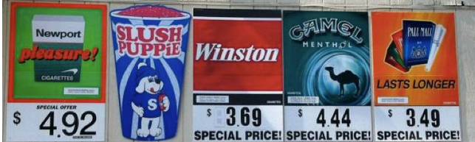
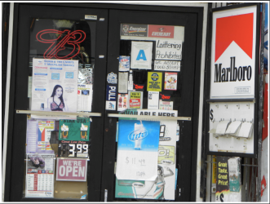
Ban Forms of Tobacco Advertising
Notes:
Top picture: http://countertobacco.org/why-retail-tobacco-control-important
Bottom picture: Assessing Tobacco Point-of-Sale Advertising in Guam (UOG U54 Pilot Program 1)

Slide 2
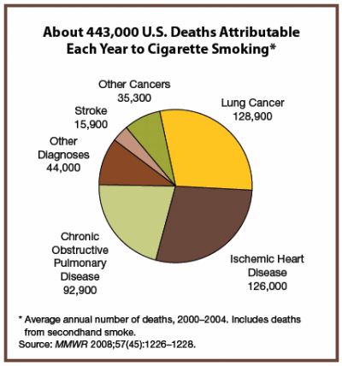
Background
Misuse and Abuse of Tobacco
Increase rates of cancer
  Lung cancer
Heart disease
Poor circulation
  asthma
High blood pressure
Notes:
Source: Morbidity and Mortality Weekly Report, November 14, 2008; 57(48): 1226-1228. http://www.cdc.gov/mmwr/PDF/wk/mm5745.pdf

Slide 3
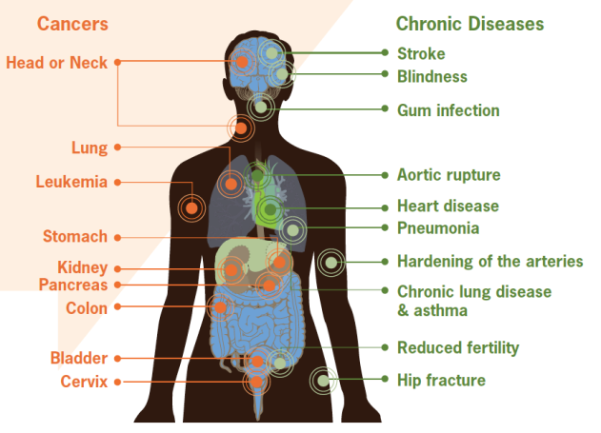
Smoking can cause damage to the body leading to various cancers and chronic diseases
Notes:
Figure: CDC vital signs, September 2010 Fact Sheet, http://www.cdc.gov/VitalSigns/pdf/2010-09-vitalsigns.pdf

Slide 4
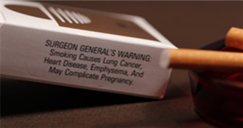
Did you know?
Tobacco kills up to half of its users, about 6 million people each year.
  5 million of those deaths are the result of direct tobacco use
  More than 600,000 deaths are the result of non-smokers being exposed to second-hand smoke.
Consumption of tobacco products is increasing globally, though it is decreasing in some high-income and upper middle-income countries.
Notes:
Source: World Health Organization Fact Sheet July 2013

Slide 5
Prevalence of Daily Smoking:
25-64 years old
Notes:
Slide source: YAP Tobacco Jeannie McKenzie (2-12).ppt
Data Sources: WHO STEPs . Fiji 2005; Nauru 2007; American Samoa 2007; Tokelau 2007; Marshall Islands 2007; FSM 2008; Kiribati 2009; Solomon Islands 2010, SPC- Wallis and Futuna 2009
It is estimated that two people die each minute from tobacco-related disease in the Western Pacific.
-Source: Jha, P., Ramasundarahettige, C., Landsman, V., Rostron, B., Thun, M., Anderson, R.N., McAfee, T., & Peto, R. (2013) 21st Century Hazards of Smoking and Benefits of Cessation in the United States. New England Journal of Medicine, 368:341–50.

Slide 6
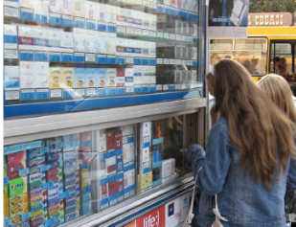
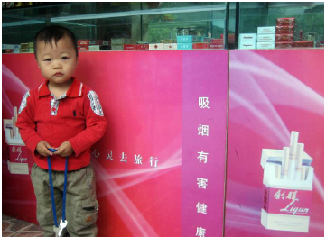
Did you know?
Tobacco companies target young people to get them to use their products
Countries that enforce bans have seen decreases in percentages of young people exposed to tobacco advertising
Notes:
Text source: http://www.who.int/mediacentre/news/releases/2013/who_ban_tobacco/en/
Images: http://global.tobaccofreekids.org/files/pdfs/en/APS_youth_facts_en.pd
Youth purchasing cigarettes (Ukraine, 2007)
Tobacco Store (Beijing, China, 2007)
f

Slide 7
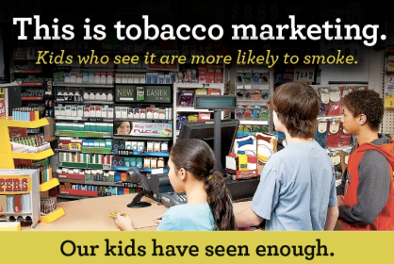
Facts
Young children and teenagers ages 11-15 who visited stores with point-of-sales tobacco advertising at least twice per week were twice as likely to start smoking compared to those who did not visit stores
Notes:
Picture: http://www.tobaccofreeadirondacks.org/userfiles//2012%20POS%20Postcard%20Front.jpg

Slide 8
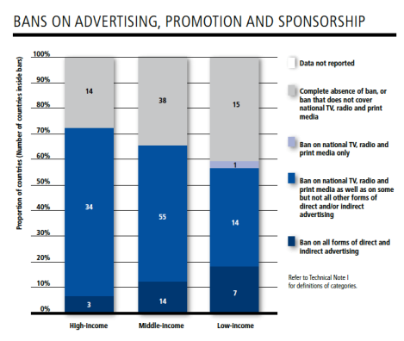
Facts
Bans on tobacco advertising, promotion, and sponsorship (TAPS) are effective BUT underused
Only 24 countries, under 10% of the world’s population, have passed complete bans on direct and indirect TAPS activities
Notes:
Source: WHO report on the global tobacco epidemic, 2013, http://apps.who.int/iris/bitstream/10665/85380/1/9789241505871_eng.pdf

Slide 9

List of forms of TAPS
Display of tobacco products at point-of-sales
Tobacco product vending machines
Communication through print means Communication through audio means
Product placement
Supply of free tobacco products
Sale or supply of toys or sweets that resemble tobacco products
Sale and display of products at venues and events
*Detailed list found here: http://www.who.int/fctc/guidelines/article_13.pdf (Appendix)
Notes:
tobacco advertising, promotion, and sponsorship (TAPS)

Slide 10
Key Steps that We Can Take
Step 1: Identify targets and seek 70% coverage
  Potential advertisement locations and promotionals include:
    Broadcast (radio and TV)
    Print media (magazines, newspapers)
    Advertising (billboards, signs)
    Point of sale advertising
    Discounts
    Product packaging
    Internet advertising
    Logo or icon use
    Product placement in entertainment industry
Notes:
Source: Restricting advertising, promotion, and sponsorship by tobacco companies by Community Interventions for Health, An Oxford Health Alliance Programme
http://www.oxha.org/cih_manual/index.php/restricting-advertising-promotion-and-sponsorship-by-tobacco-companies

Slide 11
Key Steps that We Can Take
Step 2: Work with legislators to develop and enforce necessary bans
  Develop counter-marketing campaigns which lessens the appeal of tobacco products and advertisements.
  Long term investment
    Integrated, not isolated, components
    Integration into larger tobacco control programs
    Cultural components
    Evaluation
    Adequate funding
Notes:
Source: Restricting advertising, promotion, and sponsorship by tobacco companies by Community Interventions for Health, An Oxford Health Alliance Programme
http://www.oxha.org/cih_manual/index.php/restricting-advertising-promotion-and-sponsorship-by-tobacco-companies

Slide 12
Key Steps that We Can Take
Step 3: Measuring Impact
  Formulate systems to measure impact of legislation and restrictive policies over time:
    Surveys / Focus groups
    Spot-checks on members of the tobacco industry
    Quarterly-based reporting system that monitors who and how much is being spent on tobacco advertising vs. counter-marketing
    Rates of tobacco use within and across communities
    Frequency of tobacco advertisement and promotion
    Public perception of tobacco sponsorships
Notes:
Source: Restricting advertising, promotion, and sponsorship by tobacco companies by Community Interventions for Health, An Oxford Health Alliance Programme
http://www.oxha.org/cih_manual/index.php/restricting-advertising-promotion-and-sponsorship-by-tobacco-companies

Slide 13
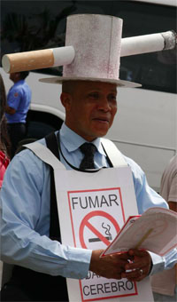
Examples of Successful Policies: Panama
2008: became 1st country in the Americas to enact complete ban on all TAPS
Restricts advertising and marketing at the point of tobacco sale
# of cigarette smoking youths aged 13-15 dropped 13.2% in 2002 to 4.3% in 2008
Notes:
Source: http://www.who.int/features/2013/panama_ban_tobacco/en/

Slide 14
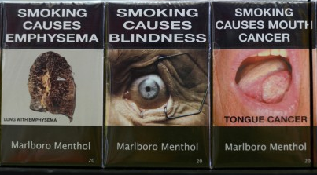
Examples of Successful Policies: Australia
December 1, 2012: Australia’s world-first laws on tobacco plain packaging came into full effect
Tobacco products must be sold in olive brown packaging with large graphic health warnings and NO tobacco industry, logos, brand imagery, or promotional text
Notes:
Picture source: http://www.washingtonpost.com/business/economy/australias-plain-packaging-stubs-out-cigarette-branding-prompting-backlash/2013/10/29/317e58cc-3ccd-11e3-a94f-b58017bfee6c_story.html
Text source: http://www.who.int/features/2013/australia_tobacco_packaging/en/

Slide 15
Who to contact?
James Rarick
Technical Officer, Tobacco Free Initiative
WHO Western Pacific Regional Office
Manila, Philippines
E-mail:  rarickj@wpro.who.int

