Slide 1
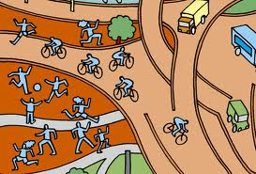
Developing a Better Environment to Promote Physical Activity

Slide 2
What you should know
The environments in most island communities no longer promote physical activity.
Roads and unleashed dogs encourage driving and discourage walking.
Most schools and workplaces do little to encourage movement. Inactive lifestyles often result in much poorer health due to NCDs.
Developing or enhancing the environments can increase and promote physical activity.
Notes:
Gordon-Larsen, P., Nelson, M., Page, P., & Popkin, B. (2006). Inequality in the built environment underlies key health disparities in physical activity and obesity. Pediatrics 117(2), 471-424.
Frank, L., Engelke, P., & Schmid, T. (2003). Health and community design: The impact of the built environment on physical activity. Washington, DC: Island Press.
Lee, V., Mikkelsen, L., Srikantharajah, J., & Cohen, L. (2008). Strategies for enhancing the built environment to support healthy eating and active living environments. Oakland, CA: Prevention Institute, Healthy Eating Active Living Convergence Partnership and PolicyLink.

Slide 3
Ensuring that people have access to daily exercise must be a priority.

Slide 4
Did you know?
Studies from a several Pacific Island countries and territories show that between 41 of 100 and 62 of 100 adults lead completely sedentary lifestyles. A sedentary lifestyle is closely linked to obesity, diabetes, and heart disease.

Slide 5
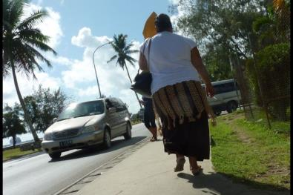
Did you know?
Environmental factors, such walkability, amount of people living in an area, and access and availibility to areas of physical activity, correlate closely to physical activity among children and young adults.
Notes:
Ding, D., Sallis, F., Kerr, J., Lee, S., & Rosenberg, D.E (2011). Neighborhood environment and physical activity among youth a review. American Journal of Preventative Medicine 41(4), 442-455.
Image courtesy of: http://www.globalpost.com/sites/default/files/imagecache/gp3_slideshow_large/4._tonga.jpg

Slide 6
What are characteristics of the built environment?
Walkable and Bikeable Neighborhoods
Features should be built into the environment that influence people to choose to walk or bicycle
Children especially need safe sidewalks and streets that are separate from fast moving traffic.
Destinations such as stores and services that are within walking distance can also influence people to walk and bicycle
Notes:
L.K. Brennan Ramirez et al.,“Indicators of Activity-Friendly Communities: An Evidence-Based Consensus Process,” American Journal of Preventive Medicine 31 (2006): 515-524.
RobertWood Johnson Foundation,“The Synthesis Project. The Built Environment and Physical Activity:What is the Relationship?” retrieved from http://www.rwjf.org/pr/ synthesis/reports_and_briefs/pdf/no11_policybrief.pdf.

Slide 7
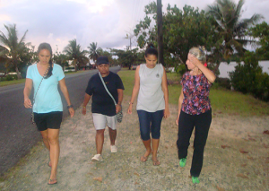
Did you know?
Studies have shown that residents in communities with walkable neighborhoods engage in about 70 more minutes/week of moderate and vigorous physical activity than those in less walkable neighborhoods.
Notes:
B.E. Saelens et al., “Neighborhood Based Differences in Physical Activity: An Environment Scale Evaluation,” American Journal of Public Health 93 (2003):1552-1558.

Slide 8
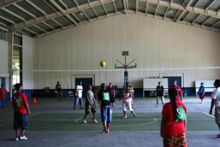
What are characteristics of the built environment?
Parks, Recreation Facilities and Open Space
Parks, recreation facilities and open space allow people a place where they can play outdoors and engage in physical activity.
Allowing schools to open their facilities to the public after hours can improve access to recreation facilities.
Notes:
R.C. Brownson et al., ”Environmental and Policy Determinants of Physical Activity in the United States,” American Journal of Public Health. 91 (2001): 1995-2003.

Slide 9
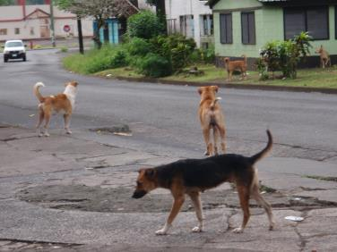
Did you know?
In American Samoa, over half of reported injuries are attributed to dog bites. Attacks by free-roaming dogs are attributed to a fear of being bitten and a barrier towards getting more physical activity.
Notes:
Vargo, Don.,DePasquale,John., Vargo, Agnes M., (2012). Incidence of Dog Bite Injuries in American Samoa and Their Impact on Society., Hawaii Journal of Medicine and Public Health., 71(1):6-12
Image courtesy of: http://3.bp.blogspot.com/_NTZU7umr_sI/TFui_j1rN7I/AAAAAAAABpk/b2Dt5rRRy6A/s1600/P1012747.JPG

Slide 10
What are characteristics of the built environment?
Safety
Safety issues and concerns can often hinder people’s desire and ability to be physically active.
In many U.S. Affiliated territories, free roaming dogs present a huge barrier in overcoming challenges to increase activity in open spaces and maintaining safety in walkable areas.
Notes:
Vargo D, DePasquale JM, Vargo AM. Incidence of Dog Bite Injuries in American Samoa and Their Impact on Society. Hawai'i J Med Pub Health. 2012;71:6–12. [PMC free article] [PubMed]

Slide 11
How can we make a difference?
Form a project or group to beautify your community
Gather together members of your community and volunteers to work together to create beautiful spaces in your community. Plant flowers, build pathways and pick up trash!

Slide 12
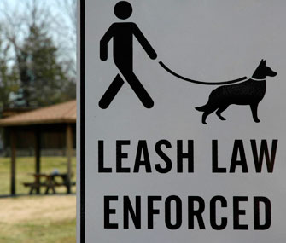
How can we make a difference?
Leash your pets!
Make sure to keep your pets and others safe by keeping pets on a leash.

Slide 13
How can we make a difference?
Recruit volunteers to help build safe spaces for outdoor activity
Team up with schools and churches to help build safer spaces where they can engage in outdoor activity. This could include helping to build barriers around playgrounds, repairing steps and sidewalks and forming areas where children and adults can gather and engage.

Slide 14
Who can I contact for more information?
Adrian Bauman
Boden Institute of Obesity, Nutrition and Exercise and Prevention Research Collaboration
University of Sydney
Sydney, Australia
Email:  adrian.bauman@sydney.edu.au

