Slide 1
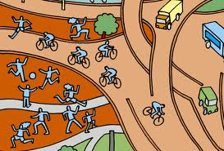
Develop the Built Environment to Promote Physical Activity

Slide 2
What you should know
The environments in most island communities no longer promote physical activity.
Roads and unleashed dogs encourage driving and discourage walking.
Most schools and workplaces do little to encourage or value movement. Sedentary lifestyles often result in much poorer health due to NCDs.
Developing or enhancing built environments can increase and promote physical activity.
Notes:
Gordon-Larsen, P., Nelson, M., Page, P., & Popkin, B. (2006). Inequality in the built environment underlies key health disparities in physical activity and obesity. Pediatrics 117(2), 471-424.
Frank, L., Engelke, P., & Schmid, T. (2003). Health and community design: The impact of the built environment on physical activity. Washington, DC: Island Press.
Lee, V., Mikkelsen, L., Srikantharajah, J., & Cohen, L. (2008). Strategies for enhancing the built environment to support healthy eating and active living environments. Oakland, CA: Prevention Institute, Healthy Eating Active Living Convergence Partnership and PolicyLink.

Slide 3
Establishing policies that support active lifestyles is critical for healthy islands. Ensuring that people have access to daily exercise must be a priority.

Slide 4
Did you know?
Studies from a several Pacific Island countries and territories show that between 41 of 100 and 62 of 100 adults lead completely sedentary lifestyles. A sedentary lifestyle is closely linked to obesity, diabetes, and heart disease.

Slide 5
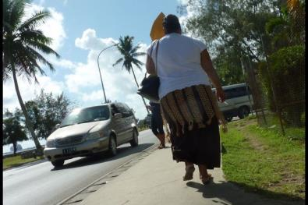
Did you know?
Environmental factors, such walkability, residential density, land use and access, and proximity to recreational facilities, correlate closely to physical activity among children and adolescents.
Notes:
Ding, D., Sallis, F., Kerr, J., Lee, S., & Rosenberg, D.E (2011). Neighborhood environment and physical activity among youth a review. American Journal of Preventative Medicine 41(4), 442-455.
Image courtesy of: http://www.globalpost.com/sites/default/files/imagecache/gp3_slideshow_large/4._tonga.jpg

Slide 6
What are characteristics of the built environment?
Walkable and Bikeable Neighborhoods
Features should be built into the environment that influences people to choose to walk or bicycle for transportation
Children especially need safe sidewalks and streets that are separate from fast moving traffic.
Destinations such as stores and services that are within walking distance of housing can also influence people to walk and bicycle as a means to transportation.
Notes:
L.K. Brennan Ramirez et al.,“Indicators of Activity-Friendly Communities: An Evidence-Based Consensus Process,” American Journal of Preventive Medicine 31 (2006): 515-524.
RobertWood Johnson Foundation,“The Synthesis Project. The Built Environment and Physical Activity:What is the Relationship?” retrieved from http://www.rwjf.org/pr/ synthesis/reports_and_briefs/pdf/no11_policybrief.pdf.

Slide 7
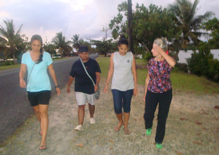
Did you know?
Studies have shown that residents in communities with walkable neighborhoods engage in about 70 more minutes/week of moderate and vigorous physical activity than those in less walkable neighborhoods.
Notes:
B.E. Saelens et al., “Neighborhood Based Differences in Physical Activity: An Environment Scale Evaluation,” American Journal of Public Health 93 (2003):1552-1558.

Slide 8
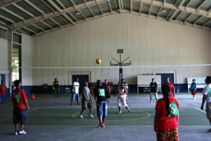
What are characteristics of the built environment?
Parks, Recreation Facilities and Open Space
Parks, recreation facilities and open space allow people a place where they can play outdoors and engage in physical activity.
Allowing schools to open their facilities to the public after hours can improve access to recreation facilities.
Notes:
R.C. Brownson et al., ”Environmental and Policy Determinants of Physical Activity in the United States,” American Journal of Public Health. 91 (2001): 1995-2003.

Slide 9
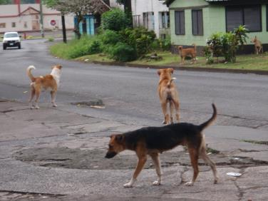
Did you know?
In American Samoa, over half of reported injuries are attributed to dog bites. Attacks by free-roaming dogs are attributed to a fear of being bitten and a barrier towards getting more physical activity.
Notes:
Vargo, Don.,DePasquale,John., Vargo, Agnes M., (2012). Incidence of Dog Bite Injuries in American Samoa and Their Impact on Society., Hawaii Journal of Medicine and Public Health., 71(1):6-12
Image courtesy of: http://3.bp.blogspot.com/_NTZU7umr_sI/TFui_j1rN7I/AAAAAAAABpk/b2Dt5rRRy6A/s1600/P1012747.JPG

Slide 10
What are characteristics of the built environment?
Safety
Safety issues and concerns can often hinder people’s desire and ability to be physically active.
In many U.S. Affiliated territories, free roaming dogs present a huge barrier in overcoming challenges to increase activity in open spaces and maintaining safety in walkable areas.
Notes:
Vargo D, DePasquale JM, Vargo AM. Incidence of Dog Bite Injuries in American Samoa and Their Impact on Society. Hawai'i J Med Pub Health. 2012;71:6–12. [PMC free article] [PubMed]

Slide 11
What are policies that can help improve the built environment?
Policies to allow public use of school athletic facilities after hours
There are many possibilities to create shared agreements between school districts and local government
Opening Outdoor School Facilities for Use During Non-School Hours
Opening Indoor and Outdoor School Facilities for Use During Non-School Hours
Opening School Facilities for Use During Non-School Hours & Authorizing Third Parties to Operate Programs
Joint Use of District and City Recreation Facilities

Slide 12
What are policies that can help improve the built environment?
A successful example:
Case Study: Oakland Unified School District and the City of Oakland
Growing concerns regarding childhood obesity, the need for open space, safe places for children to play motivated the Oakland Unified School District, the City of Oakland and the Unity Council to team up and provide a community-based school to support after-school physical activity programs for the district’s K–12 students and families.
A donated piece of land from the city was turned into the Cesar Chavez Education Center, a synthetic surface soccer field which was funded by the city and a local obligation bond.
Currently, the after-school soccer and basketball programs are full, with an additional 10 to 20 teams waiting to be scheduled. This partnership has increased physical activity opportunities for youth in the community where programs for youth did not previously exist.

Slide 13
What are policies that can help improve the built environment?
Dog leash policy implemented and reinforced
Model Dog Leash Policy
Two states within the U.S., Michigan and Pennsylvania have state requirements designating that a dog must be under the control of its owner while on the premises. Michigan provides the clearest example.

Slide 14
What are policies that can help improve the built environment?
“It shall be unlawful for any person to own any dog 6 months old or over, unless the dog is licensed as hereinafter provided, or to own any dog 6 months old or over that does not at all times wear a collar with a tag …or for any person except the owner or authorized agent, to remove any license tag from a dog; or for any owner to allow any dog, except working dogs such as leader dogs, guard dogs, farm dogs, hunting dogs, and other such dogs, when accompanied by their owner or his authorized agent, while actively engaged in activities for which such dogs are trained, to stray unless held properly in leash.”
- The Dog Law of 1919
Notes:
Dog Law of 1919, State of Michigan Legislative Council § 287.262 (1919). Web. 05 Jan. 2014

Slide 15
What are policies that can help improve the built environment?
Dog leash policy implemented and reinforced
A successful example:
Case Study: Catalonia, Spain
In Catalonia Spain, after enacting stricter regulations in 1999 and 2002, on dog ownership and breed specific regulations, there was a significant decline (-38%) in hospitalizations due to dog bites from 1997 – 2008. Decreases in injuries may have been associated with government regulations and preventative interventions.
Notes:
Villalbi JR, Cleries M, Bouis S, Perahco V, Duran J and Casas C 2010 “Decline in hospitalisations due to dog bite injuries in Catalonia, 1997-2008. An effect of government regulation?” injury Prevention 16: 408-410

Slide 16
What are policies that can help improve the built environment?
Fund projects that result in accessible and safe areas for walking
Within the U.S. several states and local communities are designating funding to build safer roads and areas where people can walk and bike. This may be done through licensing fees and motor vehicle or vehicle fuel taxes.
Notes:
Government Funding Sources." Home. Walkinginfo.org 2013. Web. 05 Jan. 2014.

Slide 17
What are policies that can help improve the built environment?
Fund projects that result in accessible and safe areas for walking
Successful examples:
Oregon dedicates 1 percent of state gas-tax revenue to providing improvements for bicycling and walking on state-managed highways.
The City of Albuquerque, New Mexico, and Bernalillo County, have a 5 percent set-aside of street bond funds which go to trails and bikeways. For the City, this has amounted to approximately $1.2 million every two years.
Pinellas County, Florida built much of the Pinellas Trail system with a portion of a one cent sales tax increase voted for by county residents.
Notes:
Government Funding Sources." Home. Walkinginfo.org 2013. Web. 05 Jan. 2014.

Slide 18
Who can I contact for more information?
Adrian Bauman
Boden Institute of Obesity, Nutrition and Exercise and Prevention Research Collaboration
University of Sydney
Sydney, Australia
Email:  adrian.bauman@sydney.edu.au

