Slide 1
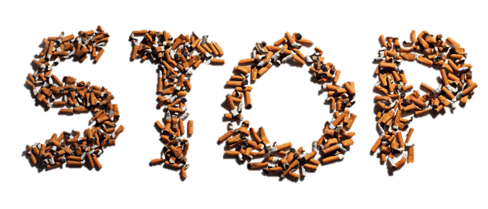
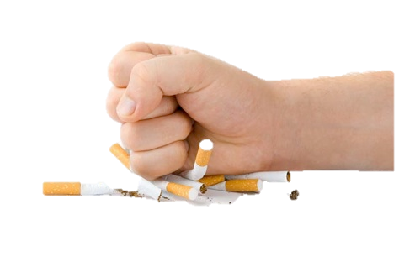
Establish and Sustain Tobacco Cessation Programs
Notes:
Top picture: http://www.hkpr.on.ca/portals/0/gallery/Images%20-%20Adults/Stop%20Smoking.jpg
Bottom picture: http://drrussfuller.com/psychotherapy/smoking-cessation/

Slide 2
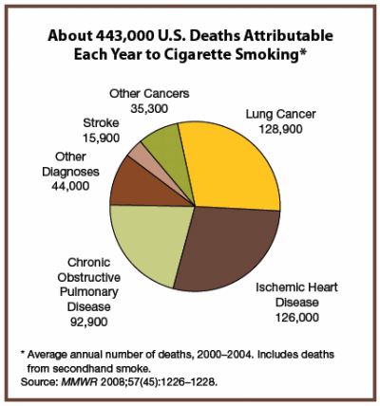
Background
Misuse and Abuse of Tobacco
Increase rates of cancer
  Lung cancer
Heart disease
Poor circulation
  asthma
High blood pressure
Notes:
Source: Morbidity and Mortality Weekly Report, November 14, 2008; 57(48): 1226-1228. http://www.cdc.gov/mmwr/PDF/wk/mm5745.pdf

Slide 3
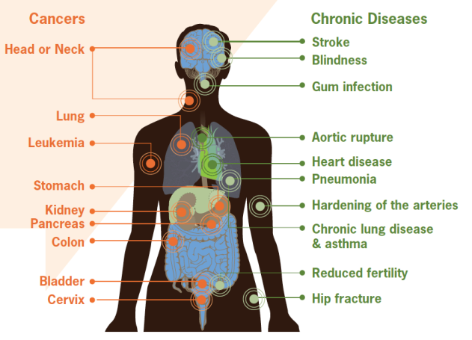
Smoking can cause damage to the body leading to various cancers and chronic diseases
Notes:
Figure: CDC vital signs, September 2010 Fact Sheet, http://www.cdc.gov/VitalSigns/pdf/2010-09-vitalsigns.pdf

Slide 4

Did you know?
Tobacco kills up to half of its users, about 6 million people each year.
  5 million of those deaths are the result of direct tobacco use
  More than 600,000 deaths are the result of non-smokers being exposed to second-hand smoke.
Nearly 80% of the world’s one billion smokers live in low- and middle-income countries.
Consumption of tobacco products is increasing globally, though it is decreasing in some high-income and upper middle-income countries.
Notes:
Source: World Health Organization Fact Sheet July 2013

Slide 5
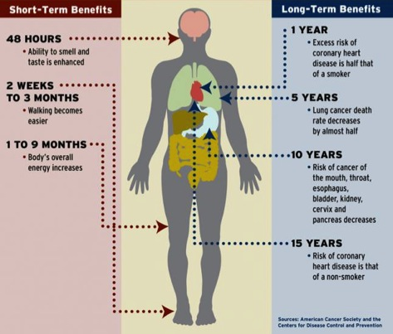
Did you know?
There are immediate and long-term health benefits to quitting smoking!
Notes:
Source: http://m.today.duke.edu/sites/default/files/quit%20smoking%20body_800.jpg, American Cancer Society and the Center of Disease Control Prevention

Slide 6
Prevalence of Daily Smoking:
25-64 years old
Notes:
Slide source: YAP Tobacco Jeannie McKenzie (2-12).ppt
Data Sources: WHO STEPs . Fiji 2005; Nauru 2007; American Samoa 2007; Tokelau 2007; Marshall Islands 2007; FSM 2008; Kiribati 2009; Solomon Islands 2010, SPC- Wallis and Futuna 2009
It is estimated that two people die each minute from tobacco-related disease in the Western Pacific.
-Source: Jha, P., Ramasundarahettige, C., Landsman, V., Rostron, B., Thun, M., Anderson, R.N., McAfee, T., & Peto, R. (2013) 21st Century Hazards of Smoking and Benefits of Cessation in the United States. New England Journal of Medicine, 368:341–50.
The graph above shows that in the Pacific smoking is common and tends to be common among males.

Slide 7
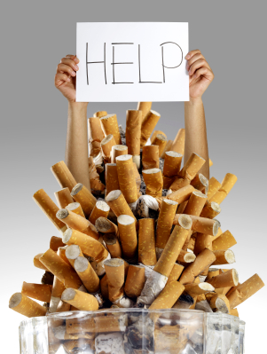
Did you know?
Most smokers that are aware of the
health dangers of smoking do want to quit
Counseling and medication
can more than double their chance
of succeeding
BUT its very difficult to do so unaided due to the addictiveness of nicotine
Notes:
Text source: http://www.who.int/fctc/guidelines/adopted/article_13/en/
Images: http://www.fhcp.com/health/programs/smoking-cessation

Slide 8
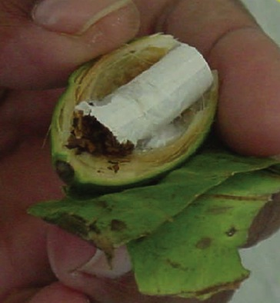
Facts
Chewing betel nut causes oral cancer and adding tobacco greatly increases the risk for oral cancer
Betel nut chewing is prevalent in the Western Pacific Region:
Commonwealth of Northern Mariana Islands: 90% of survey participants reported betel nut chewing with tobacco
Federated States of Micronesia: 29.9% of total population reported betel nut chewing
Guam: Youth Behavioral Risk Survey (1999-2003) revealed significant percentage of high school students chewed tobacco with betel nut
Republic of Palau: 86% of 1110 surveyed in 1996 aged 35-44 years old reported betel nut chewing
The Marshall Islands: 4.5% of total population use betel nut daily
Notes:
The Review of Areca (Betel) Nut and Tobacco Use in the Pacific – A Technical Report by the WHO, Western Pacific Region focuses on the reduction of smokeless tobacco use. By World Health Organization, Western Pacific Region. Published in 2012.
http://www.wpro.who.int/tobacco/documents/betelnut.pdf

Slide 9
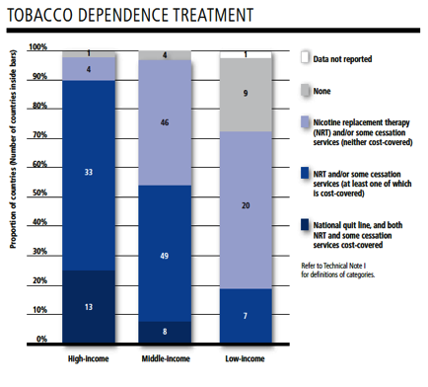
Facts on Tobacco Cessation
Clinical cessation interventions are effective and cost-effective
However, only 15% of the world’s population live in the 21 countries that provide appropriate cessation services
More tobacco cessation programs are needed worldwide!
Notes:
Source: WHO report on the global tobacco epidemic, 2013, http://apps.who.int/iris/bitstream/10665/85380/1/9789241505871_eng.pdf
The graph shows the number of countries that use tobacco dependence treatment based on high, middle and low income.

Slide 10
WHO Framework Convention on Tobacco Control – Article 14
The Framework Convention on Tobacco Control by the World Health Organization identifies key policy interventions critical to combat tobacco.
(a) design & implement effective programs aimed at promoting the cessation of tobacco use, in such locations as educational institutions, health care facilities, workplaces & sporting environments;
(b) include diagnosis & treatment of tobacco dependence & counselling services on cessation of tobacco use in national health & education programs, plans & strategies, with the participation of health workers, community workers & social workers as appropriate;
(c) establish in health care facilities & rehabilitation centers programs for diagnosing, counseling, preventing & treating tobacco dependence;
(d) collaborate with other Parties to facilitate accessibility & affordability for treatment of tobacco dependence including pharmaceutical products pursuant to Article 22. Such products & their constituents may include medicines, products used to administer medicines & diagnostics when appropriate.

Slide 11
Examples of Tobacco Cessation Services
Cessation counseling by medical provider
  Smoke-Free Families 5 A’s 1. ask about smoking behavior
  2. advise all smokers to stop
    3. assess willingness to stop
    4. assist smokers to stop
    5. arrange follow-up visits
Interventions
  Individual, group, telephone, or online counseling
  Provide social support and enhance problem solving ability
Over-the-counter nicotine replacement therapy
  Patches, gum, nasal spray
Prescription medication
System changes recommended by the Agency for Healthcare Research and Quality (AHRQ) including:
  Implement a tobacco-use screening system
  Implement healthcare provider training and feedback
  Designating staff to be responsible for treatment program
  Providing insurance coverage for proven treatments
Notes:
Source: http://www.naccho.org/topics/hpdp/tobacco/upload/tobacco-prevention-learners-guide.pdf

Slide 12
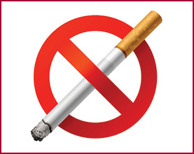
Government’s Role in Tobacco Cessation Services
Governments must support tobacco cessation programs.
  Each country’s health care system should have primary responsibility for providing smoking cessation programs
  Treatment and cessation services most effective when incorporated into a coordinated national tobacco control program
  Recommended that each country’s essential medicine list include nicotine replacement therapy (NRT)
Notes:
WHO report on the global tobacco epidemic, 2013, http://apps.who.int/iris/bitstream/10665/85380/1/9789241505871_eng.pdf
Picture: https://connection.asco.org/Magazine/Article/ID/3360/New-ASCO-Resources-Help-Oncologists-Discuss-Tobacco-Cessation.aspx

Slide 13
How Governments can Reduce Likelihood of Tobacco-Related Diseases
Recommendations by the Mayo Clinic
Make treatment a public health priority
  Governments must rank tobacco use treatment as an important public health policy
Set an example for peers and patients by ceasing tobacco use
  Government can help this process by funding treatment and education programs for health professionals in training
Fund effective treatment
  Find treatments based on methods that have been demonstrated to be effective
  Make these effective treatments widely available
  Full range of treatments (ex: behavioral and pharmacological, singly or both) should be offered and made accessible to all tobacco users
Notes:
Tools for Advancing Tobacco Control in the XXIst century: Policy Recommendations for Smoking Cessation and Treatment of Tobacco Dependence. World Health Organization. 2003. http://www.who.int/tobacco/resources/publications/en/chapter5_to_annex2.pdf

Slide 14
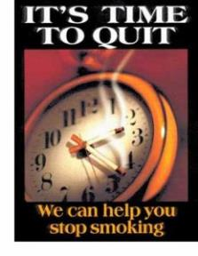
How Governments can Reduce Likelihood of Tobacco-Related Diseases (continued)
Motivate tobacco users to quit
  Responsible for educating the public about health risks of tobacco use and encouraging tobacco users to seek treatment
  Help make treatment more available, accessible and affordable
Monitor and regulate tobacco processing, marketing, and sales
  Governments should monitor and report on tobacco use and should tax and regulate sales of tobacco products -> can reduce initiation of tobacco use and help fund effective treatment
Notes:
Tobacco Cessation Among Asian American and Pacific Islanders: A Community Approach. Asian Pacific Partners for Empowerment, Advocacy, and Leadership (APPEAL). 2012. http://www.appealforcommunities.org/media/docs/2336_CessationKit05Final.pdf
Picture: http://stopsmokingaids.me/

Slide 15
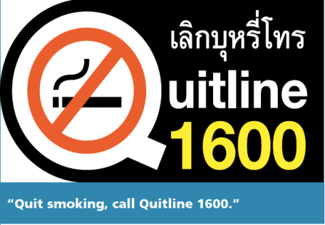
Example of Successful Quit Line: Thailand
2009: set up national Quit line, Quitline 1600
Has been operating 12.5 hours/day, 5 days/week
Have more than 11,000 calls logged each month
Quality monitoring system implemented in 2011 to provide counselors with feedback
30% of those who quit remain abstinent 6 months later-> 3x the rate of those receiving no assistance
Notes:
Source: WHO report on the global tobacco epidemic, 2013, http://apps.who.int/iris/bitstream/10665/85380/1/9789241505871_eng.pdf

Slide 16
Example of Tobacco Cessation Service
Project Habit: Hmong Against Big Tobacco
Collaboration between Hmong community and La Crosse County Health Department in Wisconsin
Gathered community input and conducted surveys
  Important cultural aspect: Hmong community is patriarchal and respect is paid to the elders -> factors had to be interwoven into delivery of services
Community education to increase tobacco issues and encourage smokers to quit
  Guest speakers: Hmong physicians, clan leaders, ex-smokers, key community leaders
Individual counseling provided:
  American Lung Association’s Freedom from Smoking curriculum adopted & culturally tailored
  Pictures widely used to show tobacco related diseases
Tobacco prevention and cessation video:
  High illiteracy rate amongst Hmong elderly so video is highly effective
Telephone quit line:
  < 1% of Hmong population call the quit line
  Not a traditional practice in Hmong culture to call someone you do not know
  Project HABIT working with quit line to obtain written consent from smokers which enables Quit Line to call smokers directly
  Example of needing to consider cultural aspects when applying and developing effective cessation programs
Notes:
Tobacco Cessation Among Asian American and Pacific Islanders: A Community Approach by Asian Pacific Partners for Empowerment, Advocacy, and Leadership (APPEAL)
Published: 2006
http://www.appealforcommunities.org/media/docs/2336_CessationKit05Final.pdf

Slide 17
Who to contact?
James Rarick
Technical Officer, Tobacco Free Initiative
WHO Western Pacific Regional Office
Manila, Philippines
E-mail:  rarickj@wpro.who.int

