Slide 1
Health in All Policies

Slide 2
What is Health in All Policies?
Health in All Policies (HiAP) is a way of thinking about policymaking while considering the social and environmental impact of its decisions.
HiAP encourages creating partnerships with people, community programs, and businesses to help make policy decisions.

Slide 3
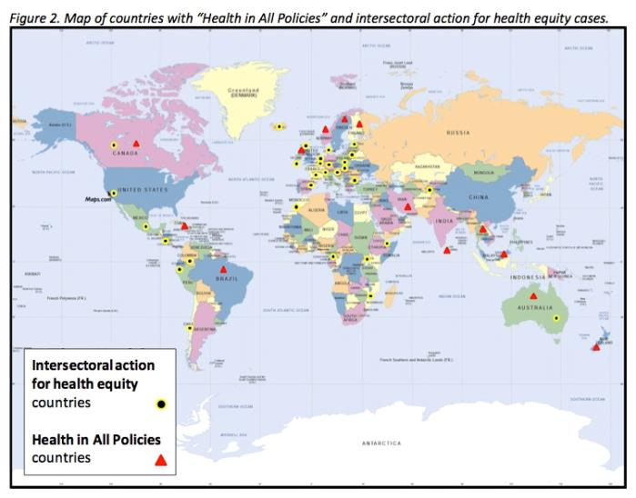
Countries using a Health in All Policies Approach

Slide 4
What is the history of Health in All Policies?
The term “Health in All Policies” was first created in the early 1990’s, but became more popular in 2006 when Finland became the head of the European Union (EU).
The EU worked to adopt a HiAP approach to policymaking that helped to strengthen policy decisions and partnerships.
Today this approach can be seen in countries around the world such as Australia, Cuba and Thailand.

Slide 5
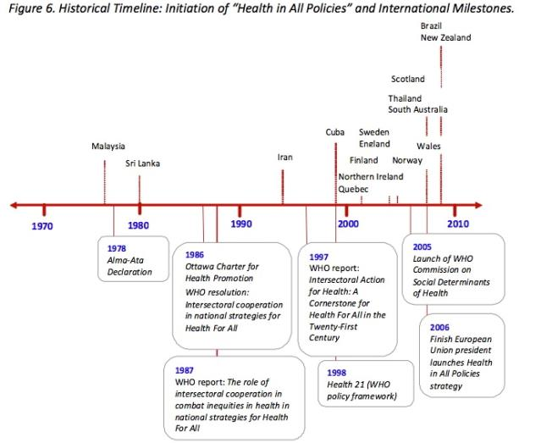
Timeline of Health in All Policies

Slide 6
Why Health in All Policies is important
The HiAP approach ensures that health is part of the policy making process and that the community and others are also involved.
Non-health policies can play a large role in shaping our environment. The social determinants of health and the environment that we live in can impact our health.

Slide 7
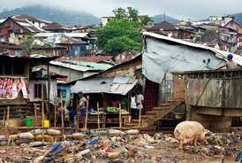
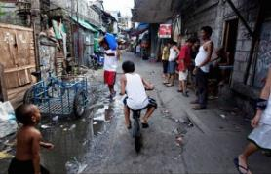
What are social determinants of health?
The World Health Organization defines social determinants of health as, “the health conditions that people are born, grow, live, work and age in.” A few are listed below :
Physical environment
Gender
Race/Ethnicity
Income
Social Status
Education
Genetics
Health services

Slide 8
Examples of using a Health in All Policies approach
Example: California 2010
Governor Arnold Schwarzenegger held a discussion to pursue eight actions to support healthy living.
He established a HiAP task force to identify ways to improve the health of Californians. 19 state agencies and departments participated on the task force.

Slide 9
Examples of using a Health in All Policies approach
California HiAP Goals:
Identify ways to...
improve air and water quality
protect natural resources and agriculture lands
increase the availability of affordable housing
improve infrastructure systems
promote public health
plan sustainable communities
meet climate change goals

Slide 10
Examples of using a Health in All Policies approach
California HiAP Stakeholders:
Air Resources Board
Office of Attorney General
Business, Transportation and Housing Agency
Department of Community Services and Development
Department of Education
Environmental Protection Agency
Department of Finance
Department of Food and Agriculture
Department. of Forestry and Fire Protection
Health and Human Services Agency
Department. of Housing and Community Development
Labor and Workforce Development Agency
Natural Resources Agency
Department. of Parks and Recreation
Office of Planning and Research
Department of Public Health
Department. of Social Services
Department. of Transportation
Office of Traffic Safety

Slide 11
Examples of using a Health in All Policies approach
California HiAP Outcome:
Task force members met several times and developed knowledge of the each stakeholders policy areas. They held workshops and meetings with the public where they evaluated ways to improve the health of communities. The task force then created recommendations and implementation plans to guide the development of policies.

Slide 12
Examples of using a Health in All Policies approach
California HiAP Successes:
In August 2012, the California Department of Finance executed an Interagency Agreement between the California Department of Education, the California Department of Food and Agriculture, and California Department of Public Health to develop an interagency Office of Farm to Fork, drawing resources from all three agencies. This office will promote policies and strategies to improve access to healthy, affordable food.

Slide 13
Examples of using a Health in All Policies approach
California HiAP Successes:
The Governor’s Office of Planning and Research and CDPH have partnered to identify land use strategies to expand the availability of affordable, locally grown produce.
The Task Force hosted an orientation workshop called Complete Streets: Designing for Pedestrian and Bicycle Safety for staff from nine different agencies, in order to provide an opportunity for collaboration among agencies

Slide 14
Examples of using a Health in All Policies approach
Example: British Columbia, Canada 2005
ActNow BC was launched in 2005 to help implement initiatives that would increase the health of all British Columbians by 2010.

Slide 15
Examples of using a Health in All Policies approach
ActNowBC Goals:
Identify ways to...
To improve health by reducing tobacco use
Eat more healthy foods
Be more active
Make healthy choices during pregnancy
Improve air and water quality

Slide 16
Examples of using a Health in All Policies approach
ActNowBC Stakeholders:
British Columbia Lung Association
Canadian Diabetes Association Pacific
Heart and Stroke Foundation
Canadian Cancer Society
Union of British Columbia Municipalities
British Columbia Recreation and Parks Association
Dietitians of Canada British Columbia Region
British Columbia Pediatric Society
Public Health Association of British Columbia
British Columbia Health Authorities
Public Health Agency of Canada
Ministry of Healthy Living and Sport
2010 Legacies Now

Slide 17
Examples of using a Health in All Policies approach
ActNowBC Outcome:
ActNow BC mandate expired in 2010, but has continues to be an ongoing initiative.

Slide 18
Examples of using a Health in All Policies approach
ActNowBC Successes:
Physical Activity: began initiatives to increase activities through active communities. Through a partnership with BC Recreation and Parks Association and 2010 Legacies Now, they mobilized community workshops and partnerships with organizations to promote healthy lifestyles.

Slide 19
Examples of using a Health in All Policies approach
ActNowBC Successes:
Healthy Eating: BC School Fruit and Vegetable Snack Program was established that used 10 pilot schools to receive BC fruit and vegetables twice a week. This was done through a partnership with BC Agriculture in the Classroom and the Ministries of Health, Education and Agriculture and Lands. 3300 Elementary Children received 6600 fruits and vegetables per week. Parents and children reported positive changes in their personal health and school lives.
Tobacco Control: QuitNow Services were formed to increase cessation services to smokers. This was done through a partnership with the BC Lung Association and the Ministry of Health. A toll free counseling and intervention service was established and in 2006 over 1,000 persons were assisted by phone.

Slide 20
Who can I contact for more information?
The World Health Organization Regional Office for the Western Pacific
P.O. Box 2932 1000 Manila Philippines Telephone: +63 2 528 8001 Email:  pio@wpro.who.int

