Slide 1
Health in All Policies

Slide 2
What is Health in All Policies?
Health in All Policies (HiAP) is an approach to policy development and implementation that considers the social and environmental implications of its decisions.
It recognizes that other factors beyond healthcare can have a significant impact on health and the community’s well being.
HiAP encourages other sectors to get involved and inform decisions in policies. Through partnership, connections can be thoroughly examined allowing a broader perspective in the process of policy making and a more effective approach to improving the health outcomes and health equity of communities.

Slide 3
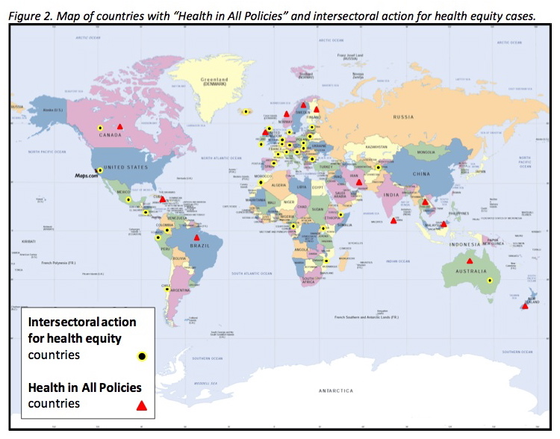
Countries using a Health in All Policies Approach

Slide 4
What is the history of Health in All Policies?
The term “Health in All Policies” was first created in the early 1990’s however, it was more thoroughly defined in 2006 during the Finnish presidency of the EU.
The EU worked to adopt a HiAP approach to policymaking that helped to strengthen policy decisions and partnerships.
Today this approach can be seen in countries around the world such as Australia, Cuba and Thailand.
It’s implementation and incorporation across varying degrees of political organization and socioeconomic status illustrate its feasibility regardless of a country’s development.

Slide 5
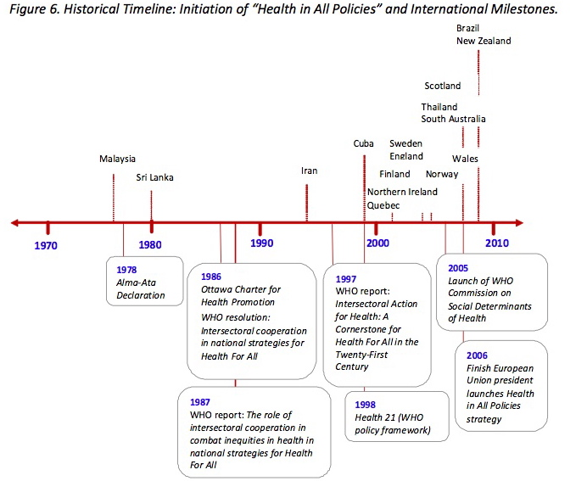
Timeline of Health in All Policies

Slide 6
Why Health in All Policies is important
The HiAP approach ensures that health is part of the policy making process and that the community and others are also involved.
Non-health policies can play a large role in shaping our environment. The social determinants of health and the environment that we live in can impact our health.
The HiAP approach ensures that health is part of the policy making process and that the community and others are also involved. It’s feasibility lies in its collaborative and cohesive approach and its promotion in “doing the best possible within the context of political will and resources."

Slide 7
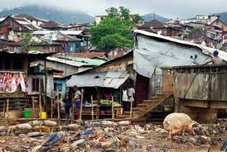
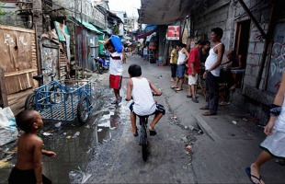
What are social determinants of health?
The World Health Organization defines social determinants of health as, “the health conditions that people are born, grow, live, work and age in.” These factors are shaped by money, power and availability of resources. A few are listed below :
Physical environment
Gender
Race/Ethnicity
Income
Social Status
Education
Genetics
Health services

Slide 8
What are the five key elements for establishing a Health in All Policies approach?
There are many variations that may be taken with this approach and initiatives may differ depending on the needs, structure and availability of resources in each jurisdiction.
There is a wide range of activities that each government can use in order to incorporate health into decision making. These may include trainings, conferences, sharing data, joint research projects and collaborative decision-making. The five key elements that have proved to be important factors in this process are included in the next few slides.

Slide 9
What are the five key elements for establishing a Health in All Policies approach?
1. Promote Health Equity and Sustainability
Promoting health equity and sustainability can be done through two different ways, through incorporating them into policies and programs and also through embedding this idea into government decision making so that consideration of health becomes part of the decision making process.

Slide 10
What are the five key elements for establishing a Health in All Policies approach?
2. Support Intersectoral Collaboration
Supporting collaboration is an essential component to the HiAP approach. HiAP is about breaking down walls and building partnerships to focus on specific issues while taking into account the social, economic and physical environments that affect ones health. All agencies should be considered in the approach as all may have a variety of perspectives to offer that may increase the background and scope of the issue.

Slide 11
What are the five key elements for establishing a Health in All Policies approach?
3. Benefit Multiple Partners
Involving multiple partners can sometimes lead to an effort in balancing the various goals of each agency and organization. HiAP should work to find “win-wins” which benefit all partners
involved. Finding a balance, may be difficult but it is important to negotiate and approach
the situation with an open mind while taking into account other agencies priorities and

Slide 12
What are the five key elements for establishing a Health in All Policies approach?
4. Engage Stakeholders
Engaging stakeholders is an important part of HiAP. Including a variety of different stakeholders from community members to policy experts is essential to gathering information in order to understand community needs and ensuring that these needs are met.

Slide 13
What are the five key elements for establishing a Health in All Policies approach?
5. Create Structural or Procedural Change
As HiAP is incorporated into decision-making, intersectoral relationships will change as
decisions are made. It is important to ensure that these relationships that are created are
kept and HiAP can be sustained over time. It is vital for the continued maintenance of HiAP
that these collaborative mechanisms be embedded into new processes of government.

Slide 14
What are characteristics of successful collaboration?
Cross agency collaboration is essential to ensuring a healthier future for all. Working together successfully and efficiently is an important part of HiAP. Below are a few characteristics of successful collaboration.
1) Identify Shared Goals
Identify shared goals to find common ground and build partnership and trust to continue collaboration.
2) Engage Partners Early and Develop Relationships
Engaging partners early is essential for the efficiency of planning and policy development.

Slide 15
What are characteristics of successful collaboration?
3)Define a Common Language
Define a common language and try to learn and understand the partners and agencies you are collaborating with in order to gain a better understanding of their goals and issues.
4) Activate the Community
Include the community into the conversation in order to better understand the issues and allow them to be a part of the decision making process.
5)Leverage Funding
Leverage funding from programs with similar goals in order to support intersectoral efforts.

Slide 16
Examples of using a Health in All Policies approach
Example: California 2010
Governor Arnold Schwarzenegger held a discussion to pursue eight actions to support healthy living.
He established a HiAP task force to identify ways to improve the health of Californians. 19 state agencies and departments participated on the task force.

Slide 17
Who are my stakeholders?
Stakeholders are those partners who are impacted by the issue or the work that you are doing. They include residents and local organizations, local governments and other partners.

Slide 18
Who are my stakeholders?
1) Policy and Issue Experts
Experts in non-governmental organizations, academia or private sector may have good ideas of ways to find solutions to the issue. They may also be familiar with the issue you are tackling and can help to offer information or help research if new information is needed.
2) Community Members and Community Based/Non Governmental Organizations
Community members and community based/non-governmental organizations can have valuable information about the needs in their communities and challenges that may be faced which can affect proposed plans. Their insight is important to understanding the specific ways issues may be approached.

Slide 19
Who are my stakeholders?
3) Private Sector
Companies may be able to provide support and contribute resources in order to impact their communities. They may also be able to apply some of the HiAP principles within their company or institution.
4) Funders
Funders are a great way to provide support to stakeholder initiatives. They can offer help and reach out to their network to provide resources and assistance to stakeholder strategies.

Slide 20
Examples of using a Health in All Policies approach
California HiAP Goals:
Identify ways to...
improve air and water quality
protect natural resources and agriculture lands
increase the availability of affordable housing
improve infrastructure systems
promote public health
plan sustainable communities
meet climate change goals

Slide 21
Examples of using a Health in All Policies approach
California HiAP Stakeholders:
Air Resources Board
Office of Attorney General
Business, Transportation and Housing Agency
Department of Community Services and Development
Department of Education
Environmental Protection Agency
Department of Finance
Department of Food and Agriculture
Department. of Forestry and Fire Protection
Health and Human Services Agency
Department. of Housing and Community Development
Labor and Workforce Development Agency
Natural Resources Agency
Department. of Parks and Recreation
Office of Planning and Research
Department of Public Health
Department. of Social Services
Department. of Transportation
Office of Traffic Safety

Slide 22
Examples of using a Health in All Policies approach
California HiAP Outcome:
Task force members met several times and developed knowledge of the each stakeholders policy areas. They held workshops and meetings with the public where they evaluated ways to improve the health of communities. The task force then created recommendations and implementation plans to guide the development of policies.

Slide 23
Examples of using a Health in All Policies approach
California HiAP Successes:
In August 2012, the California Department of Finance executed an Interagency Agreement between the California Department of Education, the California Department of Food and Agriculture, and California Department of Public Health to develop an interagency Office of Farm to Fork, drawing resources from all three agencies. This office will promote policies and strategies to improve access to healthy, affordable food.

Slide 24
Examples of using a Health in All Policies approach
California HiAP Successes:
The Governor’s Office of Planning and Research and CDPH have partnered to identify land use strategies to expand the availability of affordable, locally grown produce.
The Task Force hosted an orientation workshop called Complete Streets: Designing for Pedestrian and Bicycle Safety for staff from nine different agencies, in order to provide an opportunity for collaboration among agencies

Slide 25
Examples of using a Health in All Policies approach
Example: British Columbia, Canada 2005
ActNow BC was launched in 2005 to help implement initiatives that would increase the health of all British Columbians by 2010.

Slide 26
Examples of using a Health in All Policies approach
ActNowBC Goals:
Identify ways to...
To improve health by reducing tobacco use
Eat more healthy foods
Be more active
Make healthy choices during pregnancy
Improve air and water quality

Slide 27
Examples of using a Health in All Policies approach
ActNowBC Stakeholders:
British Columbia Lung Association
Canadian Diabetes Association Pacific
Heart and Stroke Foundation
Canadian Cancer Society
Union of British Columbia Municipalities
British Columbia Recreation and Parks Association
Dietitians of Canada British Columbia Region
British Columbia Pediatric Society
Public Health Association of British Columbia
British Columbia Health Authorities
Public Health Agency of Canada
Ministry of Healthy Living and Sport
2010 Legacies Now

Slide 28
Examples of using a Health in All Policies approach
ActNowBC Outcome:
ActNow BC mandate expired in 2010, but has continues to be an ongoing initiative.

Slide 29
Examples of using a Health in All Policies approach
ActNowBC Successes:
Physical Activity: began initiatives to increase activities through active communities. Through a partnership with BC Recreation and Parks Association and 2010 Legacies Now, they mobilized community workshops and partnerships with organizations to promote healthy lifestyles.

Slide 30
Examples of using a Health in All Policies approach
ActNowBC Successes:
Healthy Eating: BC School Fruit and Vegetable Snack Program was established that used 10 pilot schools to receive BC fruit and vegetables twice a week. This was done through a partnership with BC Agriculture in the Classroom and the Ministries of Health, Education and Agriculture and Lands. 3300 Elementary Children received 6600 fruits and vegetables per week. Parents and children reported positive changes in their personal health and school lives.
Tobacco Control: QuitNow Services were formed to increase cessation services to smokers. This was done through a partnership with the BC Lung Association and the Ministry of Health. A toll free counseling and intervention service was established and in 2006 over 1,000 persons were assisted by phone.

Slide 31
Who can I contact for more information?
The World Health Organization Regional Office for the Western Pacific
P.O. Box 2932 1000 Manila Philippines Telephone: +63 2 528 8001 Email:  pio@wpro.who.int

