Slide 1
Implement Policies that Promote Breastfeeding

Slide 2
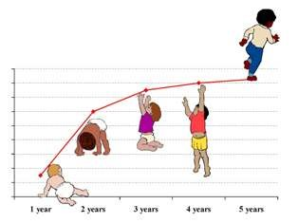
Did you know?
Breastfeeding is the best source of nourishment for infants and young children.
It contributes to a lifetime of good health, growth and development.
Notes:
Source: UNICEF and WHO
Picture: http://sound-soundage.blogspot.com/2008/07/baby-growth-chart.html

Slide 3
Did you know?
Infants who are not breastfed are at an increased risk of illness that can compromise their growth and raise the risk of death or disability.
Notes:
Source: UNICEF and WHO
Picture: http://supermommyornot.blogspot.com/2012_06_01_archive.html

Slide 4
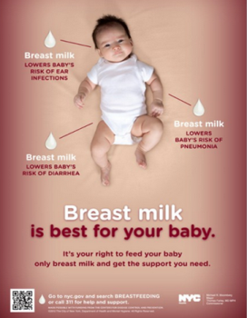
Did you know?
Globally, exclusive and continued breastfeeding could help prevent 13 of 100 deaths of children under five years old.
Notes:
Source: Jones G, Steketee RW, et al. (June 2013). How many child deaths can we prevent this year. The Lancet, 362:65-71.
Picture: New York City www.nyc.gov

Slide 5
Fact
Women who breastfeed also have a lower risk of developing obesity, breast cancer, and ovarian cancer later in life.
Notes:
Source: Stuebe A (2009). The risks of not breastfeeding for mothers and infants. Rev Obstet Gynecol: 2(4):222-231.

Slide 6
Did you know?
The World Health Organization recommends continued breastfeeding up to 2 years of age or beyond.

Slide 7
Fact
-Breast milk contains antibodies that protect infants from common childhood illnesses such as diarrhea and pneumonia, the two primary causes of child mortality worldwide.
-Breastfeeding also prevents many chronic diseases such as asthma and allergies. Exclusive breastfeeding helps hasten recovery during illness.
Notes:
Source: World Health Organization (March 2012). WHO Breastfeeding Fact Sheet. Retrieved from: http://www.wpro.who.int/mediacentre/factsheets/nutrition_breastfeeding/en/

Slide 8
Fact
Breast milk promotes sensory and cognitive development. Breastfed children achieve higher academic scores and perform better in intelligence tests. Because it is readily available and affordable, breastfeeding helps ensure that infants get adequate sustenance.
Notes:
Source: World Health Organization (March 2012). WHO Breastfeeding Fact Sheet. Retrieved from: http://www.wpro.who.int/mediacentre/factsheets/nutrition_breastfeeding/en/

Slide 9
Economic Benefit
Families who follow the optimal breastfeeding practices can save between $1,200–$1,500 in expenditures on infant formula in the first year alone
Notes:
Source: The Surgeon General (2011). The Surgeon General’s Call to Action to Support Breastfeeding Fact Sheet. Retrieved from: http://www.surgeongeneral.gov/library/calls/breastfeeding/factsheet.html
Picture: http://www.usbreastfeeding.org/LegislationPolicy/BreastfeedingAdvocacyHQ/BreastfeedingSavesDollarsandMakesSense/tabid/339/Default.aspx

Slide 10
Economic Benefit
If 90 of 100 U.S. families followed guidelines to breastfeed exclusively for six months, the U.S. would annually save $13 billion from reduced medical and other costs.
Notes:
Source: Bartick M & Reinhold A (2010). The burden of suboptimal breastfeeding in the U.S.: A pediatric cost analysis, 125(5);1048-1056.
Picture: http://www.circleofmoms.com/top25/Top-25-Money-Saving-Moms-2012

Slide 11
What can families and friends of mothers do?
Give mothers the support and encouragement they need to breastfeed.
Take advantage of programs to educate fathers and grandmothers about breastfeeding.

Slide 12
What can communities do?
Make a commitment to support breastfeeding mothers where you live. Make sure your community helps mothers who want to breastfeed.
Encourage community programs and organizations to build on the support that mothers receive in the hospital.
Use the resources of your community to connect mothers to assistance such as mother-to-mother support groups that can help them keep breastfeeding even if they have problems.

Slide 13
What can employers do to support breastfeeding in the workplace?
Consider flexible scheduling options.
Allow women sufficient break time to breastfeed or express milk on the job, and provide space in a private, clean place (not a bathroom).
Develop a breastfeeding support program tailored to the company.
Inform all employees about the company’s breastfeeding support policy.
Support and be aware of legislation and policies promoting workplace support for breastfeeding women.

Slide 14
What can public health professionals do?
Promote changes to health care systems that make it easier for women to start and keep breastfeeding.
Support efforts to teach mothers and their families about the benefits of breastfeeding.
Take part in writing health care standards, putting policies in place, and displaying leadership that supports breastfeeding.
Look at the selected actions recommended by the Surgeon General to make support for breastfeeding part of programs serving mothers and babies in your community.

Slide 15
Who can I contact for more information?
???

