Slide 1
Implement Policies that Promote Breastfeeding

Slide 2
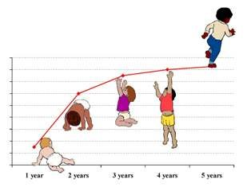
Did you know?
Breastfeeding is the best source of nourishment for infants and young children.
It contributes to a lifetime of good health, growth and development.
Notes:
Source: UNICEF and WHO
Picture: http://sound-soundage.blogspot.com/2008/07/baby-growth-chart.html

Slide 3
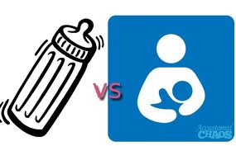
Did you know?
Infants who are not breastfed are at an increased risk of illness that can compromise their growth and raise the risk of death or disability.
Notes:
Source: UNICEF and WHO
Picture: http://supermommyornot.blogspot.com/2012_06_01_archive.html

Slide 4
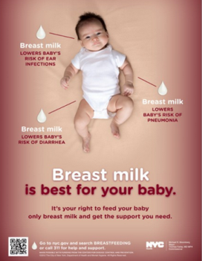
Did you know?
Globally, exclusive and continued breastfeeding could help prevent 13 of 100 deaths of children under five years old.
Notes:
Source: Jones G, Steketee RW, et al. (June 2013). How many child deaths can we prevent this year. The Lancet, 362:65-71.
Picture: New York City www.nyc.gov

Slide 5
Fact
Women who breastfeed also have a lower risk of developing obesity, breast cancer, and ovarian cancer later in life.
Notes:
Source: Stuebe A (2009). The risks of not breastfeeding for mothers and infants. Rev Obstet Gynecol: 2(4):222-231.

Slide 6
Did you know?
The World Health Organization recommends continued breastfeeding up to 2 years of age or beyond.

Slide 7
Fact
Breast milk contains antibodies that protect infants from common childhood illnesses such as diarrhea and pneumonia, the two primary causes of child mortality worldwide. Breastfeeding also prevents many chronic diseases such as asthma and allergies. Exclusive breastfeeding helps hasten recovery during illness.
Notes:
Source: World Health Organization (March 2012). WHO Breastfeeding Fact Sheet. Retrieved from: http://www.wpro.who.int/mediacentre/factsheets/nutrition_breastfeeding/en/

Slide 8
Fact
Breast milk promotes sensory and cognitive development. Breastfed children achieve higher academic scores and perform better in intelligence tests. Because it is readily available and affordable, breastfeeding helps ensure that infants get adequate sustenance.
Notes:
Source: World Health Organization (March 2012). WHO Breastfeeding Fact Sheet. Retrieved from: http://www.wpro.who.int/mediacentre/factsheets/nutrition_breastfeeding/en/

Slide 9
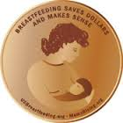
Economic Benefit
Families who follow the optimal breastfeeding practices can save between $1,200–$1,500 in expenditures on infant formula in the first year alone
Notes:
Source: The Surgeon General (2011). The Surgeon General’s Call to Action to Support Breastfeeding Fact Sheet. Retrieved from: http://www.surgeongeneral.gov/library/calls/breastfeeding/factsheet.html
Picture: http://www.usbreastfeeding.org/LegislationPolicy/BreastfeedingAdvocacyHQ/BreastfeedingSavesDollarsandMakesSense/tabid/339/Default.aspx

Slide 10
Economic Benefit
If 90% of U.S. families followed guidelines to breastfeed exclusively for six months, the U.S. would annually save $13 billion from reduced medical and other costs.
Notes:
Source: Bartick M & Reinhold A (2010). The burden of suboptimal breastfeeding in the U.S.: A pediatric cost analysis, 125(5);1048-1056.
Picture: http://www.circleofmoms.com/top25/Top-25-Money-Saving-Moms-2012

Slide 11
Examples of policies
The Baby-Friendly Hospital Initiative is an effort by United Nations Children’s Fund (UNICEF) and the World Health Organization (WHO) to ensure that all maternity facilities become centers of breastfeeding support. A maternity facility or hospital is designated 'baby-friendly' when it:
does not accept free or low-cost breast milk substitutes
feeding bottles or teats
has implemented 10 specific steps to support successful breastfeeding

Slide 12
Examples of policies
Coalition of Oklahoma Breastfeeding Advocates:
Policy statements
for health care providers;
for documentation, monitoring and continuing education;
for breastfeeding education;
for clinical care of breastfeeding mothers and their infants; and
for exceptions.

Slide 13
Examples of policies
Fringe benefits – Special paid leave for breastfeeding
This policy allows time for breastfeeding mothers to have an opportunity to breastfeed their babies at the child care center or for milk extraction for a designated time. Also the place of business shall designate an area for privacy and hygiene for the breastfeeding mother.

Slide 14
Examples of policies
Breastfeeding Awareness Month
This policy supports breastfeeding , education on breastfeeding, and support activities for the development of breastfeeding.

Slide 15
Examples of policies
Freedom from discrimination – Declaration of civil rights
The right of a mother to breastfeed her child in any place of public resort, accommodation, assemblage or amusement.

Slide 16
Who can I contact for more information?
???

