Slide 1
Implement Policies that Promote Production and Consumption of Local Foods

Slide 2
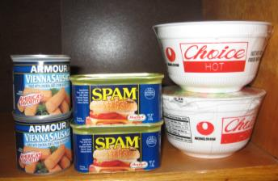
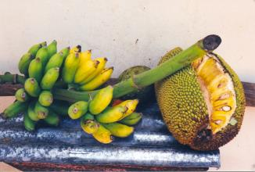
Background
The WHO STEPS report indicate that Pacific Islanders are eating more imported foods and less locally grown fresh foods that are rich in micronutrients and low in fats, sugars, and salt.
Notes:
Picture of banana and breadfruit: http://www.allenshawfoundation.org/megan

Slide 3
Fact
Obesity rates in the Pacific are among the highest in the world: 75% in American Samoa, 45% in the Republic of the Marshall Islands, and 43% in the Federated States of Micronesia, compared to the U.S. with 33%.
Notes:
Source: World Health Organization STEPS 2008

Slide 4
Did you know?
Diabetes prevalence among adults in the Pacific region is among the highest in the world; 47% in American Samoa compared with 13% in mainland USA, and it ranges from 14% to 44% elsewhere in the region.
Notes:
Source: World Health Organization (2010). Pacific Islanders pay heavy price for abandoning traditional diet. Bulletin of the WHO, 88(7):481-560.
Picture: http://healthmeup.com/photogallery-healthy-living/about-diabetes-and-misconceptions-about-diabetes/18317

Slide 5
Did you know?
Affordable food is a significant issue for Pacific Islanders. Healthier food options are often more expensive than those with high concentrations of fat and sugar.
Notes:
Source: World Health Organization (April 10, 2010). WHO Pacific Food Summit Fact Sheet. Retrieved from:
http://www.wpro.who.int/mediacentre/factsheets/fs14042010/en/
Picture: http://endtimessigns.wordpress.com/tag/food-shortages/

Slide 6
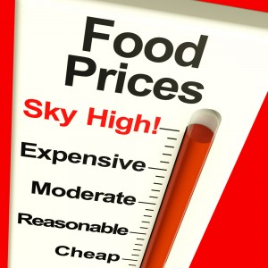
Did you know?
Purchasing imported food is taking up an increasingly large part of family incomes. The Food and Agriculture Organization index of food prices rose by 9% in 2006, by 24% in 2007 and by 51% in the first months of 2008.
Notes:
Source: World Health Organization (April 10, 2010). WHO Pacific Food Summit Fact Sheet. Retrieved from:
http://www.wpro.who.int/mediacentre/factsheets/fs14042010/en/
Picture: shutterstock_92612722_Food-Prices-High1

Slide 7
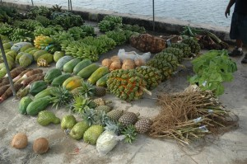
Fact
Eating local means more for the local economy. According to a study by the New Economics Foundation in London, a dollar spent locally generates twice as much income for the local economy. When businesses are not owned locally, money leaves the community at every transaction.
Notes:
Source: Eat Local Challenge Weblog. Retrieved from: http://www.lifebeginsat30.com/elc/2006/04/10_reasons_to_e.html
Picture from: http://www.nybg.org/plant-talk/2009/07/people/preserving-knowledge-of-traditional-plants-in-micronesia/

Slide 8
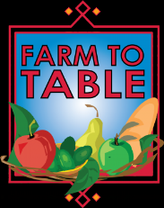
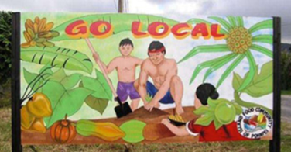
Fact
Locally grown produce is fresher. While produce that is purchased in the supermarket or a big-box store has been in transit or cold-stored for days or weeks, produce that you purchase at your local farmer’s market has often been picked within 24 hours of your purchase. This freshness not only affects the taste of your food, but the nutritional value which declines with time.
Notes:
Source: Eat Local Challenge Weblog. Retrieved from: http://www.lifebeginsat30.com/elc/2006/04/10_reasons_to_e.html
Picture Farm to Table: http://www.showclix.com/event/3734568

Slide 9
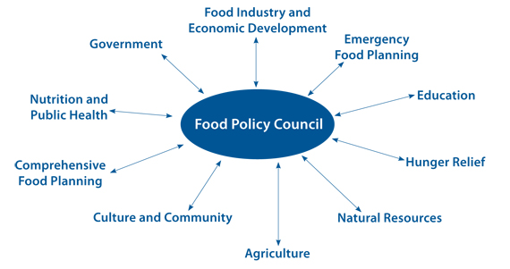
What is Food Policy?
A food policy consists of the rules and regulations that govern how food is produced and distributed. These are generally run by a Food Policy Council, whose primary goal is to cultivate a stronger and more sustainable local food system in order to bring benefits to residents of a region.
Notes:
Source: Clemson Cooperative Extension (July 2011). Local Food: Does it matter what we eat?. Retrieved from: http://www.clemson.edu/extension/county/horry/documents/local_fact_sheet.pdf
Picture: http://www.planning.org/nationalcenters/health/briefingpapers/foodcouncils.htm

Slide 10
Strengthen Local Food Production and Consumption
Pacific Islanders need to strengthen local food production and consumption through the adoption and enforcement of model school nutrition and feeding policies that include provisions for promoting local foods. Reducing processed foods decrease non-communicable diseases and obesity.

Slide 11
What can churches do?
Build a garden that your congregation can eat from, will fill the church’s food pantry or that can be donated to a local charity that feeds your community.
Help teach families about healthy eating and cooking with local foods.
Notes:
Picture: http://eatlocalguide.com/bouldercounty/slow-money-connects-finance-and-food/

Slide 12
What can communities do?
Substitute local foods for imported foods whenever you can.
Call a community meeting with people who can help donate, maintain and educate others about local foods and community gardens.
Encourage local policy changes to increase availability and access to local, traditional foods and forms of exercise.

Slide 13
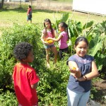
What can schools do?
Purchase local foods to use as authentic teaching materials for nutrition concepts and taste education.
Coordinate with your cafeteria manager so you can highlight foods that will be served in the cafeteria that day or week.
Incorporate fresh, locally grown products into school lunch and breakfast menus, cafeteria promotions, or classroom snacks.
Augment Farm to School concepts by enlisting families, business owners, and community members to create a schoolyard garden.
Encourage families to visit farmers markets to purchase the same local foods being served at school. Invite farmers to sell produce at PTA meetings or other school functions.
Notes:
Picture: http://mauischoolgardennetwork.org/2011/03/gardens-for-learning-creating-and-sustaining-your-school-garden/

Slide 14
What can I do?
Start by making a commitment to eat some local foods at every meal. Try to substitute imported foods with local alternatives whenever you can.
Grow a small food garden at home or at your workplace. Local foods are easy to grow and maintain with minimal inputs. Planting, maintaining and harvesting also gives you physical exercise.
Talk to your family, community and workplace about having a local food policy.

Slide 15
Who can I contact?
Adrian Bauman
Boden Institute of Obesity, Nutrition and Exercise and Prevention Research Collaboration
University of Sydney
Sydney, Australia
Email:  adrian.bauman@sydney.edu.au
Island Food Community of Pohnpei
P. O. Box 1995 Kolonia, Pohnpei 96941 Federated States of Micronesia Email:  info@islandfood.org
Website:  http://www.islandfood.org

