Slide 1
Implement Policies that Promote Production and Consumption of Local Foods

Slide 2
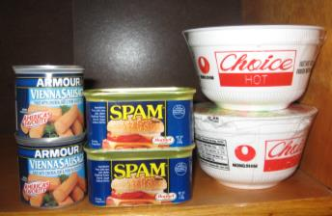
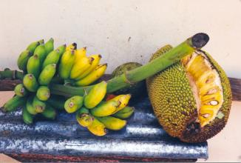
Background
The WHO STEPS report indicate that Pacific Islanders are eating more imported foods and less locally grown fresh foods that are rich in micronutrients and low in fats, sugars, and salt.
Notes:
Picture of banana and breadfruit: http://www.allenshawfoundation.org/megan

Slide 3
Fact
Obesity rates in the Pacific are among the highest in the world: 75% in American Samoa, 45% in the Republic of the Marshall Islands, and 43% in the Federated States of Micronesia, compared to the U.S. with 33%.
Notes:
Source: World Health Organization STEPS 2008

Slide 4
Did you know?
Diabetes prevalence among adults in the Pacific region is among the highest in the world; 47% in American Samoa compared with 13% in mainland USA, and it ranges from 14% to 44% elsewhere in the region.
Notes:
Source: World Health Organization (2010). Pacific Islanders pay heavy price for abandoning traditional diet. Bulletin of the WHO, 88(7):481-560.
Picture: http://healthmeup.com/photogallery-healthy-living/about-diabetes-and-misconceptions-about-diabetes/18317

Slide 5
Did you know?
Affordable food is a significant issue for Pacific Islanders. Healthier food options are often more expensive than those with high concentrations of fat and sugar.
Notes:
Source: World Health Organization (April 10, 2010). WHO Pacific Food Summit Fact Sheet. Retrieved from:
http://www.wpro.who.int/mediacentre/factsheets/fs14042010/en/
Picture: http://endtimessigns.wordpress.com/tag/food-shortages/

Slide 6
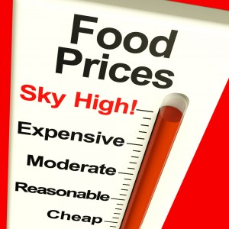
Did you know?
Purchasing imported food is taking up an increasingly large part of family incomes. The Food and Agriculture Organization index of food prices rose by 9% in 2006, by 24% in 2007 and by 51% in the first months of 2008.
Notes:
Source: World Health Organization (April 10, 2010). WHO Pacific Food Summit Fact Sheet. Retrieved from:
http://www.wpro.who.int/mediacentre/factsheets/fs14042010/en/
Picture: shutterstock_92612722_Food-Prices-High1

Slide 7
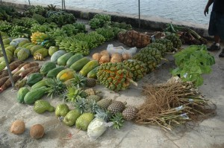
Fact
Eating local means more for the local economy. According to a study by the New Economics Foundation in London, a dollar spent locally generates twice as much income for the local economy. When businesses are not owned locally, money leaves the community at every transaction.
Notes:
Source: Eat Local Challenge Weblog. Retrieved from: http://www.lifebeginsat30.com/elc/2006/04/10_reasons_to_e.html
Picture from: http://www.nybg.org/plant-talk/2009/07/people/preserving-knowledge-of-traditional-plants-in-micronesia/

Slide 8
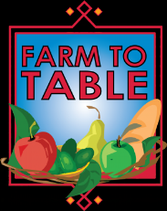
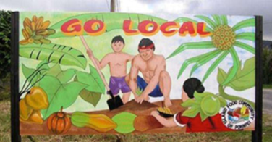
Fact
Locally grown produce is fresher. While produce that is purchased in the supermarket or a big-box store has been in transit or cold-stored for days or weeks, produce that you purchase at your local farmer’s market has often been picked within 24 hours of your purchase. This freshness not only affects the taste of your food, but the nutritional value which declines with time.
Notes:
Source: Eat Local Challenge Weblog. Retrieved from: http://www.lifebeginsat30.com/elc/2006/04/10_reasons_to_e.html
Picture Farm to Table: http://www.showclix.com/event/3734568

Slide 9
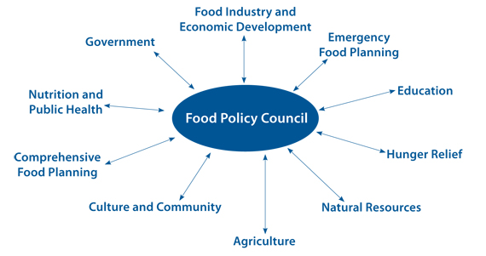
What is Food Policy?
A food policy consists of the rules and regulations that govern how food is produced and distributed. These are generally run by a Food Policy Council, whose primary goal is to cultivate a stronger and more sustainable local food system in order to bring benefits to residents of a region.
Notes:
Source: Clemson Cooperative Extension (July 2011). Local Food: Does it matter what we eat?. Retrieved from: http://www.clemson.edu/extension/county/horry/documents/local_fact_sheet.pdf
Picture: http://www.planning.org/nationalcenters/health/briefingpapers/foodcouncils.htm

Slide 10
Strengthen Local Food Production and Consumption
Pacific Islanders need to strengthen local food production and consumption through the adoption and enforcement of model school nutrition and feeding policies that include provisions for promoting local foods. Reducing processed foods decrease non-communicable diseases and obesity.

Slide 11
Local Food Policy Examples
In New Mexico, the legislature is requiring the purchasing division of the general services department to set a procurement requirement for a minimum percentage of the total dollar amount of food purchased by state agencies and local public bodies to be produced in New Mexico
http://farmtotablenm.org/wp-content/uploads/2013/02/Local-Food-procurement-SB0063-010411.pdf
Notes:
Picture: http://eatlocalguide.com/bouldercounty/slow-money-connects-finance-and-food/

Slide 12
Local Food Policy Examples
Federated States of Micronesia
Personal and Family level:
Personal commitment
i.e. Stop eating rice
Community level:
Local foods would only be served at events
and meetings
Communities banned soft drinks at events
Government level:
Karat proclaimed the Pohnpei State Banana
Banning all imported foods from the Department of Health and Social Affairs offices
Notes:
Source:Local Food Policies Can Help Promote Local Foods and Improve Health: A Case Study from the Federal States of Micronesia by L Englberger, A Lorens, M Pretrick, M Tara, and E Johnson. Published by the Hawai'i Journal of Medicine and Public Health in November 2011. http://www.hjmph.org/70.11.suppl2.htm
Picture: http://www.fao.org/docrep/015/an763e/an763e.pdf

Slide 13
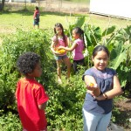
Local Food Policy Examples
Good Laws, Good Food: Putting Local Food Policies to work for our communities
advocate for policies that increase consumption of fresh and local produce
Businesses to commit 10% of their food money to purchase local foods
Local institutions like universities and hospitals to allocate a percentage of their funds to local foods
Farm to school program
Notes:
Source: Good Laws, Good Food: Putting Local Food Policies to work for our Communities by the Harvard Food Law and Policy Clinic. Published in 2012. http://www.law.harvard.edu/academics/clinical/lsc/documents/FINAL_LOCAL_TOOLKIT2.pdf
Picture: http://mauischoolgardennetwork.org/2011/03/gardens-for-learning-creating-and-sustaining-your-school-garden/

Slide 14
Local Food Policy Examples
Supporting Agricultural Viability and Community Food Security: A Review of Food Policy Councils and Food System Plans
Food Policy Council tent to focus on policy analysis, education, coordination and partnerships, and generally address individual components, such as food access.
Food system plans tend to be more holistic and suggest broad policy, program and investment recommendations.
Both FPCs and food system plans appear effective at engaging diverse stakeholders, giving them a voice, fostering dialogue and educating the public.
Notes:
Source: Supporting Agricultural Viability and Community Food Security: A Review of Food Policy Councils and Food System Plans by Julia Freedgood and Anelkis Royce. Published in December 2012. http://farmland.org/documents/AFT_NNPHI_WhitePaper_FINAL.pdf

Slide 15
Who can I contact?
Adrian Bauman
Boden Institute of Obesity, Nutrition and Exercise and Prevention Research Collaboration
University of Sydney
Sydney, Australia
Email:  adrian.bauman@sydney.edu.au
Island Food Community of Pohnpei
P. O. Box 1995 Kolonia, Pohnpei 96941 Federated States of Micronesia Email:  info@islandfood.org
Website:  http://www.islandfood.org

