Slide 1
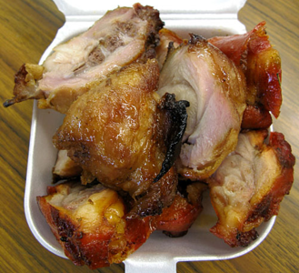
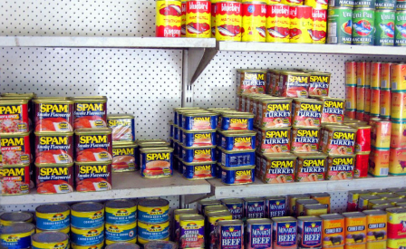
Implement Policies that Reduce Fat Consumption
Notes:
Picture of canned goods: http://www.moanasailing.com/Kiribati-cruising.html
Picture of turkey tail: http://tastyislandhawaii.com/2008/09/06/kalihi-eats-alicias-market/

Slide 2
What is fat?
While fats are essential for normal body function, some fats are better for you than others.
BAD FATS |  | GOOD FATS
Trans fats | Saturated fats | Monounsaturated fats | Polyunsaturated fats
Pastries, cookies, muffins | High-fat cuts of meat | Olive, sesame, peanut oils | Sesame seeds
Chips, microwave popcorn | Whole-fat dairy products | Avocados | Fatty fish: salmon, tuna, sardines
Fried foods | Butter | Nuts | Tofu
Candy bar | Chicken with skin | Peanut butter | Soymilk

Slide 3
Examples of high fat content food
Serving size | Estimated Fat Content (grams)
instant ramen noodles with flavoring (1 package) | 13g
2 oz Spam (1/6 can of Spam) | 15g
1 cup Libby’s corned beef hash | 24g
7 links of vienna sausage | 22-30g
¼ of a frozen pepperoni pizza | 16-21g
1 oz bag of plain salted potato chips (13-16 chips) | 10g
2 tbsp of peanut butter (salted) | 16g
1 piece of turkey tail | 16g

Slide 4
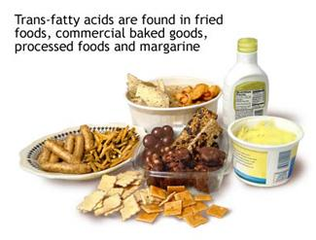
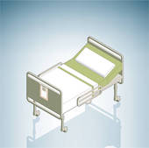
Fact
Animal fats and trans fats in excess can cause heart attacks, strokes, obesity, and diabetes.
can cause
Notes:
Source: American Heart Association (Jan 3, 2012). High Protein Diets Fact Sheet. http://www.heart.org/HEARTORG/GettingHealthy/NutritionCenter/High-Protein-Diets_UCM_305989_Article.jsp#
Picture of turkey tail: http://tastyislandhawaii.com/2008/09/06/kalihi-eats-alicias-market/
Picture of hospital bed: http://www.fotosearch.com/illustration/hospital-bed.html
Picture of trans fat: http://www.exercisebiology.com/index.php/site/articles/5_greatest_recent_nutrition_discoveries/

Slide 5
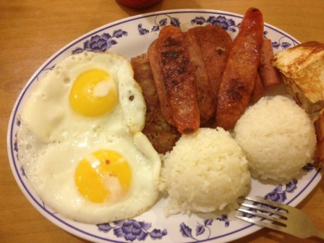
Fact
Most of the fats in the USAPI diet comes from imported and processed foods, such as Spam, vienna sausage and turkey tail.
Notes:
Picture from Yelper Komai: http://www.yelp.com/biz_photos/aloha-caf%C3%A9-los-angeles-2?select=XaZcgxsUZusSdVRPuD5nig#XaZcgxsUZusSdVRPuD5nig

Slide 6
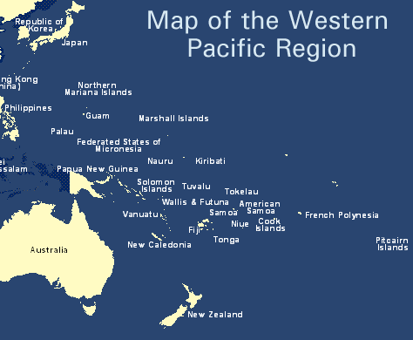
Did you know?
In the Western Pacific Region obesity prevalence is highest in the Pacific countries, where some of the highest rates of overweight and diabetes are found.
Notes:
Source: World Health Organization (March 2012). Obesity Fact Sheet. Retrieved from: http://www.wpro.who.int/mediacentre/factsheets/obesity/en/index.html
Picture from: http://www.japanfocus.org/-kimie-hara/2493

Slide 7
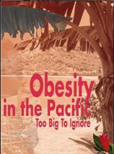
Fact
Obesity rates (based on published STEPS Reports): 75% in American Samoa, Nauru and Tokelau; 51% in Kiribati; 45% in Marshall Islands; 43% in Federated States of Micronesia (Pohnpei); 33% in Solomon Islands; 30% in Fiji.
Notes:
Source: World Health Organization (April 2010). WHO Pacific Food Summit Fact Sheet. Retrieved from: http://www.wpro.who.int/mediacentre/factsheets/fs14042010/en/
Picture: Based on WHO publication, http://www.who.int/nutrition/publications/obesity/9822039255/en/index.html

Slide 8
Fact
There are 25-47% of young children who are overweight or obese in American Samoa, CNMI, Guam and Hawaii.
Notes:
Source: Children’s Healthy Living Program for Remote Underserved Minority Populations in the Pacific Region
Picture: http://wtkr.com/2013/01/29/new-type-ii-diabetes-guidelines-for-children/

Slide 9
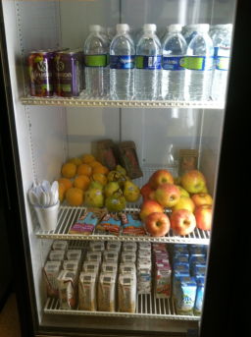
Fact
About 80% of heart diseases, stroke and type-2 diabetes and 40% of cancer can be prevented through inexpensive and cost-effective interventions.
Notes:
Sources: World Health Organization (2002). Diet, nutrition, and the prevention of chronic diseases: WHO Technical Report Series 916. Geneva: World Health Organization.
World Cancer Research Fund and American Institute for Cancer Research (1997). Food, nutrition and the prevention of cancer: a global perspective. Washington, DC: American Institute for Cancer Research: 530–34.
Picture of garden: Picture: http://mauischoolgardennetwork.org/2011/03/gardens-for-learning-creating-and-sustaining-your-school-garden/
Picture of vending machine: http://mauinow.com/files/2012/10/ymca-vending-machine.jpg

Slide 10
Everyone can…
Read the Nutrition Facts label and ingredient list to compare foods.
Choose products with 0 grams trans fat.
Check the Ingredient List to see if there is any partially hydrogenated oil in the product.
Because products containing less than 0.5 grams of trans fat per serving can be labeled as having 0 grams trans fat, checking the Ingredient List is important to avoid all artificial trans fat.
When choosing foods low in trans fat, make sure they are also low in saturated fat and cholesterol: look for foods with 5% of the Daily Value or less. Foods with 20% or more of the Daily Value of these two components are high.
Use monounsaturated fat (canola and olive oil) and polyunsaturated fat (soybean, corn, and sunflower oil) in recipes that call for fat.

Slide 11
Also…
A good way to avoid trans fat is to eat a balanced diet rich in fruits, vegetables, whole grains, lean sources of protein, and low-fat or fat-free dairy products.
Ask your grocer to stock products free of “partially hydrogenated oil” and “shortening”.
Talk with your favorite restaurant establishment about current use of partially hydrogenated oils or changing to a menu that is 100% free of “partially hydrogenated oil” and “shortening”.
Choose restaurants that do not use partially hydrogenated oil to prepare food.

Slide 12
Restaurants and Cafeterias can:
Change their frying and cooking oils to ones that do not contain any partially hydrogenated oil.
Ask suppliers to provide products that do not contain partially hydrogenated oil and are low in saturated fat.
Promote partially hydrogenated oil-free and low saturated fat items on the menu.

Slide 13
Food Producers and Processors can:
Continue to reformulate products to remove partially hydrogenated oil by increasing the use of mono–and polyunsaturated fats as replacements.
Find innovative ways to remove partially hydrogenated oil, without increasing saturated fat, from baked goods, frosting, and other products that currently contain significant amounts of trans fat.

Slide 14
State and Local Governments can:
Increase public awareness about the use of partially hydrogenated oil in foods and cardiovascular risks of consuming trans fat.
Adopt procurement guidelines regarding the sale and/or use of foods containing artificial trans fat (partially hydrogenated oil).

Slide 15
Who to contact for information?
Adrian Bauman
Boden Institute of Obesity, Nutrition and Exercise and Prevention Research Collaboration
University of Sydney
Sydney, Australia
Email:  adrian.bauman@sydney.edu.au

