Slide 1
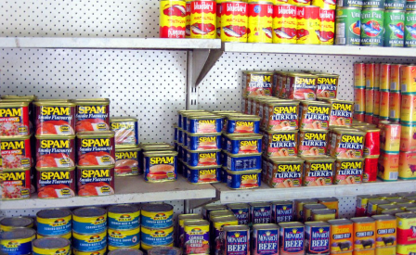
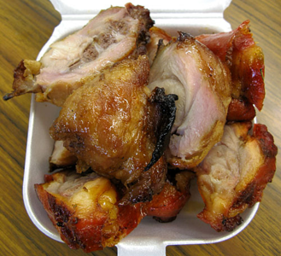
Implement Policies that Reduce Fat Consumption
Notes:
Picture of canned goods: http://www.moanasailing.com/Kiribati-cruising.html
Picture of turkey tail: http://tastyislandhawaii.com/2008/09/06/kalihi-eats-alicias-market/

Slide 2
What is fat?
While fats are essential for normal body function, some fats are better for you than others.
BAD FATS |  | GOOD FATS
Trans fats | Saturated fats | Monounsaturated fats | Polyunsaturated fats
Pastries, cookies, muffins | High-fat cuts of meat | Olive, sesame, peanut oils | Sesame seeds
Chips, microwave popcorn | Whole-fat dairy products | Avocados | Fatty fish: salmon, tuna, sardines
Fried foods | Butter | Nuts | Tofu
Candy bar | Chicken with skin | Peanut butter | Soymilk

Slide 3
Examples of high fat content food
Serving size | Estimated Fat Content (grams)
instant ramen noodles with flavoring (1 package) | 13g
2 oz Spam (1/6 can of Spam) | 15g
1 cup Libby’s corned beef hash | 24g
7 links of vienna sausage | 22-30g
¼ of a frozen pepperoni pizza | 16-21g
1 oz bag of plain salted potato chips (13-16 chips) | 10g
2 tbsp of peanut butter (salted) | 16g
1 piece of turkey tail | 16g

Slide 4
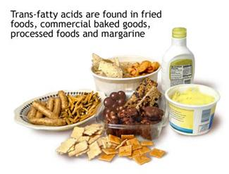
Fact
Animal fats and trans fats in excess can cause heart attacks, strokes, obesity, and diabetes.
can cause
Notes:
Source: American Heart Association (Jan 3, 2012). High Protein Diets Fact Sheet. http://www.heart.org/HEARTORG/GettingHealthy/NutritionCenter/High-Protein-Diets_UCM_305989_Article.jsp#
Picture of turkey tail: http://tastyislandhawaii.com/2008/09/06/kalihi-eats-alicias-market/
Picture of hospital bed: http://www.fotosearch.com/illustration/hospital-bed.html
Picture of trans fat: http://www.exercisebiology.com/index.php/site/articles/5_greatest_recent_nutrition_discoveries/

Slide 5
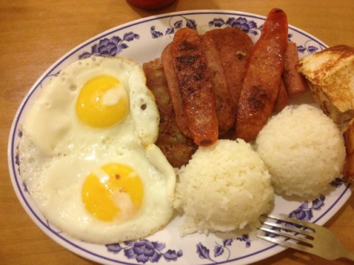
Fact
Most of the fats in the USAPI diet comes from imported and processed foods, such as Spam, vienna sausage and turkey tail.
Notes:
Picture from Yelper Komai: http://www.yelp.com/biz_photos/aloha-caf%C3%A9-los-angeles-2?select=XaZcgxsUZusSdVRPuD5nig#XaZcgxsUZusSdVRPuD5nig

Slide 6
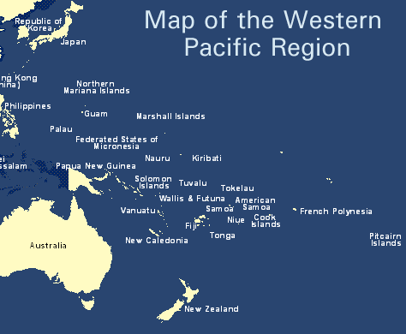
Did you know?
In the Western Pacific Region obesity prevalence is highest in the Pacific countries, where some of the highest rates of overweight and diabetes are found.
Notes:
Source: World Health Organization (March 2012). Obesity Fact Sheet. Retrieved from: http://www.wpro.who.int/mediacentre/factsheets/obesity/en/index.html
Picture from: http://www.japanfocus.org/-kimie-hara/2493

Slide 7
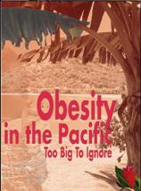
In fact
Obesity rates (based on published STEPS Reports): 75% in American Samoa, Nauru and Tokelau; 51% in Kiribati; 45% in Marshall Islands; 43% in Federated States of Micronesia (Pohnpei); 33% in Solomon Islands; 30% in Fiji.
Notes:
Source: World Health Organization (April 2010). WHO Pacific Food Summit Fact Sheet. Retrieved from: http://www.wpro.who.int/mediacentre/factsheets/fs14042010/en/
Picture: Based on WHO publication, http://www.who.int/nutrition/publications/obesity/9822039255/en/index.html

Slide 8
Fact
There are 25-47% of young children who are overweight or obese in American Samoa, CNMI, Guam and Hawaii.
Notes:
Source: Children’s Healthy Living Program for Remote Underserved Minority Populations in the Pacific Region
Picture: http://wtkr.com/2013/01/29/new-type-ii-diabetes-guidelines-for-children/

Slide 9
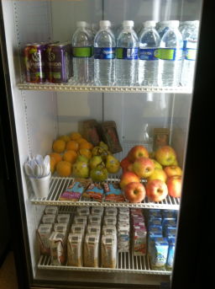
Fact
About 80 of 100 heart diseases, stroke and type-2 diabetes and 40 of 100 cancers can be prevented through inexpensive and cost-effective interventions.
Notes:
Sources: World Health Organization (2002). Diet, nutrition, and the prevention of chronic diseases: WHO Technical Report Series 916. Geneva: World Health Organization.
World Cancer Research Fund and American Institute for Cancer Research (1997). Food, nutrition and the prevention of cancer: a global perspective. Washington, DC: American Institute for Cancer Research: 530–34.
Picture of garden: Picture: http://mauischoolgardennetwork.org/2011/03/gardens-for-learning-creating-and-sustaining-your-school-garden/
Picture of vending machine: http://mauinow.com/files/2012/10/ymca-vending-machine.jpg

Slide 10
Examples of policies
LICENSING FOR LETTUCE: A Guide to the Model Licensing Ordinance for Healthy Food Retailers by ChangeLab Solutions
Communities have established programs to encourage food retailers to stock healthier products. The ordinance changes business licensing policies to require all food stores (not including restaurants) to carry a minimum selection of healthy food and meet other basic operating standards

Slide 11
Examples of policies
School Policy Framework: Implementation of the WHO global strategy on diet, physical activity and health is to guide policymakers at the ministries of education and health in the development and implementation of policies that promote healthy eating in the schools. Policy options that can be considered are:
Nutritional standards for school food
School food programs
Vending machines and school snack bars
Food availability near schools

Slide 12
Examples of policies
Vending Machine Food and Beverage Standards was created to increase access to healthy food and beverage options at work.
At least 50% of foods should have no more than 35% of its calories from total fat, excluding nuts and seeds
Foods that meet the mandatory nutrition standards must be sold at a price that is equivalent to or lower than the price the remaining items in the vending machines.

Slide 13
Who to contact for information?
Adrian Bauman
Boden Institute of Obesity, Nutrition and Exercise and Prevention Research Collaboration
University of Sydney
Sydney, Australia
Email:  adrian.bauman@sydney.edu.au

