Slide 1
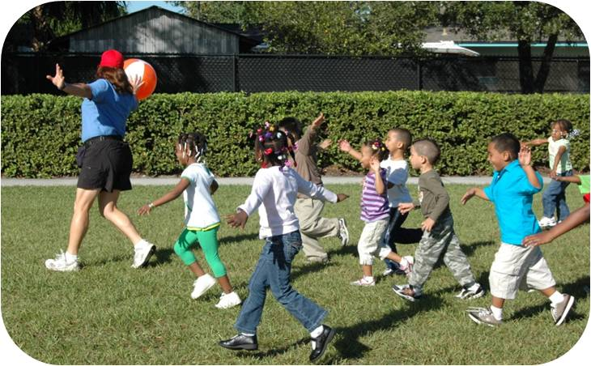
Promote Physical Activity in the School

Slide 2
What you should know
The environments in most island communities no longer promote physical activity.
Most schools and workplaces do little to encourage or value movement. Sedentary lifestyles often result in much poorer health due to NCDs.
A large number of school-aged children are physically inactive or insufficiently active.
The current generation of island children is the most obese in island history and may have worse health outcomes and shorter lives than their parents. This is due in part to lack of physical activity.
Notes:
Gordon-Larsen, P., Nelson, M., Page, P., & Popkin, B. (2006). Inequality in the built environment underlies key health disparities in physical activity and obesity. Pediatrics 117(2), 471-424.
Frank, L., Engelke, P., & Schmid, T. (2003). Health and community design: The impact of the built environment on physical activity. Washington, DC: Island Press.
Lee, V., Mikkelsen, L., Srikantharajah, J., & Cohen, L. (2008). Strategies for enhancing the built environment to support healthy eating and active living environments. Oakland, CA: Prevention Institute, Healthy Eating Active Living Convergence Partnership and PolicyLink.

Slide 3
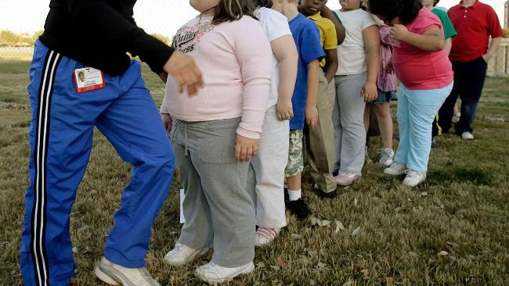
Did you know?
Young people are heavier today than at any time in history. Two main reasons for the rise in obesity over the past few decades are change in diets and decline in physical activity.
Notes:
WHO (World Health Organization). (2011). Obesity and overweight (Factsheet 311). Retrieved March 3, 2008, from www.who.int/mediacen- tre/factsheets/fs311/en/index.html.
Image Courtesy of: http://resources0.news.com.au/images/2010/06/29/1225885/606968-overweight-children.jpg

Slide 4
Establishing policies that support active lifestyles is critical for healthy islands. Ensuring that people have access to daily exercise must be a priority.

Slide 5
Did you know?
Data from the WHO show that 7 of the 10 countries with the highest prevalence of overweight people are Pacific Island nations. Children in these nation states are at increased risk of developing non-communicable diseases
Notes:
WHO (World Health Organization). (2010). WHO Global Info Database. Retrieved January 12, 2011, from https://apps.who.int/infobase/ Comparisons.aspx?l=&NodeVal=WGIE_ BMI_5_cd.0704&DO=1&DDLReg=ALL& DDLSex=1&DDLAgeGrp=15-100&DDLYear= 2010&DDLMethod=INTMDCTM& DDLCateNum=6&TxtBxCtmNum=20,35,50, 65,80&CBLC1=ON&CBLC3=ON&CBLC4= ON&CBLC6=ON&CBLC8=ON&CBLC10= ON&DDLMapsize=800x480&DDLMapLabels =none&DDLTmpRangBK=0& DDLTmpColor=-3342388.

Slide 6
Key Facts
Fewer than half the jurisdictions have nutrition education curriculum standards, provide nutrient content for school meals to students and parents, or require physical education in every grade.
American Samoa is the only jurisdiction that reported 100 percent of secondary schools requiring a health education course in grades 6–12, and the Republic of Palau is the only jurisdiction that reported requiring a physical education course in all secondary schools in grades 6–12.
Notes:
Facts taken from the following source: Wilson, M., Linke, L, Bellhouse-King, M, and Singh, M. (2011). Nutrition and physical education policy and practice in Pa- cific Region secondary schools. (Issues & Answers Report, REL 2012–No. 117). Washington, DC: U.S. Department of Educa- tion, Institute of Education Sciences, National Center for Education Evaluation and Regional Assistance, Regional Educa- tional Laboratory Pacific. Retrieved from http://ies.ed.gov/ncee/edlabs.

Slide 7
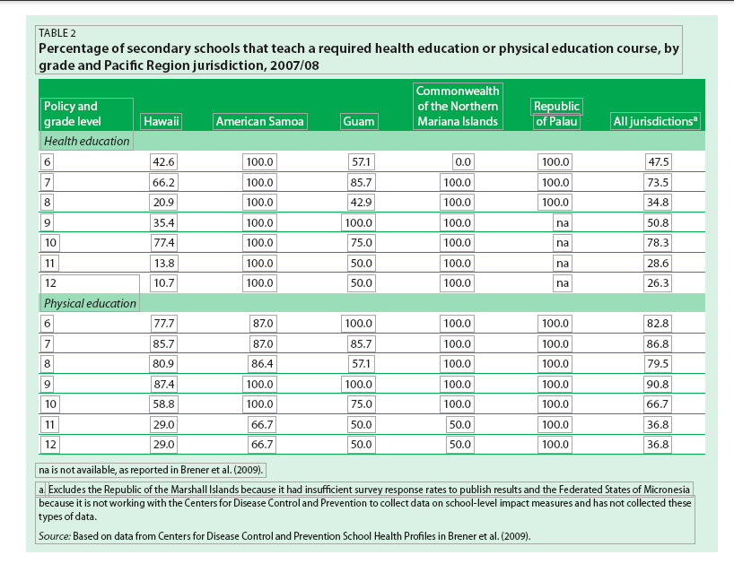
What are the current policies for student physical education?
Notes:
Facts taken from the following source: Wilson, M., Linke, L, Bellhouse-King, M, and Singh, M. (2011). Nutrition and physical education policy and practice in Pa- cific Region secondary schools. (Issues & Answers Report, REL 2012–No. 117). Washington, DC: U.S. Department of Educa- tion, Institute of Education Sciences, National Center for Education Evaluation and Regional Assistance, Regional Educa- tional Laboratory Pacific. Retrieved from http://ies.ed.gov/ncee/edlabs.

Slide 8
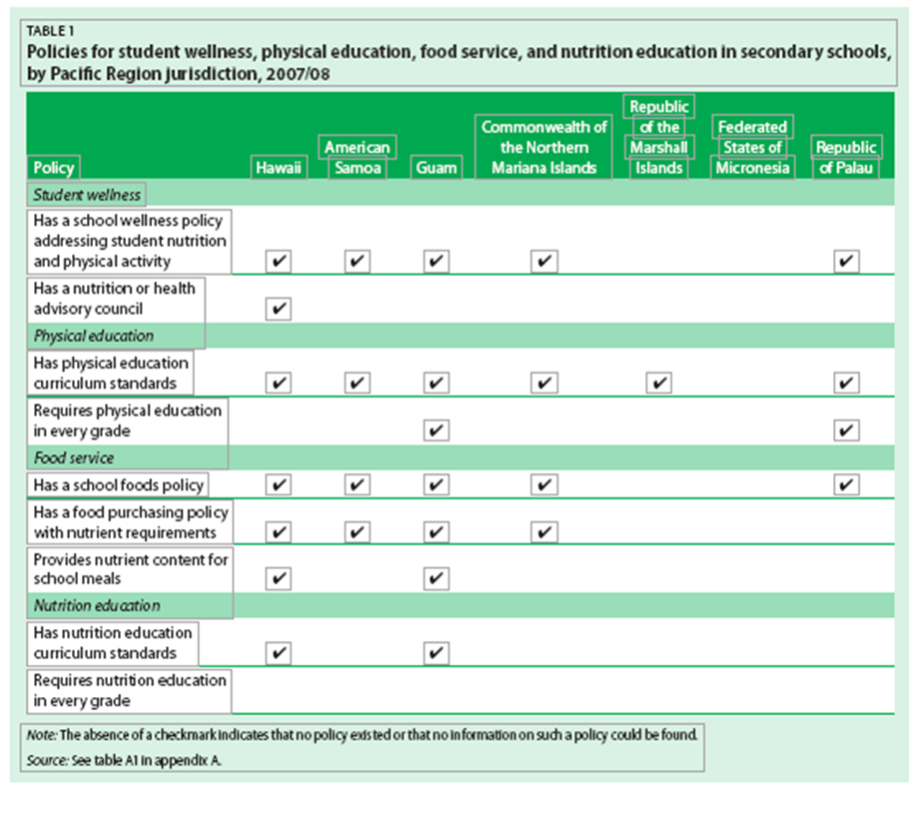
What are the current policies for student physical education?
Notes:
Facts taken from the following source: Wilson, M., Linke, L, Bellhouse-King, M, and Singh, M. (2011). Nutrition and physical education policy and practice in Pa- cific Region secondary schools. (Issues & Answers Report, REL 2012–No. 117). Washington, DC: U.S. Department of Educa- tion, Institute of Education Sciences, National Center for Education Evaluation and Regional Assistance, Regional Educa- tional Laboratory Pacific. Retrieved from http://ies.ed.gov/ncee/edlabs.

Slide 9
Key Facts
Only American Samoa (11.5 percent) and the Commonwealth of the Northern Mariana Islands (14.3 percent) reported double- digit percentages of secondary schools that allow students to purchase fruits or non-fried vegetables in vending machines or school stores. Guam and the Republic of Palau reported that no schools in their jurisdictions offer such products for sale to students.
Approximately 83 percent of secondary schools in the Republic of Palau help students’ families develop or implement policies and programs related to physical activity and nutrition and healthy eating, while 18 percent of secondary schools in Guam do.
Notes:
Facts taken from the following source: Wilson, M., Linke, L, Bellhouse-King, M, and Singh, M. (2011). Nutrition and physical education policy and practice in Pa- cific Region secondary schools. (Issues & Answers Report, REL 2012–No. 117). Washington, DC: U.S. Department of Educa- tion, Institute of Education Sciences, National Center for Education Evaluation and Regional Assistance, Regional Educa- tional Laboratory Pacific. Retrieved from http://ies.ed.gov/ncee/edlabs.

Slide 10
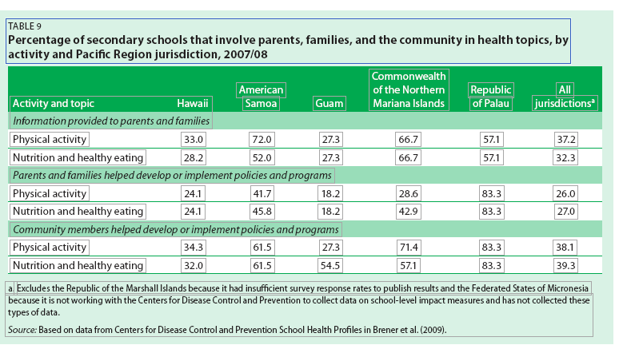
What is the involvement of parents and community?
Notes:
Facts taken from the following source: Wilson, M., Linke, L, Bellhouse-King, M, and Singh, M. (2011). Nutrition and physical education policy and practice in Pa- cific Region secondary schools. (Issues & Answers Report, REL 2012–No. 117). Washington, DC: U.S. Department of Educa- tion, Institute of Education Sciences, National Center for Education Evaluation and Regional Assistance, Regional Educa- tional Laboratory Pacific. Retrieved from http://ies.ed.gov/ncee/edlabs.

Slide 11
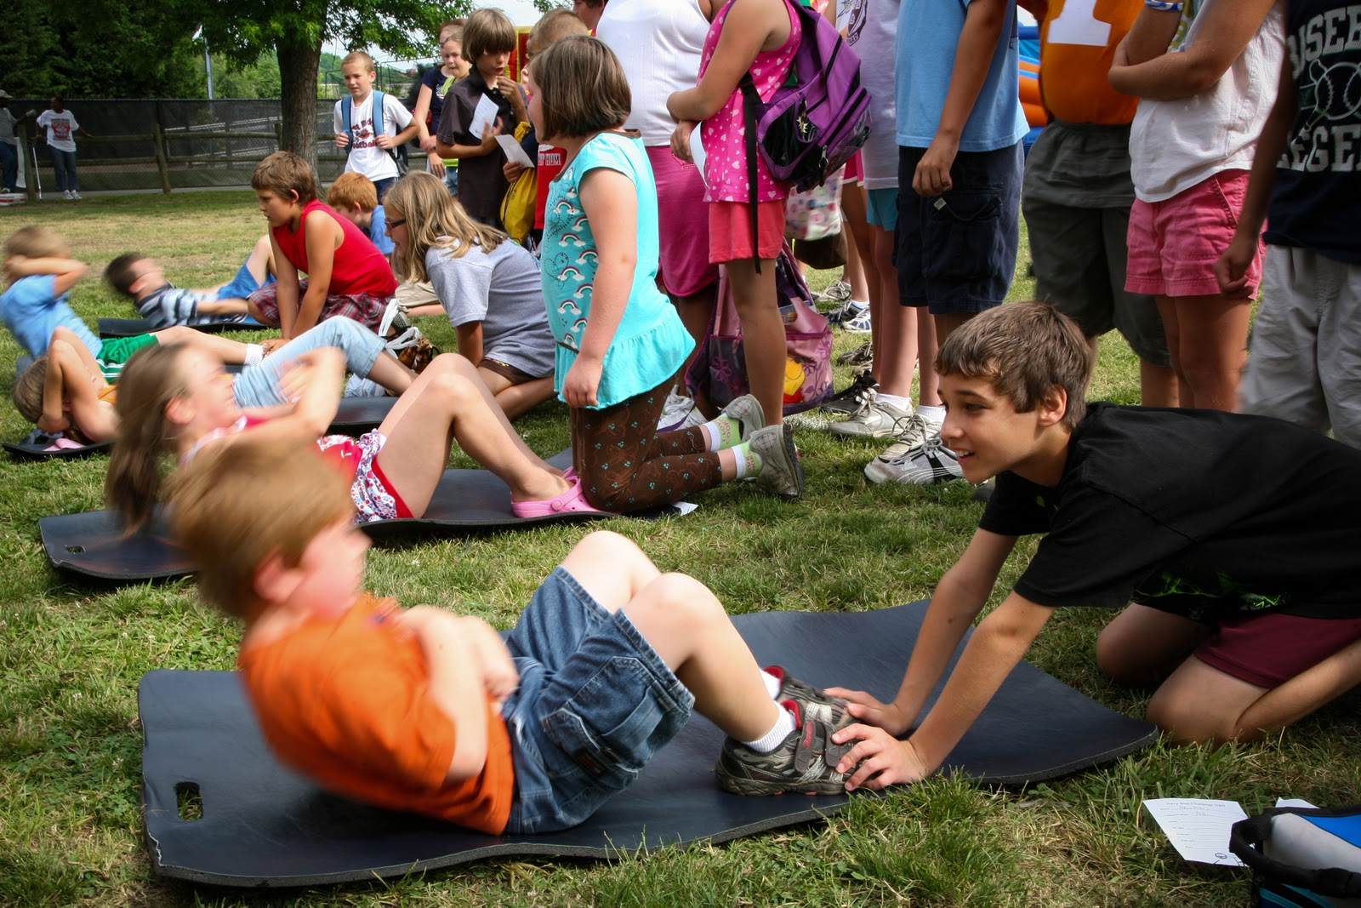
Did you know?
School-based physical activity programs, such as physical education, recess, classroom-based physical activity and extracurricular physical activity, are shown to have positive mental health and academic benefits for children and adolescents.
Notes:
Centers for Disease Control and Prevention. (2010). The association between school-based physical activity, including physical education, and academic performance. Atlanta, GA: U S Department of Health and Human Services.
Image Courtesy of: http://3.bp.blogspot.com/_KdcWntyPmeg/TUS5y3D365I/AAAAAAAAA5w/i-su8bkgDHg/s1600/Photo+of+Juvenile+Physical+Fitness+Program.jpg

Slide 12
Did you know?
Poor dietary habits during childhood and adolescence also increase the risk of disease, unhealthy behaviors associated with weight gain during adulthood, adult overweight or obesity, and aberrant emotional and cognitive development
Notes:
Telljohann, S.K., Symons, C.W., and Pateman, B. (2007). Health education: elementary and middle school applications. New York: McGraw-Hill.
WHO (WHO (World Health Organization). (2000).
Obesity: preventing and managing a global epi- demic (Technical Report Series 894). Geneva: World Health Organization.

Slide 13
Health and Academic Achievement
Notes:
Department of PE and Health. California State University Stanislaus. Ping Luo, PhD (Slides).

Slide 14
Health and Academic Achievement
Notes:
Department of PE and Health. California State University Stanislaus. Ping Luo, PhD (Slides).

Slide 15
What are ways we can promote physical activity in schools?
Create mandatory structured physical education for 30 minutes/day
Physical activity should meet the needs and interests of all students. Federal and state policies should be enacted to increase the quality and quantity of physical education in schools.
Notes:
Centers for Disease Control and Prevention. Guidelines for school and community programs to promote lifelong physical activity among young people. MMWR 1997;46(No. RR-6)

Slide 16
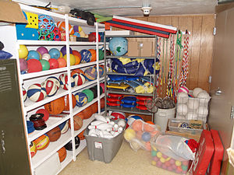
Did you know?
Participating in regular school physical education increases the likelihood that children will maintain moderate to vigorous physical activity.
Notes:
Gordon-Larsen, P , McMurray, R G , Popkin, BM. (2000). Determinants of adolescent physical activity and inactivity patterns. Pediatrics, 105, E83-E91.

Slide 17
What are ways we can promote physical activity in schools?
Enact policies that make investments and support sport activities
Policies that increase the number of mandatory physical education, variety of education and sports classes, and ensure that physical education teachers are well qualified and properly trained are ways that policies can promote physical activity at schools.
Notes:
Centers for Disease Control and Prevention. Guidelines for school and community programs to promote lifelong physical activity among young people. MMWR 1997;46(No. RR-6)

Slide 18
Did you know?
One study of school initiatives that encouraged children to walk or ride their bikes to school found that boys who walked to school expended 44 more calories and girls expended 33 more calories per day than children who rode the bus or were driven to school.
Notes:
Tudor-Locke, C., et al. (2003). Objective physical activity of Filipino youth stratified for commuting mode to school. Medicine & Science in Sports & Exercise 35(3), 465–71.

Slide 19
What are ways we can promote physical activity in schools?
A Successful Example:
Case Study: Michigan Model Local Wellness Policy
The state of Michigan provides a model local wellness policy for its school districts. The state recognizes the importance of physical and social activity in education. The local wellness policy provides guidelines for a quality physical activity program and includes a framework for recess before lunch and rewarding good behavior with extra breaks for physical activity instead of snacks.
 Michigan Model Local Wellness Policy
Notes:
Michigan Department of Education, Local Wellness Policy Implementation Grant, October 2007. Accessed on January 7, 2014

Slide 20
What are ways we can promote physical activity in schools?
School administrations and national government to provide resources for school-based physical activity programs.
School administrations and national government should ensure that extracurricular activities have adequate facilities and sports equipment. Government can create grants and provide technical assistance to help schools implement clubs, recess, intramural sports, and campaigns for walking and activity.
Notes:
School-Based Obesity Prevention Strategies for State Policymakers. Issue brief. Center for Disease Control, n.d. Web. 7 Jan. 2014.

Slide 21
What are ways we can promote physical activity in schools?
Non-governmental organizations to develop programs that can be used by schools
Collaborative strategies are important to building healthy schools and assisting them in implementing programs to increase physical activity among students. Organizations can provide schools with the tools they need to educate students and implement potential programs that may help while fostering community-school partnerships.
Notes:
Fisher C, Hunt P, Kann L, Kolbe L, Patterson B, Wechsler H. Building a healthier future through school health programs, in Centers for Disease Control and Prevention. Promising Practices in Chronic Disease Prevention and Control: A Public Health Framework for Action. Atlanta, GA: Department of Health and Human Services. 2003. Online: http://www.cdc.gov/nccdphp/promising_practices/school_health.

Slide 22
What are ways we can promote physical activity in schools?
A Successful Example:
Case Study: North Carolina Energizers
East Carolina University Activity Promotion Laboratory in collaboration with other community and organizations formed a pilot to develop the “Energizers” short 10 minute activities that classroom teachers can use to incorporate physical activity within the classroom. Activities include acting out scenes from a story, learning fire safety through a stop, drop and roll exercise and a physical activity twist to the 12 days of Christmas. The pilot has been a success at incorporating activity into learning.
Notes:
Eat Smart Move More North Carolina. Energizers for elementary school. Accessed on January 7, 2014

Slide 23
Who can I contact for more information?
Adrian Bauman
Boden Institute of Obesity, Nutrition and Exercise and Prevention Research Collaboration
University of Sydney
Sydney, Australia
Email:  adrian.bauman@sydney.edu.au

