Slide 1
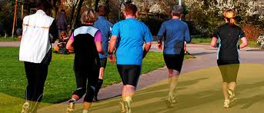
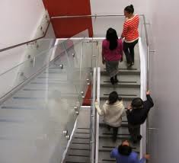
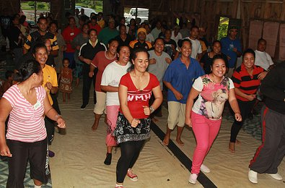
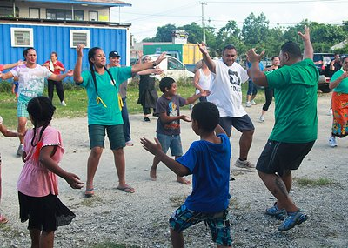
Promote Physical Activity in the Workplace

Slide 2
What you should know
The environments in most island communities no longer promote physical activity.
Most schools and workplaces do little to encourage or value movement. Sedentary lifestyles often result in much poorer health due to NCDs.
Getting people moving at work will result in a healthier workforce. A healthier workforce can be more productive, with fewer sick days and more revenue or products generated.
Notes:
Gordon-Larsen, P., Nelson, M., Page, P., & Popkin, B. (2006). Inequality in the built environment underlies key health disparities in physical activity and obesity. Pediatrics 117(2), 471-424.
Frank, L., Engelke, P., & Schmid, T. (2003). Health and community design: The impact of the built environment on physical activity. Washington, DC: Island Press.
Lee, V., Mikkelsen, L., Srikantharajah, J., & Cohen, L. (2008). Strategies for enhancing the built environment to support healthy eating and active living environments. Oakland, CA: Prevention Institute, Healthy Eating Active Living Convergence Partnership and PolicyLink.

Slide 3
Ensuring that people have access to daily exercise must be a priority.

Slide 4
Did you know?
Studies from a several Pacific Island countries and territories show that between 41% and 62% of adults lead completely sedentary lifestyles. A sedentary lifestyle is closely linked to obesity, diabetes, and heart disease.
Notes:
Image courtesy of: http://www.virtualmedicalcentre.com/uploads/VMC/PageImages/obesity_250.jpg

Slide 5
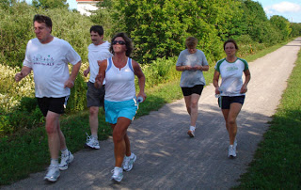
Did you know?
Engaging in physical activity in groups is effective in increasing levels of physical activity
Notes:
Briss PA, Zaza S, Pappaioanou M, et al. Developing an evidence-based Guide to Community Preventive Services—methods. Am J Prev Med 2000;18(suppl 1):35–43.

Slide 6
Examples of Interventions in the Workplace
Offering healthy food options in cafeterias, vending machines and at company-sponsored events;
Introducing point-of-decision signs encouraging stairway use;
Allowing flexible work schedules to accommodate physical activity during the work day;
Providing reimbursement for use of community fitness centers; and
Building or opening up facilities and areas that can be used for physical activity and exercise, such as on-site fitness centers, walking paths, and bike trails.
Notes:
Hymel, Pamela A., et al. "Workplace health protection and promotion: a new pathway for a healthier—and safer—workforce." Journal of Occupational and Environmental Medicine 53.6 (2011): 695-702.

Slide 7
Did you know?
Workplace physical activity programs have shown potential to increase employee productivity and improve health outcomes
Notes:
Brown, H.E., Gilson, N.D., Burton, N.W., & Brown, W.J. (2011). Does physical activity impact on presenteeism and other indicators of workplace well-being?. Sports Medicine, 41(3), 249-262.
Hutchinson, A.D. & Wilson, C. (2011). Improving nutrition and physical activity in the workplace: a meta-analysis of intervention studies. Health Promotion International, Advanced Access doi:10.1093/heapro/dar035.

Slide 8
Did you know?
Workplace programs, in spite of their variability in terms of comprehensiveness, intensity, and duration, achieved long-term behavior change and risk reduction among workers.
Notes:
Heaney CA, Goetzel RZ. A review of health-related outcomes of multi-component worksite health promotion programs. American Journal of Health Promotion. 1997;11(4):290-307.

Slide 9
What are policies that can help improve the built environment?
A Successful Example:
Case Study: CDC StairWELL Project
In 1998, CDC's Division of Nutrition, Physical Activity and Obesity conducted a study to see if making physical changes to a stairwell in the Atlanta-based Koger Center Rhodes Building would motivate employees to use the stairs.
Notes:
"StairWELL to Better Health." Centers for Disease Control and Prevention. Centers for Disease Control and Prevention, 06 Jan. 2010. Web. 07 Jan. 2014.
Kerr, N.A., Yore, M.M., Ham, S.A., & Dietz, W.H. (2004). Increasing Stair Use in a Worksite Through Environmental Changes. American Journal of Health Promotion, 18 (4): 312–315.

Slide 10
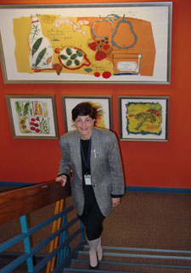
What are policies that can help improve the built environment?
A Successful Example:
Case Study: CDC StairWELL Project
Over 3½ years, changes to the stairwell were made which included painting and carpeting, framed artwork, motivational signs, and music. Infrared beams were used to track the number of stair users.
The data suggest that physical improvements, motivational signs, and music can increase stairwell use among building occupants.
Notes:
"StairWELL to Better Health." Centers for Disease Control and Prevention. Centers for Disease Control and Prevention, 06 Jan. 2010. Web. 07 Jan. 2014.
Kerr, N.A., Yore, M.M., Ham, S.A., & Dietz, W.H. (2004). Increasing Stair Use in a Worksite Through Environmental Changes. American Journal of Health Promotion, 18 (4): 312–315.

Slide 11
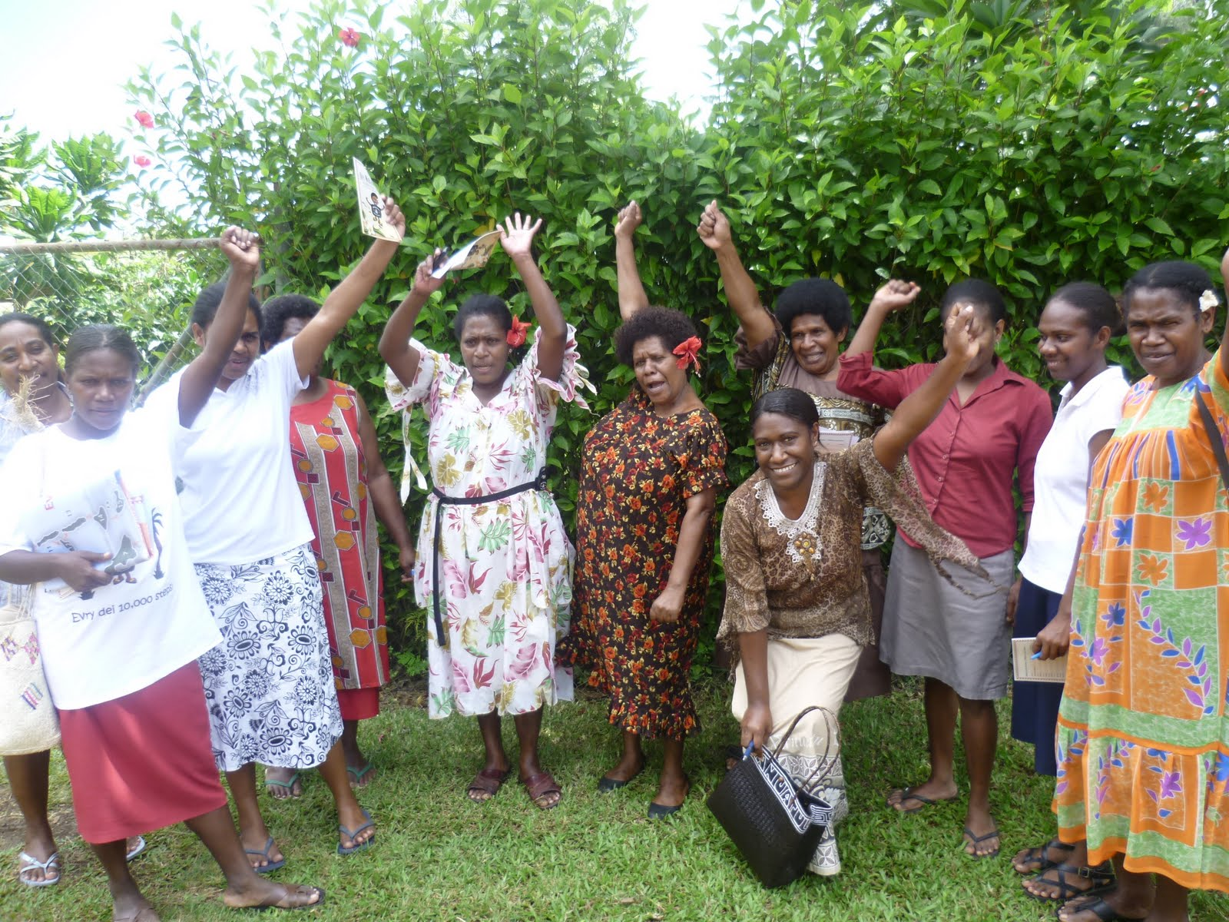
What are policies that can help improve the built environment?
A Successful Example:
Case Study: A workplace health promotion program in Vanuatu
Strong gender roles can result in disadvantages for women in relation to sport and recreation activities. Wokabaot Jalens was a health intervention which was created for women in Port Vila, Vanuatu.
The program is part of the “Walk for Life” government based healthy workplace initiative. Employees were encouraged to participate in physical activities every Wednesday.
Notes:
Siefken, Katja E. "Preventing Chronic Diseases through Physical Activity in the Pacific Islands. A Workplace Health Promotion Programme in Vanuatu." Thesis. AUT University, 2012. Web. 7 Jan. 2014.

Slide 12
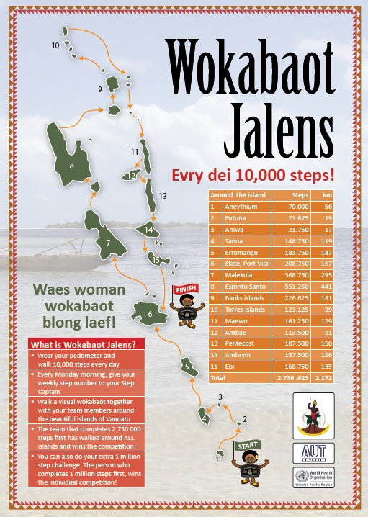
What are policies that can help improve the built environment?
A Successful Example:
Case Study: A workplace health promotion program in Vanuatu
The initiative began in 2011 and has shown an increase in about 2075 steps/day. Participants had designated walking captains, were given walking maps, educational information and a pedometer.
Physical activity behavior increased and waist circumference decreased. Several participants experienced significant health benefits such as weight loss, reduced fasting blood sugar and enhanced self-esteem.
Notes:
Siefken, Katja E. "Preventing Chronic Diseases through Physical Activity in the Pacific Islands. A Workplace Health Promotion Programme in Vanuatu." Thesis. AUT University, 2012. Web. 7 Jan. 2014.
Image Courtesy of: http://2.bp.blogspot.com/-quGB9sRCI48/TlbzNau4zUI/AAAAAAAAG9A/DiNLYl0qhVY/s1600/P1020658.JPG

Slide 13
Take Action and Make a Difference!
Form walking groups
Form lunchtime walking groups with your co-workers. Instead of eating at your desk spend time eating together and then walking together outside. Encourage others to join you!

Slide 14
Take Action and Make a Difference!
Take the stairs!
Instead of using the elevator, take the stairs! Encourage others to take them with you!
Notes:
Image courtesy of: http://www.hercampus.com/sites/default/files/media_crop/30902/public/take_the_stairs_1848i05-1848jb7_0.jpg

Slide 15
Take Action and Make a Difference!
Organize sports teams
Engage in competitive sports with your co-workers!

Slide 16
Who can I contact for more information?
Adrian Bauman
Boden Institute of Obesity, Nutrition and Exercise and Prevention Research Collaboration
University of Sydney
Sydney, Australia
Email:  adrian.bauman@sydney.edu.au

