Slide 1
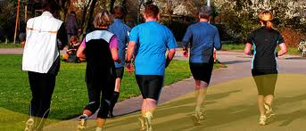
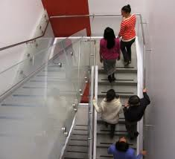
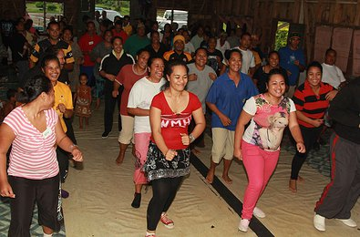
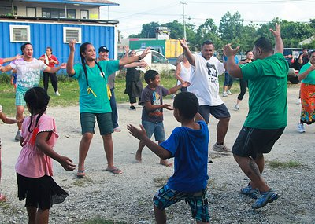
Promote Physical Activity in the Workplace

Slide 2
What you should know
The environments in most island communities no longer promote physical activity.
Most schools and workplaces do little to encourage or value movement. Sedentary lifestyles often result in much poorer health due to NCDs.
Getting people moving at work will result in a healthier workforce. A healthier workforce can be more productive, with fewer sick days and more revenue or products generated.
Notes:
Gordon-Larsen, P., Nelson, M., Page, P., & Popkin, B. (2006). Inequality in the built environment underlies key health disparities in physical activity and obesity. Pediatrics 117(2), 471-424.
Frank, L., Engelke, P., & Schmid, T. (2003). Health and community design: The impact of the built environment on physical activity. Washington, DC: Island Press.
Lee, V., Mikkelsen, L., Srikantharajah, J., & Cohen, L. (2008). Strategies for enhancing the built environment to support healthy eating and active living environments. Oakland, CA: Prevention Institute, Healthy Eating Active Living Convergence Partnership and PolicyLink.

Slide 3
Establishing policies that support active lifestyles is critical for healthy islands. Ensuring that people have access to daily exercise must be a priority.

Slide 4
Did you know?
Studies from a several Pacific Island countries and territories show that between 41% and 62% of adults lead completely sedentary lifestyles. A sedentary lifestyle is closely linked to obesity, diabetes, and heart disease.
Notes:
Image courtesy of: http://www.virtualmedicalcentre.com/uploads/VMC/PageImages/obesity_250.jpg

Slide 5
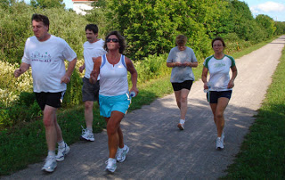
Did you know?
Workplace physical activity and healthy eating interventions have shown to significantly reduce body weight.
Notes:
Verweij, L. M., Coffeng, J. J., van Mechelen, W. W., & Proper, K. I. (2011). Meta-analyses of workplace physical activity and dietary behaviour interventions on weight outcomes. Obesity Reviews, 12(6), 406-429.

Slide 6
Examples of Interventions in the Workplace
Offering healthy food options in cafeterias, vending machines and at company-sponsored events;
Introducing point-of-decision signs encouraging stairway use;
Allowing flexible work schedules to accommodate physical activity during the work day;
Providing reimbursement for use of community fitness centers; and
Building or opening up facilities and areas that can be used for physical activity and exercise, such as on-site fitness centers, walking paths, and bike trails.
Notes:
Hymel, Pamela A., et al. "Workplace health protection and promotion: a new pathway for a healthier—and safer—workforce." Journal of Occupational and Environmental Medicine 53.6 (2011): 695-702.

Slide 7
What are ways we can promote physical activity in the workplace?
Establish policies that allow 30 minutes to an hour of physical activity a day
This promotes employees to engage in healthy activities while maintaining the expected number of work hours and encouraging them to seek ways to incorporate activity into their work environment

Slide 8
Did you know?
Workplace physical activity programs have shown potential to increase employee productivity and improve health outcomes
Notes:
Brown, H.E., Gilson, N.D., Burton, N.W., & Brown, W.J. (2011). Does physical activity impact on presenteeism and other indicators of workplace well-being?. Sports Medicine, 41(3), 249-262.
Hutchinson, A.D. & Wilson, C. (2011). Improving nutrition and physical activity in the workplace: a meta-analysis of intervention studies. Health Promotion International, Advanced Access doi:10.1093/heapro/dar035.

Slide 9
What are ways we can promote physical activity in the workplace?
Incentivize and recognize companies that create successful wellness and physical activity programs for their workplace
Government agencies at the national, state or local levels should recognize and reward those companies that create successful wellness and activity programs for their employees. This would increase attention to these employers and elevate their company within their field. Other businesses may notice these efforts and adopt or improve their programs.

Slide 10
Did you know?
Workplace programs, in spite of their variability in terms of comprehensiveness, intensity, and duration, achieved long-term behavior change and risk reduction among workers.
Notes:
Heaney CA, Goetzel RZ. A review of health-related outcomes of multi-component worksite health promotion programs. American Journal of Health Promotion. 1997;11(4):290-307.

Slide 11
What are ways we can promote physical activity in the workplace?
Executives to issue mandates to encourage government-sponsored worksite wellness programs that promote physical activity
Government agencies at the national, state or local levels should recognize and reward those companies that create successful wellness and activity programs for their employees. This would increase attention to these employers and elevate their company within their field. Other businesses may notice these efforts and adopt or improve their programs.

Slide 12
What are policies that can help improve the built environment?
A Successful Example:
Case Study: Let’s Move! Commonwealth of the Northern Mariana Islands
A government mandate was created to support the “Let’s Move! Walk for a Healthier Marianas!” campaign. The Director of Public Health Services, Eloy S. Inos supported the endorsement of each government employee to receive one hour of administrative leave to join the event. The “Let’s Move!” campaign has been a huge success. At the 2nd event in September 2013, the campaign drew over 700 participants, 30 different sponsors, and a variety of activities.
The CNMI is now an official ’Let’s Move! City" as of July 2013, which was a nomination approved by the National Let’s Move! Council. CNMI is ranked No. 16 and is in the Top 20 in the nation among 400 other Let’s Move! Cities
Notes:
Mangiona, Thomas A. "Saipan Tribune." Saipan Tribune. Saipan Tribune, 30 Sept. 2013. Web. 07 Jan. 2014.

Slide 13
What are ways we can promote physical activity in the workplace?
Encourage government agencies and businesses to adopt and implement work and wellness programs that encourage physical activity
Businesses can adopt and implement worksite wellness programs that encourage physical activity. These can be group initiatives and competitions, company department sports teams, and encouraging physical activity through walking trails and stairwell use.

Slide 14
What are policies that can help improve the built environment?
A Successful Example:
Case Study: CDC StairWELL Project
In 1998, CDC's Division of Nutrition, Physical Activity and Obesity conducted a study to see if making physical changes to a stairwell in the Atlanta-based Koger Center Rhodes Building would motivate employees to use the stairs.
Notes:
"StairWELL to Better Health." Centers for Disease Control and Prevention. Centers for Disease Control and Prevention, 06 Jan. 2010. Web. 07 Jan. 2014.
Kerr, N.A., Yore, M.M., Ham, S.A., & Dietz, W.H. (2004). Increasing Stair Use in a Worksite Through Environmental Changes. American Journal of Health Promotion, 18 (4): 312–315.

Slide 15
What are policies that can help improve the built environment?
A Successful Example:
Case Study: CDC StairWELL Project
Over 3½ years, changes to the stairwell were made which included painting and carpeting, framed artwork, motivational signs, and music. Infrared beams were used to track the number of stair users.
The intervention was low in cost and the data suggest that physical improvements, motivational signs, and music can increase stairwell use among building occupants.
Notes:
"StairWELL to Better Health." Centers for Disease Control and Prevention. Centers for Disease Control and Prevention, 06 Jan. 2010. Web. 07 Jan. 2014.
Kerr, N.A., Yore, M.M., Ham, S.A., & Dietz, W.H. (2004). Increasing Stair Use in a Worksite Through Environmental Changes. American Journal of Health Promotion, 18 (4): 312–315.

Slide 16
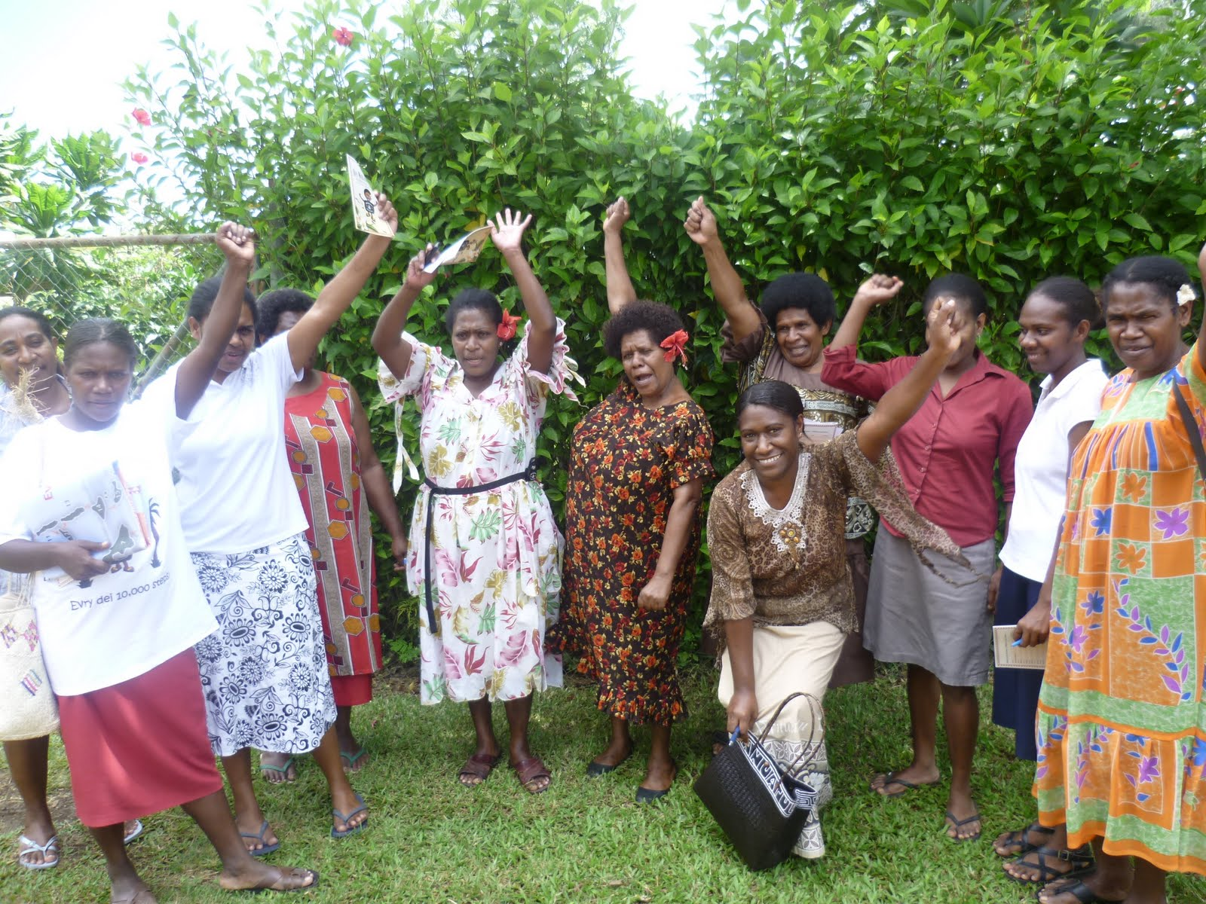
What are policies that can help improve the built environment?
A Successful Example:
Case Study: A workplace health promotion program in Vanuatu
Strong gender roles can result in disadvantages for women in relation to sport and recreation activities. Wokabaot Jalens was a health intervention which was created for women in Port Vila, Vanuatu.
The program is part of the “Walk for Life” government based healthy workplace initiative. Employees were encouraged to participate in physical activities every Wednesday.
Notes:
Siefken, Katja E. "Preventing Chronic Diseases through Physical Activity in the Pacific Islands. A Workplace Health Promotion Programme in Vanuatu." Thesis. AUT University, 2012. Web. 7 Jan. 2014.

Slide 17
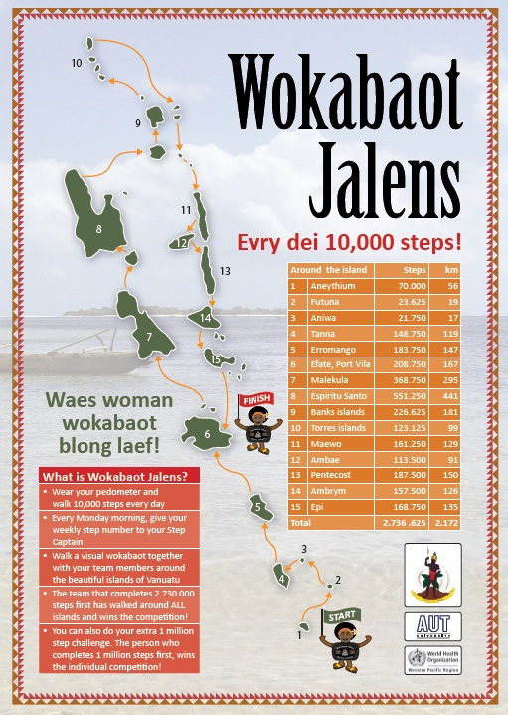
What are policies that can help improve the built environment?
A Successful Example:
Case Study: A workplace health promotion program in Vanuatu
The initiative began in 2011 and has shown an increase in about 2075 steps/day. Participants had designated walking captains, were given walking maps, educational information and a pedometer.
Physical activity behavior increased and waist circumference decreased. Several participants experienced significant health benefits such as weight loss, reduced fasting blood sugar and enhanced self-esteem.
Notes:
Siefken, Katja E. "Preventing Chronic Diseases through Physical Activity in the Pacific Islands. A Workplace Health Promotion Programme in Vanuatu." Thesis. AUT University, 2012. Web. 7 Jan. 2014.
Image Courtesy of: http://2.bp.blogspot.com/-quGB9sRCI48/TlbzNau4zUI/AAAAAAAAG9A/DiNLYl0qhVY/s1600/P1020658.JPG

Slide 18
Who can I contact for more information?
Adrian Bauman
Boden Institute of Obesity, Nutrition and Exercise and Prevention Research Collaboration
University of Sydney
Sydney, Australia
Email:  adrian.bauman@sydney.edu.au

