Slide 1
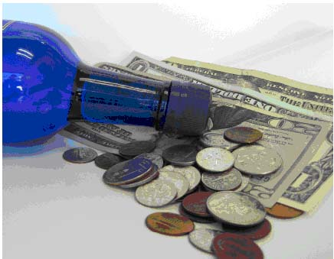
Continue Increasing Taxes on Alcohol
Notes:
Image courtesy of The Center for Science in The Public Interest, http://www.cspinet.org/alcohol/taxes.html

Slide 2
Background
Misuse and abuse of alcohol can lead to:
Injuries
Liver diseases
Cancers
Heart diseases
Premature deaths
Poverty
Family and partner violence
Poor social acceptance
Violence
Crime
Traffic accidents
Abuse
Loss of work

Slide 3
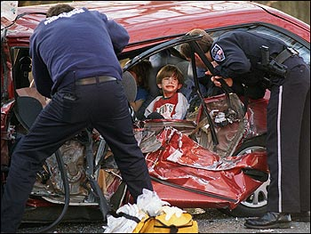
Did you know?
Harmful alcohol use kills 2.5 million people in the world each year.
Notes:
Image courtesy of Byer Media http://byermedia.com/life/5/safety/traffic-fatalitie-alcohol/traffic-fatalitie-alcohol.html

Slide 4
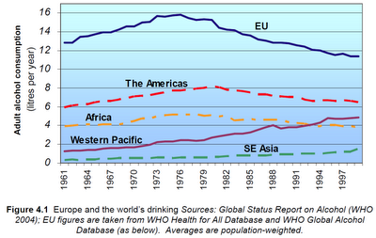
Did you know?
Alcohol is the leading risk factor for disease in the Western Pacific.
Notes:
Figure courtesy of Youth Risk Behavior Surveillance -- Pacific Island United States Territories 2007, CDC, November 2008
http://www.cdc.gov/mmwr/preview/mmwrhtml/ss5712a2.htm
The chart shows that in the Western Pacific, alcohol consumption has increased over the years.

Slide 5
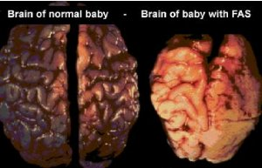
Did you know?
Alcohol drinking by pregnant mothers is harmful to the health of developing babies.
Notes:
Image courtesy of Tucson Citizen, “The Face of FAS,” November 2001
http://www.fasarizona.com/CitizenNov2001.htm

Slide 6
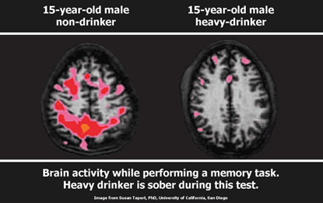
Alcohol affects our youth!
Alcohol use may affect brain development during adolescence.
Notes:
Citation: National Institute on Alcohol Abuse & Alcoholism 2004/5

Slide 7
Fact
Almost 1 out of 10 of all deaths for young adults ages 19-29 are due to alcohol related causes. This amounts to up to 320,000 deaths in this age group.

Slide 8
Alcohol affects our youth!
Alcohol use is linked to youth deaths by drowning, suicide and homicide.
Notes:
Significant changes occur in the body during adolescence.
8

Slide 9
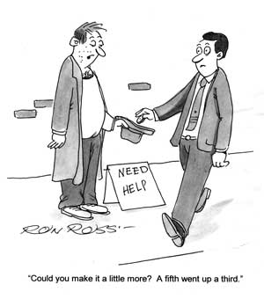
Why should we increase taxes on alcohol?
Notes:
Image courtesy of The Michigan Daily, November 2008, http://www.michigandaily.com/content/2008-11-17/cartoon-turning-blind-eye-underage-drinking

Slide 10
Fact!
Alcohol consumption the third largest factor to injury and disease worldwide, almost equal to tobacco.
Notes:
Citation: World Health Organization, Western Pacific Region (2011). Addressing the harmful use of alcohol: A guide to developing effective alcohol legislation. Geneva, Switzerland: WHO Press.

Slide 11
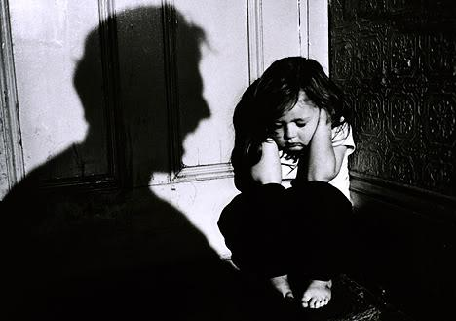
Increasing alcohol taxes and reduce alcohol related abuse!
Research shows that increases in the beer tax can be an effective policy tool in reducing child abuse and abuse of women in the community
Notes:
Works Cited: Markowitz S, & Grossman M. (1998). Alcohol regulation and domestic violence towards children. Contemp Econ Policy, 16(3):309–20
Markowitz S, & Grossman M. (2000). The effects of beer taxes on physical abuse. J Health Econ, 19:271-82.

Slide 12
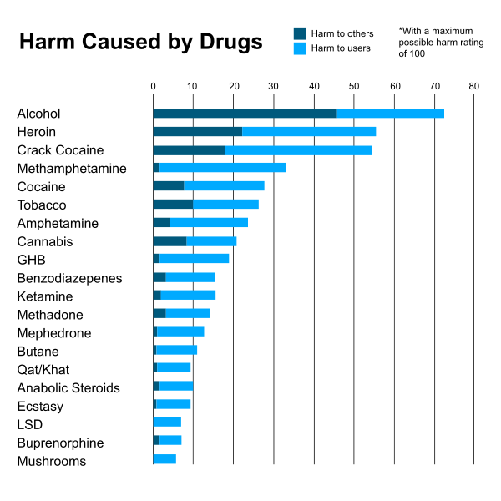
Increasing taxes decreases alcohol consumption!
A study found that higher alcohol taxes are associated with reductions in both excessive alcohol consumption and related, subsequent harms
Notes:
Image courtesy of "Scoring drugs", The Economist, data from "Drug harms in the UK: a multi-criteria decision analysis", by David Nutt, Leslie King and Lawrence Phillips, on behalf of the Independent Scientific Committee on Drugs. The Lancet. 2010 Nov 6;376(9752):1558-65. doi:10.1016/S0140-6736(10)61462-6 PMID:21036393
Citation: Elder, R.W., Lawrence, B., Ferguson, A., Naimi, T.S., Brewer, R.D., Chattopadhyay, S.K., et al. (2010). The effectiveness of tax policy interventions for reducing excessive alcohol consumption and related harms. American Journal of Preventive Medicine, 38(2), 217–229.

Slide 13
Fact!
Increasing alcohol taxes can increase the overall longevity and productivity of the community. Alcohol consumption contributes to number of life years lost due to illness and disease

Slide 14
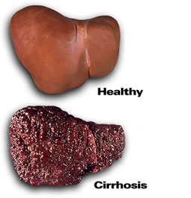
Increasing alcohol taxation can lower liver damage and death
A $1 increase in the distilled spirits tax was estimated to lower cirrhosis death rates by 5-10 percent.
Notes:
Images courtesy of: liversupport.co.uk
Citation: Cook, P.J., & Tauchen, G. (1982). The effect of liquor taxes on heavy drinking. Bell Journal of Economics, 13(2):379–390.

Slide 15
What can I do?
Talk to people that are interested in taking action in your community
Reach out to people in the public health sector or local government to address this concern
Put together a project with a team/working group to help you speak at community meetings and with local government to help increase alcohol taxes

Slide 16
Who can I contact?
Jeanie McKenzie
NCD Advisor, Tobacco and Alcohol Secretariat of the Pacific Community
Email: JeanieM@spc.int
Notes:
16

