Slide 1
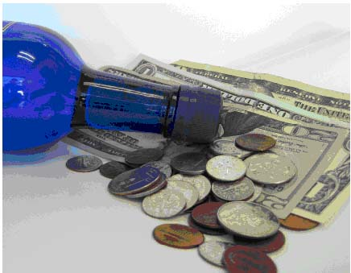
Continue Increasing Taxes on Alcohol
Notes:
Image courtesy of The Center for Science in The Public Interest, http://www.cspinet.org/alcohol/taxes.html

Slide 2
Background
Misuse and abuse of alcohol can lead to:
Injuries
Liver diseases
Cancers
Heart diseases
Premature deaths
Poverty
Family and partner violence
Poor social acceptance
Violence
Crime
Traffic accidents
Abuse
Loss of work

Slide 3
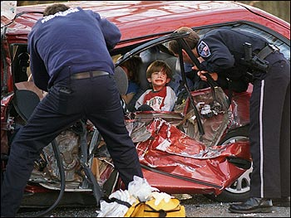
Did you know?
Harmful alcohol use kills 2.5 million people in the world each year.
Notes:
Image courtesy of Byer Media http://byermedia.com/life/5/safety/traffic-fatalitie-alcohol/traffic-fatalitie-alcohol.html

Slide 4
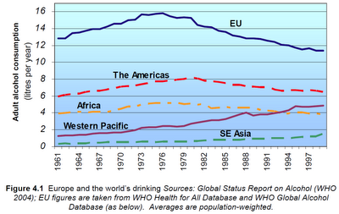
Did you know?
Alcohol is the leading risk factor for disease in the Western Pacific.
Notes:
Figure courtesy of Youth Risk Behavior Surveillance -- Pacific Island United States Territories 2007, CDC, November 2008
http://www.cdc.gov/mmwr/preview/mmwrhtml/ss5712a2.htm
The chart shows that in the Western Pacific, alcohol consumption has increased over the years.

Slide 5
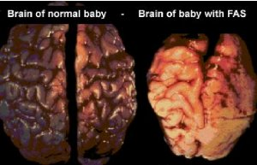
Did you know?
Alcohol drinking by pregnant mothers is harmful to the health of developing babies.
Notes:
Image courtesy of Tucson Citizen, “The Face of FAS,” November 2001
http://www.fasarizona.com/CitizenNov2001.htm

Slide 6
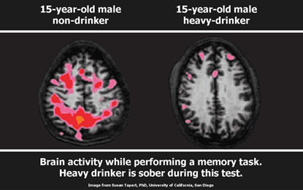
Alcohol affects our youth!
Alcohol use may affect brain development during adolescence.
Notes:
Citation: National Institute on Alcohol Abuse & Alcoholism 2004/5

Slide 7
Fact
Almost 10% of all deaths for young adults ages 19-29 are due to alcohol related causes. This amounts to up to 320,000 deaths in this age group.

Slide 8
Alcohol affects our youth!
Alcohol use is linked to youth deaths by drowning, suicide and homicide.
Notes:
Significant changes occur in the body during adolescence.
8

Slide 9
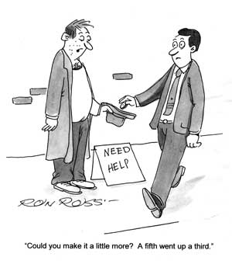
Why should we increase taxes on alcohol?
Notes:
Image courtesy of The Michigan Daily, November 2008, http://www.michigandaily.com/content/2008-11-17/cartoon-turning-blind-eye-underage-drinking

Slide 10
Fact!
Alcohol consumption is a significant risk to overall health. It is the third largest contributing factor to injury and disease worldwide, almost equal to tobacco, and in developing countries with overall low mortality, it is now the leading factor
Notes:
Citation: World Health Organization, Western Pacific Region (2011). Addressing the harmful use of alcohol: A guide to developing effective alcohol legislation. Geneva, Switzerland: WHO Press.

Slide 11
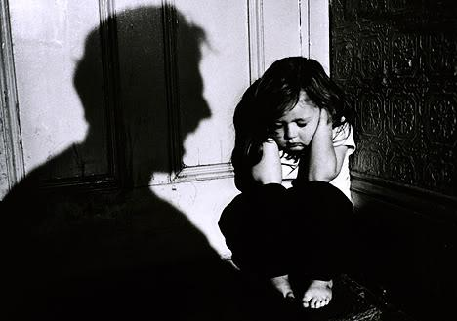
Increasing alcohol taxes and reduce alcohol related abuse!
Research shows that increases in the beer tax can be an effective policy tool in reducing child abuse and abuse of women in the community
Notes:
Works Cited: Markowitz S, & Grossman M. (1998). Alcohol regulation and domestic violence towards children. Contemp Econ Policy, 16(3):309–20
Markowitz S, & Grossman M. (2000). The effects of beer taxes on physical abuse. J Health Econ, 19:271-82.

Slide 12
Alcohol and Abuse
It is estimated that a 1-percent increase in the price per ounce of pure alcohol would decrease the probability of being a victim of wife abuse by 5.3 percent
Notes:
Works Cited: Markowitz S, & Grossman M. (1998). Alcohol regulation and domestic violence towards children. Contemp Econ Policy, 16(3):309–20
Markowitz S, & Grossman M. (2000). The effects of beer taxes on physical abuse. J Health Econ, 19:271-82.

Slide 13
Fact!
Raising the cost of alcohol by just 10% can have an almost equivocal decrease in consumption by 5-12%
Notes:
Citation: Young, D.J., & Bielinska-Kwapisz, A. (2006). Alcohol prices, consumption, and traffic fatalities. Southern Economic Journal. 72-3, 690-703.

Slide 14
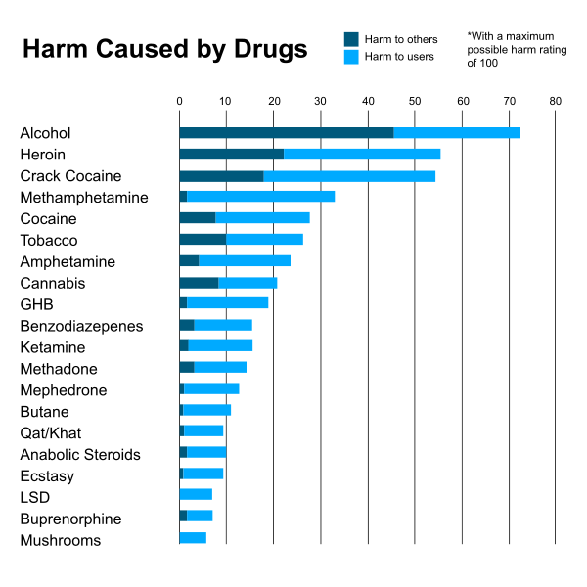
Increasing taxes decreases alcohol consumption!
A study found that higher alcohol taxes are associated with reductions in both excessive alcohol consumption and related, subsequent harms
Notes:
Image courtesy of "Scoring drugs", The Economist, data from "Drug harms in the UK: a multi-criteria decision analysis", by David Nutt, Leslie King and Lawrence Phillips, on behalf of the Independent Scientific Committee on Drugs. The Lancet. 2010 Nov 6;376(9752):1558-65. doi:10.1016/S0140-6736(10)61462-6 PMID:21036393
Citation: Elder, R.W., Lawrence, B., Ferguson, A., Naimi, T.S., Brewer, R.D., Chattopadhyay, S.K., et al. (2010). The effectiveness of tax policy interventions for reducing excessive alcohol consumption and related harms. American Journal of Preventive Medicine, 38(2), 217–229.

Slide 15
Fact!
Increasing alcohol taxes can increase the overall longevity and productivity of the community. Alcohol consumption contributes to number of life years lost due to illness and disease

Slide 16
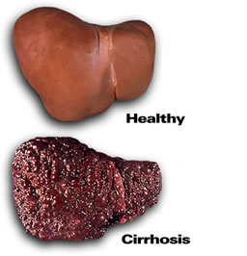
Increasing alcohol taxation can lower liver damage and death
A $1 increase in the distilled spirits tax was estimated to lower cirrhosis death rates by 5-10 percent.
Notes:
Images courtesy of: liversupport.co.uk
Citation: Cook, P.J., & Tauchen, G. (1982). The effect of liquor taxes on heavy drinking. Bell Journal of Economics, 13(2):379–390.

Slide 17
Policy in action!
The Malaysian government increased alcohol excise duties in September 2004 by 26% on beer and 20% on other alcoholic beverages.
Reports showed a decrease in beer consumption of 5% in 2005 and 8% in 2006
Notes:
Citation: World Health Organization, Western Pacific Region (2011). Addressing the harmful use of alcohol: A guide to developing effective alcohol legislation. Geneva, Switzerland: WHO Press.

Slide 18
Recommendations
Increasing Taxation on Alcohol
Inflation-indexed taxes on imported and domestic alcohol
Dedicated fund for Alcohol Control Activities
Funds can be used for reducing harms related to the use of alcohol
Programs aimed at public health
Collection, monitoring and enforcement of excise duty
Monitoring and enforcement of alcohol control laws and policies
Research and evidence based advice to government

Slide 19
Example Legislation: Increasing Taxation on Alcohol
Inflation-indexed taxes on imported and domestic alcohol
1) The Minister may from time to time impose such rates of excise duty and excise- equivalent duty on any alcoholic beverage type or class of alcohol beverage.
2) The rate of any duty established under subsection (1) shall be set out in an order of the Minister made under this section. Any change in the rates of excise duty and excise- equivalent duty made under subsection (1) of this section:
a) shall have regard to movements in the Consumers Price Index All Groups excluding credit services; and
b) in the case of a change in the rates of excise duty and excise-equivalent duty for alcoholic beverages, may come into force only on XX in any calendar year.
3) When setting a duty under subsection (1) the Minister shall ensure that the duty is set in a manner which ensures that the rate of duty for domestically produced product and imported product is the same.
Notes:
Citation: Suggested legislative example was taken from the following: World Health Organization, Addressing the Harmful Use of Alcohol: A guide to developing effective legislation (2011). http://www.wpro.who.int/publications/docs/Addressingtheharmfuluseofalcoholforupload.pdf

Slide 20
Example Legislation: Dedicated Fund for Alcohol Control Activities
A fund is established called Alcohol Control Fund [or Health Promotion Fund].
The fund shall comprise the proceeds of a levy on all importers and manufacturers of alcohol.
The rate of the levy shall be set annually by regulations.
In every financial year a levy of the amount set by regulations is payable by every person who—
a) imports for consumption any imported alcohol that contains more than 1.15% volume of alcohol; or
b) manufactures within the country any alcohol that contains more than 1.15% volume of alcohol.
Notes:
Citation: Suggested legislative example was taken from the following: World Health Organization, Addressing the Harmful Use of Alcohol: A guide to developing effective legislation (2011). http://www.wpro.who.int/publications/docs/Addressingtheharmfuluseofalcoholforupload.pdf

Slide 21
Example Legislation: Dedicated Fund for Alcohol Control Activities
5. All levies payable under this Act are payable to the Customs & Excise Department under the Customs Act for payment to the Fund.
6. The fund shall be administered by the [Ministry of Health] for the purposes and activities in subsection (7) below:
7. The fund shall be used for the purpose of reducing harms related to the use of alcohol, including:
a) programmes and activities aimed at promoting public health and reducing harmful use of alcohol;
b) collection, monitoring and enforcement of excise duty under the Act;
c) monitoring and enforcement of alcohol control laws and policies; and
d) research and evidence-based advice to government.
Notes:
Citation: Suggested legislative example was taken from the following: World Health Organization, Addressing the Harmful Use of Alcohol: A guide to developing effective legislation (2011). http://www.wpro.who.int/publications/docs/Addressingtheharmfuluseofalcoholforupload.pdf

Slide 22
Example Legislation: Dedicated Fund for Alcohol Control Activities: Alternative Tax Law
A fund is established called Alcohol Control Fund [or Health Promotion Fund].
(2) The fund shall comprise X% of the proceeds of excise tax on alcohol payable by importers and manufacturers of liquor.
(3) The fund shall be used by the [Ministry of Health] for the purposes of reducing harms related to the use of alcohol, including:
(a) programs and activities aimed at promoting public health and reducing harmful use of alcohol
(b) collection, monitoring and enforcement of excise duty under the Act
(c) monitoring and enforcement of alcohol control laws and policies
(d) research and evidence-based advice to government.
Notes:
Citation: Suggested legislative example was taken from the following: World Health Organization, Addressing the Harmful Use of Alcohol: A guide to developing effective legislation (2011). http://www.wpro.who.int/publications/docs/Addressingtheharmfuluseofalcoholforupload.pdf

Slide 23
Example Legislation: Dedicated Fund for Alcohol Control Activities: Dedicated Foundation for Alcohol Control Purposes
1) The purpose of this Act is to:
a) provide for the establishment of a health promotion foundation having as its primary objective the reduction of harms related to the use of alcohol;
b) define the Foundation’s functions and powers; and
c) make provision for the funding of the Foundation’s activities by means of a levy on alcohol imported into or manufactured in (country).
Notes:
Citation: Suggested legislative example was taken from the following: World Health Organization, Addressing the Harmful Use of Alcohol: A guide to developing effective legislation (2011). http://www.wpro.who.int/publications/docs/Addressingtheharmfuluseofalcoholforupload.pdf

Slide 24
Who can I contact?
Jeanie McKenzie
NCD Advisor, Tobacco and Alcohol Secretariat of the Pacific Community
Email: JeanieM@spc.int
Notes:
24

