Slide 1
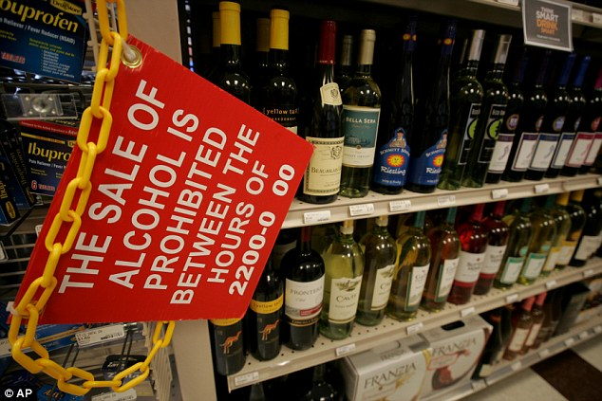
Restricting Access to Alcohol
Notes:
Image courtesy of The UK Daily Mail, August, 2013. http://www.dailymail.co.uk/news/article-2396296/Navy-bans-alcohol-sale-bases-10pm-6am-curb-drink-related-crimes.html

Slide 2
Background
Misuse and abuse of alcohol can lead to:
  Injuries
  Liver diseases
  Cancers
  Heart diseases
  Premature deaths
  Poverty
  Family and partner violence
  Poor social acceptance
  Violence
  Crime
  Traffic accidents
  Abuse
  Loss of work

Slide 3
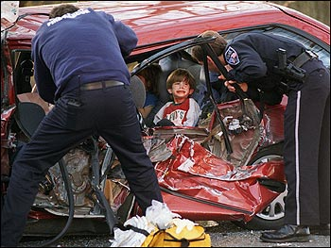
Did you know?
Harmful alcohol use kills 2.5 million people in the world each year.
Notes:
Image courtesy of Byer Media http://byermedia.com/life/5/safety/traffic-fatalitie-alcohol/traffic-fatalitie-alcohol.html

Slide 4
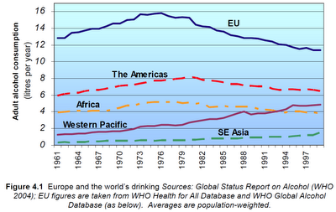
Did you know?
Alcohol is the leading risk factor for disease in the Western Pacific.
Notes:
Figure courtesy of Youth Risk Behavior Surveillance -- Pacific Island United States Territories 2007, CDC, November 2008
http://www.cdc.gov/mmwr/preview/mmwrhtml/ss5712a2.htm
The chart shows that in the Western Pacific, alcohol consumption has increased over the years.

Slide 5
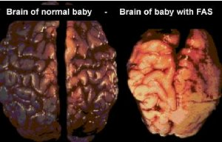
Did you know?
Alcohol drinking by pregnant mothers is harmful to the health of developing babies.
Notes:
Image courtesy of Tucson Citizen, “The Face of FAS,” November 2001
http://www.fasarizona.com/CitizenNov2001.htm

Slide 6
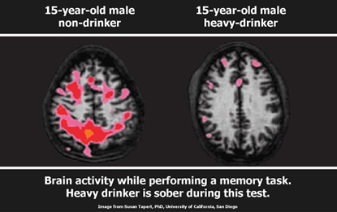
Alcohol affects our youth!
Alcohol use may affect brain development during adolescence.
Notes:
Citation: National Institute on Alcohol Abuse & Alcoholism 2004/5

Slide 7
Fact
Almost 1 out of 10 of all deaths for young adults ages 19-29 are due to alcohol related causes. This amounts to up to 320,000 deaths in this age group.

Slide 8
Alcohol affects our youth!
Alcohol use is linked to youth deaths by drowning, suicide and homicide.
Notes:
Significant changes occur in the body during adolescence.
8

Slide 9
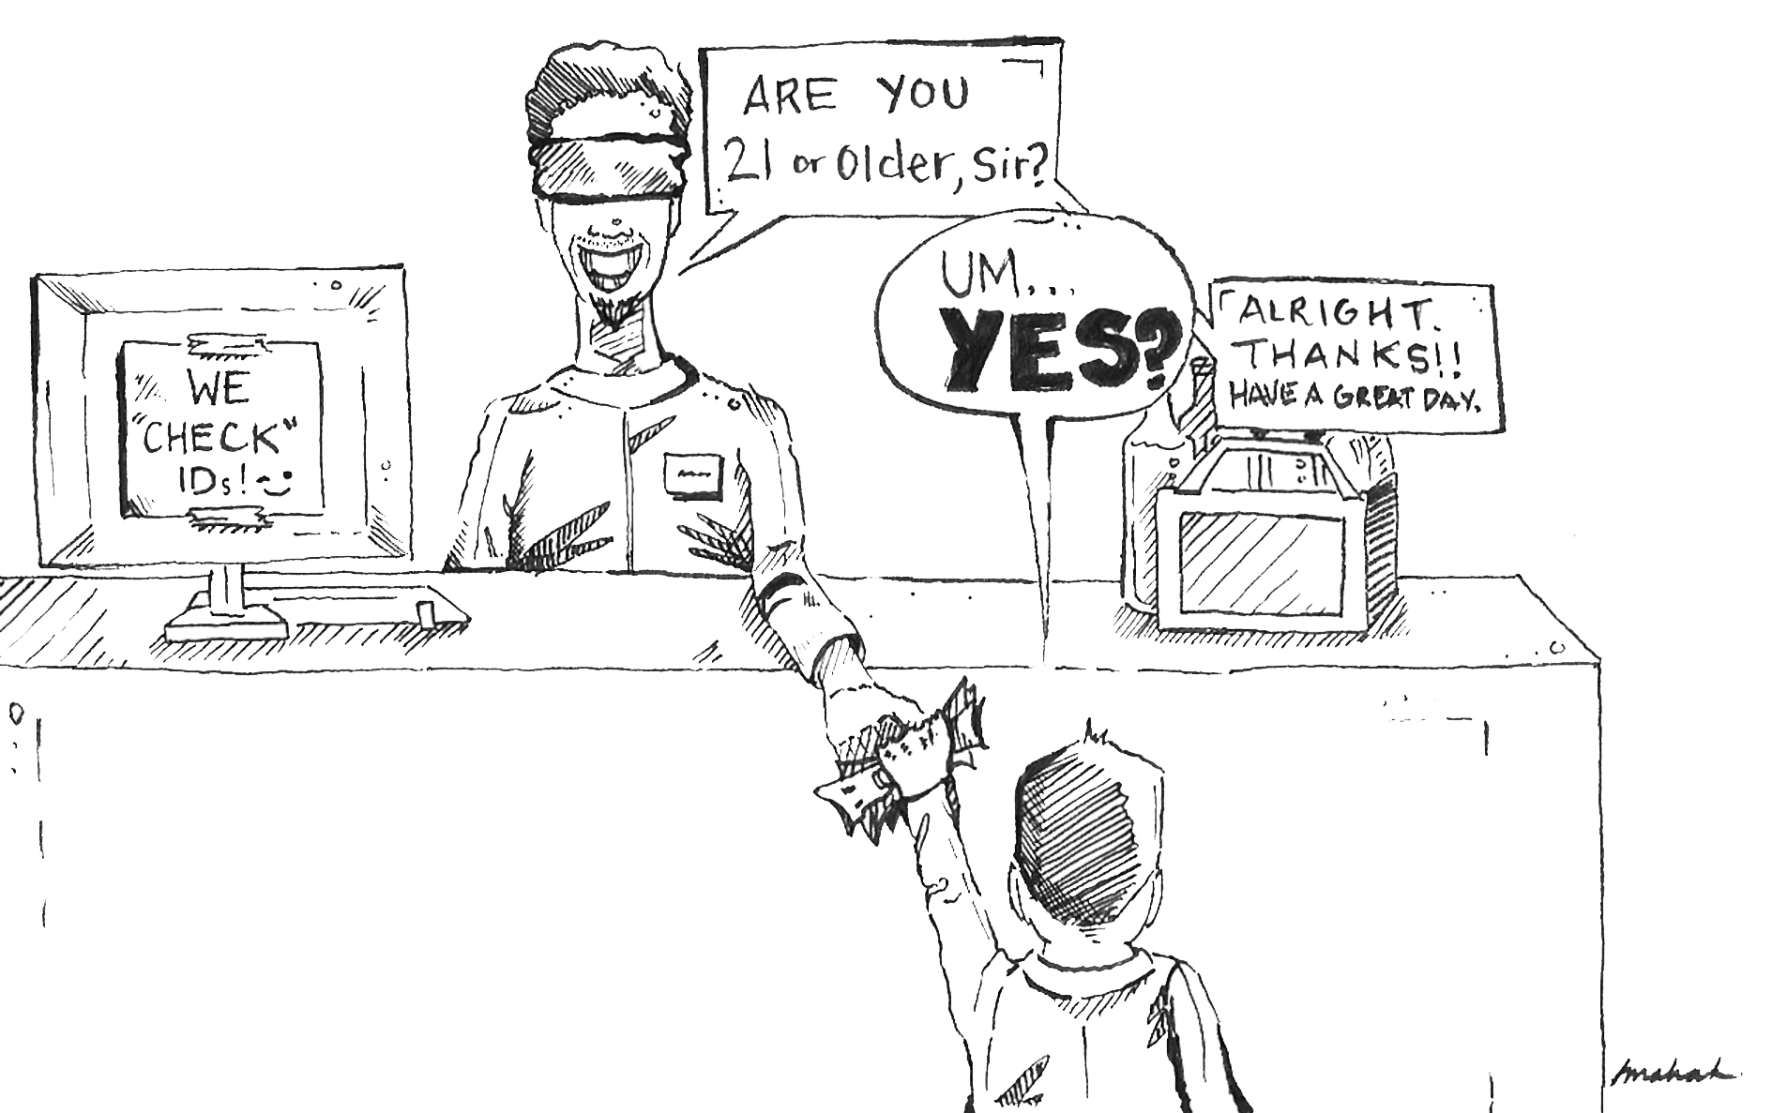
We must protect our youth!
Notes:
Image courtesy of The Michigan Daily, November 2008, http://www.michigandaily.com/content/2008-11-17/cartoon-turning-blind-eye-underage-drinking

Slide 10
How do we restrict access to alcohol?
Restrict hours of alcohol sales
Strengthen minimum age laws
Limit the amount of alcohol outlets
Ban the use of alcohol at cultural events

Slide 11
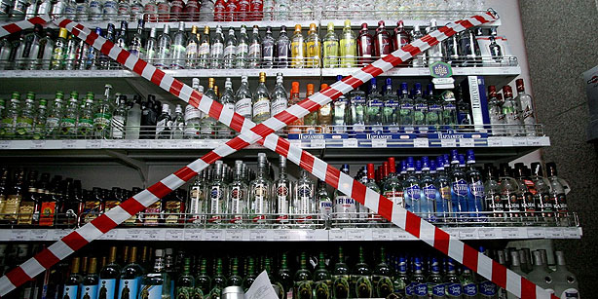
Restrict hours of alcohol sales!
Several studies have shown that limiting the hours of alcohol sales and the amount of alcohol stores can decrease violence, minimize underage drinking, and reduce crime
Notes:
Image courtesy of Today’s Zaman, May 2013, Cihan/Ria Novosti (http://www.todayszaman.com/news-316365-parliament-passes-bill-limiting-sale-of-alcohol-banning-ads.html)
Citation: Voas, R., Roman, E., Kelley-Baker. T., (2007). The effects of establishing closing hours in Juarez, in Stewart, K., Alcohol Regulation and Traffic Safety, Transportation Research Board, Washington D.C.
Bye, E.K. Alcohol and violence: Use of possible confounders in a time-series analysis. Addiction 102:369–376, 2007. PMID: 17298643
Norstrom, T. Outlet density and criminal violence in Norway, 1960-1995. Journal of Studies on Alcohol 61:907–911, 2000. PMID: 11188497
Freisthler, B.; Gruenewald, P.J.; Treno, A.J.; and Lee, J. Evaluating alcohol access and the alcohol environment in neighborhood areas. Alcoholism: Clinical and Experimental Research 27:477–484, 2003. PMID: 12658114

Slide 12

Fact!
In the United Kingdom allowing alcohol to be sold 24 hours a day led to more night-time alcohol-related emergency hospital admissions in a London Hospital.
Notes:
Image courtesy of http://cottagecheeseandcrepepaper.com/emergency-education/
Citation: Newton, A., S. J. Sarker, G. S. Pahal et al. 2007. 的mpact of the new UK licensing law on
emergency hospital attendances: a cohort study.� Emergency Medicine Journal (24): 532-534.

Slide 13
Strengthen minimum age laws!
Raising the drinking age greatly lowers death due to alcohol among young people and accidents and problems among youth.
Notes:
Image courtesy of The Youth Risk Behavior Surveillance -- Pacific Island United States Territories, CDC, 2007 (http://www.cdc.gov/mmwr/preview/mmwrhtml/ss5712a2.htm)
Citation: Everitt, R., and Jones, P. Changing the minimum legal drinking age: Its effect on a central city emergency department. New Zealand Medical Journal 115:9–10, 2002. PMID: 11936350

Slide 14
Fact!
A U.S. study showed that those who begin drinking in their teenage years are more likely to experience injuries due to alcohol (motor vehicle accidents, falls, burns, etc.) than those who begin drinking at a later age

Slide 15
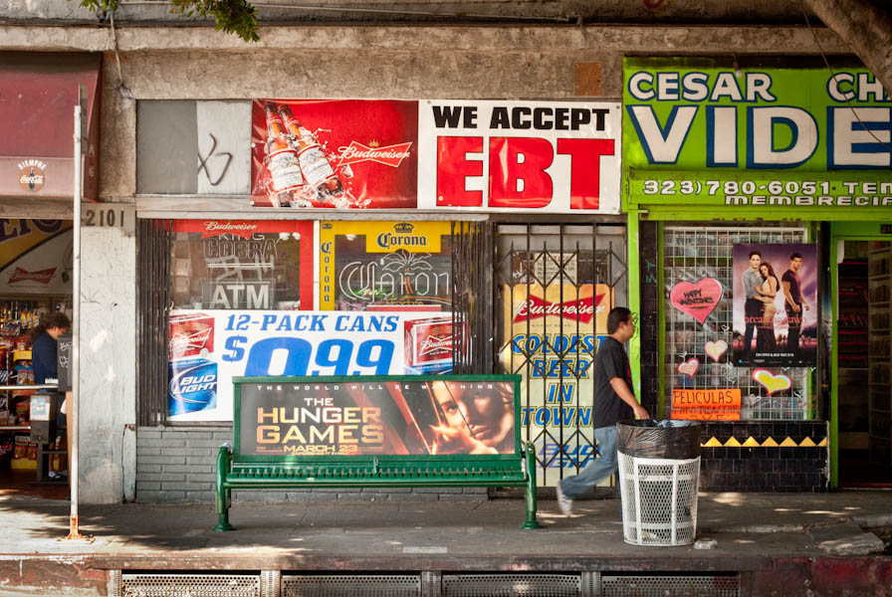
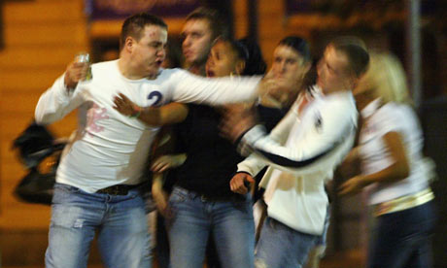
Limit the amount of alcohol outlets
Research has also shown that the amount of alcohol stores is associated with more alcohol-related problems like drunk driving and violence.
Notes:
Images courtesy of: la.streetsblog.org (http://la.streetsblog.org/2012/03/20/too-many-liquor-stores-boyle-heights-high-frequency-of-liquor-vendors-causes-concern-from-community-groups/)
Citation: Lipton, Robert and Paul Grunewald (2002) The spatial dynamics of violence and alcohol outlets. Journal of Studies on Alcohol. 63:187-195

Slide 16

Ban the use of alcohol at cultural events!
Alcohol companies use sporting events to market to young people that attend. Research has linked the amount of alcohol marketing young people see to earlier and heavier drinking among young people
Notes:
Images courtesy of http://slingshotsponsorship.com/2012/11/26/should-alcohol-sponsorship-be-banned/
Citation: Babor, T., R. Caetano, S. Casswell, et al. 2010. Alcohol, No Ordinary Commodity: Research and public policy. 2nd edition. Oxford University Press.

Slide 17
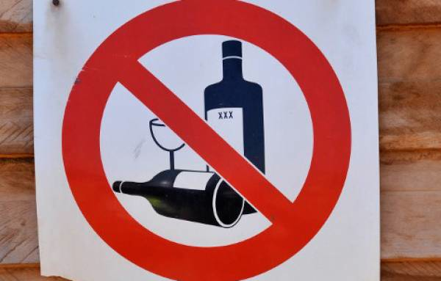
We must protect our youth!
Policies on alcohol marketing are essential to control alcohol and lower alcohol-related harm. These policies will protect our youth from starting bad habits that can eventually lead to a future of terrible health

Slide 18
What can I do?
      Talk to people that are interested in taking action in your community
      Reach out to people in the public health sector or local government to address this concern
      Put together a project with a team/working group to help you speak at community meetings and with local government to help restrict access to alcohol
      Talk to businesses about the harmful affects of alcohol ads to our youth and encourage them to enforce laws on underage drinking

Slide 19
What can churches do?
    Encourage youth to involve themselves in church activities
    Educate your community about the harmful effects of alcohol and the problems it can have on young people
    Support those who are struggling with alcohol problems
    Ban alcohol at church related events and condemn underage drinking
Notes:
19

Slide 20
What can schools do?
      Educate youth about the harmful effects of alcohol
      Enforce rules about drinking at school and prohibit underage drinking
      Promote activities or a week of awareness to discuss the harmful problems and effects of drinking
      Ban alcohol at school events and other school activities
Notes:
20

Slide 21
What can communities do?
      Talk to businesses in your community about limiting the number of alcohol ads in their windows
      Strictly enforce drinking laws
      Initiate alcohol free events and ban alcohol at community gatherings and activities
      Investigate alcohol harms in your community and collect information
      Call a community meeting with people in your community who can help reduce alcohol harms
      Work together and contact local government to ask them to help enforce policies to that will help restrict access to alcohol
Notes:
21

Slide 22
Who can I contact?
Jeanie McKenzie
NCD Advisor, Tobacco and Alcohol Secretariat of the Pacific Community
Email: JeanieM@spc.int
Notes:
22

