Slide 1
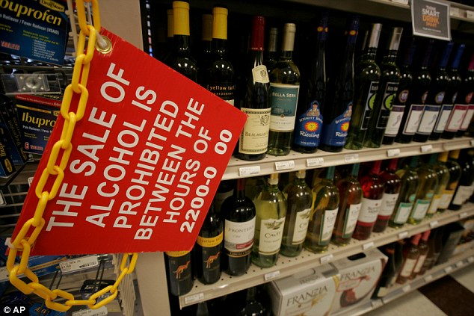
Restricting Access to Alcohol
Notes:
Image courtesy of The UK Daily Mail, August, 2013. http://www.dailymail.co.uk/news/article-2396296/Navy-bans-alcohol-sale-bases-10pm-6am-curb-drink-related-crimes.html

Slide 2
Background
Misuse and abuse of alcohol can lead to:
  Injuries
  Liver cirrhosis
  Cancers
  Cardiovascular diseases
  Premature deaths
  Poverty
  Family and partner violence
  Poor social acceptance
  Violence
  Crime
  Traffic accidents
  Abuse
  Loss of work

Slide 3
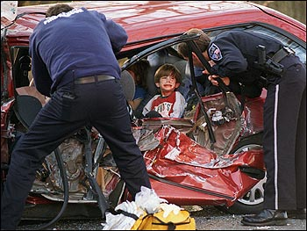
Did you know?
Harmful alcohol use kills 2.5 million people in the world each year.
Notes:
Image courtesy of Byer Media http://byermedia.com/life/5/safety/traffic-fatalitie-alcohol/traffic-fatalitie-alcohol.html

Slide 4
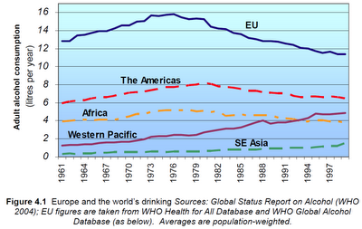
Did you know?
Alcohol is the leading risk factor for disease in the Western Pacific.
Notes:
Figure courtesy of Youth Risk Behavior Surveillance -- Pacific Island United States Territories 2007, CDC, November 2008
http://www.cdc.gov/mmwr/preview/mmwrhtml/ss5712a2.htm

Slide 5
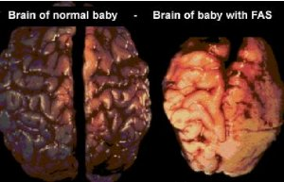
Did you know?
Alcohol drinking by mothers is harmful to the health of the developing fetus.
Notes:
Image courtesy of Tucson Citizen, “The Face of FAS,” November 2001
http://www.fasarizona.com/CitizenNov2001.htm

Slide 6
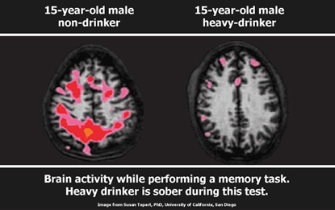
Alcohol affects our youth!
Alcohol use may affect brain development during adolescence.
Notes:
Citation: National Institute on Alcohol Abuse & Alcoholism 2004/5

Slide 7
Fact
Almost 10% of all deaths for young adults ages 19-29 are due to alcohol related causes. This amounts to up to 320,000 deaths in this age group.

Slide 8
Alcohol affects our youth!
Alcohol use is linked to youth deaths by drowning, suicide and homicide.
Notes:
Significant changes occur in the body during adolescence.
8

Slide 9
How do we restrict access to alcohol?
Restrict hours of alcohol sales
Strengthen minimum age laws
Limit the amount of alcohol outlets
Ban the use of alcohol at cultural events

Slide 10
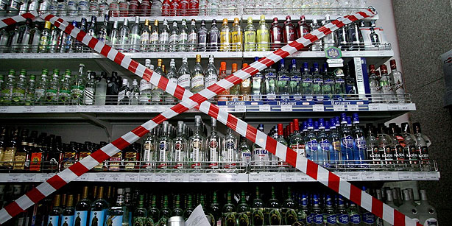
Restrict hours of alcohol sales!
Research has shown that restricting the hours of alcohol sales and limiting the density of alcohol outlets can decrease alcohol related violence, minimize underage drinking, and reduce alcohol related crime.
Notes:
Image courtesy of Today’s Zaman, May 2013, Cihan/Ria Novosti (http://www.todayszaman.com/news-316365-parliament-passes-bill-limiting-sale-of-alcohol-banning-ads.html)
Citation: Voas, R., Roman, E., Kelley-Baker. T., (2007). The effects of establishing closing hours in Juarez, in Stewart, K., Alcohol Regulation and Traffic Safety, Transportation Research Board, Washington D.C.
Bye, E.K. Alcohol and violence: Use of possible confounders in a time-series analysis. Addiction 102:369–376, 2007. PMID: 17298643
Norstrom, T. Outlet density and criminal violence in Norway, 1960-1995. Journal of Studies on Alcohol 61:907–911, 2000. PMID: 11188497
Freisthler, B.; Gruenewald, P.J.; Treno, A.J.; and Lee, J. Evaluating alcohol access and the alcohol environment in neighborhood areas. Alcoholism: Clinical and Experimental Research 27:477–484, 2003. PMID: 12658114

Slide 11
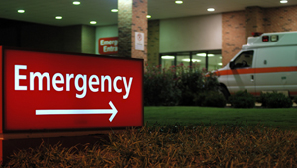
Fact!
A study showed that the UK’s recent law change allowing alcohol to be sold 24 hours a day resulted in an increase in night-time alcohol-related emergency admissions in a London Hospital
Notes:
Image courtesy of http://cottagecheeseandcrepepaper.com/emergency-education/
Citation: Newton, A., S. J. Sarker, G. S. Pahal et al. 2007. 的mpact of the new UK licensing law on
emergency hospital attendances: a cohort study.� Emergency Medicine Journal (24): 532-534.

Slide 12
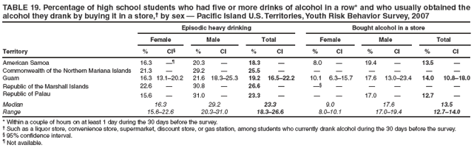
Strengthen minimum age laws!
Raising the drinking age greatly lowers death due to alcohol among young people and accidents and problems among youth.
Notes:
Image courtesy of The Youth Risk Behavior Surveillance -- Pacific Island United States Territories, CDC, 2007 (http://www.cdc.gov/mmwr/preview/mmwrhtml/ss5712a2.htm)
Citation: Everitt, R., and Jones, P. Changing the minimum legal drinking age: Its effect on a central city emergency department. New Zealand Medical Journal 115:9–10, 2002. PMID: 11936350

Slide 13
Fact!
A U.S. study showed that those who begin drinking in their teenage years are more likely to experience injuries due to alcohol (motor vehicle accidents, falls, burns, etc.) than those who begin drinking at a later age
Notes:
Citation: Hingson, Ralph W., Timothy Heeren, Amber Jamanka, and Jonathan Howland. 2000. �Age of Drinking Onset and Unintentional Injury Involvement After Drinking.� Journal of the American Medical Association 284(12):1527–33.

Slide 14
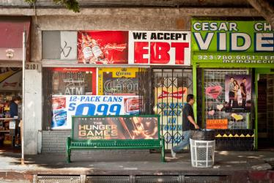
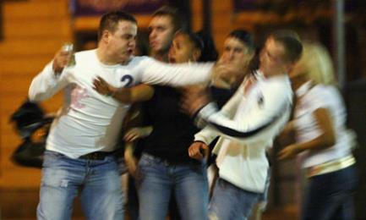
Limit the amount of alcohol outlets
Research has also shown that the amount of alcohol stores is associated with more alcohol-related problems like drunk driving and violence.
Notes:
Images courtesy of: la.streetsblog.org (http://la.streetsblog.org/2012/03/20/too-many-liquor-stores-boyle-heights-high-frequency-of-liquor-vendors-causes-concern-from-community-groups/)
Citation: Lipton, Robert and Paul Grunewald (2002) The spatial dynamics of violence and alcohol outlets. Journal of Studies on Alcohol. 63:187-195

Slide 15
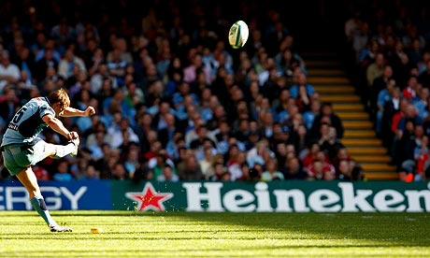
Ban the use of alcohol at cultural events!
Alcohol companies use sporting events to market to young people that attend. Research has linked the amount of alcohol marketing young people see to earlier and heavier drinking among young people
Notes:
Images courtesy of http://slingshotsponsorship.com/2012/11/26/should-alcohol-sponsorship-be-banned/
Citation: Babor, T., R. Caetano, S. Casswell, et al. 2010. Alcohol, No Ordinary Commodity: Research and public policy. 2nd edition. Oxford University Press.

Slide 16
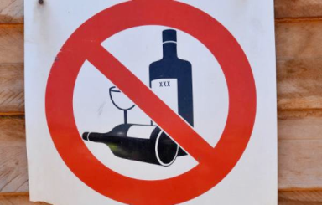
We must protect our youth!
Policies on alcohol marketing are essential to control alcohol and lower alcohol-related harm. These policies will protect our youth from starting bad habits that can eventually lead to a future of terrible health

Slide 17
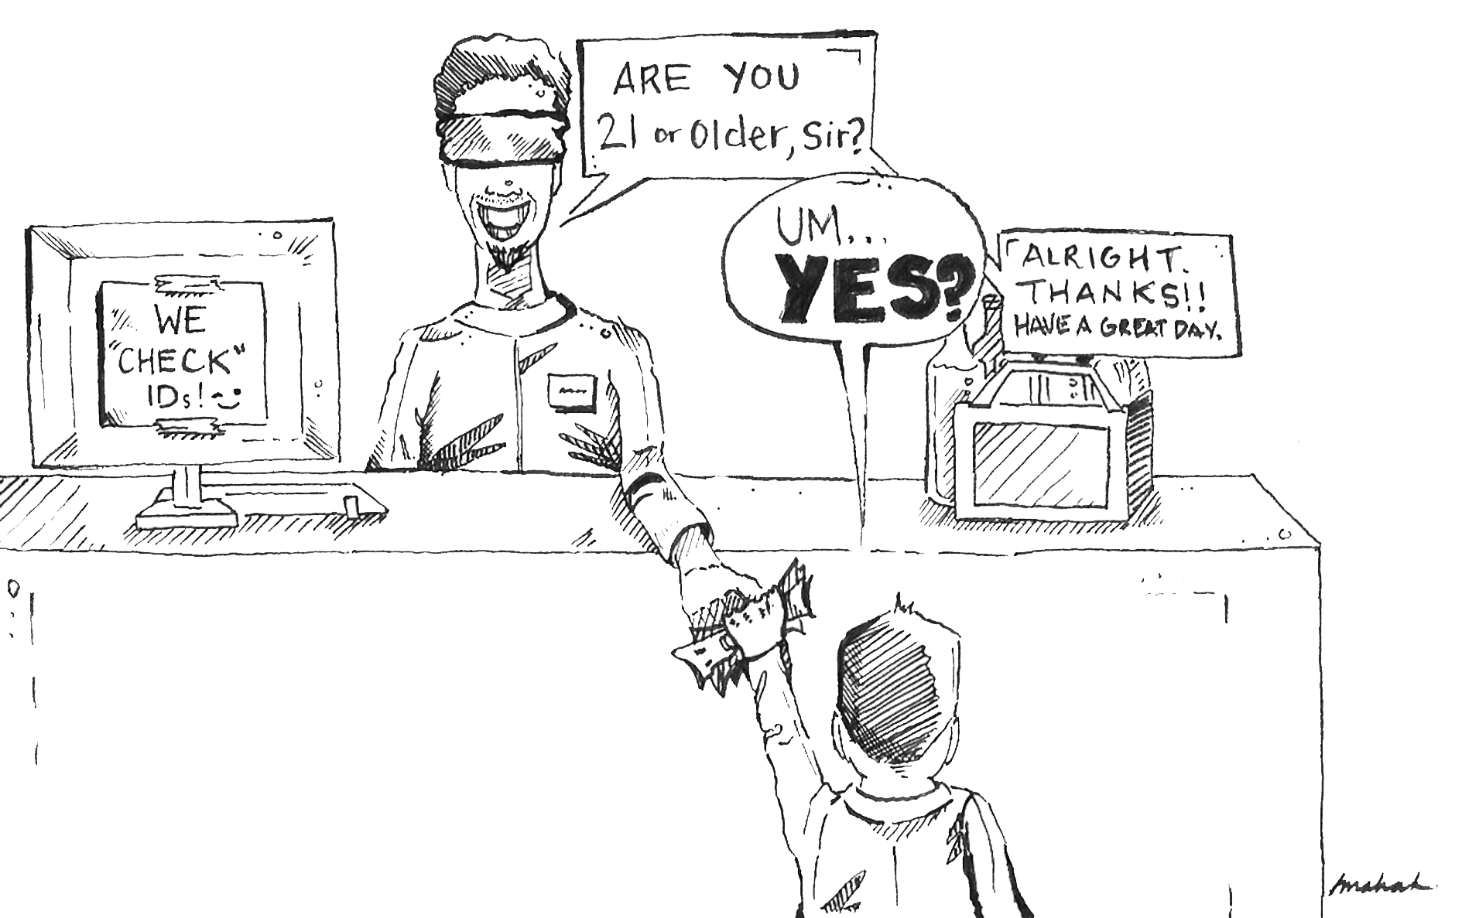
We must protect our youth!
Sales restrictions are not effective unless they are properly enforced through checks by bar staff and sales people
Notes:
Image courtesy of The Michigan Daily, November 2008, http://www.michigandaily.com/content/2008-11-17/cartoon-turning-blind-eye-underage-drinking

Slide 18
Enact legislation that strengthens minimum age laws!
Make it a prosecutable offence if you:
    Buy alcohol and are under the minimum age
    Present false evidence of age; and/or
    Supply alcohol to a minor or purchase alcohol on their behalf
Notes:
Image courtesy of The Michigan Daily, November 2008, http://www.michigandaily.com/content/2008-11-17/cartoon-turning-blind-eye-underage-drinking

Slide 19
Example Policy:
Strengthening Minimum Age Laws
Definition of evidence of age
    Evidence of age document means a passport, a driver’s license or (specify other official document which provides reliable evidence of age).
Sales to persons below the minimum age
    1) No person, being the licensee, manager or server on licensed premises, shall sell or supply alcohol to any person below the age of XX years.
    2) The licensee shall take steps to ensure verification of the age of any person who appears to be under the age of 25 years by requesting an evidence of age document.
    3) No person shall allow any person below the age of XX years to enter or remain on age- restricted licensed premises.
Notes:
Citation: Suggested legislative example was taken from the following: World Health Organization, Addressing the Harmful Use of Alcohol: A guide to developing effective legislation (2011). http://www.wpro.who.int/publications/docs/Addressingtheharmfuluseofalcoholforupload.pdf

Slide 20
Example Policy:
Strengthening Minimum Age Laws
    It is a defense against prosecution under subsection (1) and (3) if it is proved that the defendant was provided with an evidence of age document that may reasonably be accepted as applying to the person and as proving that the person was of legal age for sale and supply of alcohol.
    No person may supply alcohol to a person below the age of XX years or obtain alcohol on their behalf from licensed premises.
    No person aged under XX years shall purchase alcohol or enter age-restricted licensed premises.
    No person shall present false or another person’s evidence of age document for the purposes of purchasing alcohol or entering age-restricted premises.
Notes:
Citation: Suggested legislative example was taken from the following: World Health Organization, Addressing the Harmful Use of Alcohol: A guide to developing effective legislation (2011). http://www.wpro.who.int/publications/docs/Addressingtheharmfuluseofalcoholforupload.pdf

Slide 21
Example Policy:
Restricting Hours of Sales
    1) No person may sell alcohol to the public outside of the standard trading periods set by this Act.
    2) Any person who contravenes sub section (1) commits an offence punishable on conviction by a fine of XX.
    3) For the purposes of this Act, the “standard trading period” means any day of the week other than Sunday, Christmas day, Good Friday or Easter Monday (or other religious and public holidays appropriate to the country):
      i) from 10:00 to 20:30 pm for consumption off the premises. ii) from 10:00 to 12:00 for consumption on the premises except that this restriction shall not apply to the sale of alcohol to guests resident in a licensed accommodation hotel
    No person may sell alcohol to the public outside of the standard trading periods.
    The “standard trading period” means any day of the week other than Sunday, Christmas day, Good Friday or Easter Monday (or other religious and public holidays appropriate to the country):
    i) from 10:00 to 20:30 pm for consumption off the premises
ii) from 10:00 to 12:00 for consumption on the premises except that this restriction shall not apply to the sale of alcohol to guests resident in a licensed accommodation hotel
Notes:
Citation: Suggested legislative example was taken from the following: World Health Organization, Addressing the Harmful Use of Alcohol: A guide to developing effective legislation (2011). http://www.wpro.who.int/publications/docs/Addressingtheharmfuluseofalcoholforupload.pdf

Slide 22
Example Policy:
Limiting Density of Alcohol Outlets
    1) No person may sell alcohol to the public outside of the standard trading periods set by this Act.
    2) Any person who contravenes sub section (1) commits an offence punishable on conviction by a fine of XX.
    3) For the purposes of this Act, the “standard trading period” means any day of the week other than Sunday, Christmas day, Good Friday or Easter Monday (or other religious and public holidays appropriate to the country):
      i) from 10:00 to 20:30 pm for consumption off the premises. ii) from 10:00 to 12:00 for consumption on the premises except that this restriction shall not apply to the sale of alcohol to guests resident in a licensed accommodation hotel
The Alcohol Control Board
1) An alcohol control board is established. The board’s functions are to: give effect to the purposes of the Act;
a) sell alcohol and non-alcoholic beverages for consumption off the premises;
b) control the sale, transportation and distribution of alcohol;
c) establish and operate stores for the sale of alcohol to the public;
d) control and supervise the marketing of alcohol; and
e) fix uniform prices for the sale of alcohol in all stores operated by the board.
2) Nothing in this section affects the licensing of any person to sell alcohol for consumption on the premises which is under the sole jurisdiction of the [separate licensing board or authority].
Notes:
Citation: Suggested legislative example was taken from the following: World Health Organization, Addressing the Harmful Use of Alcohol: A guide to developing effective legislation (2011). http://www.wpro.who.int/publications/docs/Addressingtheharmfuluseofalcoholforupload.pdf

Slide 23
Example Policy:
Limiting Density of Alcohol Outlets
Prohibited to sell alcohol
No person other than the Alcohol Control Board shall sell or supply alcohol for consumption off the premises.
No person, other than the Alcohol Control Board, may sell or distribute alcohol from any store, warehouse or other place which is not operated by the board.
No person shall sell or supply alcohol without a license for consumption on the premises.
No person shall allow any unlicensed premises which they own, rent, manage or control to be used as a place of resort for the consumption of alcohol.
Subsection (2) does not apply to any dwelling house and to a gift of alcohol to another person by the person at their dwelling house.
Notes:
Citation: Suggested legislative example was taken from the following: World Health Organization, Addressing the Harmful Use of Alcohol: A guide to developing effective legislation (2011). http://www.wpro.who.int/publications/docs/Addressingtheharmfuluseofalcoholforupload.pdf

Slide 24
Example Policy:
Banning Use of Alcohol at Cultural Events
Restrictions on sponsorship of events
This section applies to any event or activity if its name or any item used or associated with it or in connection with the organization, promotion, marketing or merchandising of the event or activity includes or is associated directly or indirectly with:
a) any alcohol product; or
b) any trade mark of an alcohol product; or
c) a company name or any part of a company name which may be included in that alcohol product trade mark.
Notes:
Citation: Suggested legislative example was taken from the following: World Health Organization, Addressing the Harmful Use of Alcohol: A guide to developing effective legislation (2011). http://www.wpro.who.int/publications/docs/Addressingtheharmfuluseofalcoholforupload.pdf

Slide 25
Example Policy:
Banning Use of Alcohol at Cultural Events
2) No person shall:
    a) organize or promote any such event or activity which is to take place, in whole or in part, in (name of country); or
    b) make any financial contribution towards the event or activity which is to take place, or is taking place, or has taken place, in whole or in part, in (name of country); or
    c) make any financial contribution to any person in respect of:
i) the organization or promotion of the event or activity by that person; or
ii) participation by the person.
Notes:
Citation: Suggested legislative example was taken from the following: World Health Organization, Addressing the Harmful Use of Alcohol: A guide to developing effective legislation (2011). http://www.wpro.who.int/publications/docs/Addressingtheharmfuluseofalcoholforupload.pdf

Slide 26
What can we do?
      Put together a project with a team/working group to help you restrict access to alcohol
      Talk to businesses about the harmful affects of alcohol ads to our youth and encourage them to enforce laws on underage drinking
      Help implement policies that restrict access to youth

Slide 27
Who can I contact?
Jeanie McKenzie
NCD Advisor, Tobacco and Alcohol Secretariat of the Pacific Community
Email: JeanieM@spc.int
Notes:
27

