Slide 1
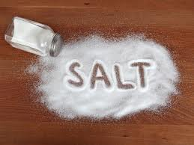
Implement Policies on Sodium Reduction
Notes:
Picture from: http://theshiksa.com/2012/06/04/salt-friend-or-foe/

Slide 2
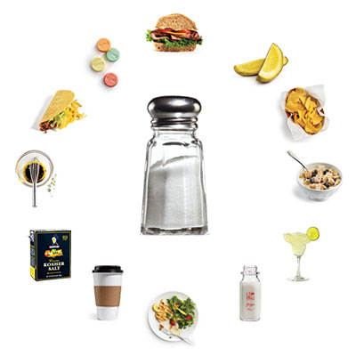
What is Sodium?
NaCl (table salt)
Maintain balance of fluids
Helps to transmit nerve impulses
Aids in contraction and relaxation of muscles
Notes:
A normal balance of electrolytes is essential to the normal function of cells and organs. Electrolytes help maintain voltages across cell membranes especially in heart, muscle, and nerve cells. They also carry electrical impulses to create nerve impulses and muscle contractions. Kidneys work to keep the electrolyte concentrations in blood constant. In simpler terms, sodium helps maintain balance of fluids, helps transmit nerve impulses, and influences contraction and relaxation of muscles.
Image courtesy:
http://thehealthyapron.com/wp-content/uploads/2012/02/hidden-sodium.jpg

Slide 3
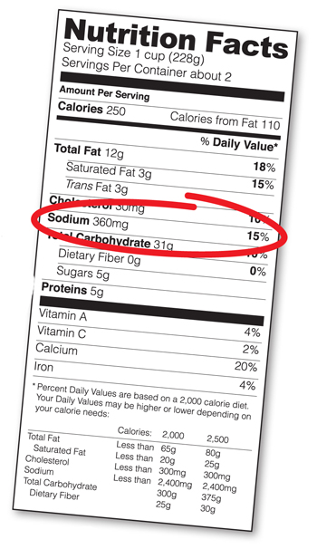
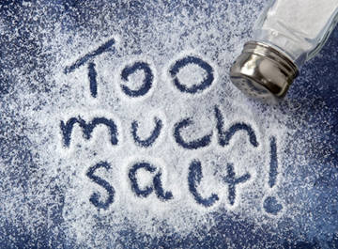
Dietary Recommendations
Recommended levels of sodium intake :
Less than 2,300 mg/day
Majority of adults’ actual sodium intake:
More than 3,400 mg/day
Notes:
The 2010 Dietary Guidelines recommended Americans 2 and up reduce sodium to < 2300 mg/day. Specific populations are recommended to further reduce intake to 1,500 mg/day. These populations include people ≥51 years old, African Americans, and those that have high blood pressure, diabetes, or chronic kidney disease.
These specific populations comprise about half the U.S. population and the majority of adults.
USDA and HHS. Dietary Guidelines for Americans, 2010. 7th edition. Washington, DC: Government Printing Office; 2010.
Vital Signs: MMWR 2012; 61(Early Release);1-7
http://www.fda.gov/forconsumers/consumerupdates/ucm327369.htm
Actual sodium intake greatly exceeds recommendations. Average daily sodium intake for U.S. adults is >3,300 mg/day.
Image courtesy:
http://www.msgfacts.com/news/~/media/images/too_much_salt_360.ashx

Slide 4
Where’s the salt?
77 percent of a person’s salt intake comes from restaurant or processed food.
Notes:
Source: Mattes RD & Donnelly D (1991). Relative contributions of dietary sodium sources. J Am Coll Nutr;10:383–93.
Image courtesy of: http://www.visit-micronesia.fm/report/inauguralflight/if_e.html

Slide 5
High Sodium Foods
Serving size | Sodium (milligrams)
1 teaspoon of salt | 2,400 mg
instant ramen noodles with flavoring | 500-1500 mg
2 oz Spam (1/6 can of Spam) | 790 mg
1 cup of corned beef hash | 1,230 mg
1 tablespoon of soy sauce | 1,000 mg
3 links of vienna sausage | 410 mg
½ cup of canned corn | 360 mg
¼ of a frozen pepperoni pizza | 480-860 mg
1 oz bag of regular potato chips (13-16 chips) | 120-215 mg
1 oz serving of dry roasted, salted peanuts (28-30 peanuts) | 230 mg
1 fast food restaurant cheeseburger | 710-1690 mg
¼ cup of tomato sauce | 340 mg

Slide 6
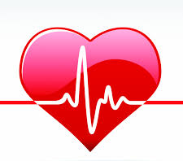
High Sodium Intake’s Effect on Health
Heart diseases
High blood pressure / hypertension
about 68 million U.S. adults (1 in 3) have hypertension
Heart Disease
Stroke
Only 46 of 100 of adults with hypertension had adequately controlled blood pressure
Notes:
The excess intake of sodium in one’s diet is linked to high blood pressure (hypertension) and cardiovascular disease which includes heart disease and stroke. A reduction in population-level sodium intake can improve public health. Understanding the sources of dietary sodium andcreating a systemic evaluation and assessment of sodium within food products can allow for informed decisions on state, community, and individual level.
Sodium affects blood pressure by changing blood volume.
Normal concentrations of sodium in extracellular compartments maintain blood pressure within normal range.
An increase in sodium intake leads to an increase in blood volume which translates to higher blood pressure.
When sodium intake is reduced, a subsequent reduction in blood volume occurs which lowers blood pressure.
Image courtesy:
http://www.blogs.va.gov/VAntage/wp-content/uploads/2013/10/Sept-blog-heart-picture-1.jpg

Slide 7
Did you know?
High blood pressure is known as the silent killer since usually it does not have warning signs or symptoms.
Notes:
Image courtesy of: http://www.askmen.com/sports/keywords/high-blood-pressure.html

Slide 8
Sodium Reduction Benefits on Health
Evidence supports a strong, direct relationship between blood pressure and vascular (blood vessels) mortality
Average blood pressure was in patients with resistant hypertension (high blood pressure) when switched from a high to low sodium diet
In most individuals blood pressure is reduced within days reducing sodium intake
Notes:
Sodium reduction benefits those with normortension, prehypertension, and hypertension. Vascular mortality increases throughout the range of blood pressures beginning at 115 mm Hg.
People with resistant hypertension may see even greater benefits when sodium intake is reduced. When switched from a high (5700 mg) to low (1150 mg) sodium diet an average blood pressure reduction of 22.7/9.1 mm Hg was seen.
In most individuals blood pressure is reduced within days to weeks of reducing sodium intake.
Institute of Medicine. Dietary reference intakes for water, potassium, sodium chloride, and sulfate. Washington, DC: National
Academies Press; 2004.
Pimenta E, Gaddam KK, Oparil S, Aban I, Husain S, Dell'Italia J, Calhoun DA. Effects of dietary sodium reduction on blood
pressure in subjects with resistant hypertension: results from a randomized trial. Hypertension. 2009; 54: 475 - 481

Slide 9
What should we do?
WHO states that population-wide reductions in dietary sodium consumption are highly cost effective. There is a need to give priority to implement national strategies and policies aiming at the reduction of dietary salt consumption.
Notes:
Source: World Health Organization (2006). Reducing salt intake in populations: Report of a WHO forum and technical meeting. Retrieved from http://www.who.int/dietphysicalactivity/reducingsaltintake_EN.pdf

Slide 10
What can schools do?
Educate your youth about the health risks of too much sodium in their diets and the problems it can have on their future
Educate students on understanding food labels, including information on salt content
Promote school activities or a week of health awareness to discuss the health risks of too much sodium
Ban high sodium foods from school events and other school activities
Initiate a policy to reduce sodium and provide healthier food options to be served at school

Slide 11
What can communities do?
Talk to restaurants in your community about reducing sodium in their food
Initiate a policy to reduce sodium and provide healthier food options to be served at community events and activities
Work together and contact local government to ask them to help enforce policies to that will reduce sodium in your jurisdiction

Slide 12
What can I do?
Talk to people that you know are interested in taking action in your community
Educate others on the health risks of high dietary salt and how to reduce salt intake
Educate others on understanding food labels, including information on salt content
Reach out to people in the public health sector or local government to address this concern
Put together a project with a team/working group who can help you speak at community meetings and local government to help reduce sodium in food at restaurants, schools, community events, etc.
Talk to restaurants and markets in your community about providing foods with low to no sodium food

Slide 13
What can churches do?
Encourage the congregation to eat healthier
Educate your community about the health risks of too much sodium in their diets and health benefits of lowering sodium
Initiate a policy for healthier foods at church events

Slide 14
Who can I contact for more information?
Adrian Bauman
Boden Institute of Obesity, Nutrition and Exercise and Prevention Research Collaboration
University of Sydney
Sydney, Australia
Email:  adrian.bauman@sydney.edu.au

