Slide 1
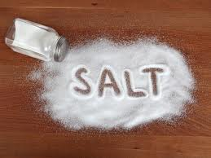
Implement Policies on Sodium Reduction
Notes:
Picture from: http://theshiksa.com/2012/06/04/salt-friend-or-foe/

Slide 2
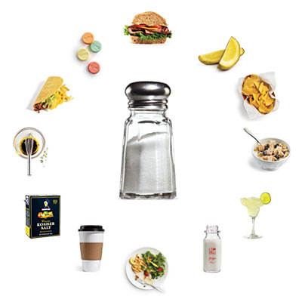
What is Sodium?
NaCl (table salt)
Maintain balance of fluids
Helps to transmit nerve impulses
Aids in contraction and relaxation of muscles
Notes:
A normal balance of electrolytes is essential to the normal function of cells and organs. Electrolytes help maintain voltages across cell membranes especially in heart, muscle, and nerve cells. They also carry electrical impulses to create nerve impulses and muscle contractions. Kidneys work to keep the electrolyte concentrations in blood constant. In simpler terms, sodium helps maintain balance of fluids, helps transmit nerve impulses, and influences contraction and relaxation of muscles.
Image courtesy:
http://thehealthyapron.com/wp-content/uploads/2012/02/hidden-sodium.jpg

Slide 3
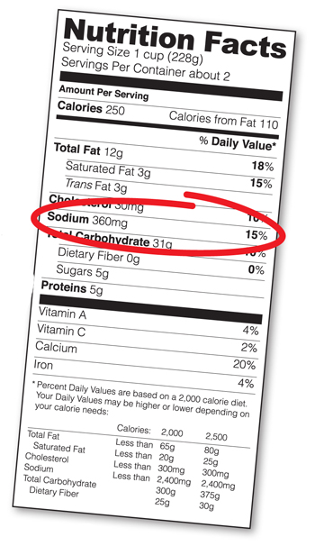
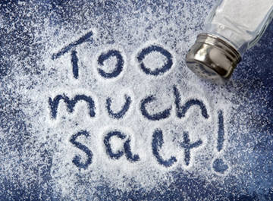
Dietary Recommendations
Recommended levels of sodium intake :
Less than 2,300 mg/day
Majority of adults’ actual sodium intake:
More than 3,400 mg/day
Notes:
The 2010 Dietary Guidelines recommended Americans 2 and up reduce sodium to < 2300 mg/day. Specific populations are recommended to further reduce intake to 1,500 mg/day. These populations include people ≥51 years old, African Americans, and those that have high blood pressure, diabetes, or chronic kidney disease.
These specific populations comprise about half the U.S. population and the majority of adults.
USDA and HHS. Dietary Guidelines for Americans, 2010. 7th edition. Washington, DC: Government Printing Office; 2010.
Vital Signs: MMWR 2012; 61(Early Release);1-7
Actual sodium intake greatly exceeds recommendations. Average daily sodium intake for U.S. adults is >3,300 mg/day.
Image courtesy:
http://www.msgfacts.com/news/~/media/images/too_much_salt_360.ashx

Slide 4
Where’s the salt?
77 percent of a person’s salt intake comes from restaurant or processed food.
Notes:
Source: Mattes RD & Donnelly D (1991). Relative contributions of dietary sodium sources. J Am Coll Nutr;10:383–93.
Image courtesy of: http://www.visit-micronesia.fm/report/inauguralflight/if_e.html

Slide 5
High Sodium Foods
Serving size | Sodium (milligrams)
1 teaspoon of salt | 2,400 mg
instant ramen noodles with flavoring | 500-1500 mg
2 oz Spam (1/6 can of Spam) | 790 mg
1 cup of corned beef hash | 1,230 mg
1 tablespoon of soy sauce | 1,000 mg
3 links of vienna sausage | 410 mg
½ cup of canned corn | 360 mg
¼ of a frozen pepperoni pizza | 480-860 mg
1 oz bag of regular potato chips (13-16 chips) | 120-215 mg
1 oz serving of dry roasted, salted peanuts (28-30 peanuts) | 230 mg
1 fast food restaurant cheeseburger | 710-1690 mg
¼ cup of tomato sauce | 340 mg

Slide 6
High Sodium Intake’s Effect on Health
Heart diseases
High blood pressure / hypertension
about 68 million U.S. adults (1 in 3) have hypertension
Heart Disease
Stroke
Only 46 of 100 adults with hypertension had adequately controlled blood pressure
Notes:
The excess intake of sodium in one’s diet is linked to high blood pressure (hypertension) and cardiovascular disease which includes heart disease and stroke. A reduction in population-level sodium intake can improve public health. Understanding the sources of dietary sodium andcreating a systemic evaluation and assessment of sodium within food products can allow for informed decisions on state, community, and individual level.
Sodium affects blood pressure by changing blood volume.
Normal concentrations of sodium in extracellular compartments maintain blood pressure within normal range.
An increase in sodium intake leads to an increase in blood volume which translates to higher blood pressure.
When sodium intake is reduced, a subsequent reduction in blood volume occurs which lowers blood pressure.
Image courtesy:
http://www.blogs.va.gov/VAntage/wp-content/uploads/2013/10/Sept-blog-heart-picture-1.jpg

Slide 7
Did you know?
High blood pressure is known as the silent killer since usually it does not have warning signs or symptoms.
Notes:
Image courtesy of: http://www.askmen.com/sports/keywords/high-blood-pressure.html

Slide 8
Sodium Reduction Benefits on Health
Evidence supports a strong, direct relationship between blood pressure and vascular (blood vessels) mortality
Average blood pressure was in patients with resistant hypertension (high blood pressure) when switched from a high to low sodium diet
In most individuals blood pressure is reduced within days reducing sodium intake
Notes:
Sodium reduction benefits those with normortension, prehypertension, and hypertension. Vascular mortality increases throughout the range of blood pressures beginning at 115 mm Hg.
People with resistant hypertension may see even greater benefits when sodium intake is reduced. When switched from a high (5700 mg) to low (1150 mg) sodium diet an average blood pressure reduction of 22.7/9.1 mm Hg was seen.
In most individuals blood pressure is reduced within days to weeks of reducing sodium intake.
Institute of Medicine. Dietary reference intakes for water, potassium, sodium chloride, and sulfate. Washington, DC: National
Academies Press; 2004.
Pimenta E, Gaddam KK, Oparil S, Aban I, Husain S, Dell'Italia J, Calhoun DA. Effects of dietary sodium reduction on blood
pressure in subjects with resistant hypertension: results from a randomized trial. Hypertension. 2009; 54: 475 - 481

Slide 9
What should we do?
WHO states that population-wide reductions in dietary sodium consumption are highly cost effective. There is a need to give priority to implement national strategies and policies aiming at the reduction of dietary salt consumption.
Notes:
Source: World Health Organization (2006). Reducing salt intake in populations: Report of a WHO forum and technical meeting. Retrieved from http://www.who.int/dietphysicalactivity/reducingsaltintake_EN.pdf

Slide 10
Law and Policy
Food and Drug Administration
Nutrition labeling
Improve effectiveness of the Nutrition Facts Panel through labeling
Menu labeling/Sodium Claims
Expand regulations under the Nutrition Labeling Education Act of 1990 (NLEA) to cover sodium content claims on menu items
Daily Value
Lower sodium intake to 2,300mg or less
Notes:
Image courtesy:
http://planning.maryland.gov/images/redistricting/icons/New_Law.jpg

Slide 11
Program Examples
USDA School Breakfast Program
National School Breakfast Program guidelines
3 step reduction plan
25%-27% reduction in breakfast meals (2004-2005)
430-500 mg of sodium per meal
Notes:
Image courtesy:
http://www.ers.usda.gov/media/1014696/findings_dh1_new.jpg

Slide 12
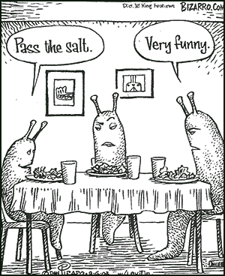
State and Local Level
Menu Labeling
Warning Labels
Procurement Policies
Licensing/Taxing
Notes:
Image courtesy:
http://heartcurrents.com/wp-content/uploads/2010/02/salt_cartoon_heartcurrents1.gif

Slide 13
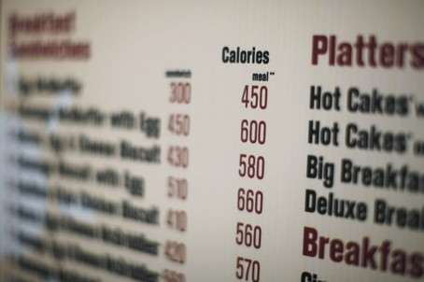
Labeling
Menu Labeling
Disclosure of sodium content on menus
FDA Waiver
Warning Labeling
Under NLEA, state and local authorities can mandate warnings related to safety of food
Notes:
Image courtesy:
http://www.washingtonpost.com/blogs/ezra-klein/files/2012/07/menulabeling-thumb-454x302.jpg

Slide 14
Procurement, Licensing, Taxing
Procurement
Government use of purchasing power to reduce sodium
MA Department of Public Health
Nutritional policies for purchased and prepared foods for all state agencies
NYC Nutritional Purchasing Criteria
Vending machines (2011)
Licensing/Taxing
Inclusion of a sodium reduction requirement as part of licensing standards
Higher sales tax on high sodium meals
Notes:
Required food purchased, provided or made available by a government or executive agency to meet nutritional standards established by public health authorities. For example,
packaged fruit should be in water or unsweetened juice
vegetables should contain less than 230mg of sodium per serving
whole grains should always be offered and contain less than 230mg of sodium per serving
Image courtesy:
http://www.britannica.com/blogs/wp-content/uploads/2009/10/dollar.jpg

Slide 15
Who can I contact for more information?
Adrian Bauman
Boden Institute of Obesity, Nutrition and Exercise and Prevention Research Collaboration
University of Sydney
Sydney, Australia
Email:  adrian.bauman@sydney.edu.au

