Slide 1
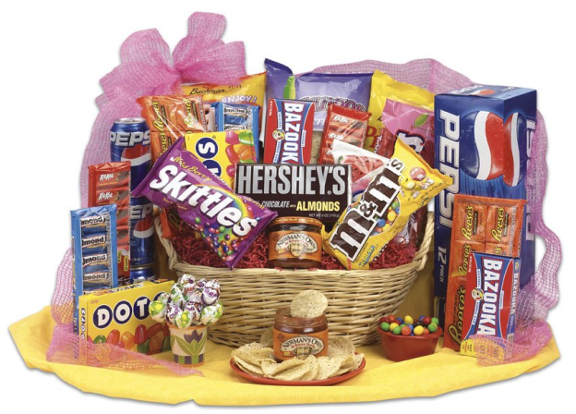
Policies that Promote Sugar Reduction

Slide 2
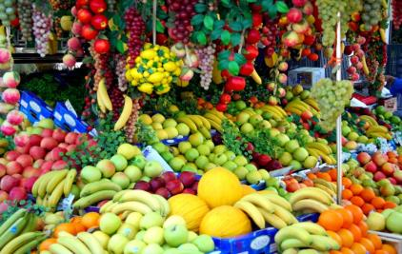
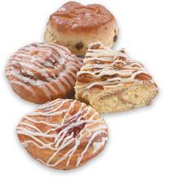
Natural Sugars VS Added Sugars
Natural sugars
Fruits
Apples
Bananas
Mango
Added sugars
soft drinks
candy
fruit drinks
pastries
Notes:
Image courtesy:
http://www.unfailingwaters.com/wp-content/uploads/2013/07/fruit_stand.jpg
http://www.justbizgh.com/wp-content/uploads/2013/11/12563732-soft-drinks.jpg
http://www.michelsbakery.com/images/pastries_photo.jpg

Slide 3
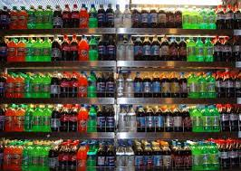
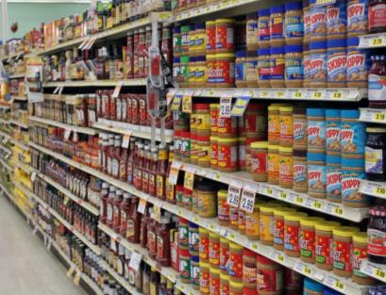
Added Sugars Links to Obesity & Diabetes
Grocery stores are filled with products containing added sugar
Consumption of added sugars is on the rise
→

Slide 4
How much sugar do you need?
Women: 6 teaspoons of sugar or 24 grams
Men: 9 teaspoons of sugar or 36 gram
Notes:
http://www.heart.org/HEARTORG/GettingHealthy/NutritionCenter/HealthyDietGoals/Sugars-and-Carbohydrates_UCM_303296_Article.jsp#
Image courtesy:
http://s.wsj.net/public/resources/images/PJ-AR200_HEARTB_F_20090824160810.jpg

Slide 5
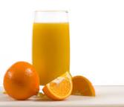
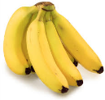
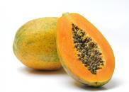
Examples of Sugar Content in Products
Serving size (Examples of common foods) | Estimated Sugar Content (grams)
1 teaspoon of sugar | 4g
1 can Coca Cola (12 oz) | 39g
1 can RedBull Energy Drink (8.3 oz) | 27g
8 oz orange juice | 24g
8 oz Nesquik chocolate milk | 29g
1 cup of coffee with sugar | 6-8g
½ cup fruit cocktail (in a can) | 23g
1 small papaya | 12g
1 medium sized banana | 14g
1 cup of breadfruit | 24g
1 Hershey’s milk chocolate bar | 24g
Notes:
Image courtesy of:
http://authenticselfwellness.files.wordpress.com/2012/01/orange-juice.jpg
http://www.triuk.com/media/product-images/red-bull/urb01.jpg
http://static.comicvine.com/uploads/original/11111/111114474/3293584-banana.jpg
http://www.bubblews.com/assets/images/news/898668677_1381754078.jpg
http://1.bp.blogspot.com/-i-xpy7bMEwc/UTn6tkk-LrI/AAAAAAAASdY/0KRBzev7IDE/s1600/hersheybar.jpg

Slide 6
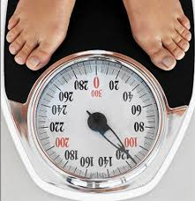
Added Sugars Links to Obesity & Diabetes
Studies have linked sugar intake to diabetes, cancer and heart disease
Reducing intake of sugar is recommended to weight management
Notes:
Image courtesy:
http://www.google.com/url?sa=i&rct=j&q=&esrc=s&source=images&cd=&cad=rja&docid=ku3i6yAz57K2hM&tbnid=6qPbWg7LOMgG-M:&ved=0CAUQjRw&url=http%3A%2F%2Fwww.johnstonefitness.com%2F2012%2F01%2F11%2Ffat-loss-101-the-scale-is-not-nearly-as-important-as-you-may-think%2F&ei=fhPCUvWKMNLxoASwnIDoCA&bvm=bv.58187178,d.cGU&psig=AFQjCNES8vBZNb_ldfEz0L_CYLpABBR8-Q&ust=1388537027356954

Slide 7
Health Impacts in the Pacific
Obesity rates in the Pacific are among the highest in the world:
Notes:
American Heart Association (2013). Reduce Blood Sugar. Retrieved from: http://mylifecheck.heart.org/Multitab.aspx?NavID=13&CultureCode=en-US
World Health Organization STEPS 2008

Slide 8
Added Sugars Links to Obesity & Diabetes
Dietary Guidelines for Americans 2005:
the healthiest way to reduce caloric intake is to decrease consumption of added sugars, fats, and alcohol
Reduction of high caloric diet few or no essential nutrients

Slide 9
Health Impacts in the Pacific
There are 25-47% of young children who are overweight or obese in American Samoa, CNMI, Guam and Hawaii
Diabetes prevalence among adults in the Pacific region is among the highest in the world:
47% in American Samoa compared with 13% in mainland USA
Women who are diagnosed with diabetes while pregnant have gestational diabetes
They have a 35% to 60% chance of developing diabetes in the next 10-20 years.
Notes:
Children’s Healthy Living Program for Remote Underserved Minority Populations in the Pacific Region
World Health Organization (2010). Pacific Islanders pay heavy price for abandoning traditional diet. Bulletin of the WHO, 88(7):481-560.
Mathers CD, Loncar D. Projections of global mortality and burden of disease from 2002 to 2030. PLoS Med, 2006, 3(11):e442

Slide 10
Why Policies in Reducing Sugar Intake?
Impact of obesity includes the value of income lost from decreased productivity and absenteeism.
The U.S. spends an estimated $190b on obesity-related conditions annually.
About 80% of heart diseases, stroke
and type-2 diabetes and 40% of cancer
can be prevented through inexpensive
and cost-effective interventions.
Notes:
Youfa Wang et al. (2008). Will All Americans Become Overweight or Obese? Estimating the Progression and Cost of the US Obesity Epidemic, 16 OBESITY 2324
Cawley, J and Meyerhoefer, C. The medical care costs of obesity: An instrumental variables approach. Journal of Health Economics, 2012; 31 (1): 219
World Health Organization (2002). Diet, nutrition, and the prevention of chronic diseases: WHO Technical Report Series 916. Geneva: World Health Organization..
Image courtesy of:
http://thumbs.dreamstime.com/z/gold-coins-dollar-sign-clipart-2638170.jpg
World Cancer Research Fund and American Institute for Cancer Research (1997). Food, nutrition and the prevention of cancer: a global perspective.
Washington, DC: American Institute for Cancer Research: 530–34.

Slide 11
Examples of policies
ChangeLab Solutions’ Model Sugar-Sweetened Beverages Tax Legislation
The USAPI jurisdictions can help reduce the amount of sugar-sweetened beverages consumed by imposing an excise tax on sugar-sweetened beverages. These funds can raise money that can be dedicated to non-communicable disease prevention and treatment programs. There are examples of policies (including tax per ounce of beverage and tax per teaspoon of added caloric sweetener) starting from page 9.

Slide 12
Examples of policies
School Policy Framework: Implementation of the WHO global strategy on diet, physical activity and health is to guide policymakers at the ministries of education and health in the development and implementation of policies that promote healthy eating in the schools. Policy options that can be considered are:
Nutritional standards for school food
School food programs
Vending machines and school snack bars
Food availability near schools

Slide 13
Examples of policies
Centers of Disease Control and Prevention recommends these strategies:
Ensure ready access to potable drinking water
Limit access to sugar-sweetened beverages (SSB)
Promote access to and consumption of more healthful alternatives to SSBs
Limit marketing of SSBs and minimize marketing’s impact on children
Decrease the relative cost of more healthful beverage alternatives through differential pricing of SSBs
Include screening and counseling about SSB consumption as part of routine medical care
Expand the knowledge and skills of medical care providers to conduct nutrition screening and counseling regarding SSB consumption

Slide 14
Examples of policies
All beverages served and sold in Burlingame facilities, including vending machines and city-sponsored meetings, much comply with this beverage standard.
Water with no added sweeteners
Unflavored non-fat or 1% cow’s milk with no added sweeteners
Unflavored non-dairy milk alternatives with no added sweeteners
No more than 2.5 grams of fat per 8 fluid ounces
Fruit or vegetable-based juice drinks that have a maximum of 160 calories and 230 mg of sodium per container and no added sweeteners
100% fruit or vegetable juices with a maximum of 160 calories, 230 mg of sodium per container and no added sweeteners
Coffee and tea with no added sweeteners
Diet beverages with non-caloric sweeteners

Slide 15
Example of policies
New York City created a comprehensive food procurement that outlines standards for any food purchased or served on government property, including schools and correctional facilities. For example:
Restriction on transfat foods
No food prepared by deep frying
Must have 480 mg or less of sodium
Require 100% fruit juice
Milk be 1% or non-fat and ≤ 100 calories per 8oz

Slide 16
Who Can You Contact?
Adrian Bauman
Boden Institute of Obesity, Nutrition and Exercise and Prevention Research Collaboration
University of Sydney
Sydney, Australia
Email:  adrian.bauman@sydney.edu.au

