Slide 1
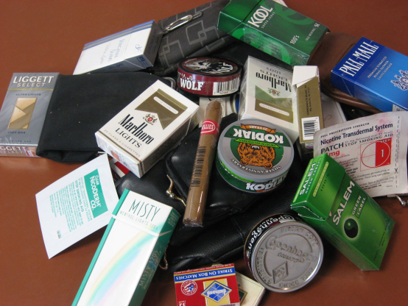
Continue Increasing Taxes on Tobacco Products

Slide 2
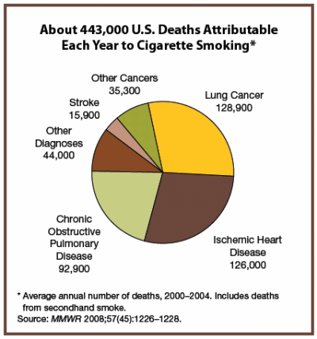
Background
Misuse and abuse of tobacco
Increase rates of cancer
Lung cancer
Heart disease
Poor circulation
Hypertension
Secondhand smoke cause premature birth and miscarriages

Slide 3
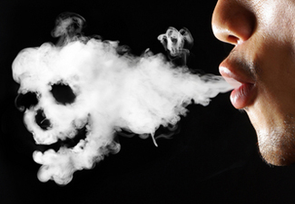
Key Facts on Tobacco Use
Tobacco use accounts for 6 million deaths per year
Tobacco kills up to HALF of its users
Predicted deaths to increase up to
8 million by 2030
over 7,000 known chemicals
found in secondhand smoke
Notes:
Source:
World Health Organization Tobacco Fact Sheet (July 2013). http://www.who.int/mediacentre/factsheets/fs339/en/
U.S. Department of Health and Human Services. The Health Consequences of Involuntary Exposure to Tobacco Smoke: A Report of the Surgeon General. Atlanta: U.S. Department of Health and Human Services, Centers for Disease Control and Prevention, Coordinating Center for Health Promotion, National Center for Chronic Disease Prevention and Health Promotion, Office on Smoking and Health, 2006.
World Health Organization Tobacco Fact Sheet (July 2013). http://www.who.int/mediacentre/factsheets/fs339/en/
Image:
http://thehearingprofessionals.files.wordpress.com/2011/09/second-hand-smoke-1.jpg

Slide 4
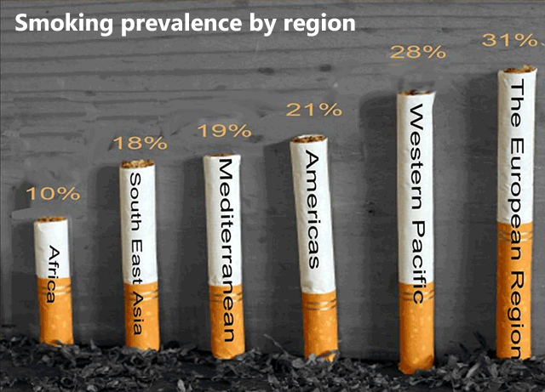
Notes:
It is estimated that two people die each minute from tobacco-related disease in the Western Pacific Region.
Source: www.euro.who.int

Slide 5
Community Preventative Services Task Force
Reviewed 116 studies on increasing tobacco products
Reduces the total amount of tobacco consumed
Reduces the prevalence of tobacco use
Increases the number of tobacco users who quit
Reduces initiation of tobacco use among young people
Reduces tobacco-related morbidity and mortality
Notes:
Source: Task Force on Community Preventive Services. (2001). Recommendations regarding interventions to reduce tobacco use and exposure to environmental tobacco smoke. Am J Prev Med; 20(2S):10-5.

Slide 6
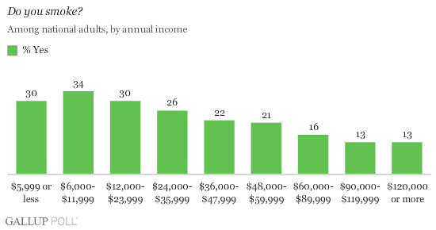
General Tobacco Effects
Increase tobacco prices will decrease smoking prevalence
Decrease in tobacco use, decreases the level of poverty

Slide 7
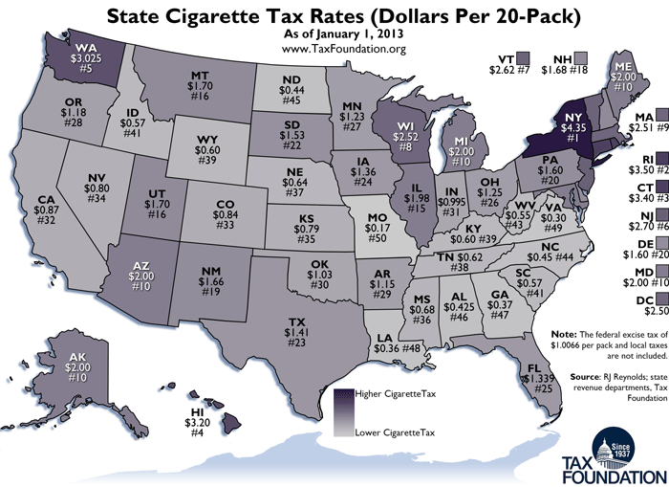
U.S. State Cigarette Tax Rates, 2013
Notes:
Source: http://taxfoundation.org/blog/monday-map-state-cigarette-tax-rates-2013

Slide 8
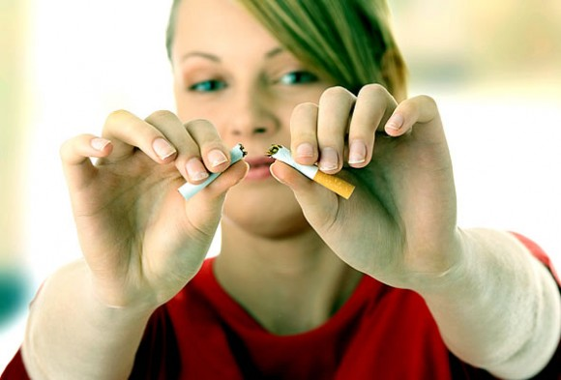
Important Considerations
Tobacco tax revenues can be used to support health promotion and disease prevention programs
If tobacco prices increase by 10%:
decreased smoking cigarettes in many countries
Youth and adult smokers decrease by 2.5% to 5%
Notes:
Gilbert, A. & Cornuz, J. (2003). Which are the most effective and cost-effective interventions for tobacco control?
Copenhagen, WHO Regional Office for Europe, (Health Evidence Network report; http://www.euro.who.int/document/e82993.pdf)
Image courtesy:
http://www.toonaripost.com/2012/08/us-news/clarkson-university-hosts-contest-for-free-tuition/

Slide 9
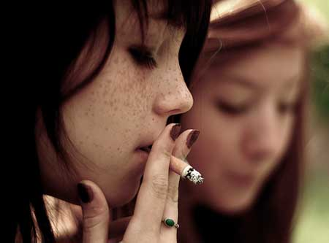
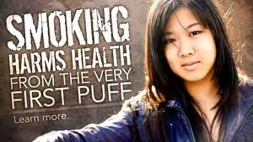
Youth and Tobacco
Decline in tobacco use among youths in Guam and the Mariana Islands due to increased tobacco taxation of about $1.36 per pack
Notes:
Image courtesy:
http://atlantablackstar.com/wp-content/uploads/2012/08/youth-smoking-f.jpg
http://tools.cdc.gov/ecards/message.aspx?cardid=635

Slide 10
Recommendations
Increasing taxation on tobacco products
Type of tax: Import duty, excise, and sales tax
Tax cigarettes
WHO tax stimulation model (TaXSim)
Very accessible simulator
Notes:
Link source: http://www.who.int/tobacco/economics/taxsim/en/index.html

Slide 11
Best Practices
Raise cigarette tax by at least 10% of a state’s average retail price per pack to achieve public health benefits. Anything less does not produce significant public health gains.
Include the definition of tobacco products, include little cigars, roll-your-own tobacco and other loose tobacco.
Notes:
Source: http://publichealthlawcenter.org/sites/default/files/resources/tclc-guide-state-taxation-cigs-2012.pdf

Slide 12
What can churches do?
Encourage youth to involve themselves in church activities
Educate your community about the harmful effects of tobacco and secondhand smoke
Support those who are struggling with tobacco use, including betel nut
Ban tobacco use at church related events

Slide 13
What can schools do?
Educate your youth about the harmful effects of tobacco and the problems it can have on
their health
Enforce rules about not smoking at school
Promote school activities or a week of awareness to discuss the problems associated
with tobacco use and their harmful effects
Ban smoking at school events and other school activities

Slide 14
What can communities do?
Strictly enforce smoke-free policies
Initiate smoke-free community events and ban tobacco ads at community gatherings and activities
Work together to help increase taxes on tobacco
Educate your community about the harmful effects of tobacco and secondhand smoke
Investigate local information on tobacco harms in your community and collect information

Slide 15
What can I do?
Form or join a coalition to strategize for a tobacco tax campaign
Talk to people that you know are interested in taking action in your community
Find out where your community stands about tobacco taxes
Reach out to people in the public health sector or local government to address this concern
Put together a project with a team/working group who can help you speak at community meetings to help educate others about the harms of tobacco and importance of increasing tobacco tax

Slide 16
Who to contact?
James Rarick
Technical Officer, Tobacco Free Initiative
WHO Western Pacific Regional Office
Manila, Philippines
E-mail:  rarickj@wpro.who.int

