Slide 1
Supplemental Slides for Alcohol Tax Increase
Notes:
These slides are additional slides that have useful information and can be included in your presentations.

Slide 2
What is alcohol?
An intoxicating ingredient found in beer, wine, toddy and other liquor.
Produced by the fermentation of yeast, sugars and starches.
A depressant

Slide 3
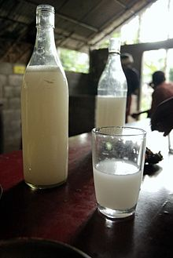
Toddy or Tuba or Palm Wine
Notes:
Picture from wikipedia
Alcoholic beverage created from the sap of the palm tree.

Slide 4
Alcohol Health Benefits
Moderate drinking
One drink a day for women
Two drinks for men
May have health benefits
Lowers risk of heart disease
Improve digestion
Gallstones and type 2 diabetes were less likely to occur than in non-drinkers
Notes:
One drink is usually considered to be 12 ounces of beer, 5 ounces of wine, or 1½ ounces of spirits (hard liquor such as gin or whiskey).
The Nurses’ Health Study, the Health Professionals Follow-up Study (gallstones and diabetes)

Slide 5
Dark Side of Alcohol
Risks:
Disrupts sleep
Cloudy judgment
Interacts with medications
Addictive
Affects every organ in the body

Slide 6
Stages of Blood Alcohol Concentration
Notes:
Graphic from The Online Traffic School, Inc.: http://www.onlinetraffic.com/topics/index2.php?ch=3

Slide 7
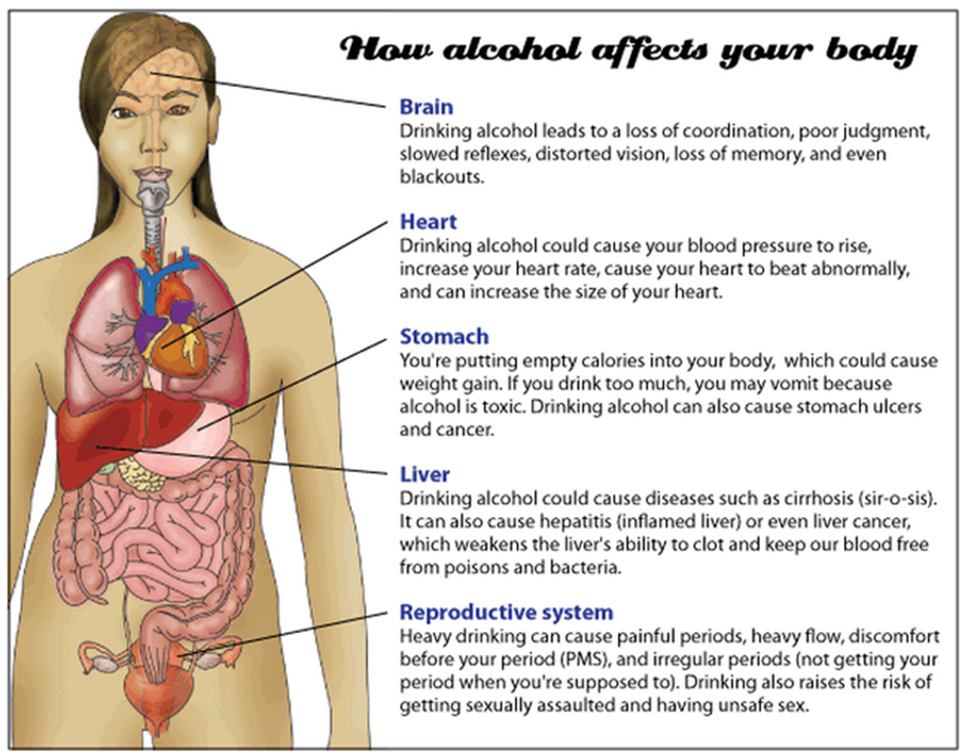
Notes:
From the www.girlshealth.gov website. Site is owned and maintained by the Office of Women’s Health.

Slide 8
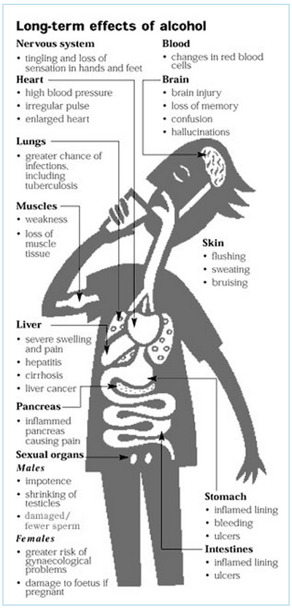
Notes:
Graphic from The Online Traffic School, Inc.: http://www.onlinetraffic.com/topics/index2.php?ch=3

Slide 9
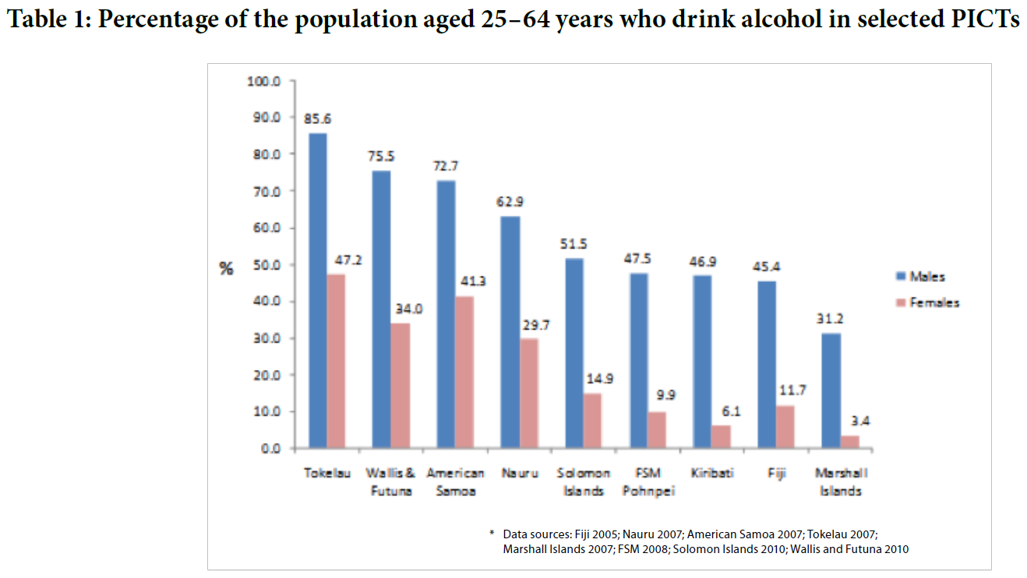
Notes:
From an Alcohol publication of the Healthy Pacific Lifestyle Section of the Secretariat of the Pacific Community (2011)

Slide 10
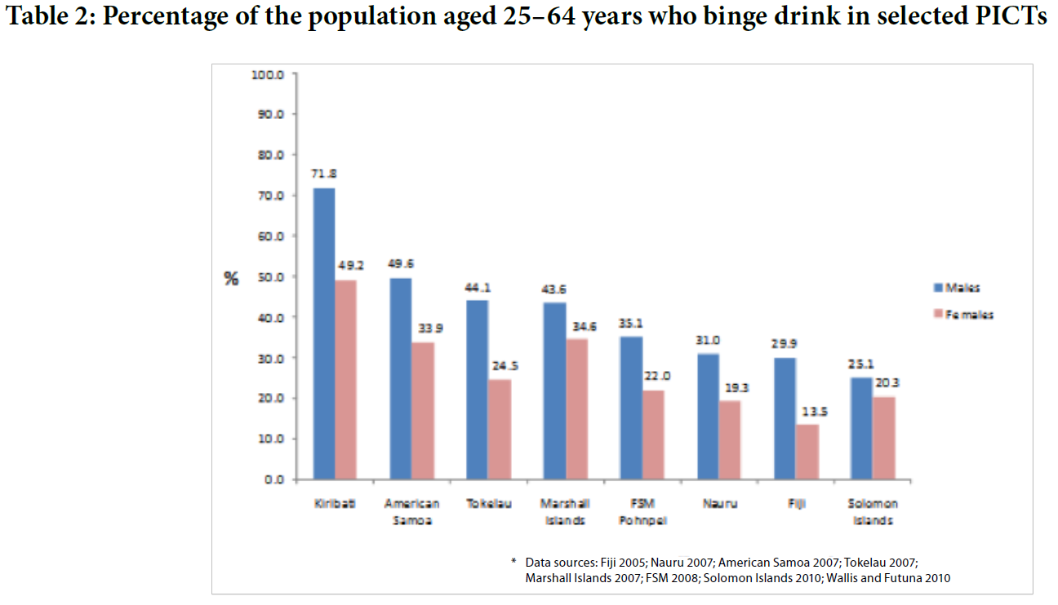
Notes:
From an Alcohol publication of the Healthy Pacific Lifestyle Section of the Secretariat of the Pacific Community (2011)

Slide 11
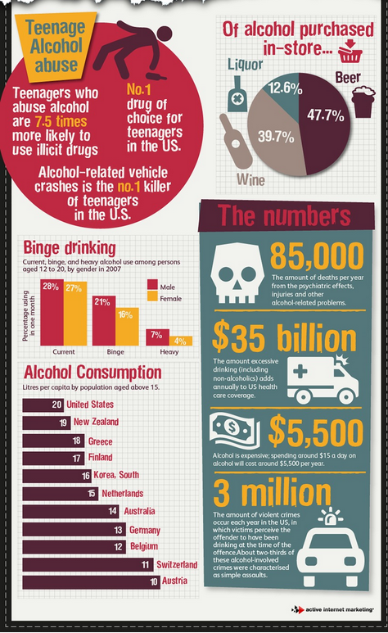
Notes:
Infographic from Active Internet Marketing

Slide 12
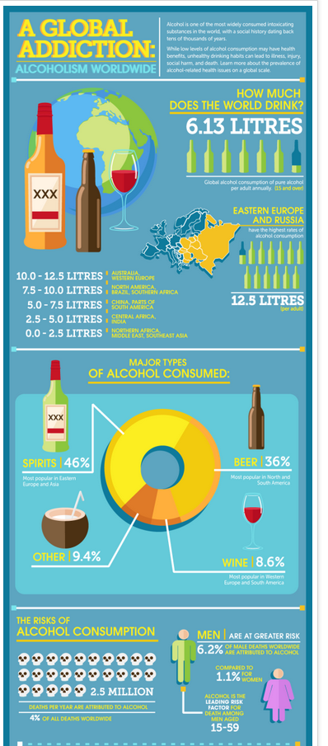
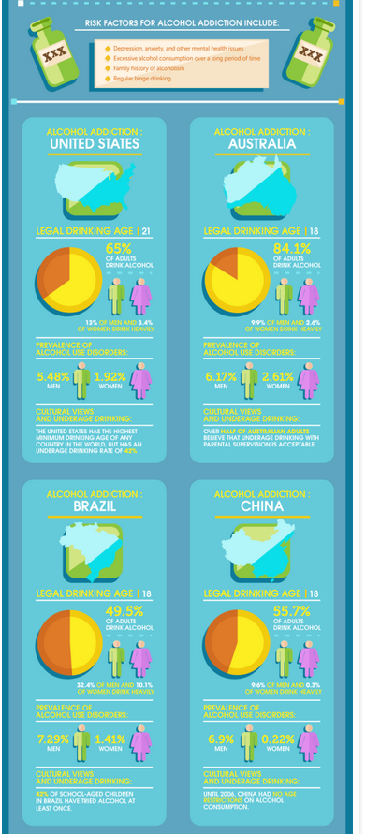
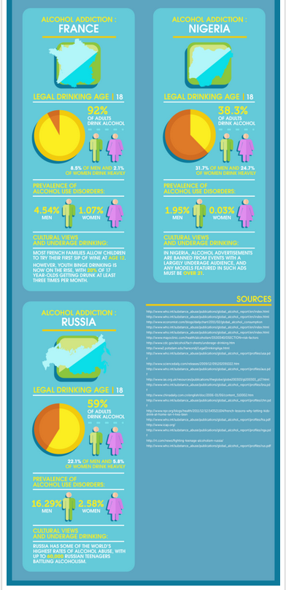
Notes:
Infographic from Rehab International

Slide 13
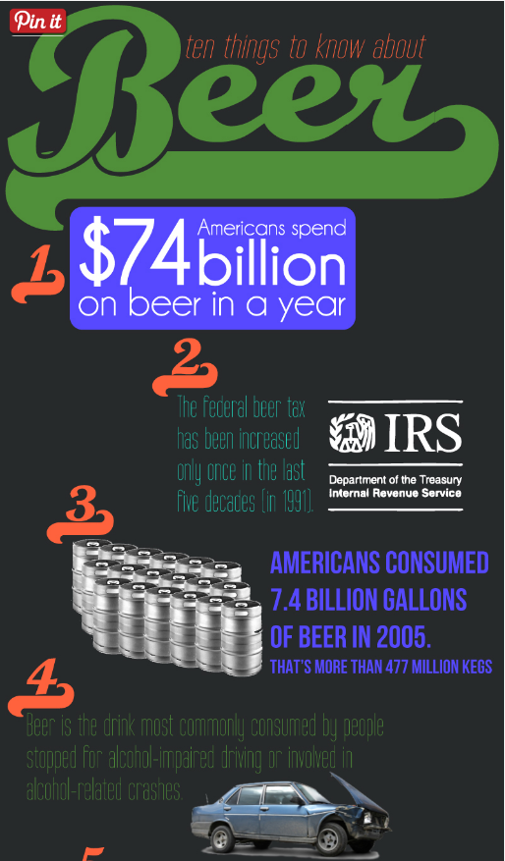
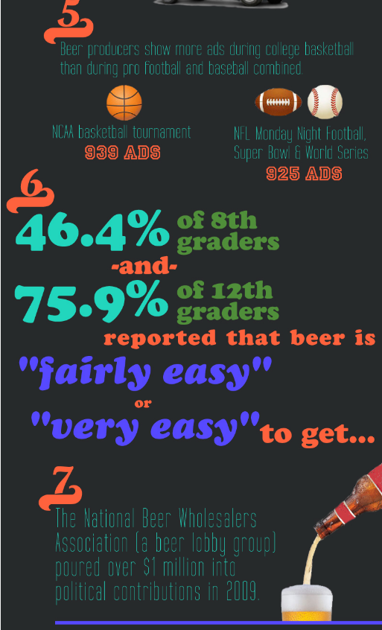
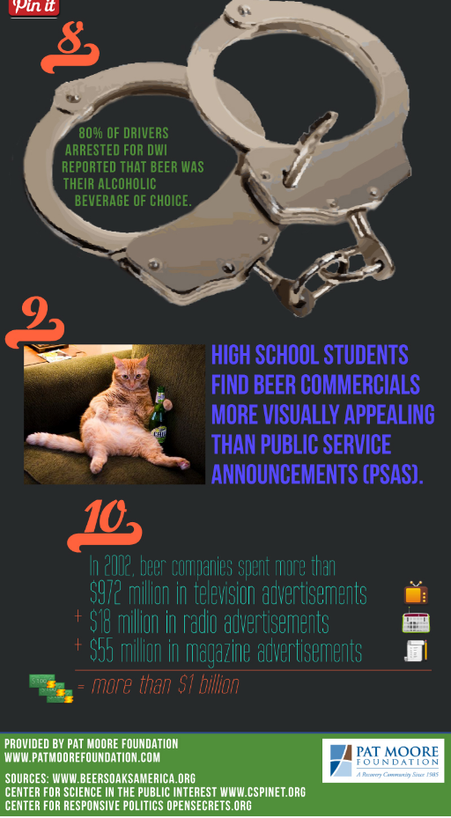
Notes:
Infographic provided by Pat Moore Foundation

Slide 14
Notes:
Infographic provided by YeastInfection.org

Slide 15
Notes:
Infographic created by oBizMedia for H&R Block

Slide 16
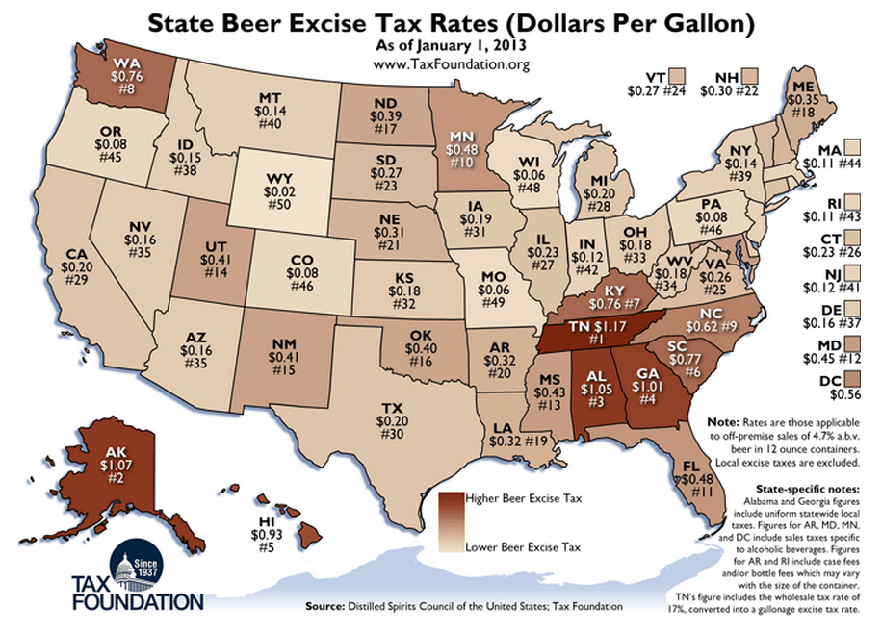
Notes:
Infographic from Tax Foundation

Slide 17
Notes:
Infographic provided by Economic Freedom

Slide 18
Notes:
Infographic provided by Avalara

Slide 19
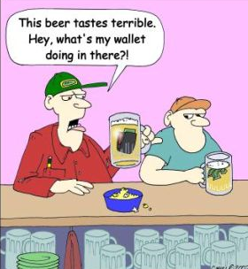
Notes:
From www.brewpublic.com

