Slide 1
Supplemental Slides for Ban Alcohol Advertising
Notes:
These slides are additional slides that have useful information and can be included in your presentations.

Slide 2
What is alcohol?
An intoxicating ingredient found in beer, wine, toddy and other liquor.
Produced by the fermentation of yeast, sugars and starches.
A depressant

Slide 3
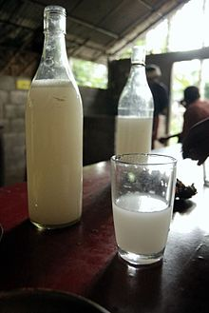
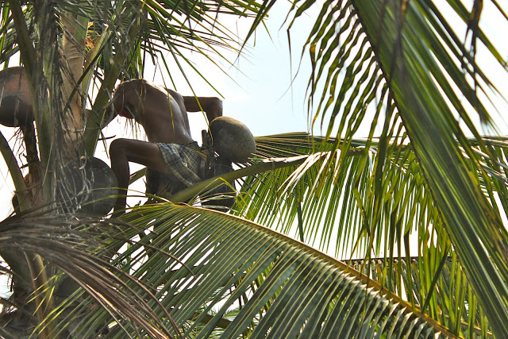
Toddy or Tuba or Palm Wine
Notes:
Picture from wikipedia
Alcoholic beverage created from the sap of the palm tree.

Slide 4
Alcohol Health Benefits
Moderate drinking
One drink a day for women
Two drinks for men
May have health benefits
Lowers risk of heart disease
Improve digestion
Gallstones and type 2 diabetes were less likely to occur than in non-drinkers
Notes:
One drink is usually considered to be 12 ounces of beer, 5 ounces of wine, or 1½ ounces of spirits (hard liquor such as gin or whiskey).
The Nurses’ Health Study, the Health Professionals Follow-up Study (gallstones and diabetes)

Slide 5
Dark Side of Alcohol
Risks:
Disrupts sleep
Cloudy judgment
Interacts with medications
Addictive
Affects every organ in the body

Slide 6
Stages of Blood Alcohol Concentration
Notes:
Graphic from The Online Traffic School, Inc.: http://www.onlinetraffic.com/topics/index2.php?ch=3

Slide 7
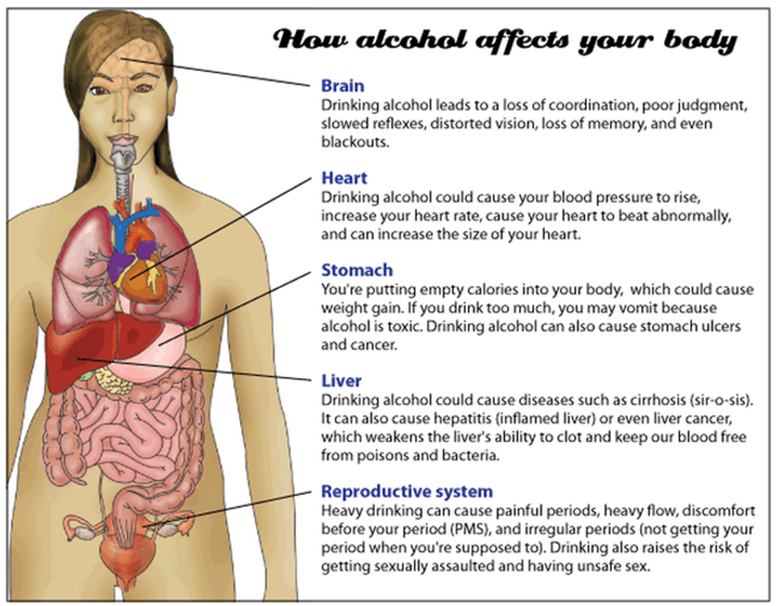
Notes:
From the www.girlshealth.gov website. Site is owned and maintained by the Office of Women’s Health.

Slide 8
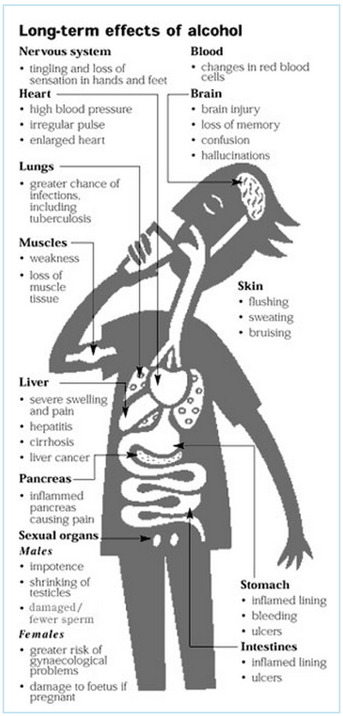
Notes:
Graphic from The Online Traffic School, Inc.: http://www.onlinetraffic.com/topics/index2.php?ch=3

Slide 9
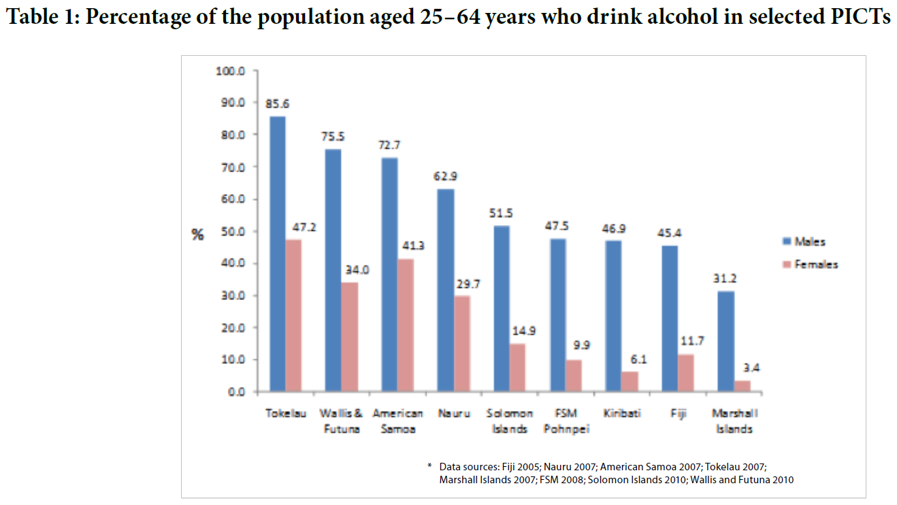
Notes:
From an Alcohol publication of the Healthy Pacific Lifestyle Section of the Secretariat of the Pacific Community (2011)

Slide 10
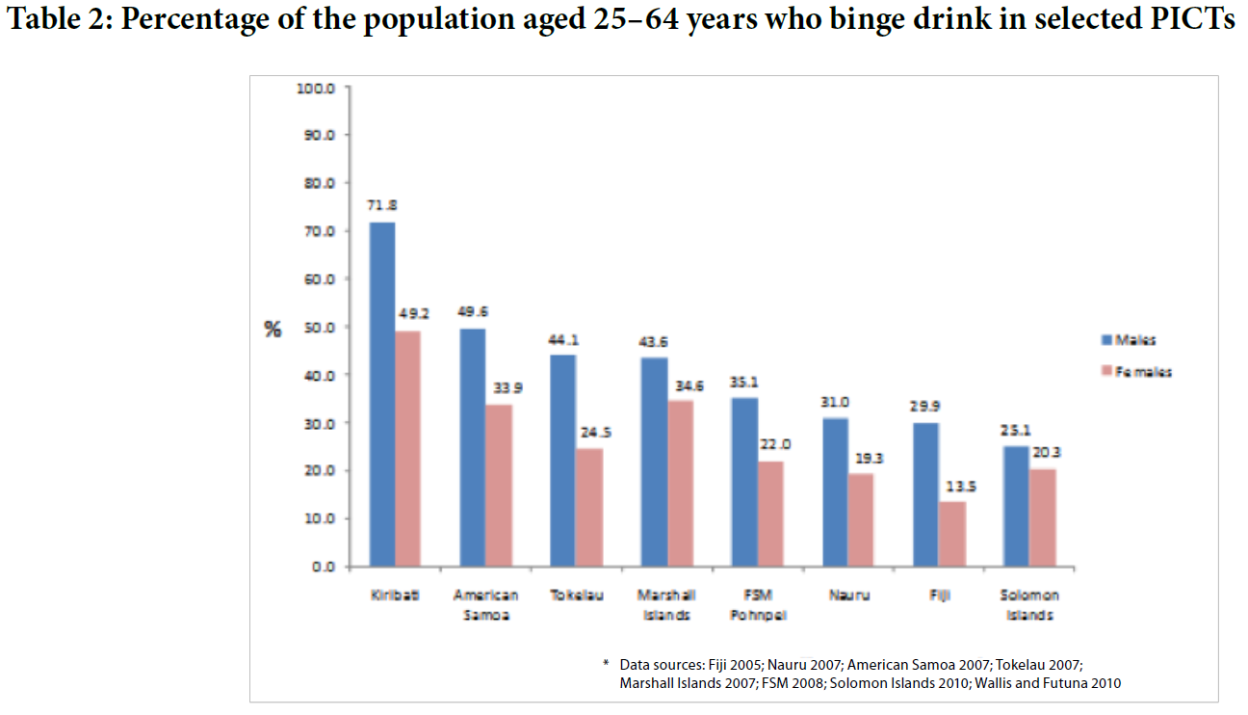
Notes:
From an Alcohol publication of the Healthy Pacific Lifestyle Section of the Secretariat of the Pacific Community (2011)

Slide 11
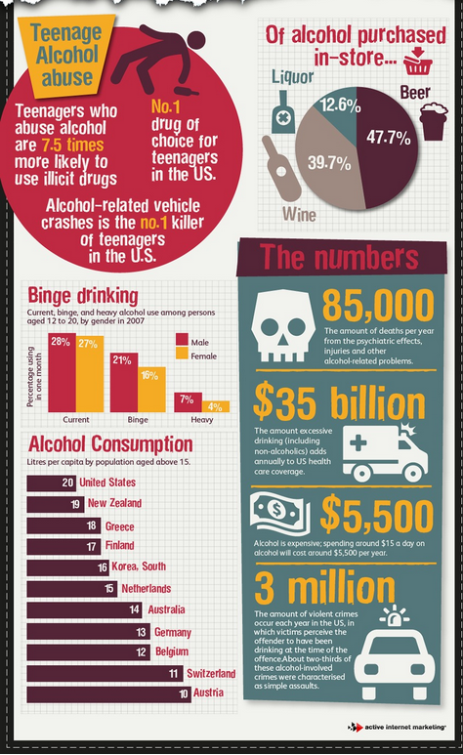
Notes:
Infographic from Active Internet Marketing

Slide 12
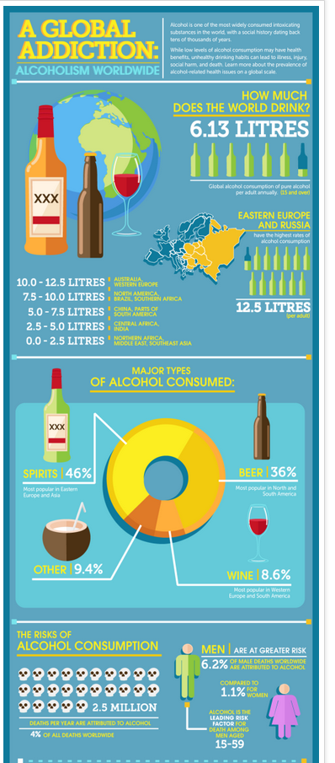
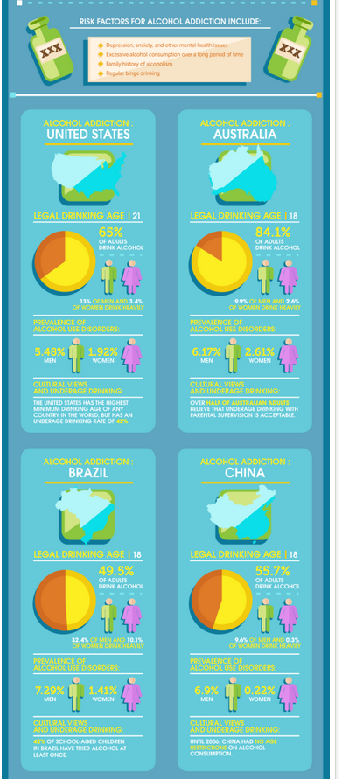
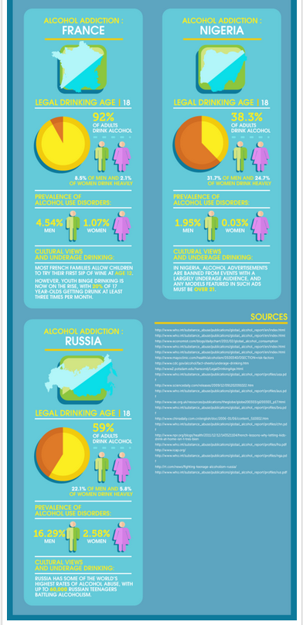
Notes:
Infographic from Rehab International

Slide 13
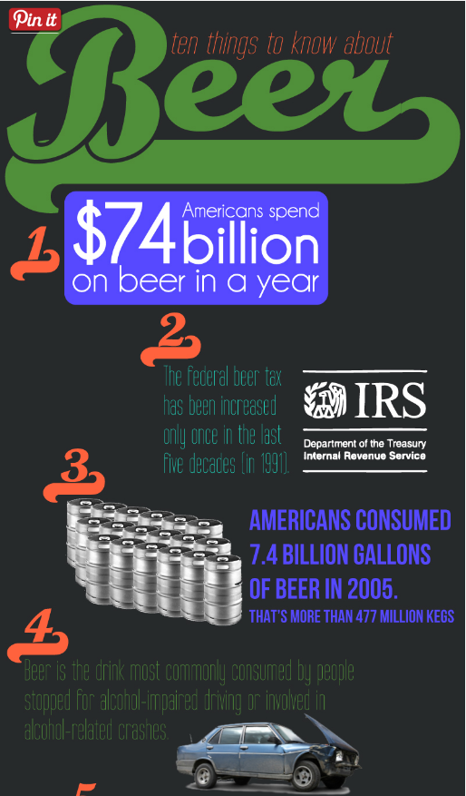
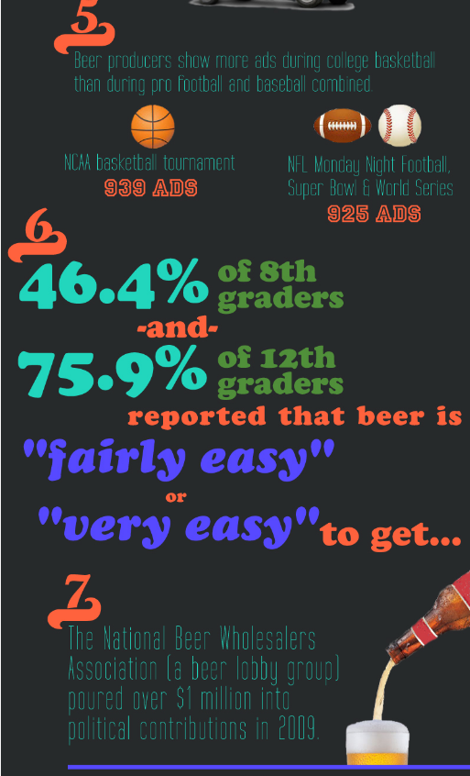
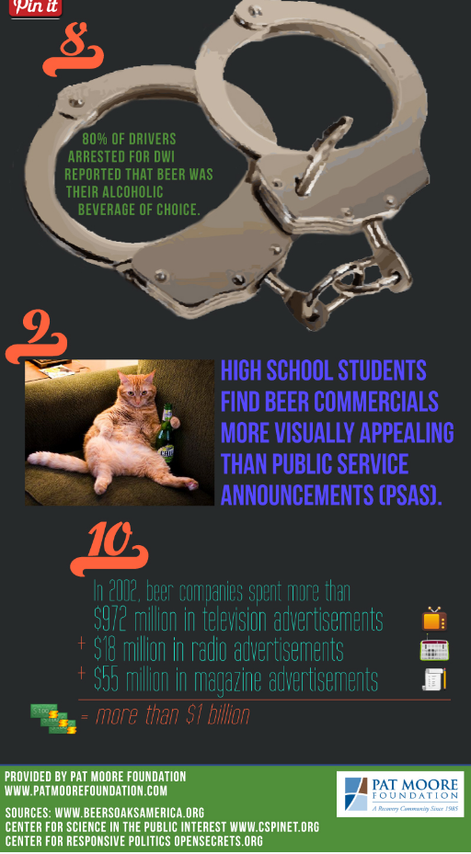
Notes:
Infographic provided by Pat Moore Foundation

Slide 14
Notes:
Infographic provided by YeastInfection.org

Slide 15
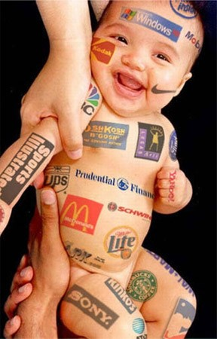
Notes:
From: http://www.generationnext.com.au/2013/07/seminar-turns-spotlight-on-to-selling-to-our-kids/
Marketing to children

Slide 16
Alcohol Advertised in Cartoons

Slide 17
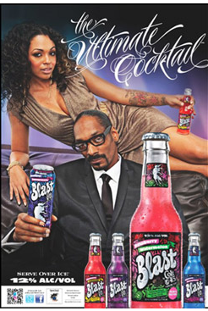

Slide 18
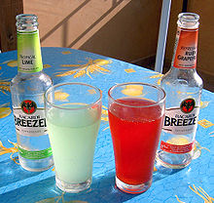
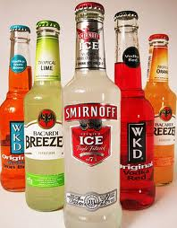
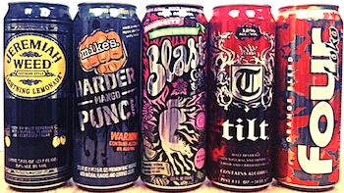
Alcopop
Flavored alcohol beverages (fruit flavored and/or carbonated)
Smirnoff Ice
Mike’s Hard Lemonade
Bacardi Breezers
Four Loko
Appeal to youth and young women
Closely resemble soda or energy drinks
Sweetness and flavoring hide the taste of alcohol
5-12% alcohol, more than most beers
Notes:
From Alcohol Justice: The Industry Watchdog (www.alcoholjustice.org)

Slide 19
Notes:
Sweetdeceitcampaign.com

Slide 20
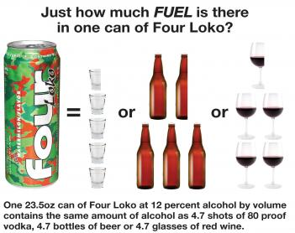
Notes:
From European Centre for Monitoring Alcohol Marketing: http://www.eucam.info/eucam/home/news.html/1881/2247/us-super-sized-alcopop-four-loko-to-become-resealable-and-informative

Slide 21
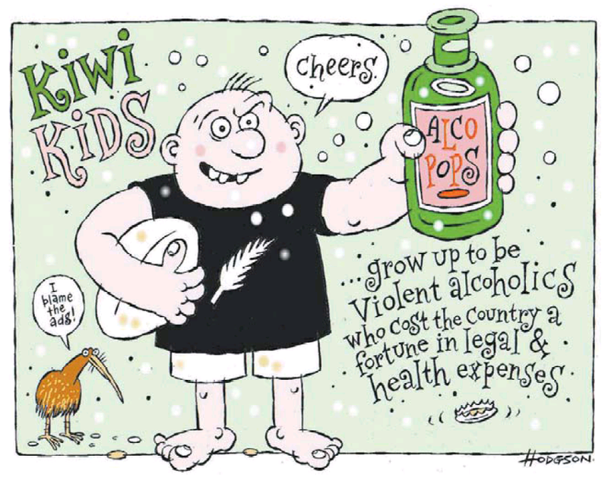
Notes:
From Australia: http://liberation.typepad.com/liberation/2012/08/nz-politics-daily-28-august-2012.html

Slide 22
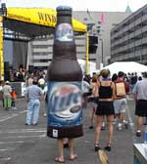
Alcohol Advertising at Local Event
Notes:
From University of Minnesota Alcohol Epidemiology Program webpage: http://www.epi.umn.edu/alcohol/policy/adrstrct.shtm

Slide 23
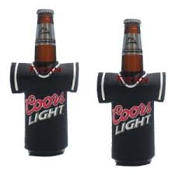
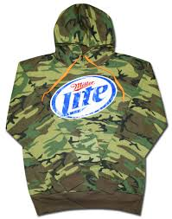
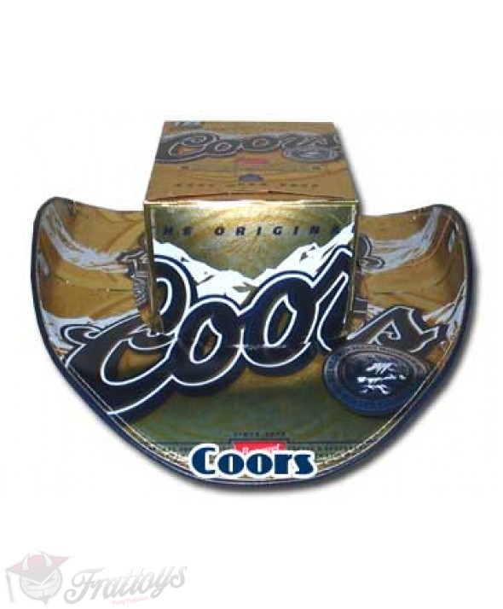
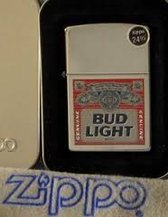
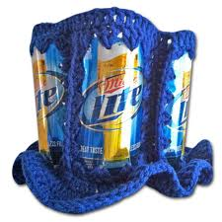
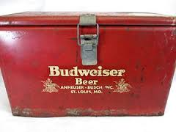
Beer Apparel and Accessories
Notes:
Picture of hats are from http://www.frattoys.com

Slide 24
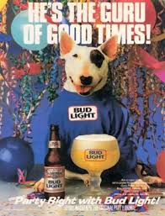
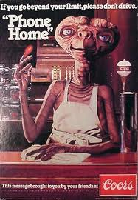
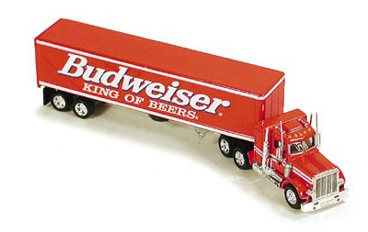
Advertising

Slide 25
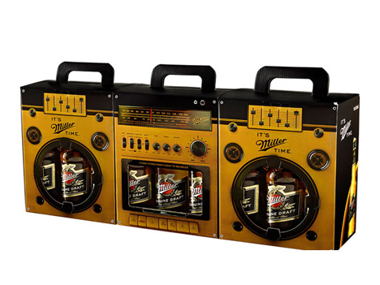
Advertising through Beer Box
A very creative packaging of Miller beer. They have created two sided boxes, one side looks like a speaker and the other is the cassette player. This way when three boxes are carried together side by side, they make a boom box.
Notes:
http://amazingcentral.com/innovative-packaging-of-miller-beer/
This packaging is to attract attention and to make Miller the favorite brand among other six packs in the summer when beer consumption spikes. In Turkey, the Miller is closely linked with music. The design was created by advertising agency Manajans/JWT, Istanbul, Turkey. It has been established Miller Music Factory, a competition to determine fresh talents for six years and Miller Freshtival, a music festival, for 2 years now. This is why they have chosen music as a theme for their six pack.

