Slide 1
Tobacco Advertising: Supplemental Slides

Slide 2
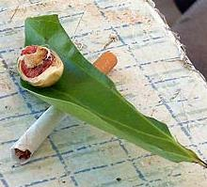
Betel Nut Use
Betel nut mixed with tobacco is used by more than 2/3 of all males and females in some Pacific Island jurisdictions
Notes:
Image courtesy:
http://media.tumblr.com/tumblr_m1ezesaGhw1qfqxsf.jpg
Source:
http://www.wakehealth.edu/uploadedFiles/User_Content/Research/Institutes_and_Centers/Maya_Angelou_Center_for_Health_Equity/Heritage_ToolKit/May/Orig_APPEALTobaccoUsein...anNativeHawaiian%5B1%5D.pdf

Slide 3
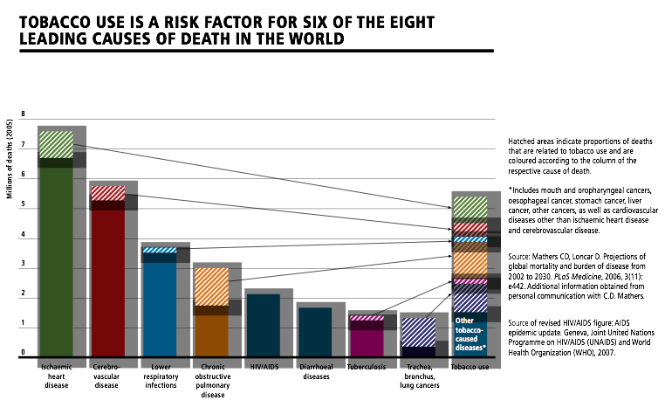
Notes:
World Health Organization. WHO report on the global tobacco epidemic, 2008---the MPOWER package. Geneva, Switzerland: World Health Organization; 2008. Available at http://www.who.int/tobacco/mpower/mpower_report_full_2008.pdf . Accessed January 24, 2014.

Slide 4
Notes:
World Health Organization. WHO report on the global tobacco epidemic, 2008---the MPOWER package. Geneva, Switzerland: World Health Organization; 2008. Available at http://www.who.int/tobacco/mpower/mpower_report_full_2008.pdf . Accessed January 24, 2014.

Slide 5
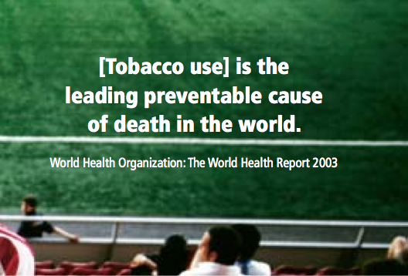
Notes:
World Health Organization. WHO report on the global tobacco epidemic, 2008---the MPOWER package. Geneva, Switzerland: World Health Organization; 2008. Available at http://www.who.int/tobacco/mpower/mpower_report_full_2008.pdf . Accessed January 24, 2014.

Slide 6
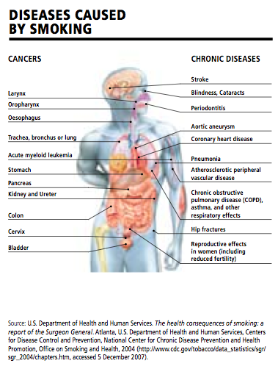
Notes:
World Health Organization. WHO report on the global tobacco epidemic, 2008---the MPOWER package. Geneva, Switzerland: World Health Organization; 2008. Available at http://www.who.int/tobacco/mpower/mpower_report_full_2008.pdf . Accessed January 24, 2014.

Slide 7
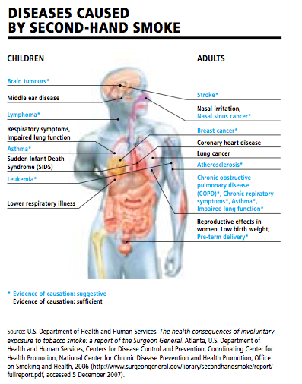
Notes:
World Health Organization. WHO report on the global tobacco epidemic, 2008---the MPOWER package. Geneva, Switzerland: World Health Organization; 2008. Available at http://www.who.int/tobacco/mpower/mpower_report_full_2008.pdf . Accessed January 24, 2014.

Slide 8
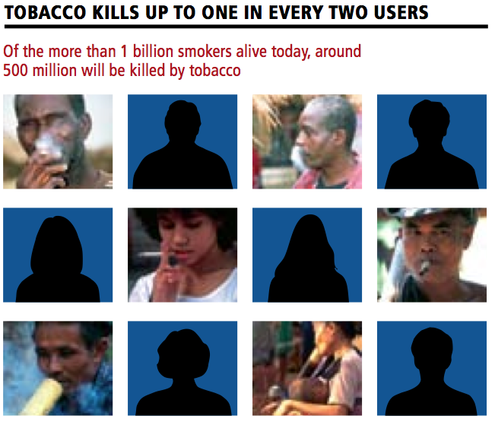
Notes:
World Health Organization. WHO report on the global tobacco epidemic, 2008---the MPOWER package. Geneva, Switzerland: World Health Organization; 2008. Available at http://www.who.int/tobacco/mpower/mpower_report_full_2008.pdf . Accessed January 24, 2014.

Slide 9
Notes:
Tobacco use is growing fastest in low-income countries, due to steady population growth coupled with tobacco industry targeting, ensuring that millions of people become fatally addicted each year. More than 80% of the world’s tobacco-related deaths will be in low- and middle-income countries by 2030
World Health Organization. WHO report on the global tobacco epidemic, 2008---the MPOWER package. Geneva, Switzerland: World Health Organization; 2008. Available at http://www.who.int/tobacco/mpower/mpower_report_full_2008.pdf . Accessed January 24, 2014.

Slide 10
Cigarette Consumption Western Pacific
Notes:
http://blogs.wsj.com/chinarealtime/2013/12/11/china-eyes-smoking-ban/

Slide 11
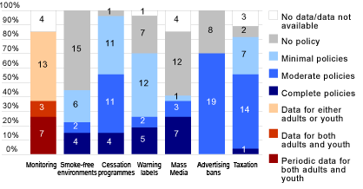
Western Pacific Region Tobacco Control Policies
Notes:
http://www.who.int/gho/tobacco/policies/region_western_pacific/en/

Slide 12
Lifetime Daily Cigarette Use (2007)
Notes:
Lifetime Daily Cigarette Use: Across surveys, the overall percentage of students who had ever smoked at least one cigarette every day for 30 days (i.e., lifetime daily cigarette use) ranged from 13.6% to 17.6% (median: 16.6%). Prevalence among female students ranged from 12.6% to 16.2% (median: 13.1%), and prevalence among male students ranged from 14.2% to 22.3% (median: 17.8%)
http://www.cdc.gov/mmwr/preview/mmwrhtml/ss5712a2.htm

Slide 13
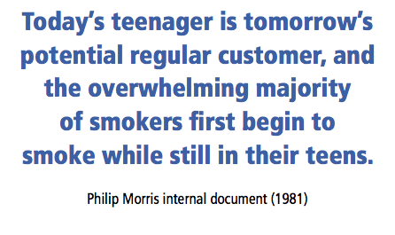
Notes:
World Health Organization. WHO report on the global tobacco epidemic, 2008---the MPOWER package. Geneva, Switzerland: World Health Organization; 2008. Available at http://www.who.int/tobacco/mpower/mpower_report_full_2008.pdf . Accessed January 24, 2014.

Slide 14
Current Cigarette Use (2007)
Notes:
Across surveys, the overall percentage of students who had smoked cigarettes on at least 1 day during the 30 days before the survey (i.e., current cigarette use) ranged from 23.1% to 37.6% (median: 31.1%). Prevalence among female students ranged from 20.4% to 31.1% (median: 25.4%), and prevalence among male students ranged from 22.9% to 44.4% (median: 31.2%)
http://www.cdc.gov/mmwr/preview/mmwrhtml/ss5712a2.htm

Slide 15
Bought cigarettes in a store or gas station (2007)
Notes:
Across surveys, among students who currently smoked cigarettes and were aged <18 years, the overall percentage of students who usually got their own cigarettes by buying them in a store (i.e., convenience store, supermarket, or discount store) or gas station during the 30 days before the survey ranged from 14.9% to 30.8% (median: 17.3%). Prevalence among female students ranged from 12.1% to 21.6% (median: 17.3%), and prevalence among male students ranged from 12.8% to 40.6% (median: 21.3%)
http://www.cdc.gov/mmwr/preview/mmwrhtml/ss5712a2.htm

Slide 16
Current cigar use (2007)
Notes:
Across surveys, the overall percentage of students who had smoked cigars, cigarillos, or little cigars on at least 1 day during the 30 days before the survey (i.e., current cigar use) ranged from 6.5% to 27.1% (median: 9.5%). Prevalence among female students ranged from 3.1% to 22.5% (median: 6.6%), and prevalence among male students ranged from 9.0% to 31.8% (median: 12.2%)
http://www.cdc.gov/mmwr/preview/mmwrhtml/ss5712a2.htm

Slide 17
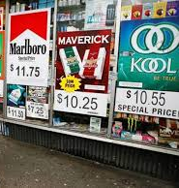
Advertising at Stores
Notes:
Picture source: http://countertobacco.org/counter-tobacco-highlights-5-pos-trends-watch-2013

Slide 18
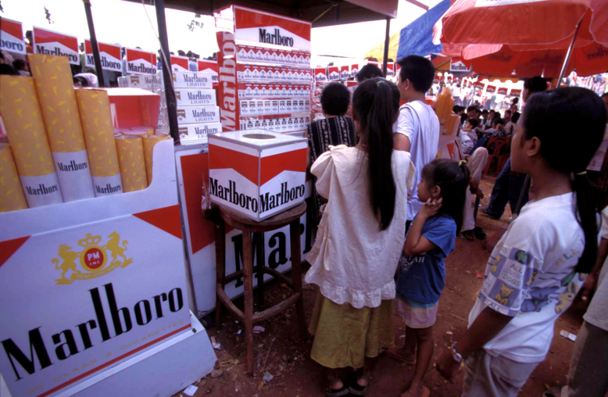
Cigarette Advertising
Notes:
Source: http://www.healthinternetwork.com/tobacco/wntd/2008/photos/en/index.html

Slide 19
Marlboro Men

Slide 20
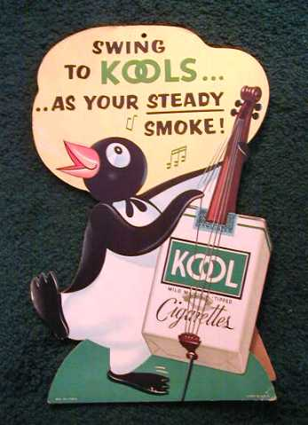
Advertising to Children
Notes:
From 1930s to 1960s, Kool cigarettes had a penguin as their mascot.
Source: http://childrenofthenineties.blogspot.com/2009/07/joe-camel.html

Slide 21
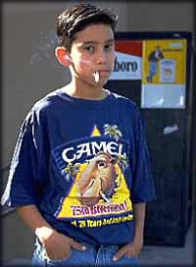
Advertising to Children
Notes:
Joe Camel was the advertising mascot for Camel Cigarettes from 1987 to 1997 appearing in magazines, billboards and other print materials.
Source: http://www.vintageadbrowser.com/joe-camel-ads-1990s
Source: http://www.grudge-match.com/History/joe-spuds.shtml

Slide 22
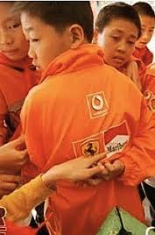
Targeting Children - School Uniform
Notes:
Tobacco industry is blatantly targeting children. For example: Marlboro sponsorship of school uniforms in China.
Source: http://www.medscape.com/viewarticle/791087#4

Slide 23
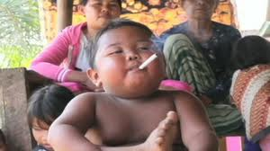
Two year old Indonesian boy
Notes:
Up to 4 pack of cigarettes a day
Smoking is part of culture for so long in Indonesia. They don’t understand the health risks from smoking.
Cold turkey stopped smoking.

Slide 24
Advertising Now
Notes:
Source: http://tobaccopreventionk12.wordpress.com/

Slide 25
Notes:
Source: http://www.tobaccofreekids.org/content/infographic/tobaccovillains/TobaccoVillains_11x17.pdf

Slide 26
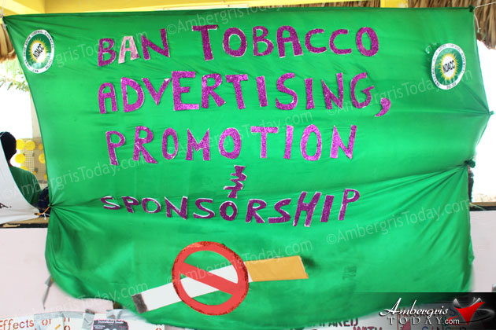
Notes:
The National Drug Abuse Control Council (NDACC) and the Ministry of Health in conjunction with supporting national and international health partners celebrated World No Tobacco Day on Friday, May 31, 2013. This year it was celebrated under the theme, “Ban Tobacco Advertising, Promotion and Sponsorship.” This picture was taking in Ambergris Caye in Belize.
Source: http://www.ambergristoday.com/content/stories/2013/june/04/world-no-tobacco-day-2013-commemorated

Slide 27
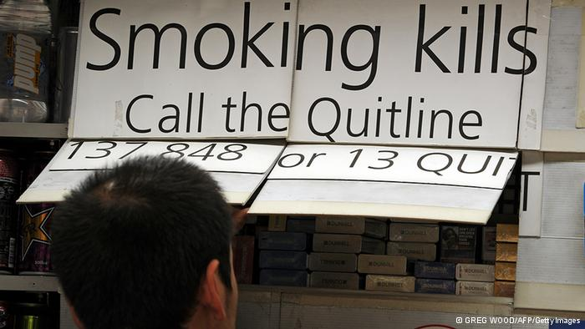
Advertise this…

