Slide 1
Tobacco and Taxation: Supplemental Slides

Slide 2
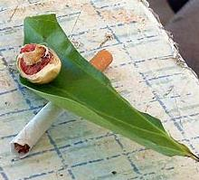
Betel Nut Use
Betel nut mixed with tobacco is used by more than 2/3 of all males and females in some Pacific Island jurisdictions
Notes:
Image courtesy:
http://media.tumblr.com/tumblr_m1ezesaGhw1qfqxsf.jpg
Source:
http://www.wakehealth.edu/uploadedFiles/User_Content/Research/Institutes_and_Centers/Maya_Angelou_Center_for_Health_Equity/Heritage_ToolKit/May/Orig_APPEALTobaccoUsein...anNativeHawaiian%5B1%5D.pdf

Slide 3
Youth and Tobacco
10% increase in tobacco taxes is estimated to:
Reduce youth initiation by 6.3%
reduce the average number of cigarettes consumed by young smokers by 12%
Reduce youth cigarette demand by 18.3%
Notes:
Source:
http://www.voxeu.org/article/do-higher-cigarette-prices-deter-smoking

Slide 4
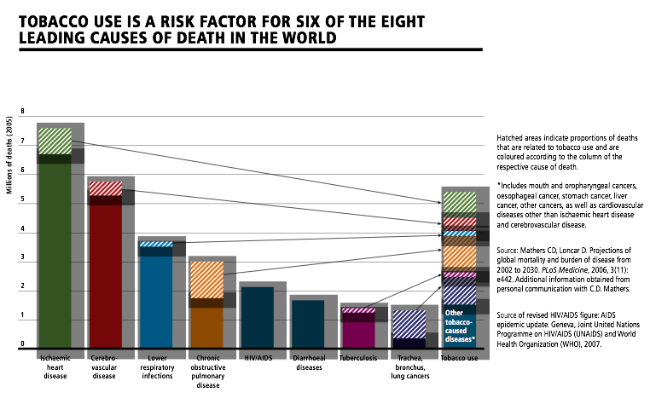
Notes:
World Health Organization. WHO report on the global tobacco epidemic, 2008---the MPOWER package. Geneva, Switzerland: World Health Organization; 2008. Available at http://www.who.int/tobacco/mpower/mpower_report_full_2008.pdf . Accessed January 24, 2014.

Slide 5
Notes:
World Health Organization. WHO report on the global tobacco epidemic, 2008---the MPOWER package. Geneva, Switzerland: World Health Organization; 2008. Available at http://www.who.int/tobacco/mpower/mpower_report_full_2008.pdf . Accessed January 24, 2014.

Slide 6
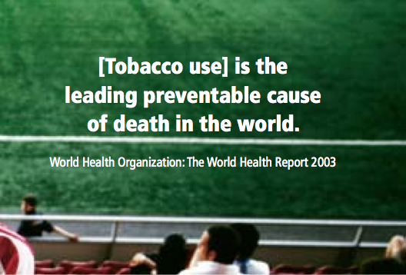
Notes:
World Health Organization. WHO report on the global tobacco epidemic, 2008---the MPOWER package. Geneva, Switzerland: World Health Organization; 2008. Available at http://www.who.int/tobacco/mpower/mpower_report_full_2008.pdf . Accessed January 24, 2014.

Slide 7
Notes:
Image courtesy of: http://www.nwlc.org/sites/default/files/earlylearning_tobacco_infographic400.jpg

Slide 8
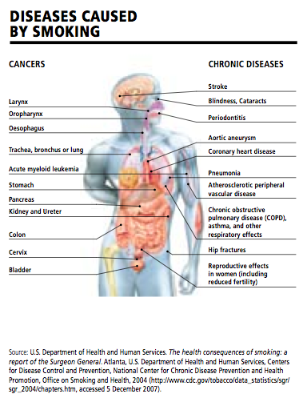
Notes:
World Health Organization. WHO report on the global tobacco epidemic, 2008---the MPOWER package. Geneva, Switzerland: World Health Organization; 2008. Available at http://www.who.int/tobacco/mpower/mpower_report_full_2008.pdf . Accessed January 24, 2014.

Slide 9
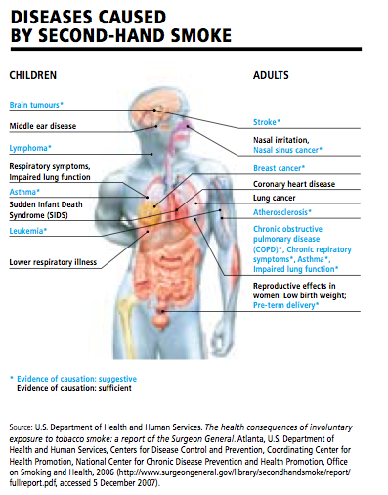
Notes:
World Health Organization. WHO report on the global tobacco epidemic, 2008---the MPOWER package. Geneva, Switzerland: World Health Organization; 2008. Available at http://www.who.int/tobacco/mpower/mpower_report_full_2008.pdf . Accessed January 24, 2014.

Slide 10
Notes:
An examination of more than 100 international studies articulates the empirical consensus: Significant increases in tobacco taxes are a highly effective tobacco control strategy and lead to significant improvements in public health.
A primary reason that cigarette taxes are so effective is that young people are particularly sensitive to price increases. The Congressional Budget Office (CBO) summarizes the existing research and concludes that a 10 percent increase in cigarette prices will lead people under age 18 to reduce their smoking by 5-15 percent. Among adults over 18, CBO concludes, the decline would be 3-7 percent
Source: Marr, Chuck, Krista Ruffini, and Chye Ching Huang. "Higher Tobacco Taxes Can Improve Health and Raise Revenue." (n.d.): n. pag. Center on Budget and Policy Resources. 19 June 2013. http://www.cbpp.org/cms/?fa=view&id=3978. Web. 23 Jan. 2014.

Slide 11
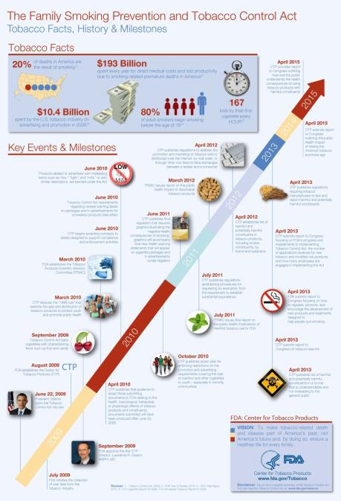
Notes:
From http://betobaccofree.hhs.gov/laws/

Slide 12
Notes:
From http://betobaccofree.hhs.gov/laws/

Slide 13
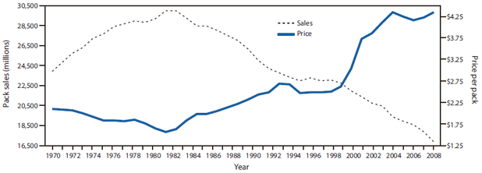
Cigarette sales and average price per pack* --- United States, 1970--2008
Notes:
The figure above shows cigarette sales and average price per pack for the United States from 1970-2008. According to the figure, as tobacco prices go up, consumption of tobacco products goes down. Evidence from the United States indicates that a 10% increase in the price reduces cigarette consumption by about 4%.
http://www.cdc.gov/mmwr/preview/mmwrhtml/mm5916a3.htm

Slide 14
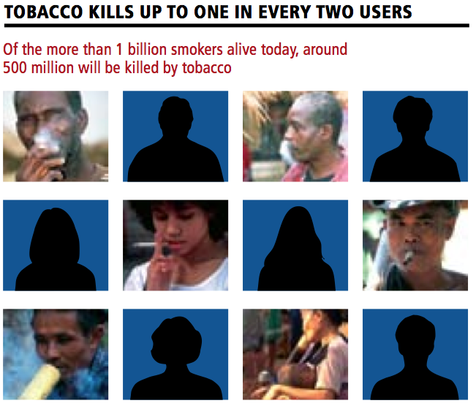
Notes:
World Health Organization. WHO report on the global tobacco epidemic, 2008---the MPOWER package. Geneva, Switzerland: World Health Organization; 2008. Available at http://www.who.int/tobacco/mpower/mpower_report_full_2008.pdf . Accessed January 24, 2014.

Slide 15
Notes:
Tobacco use is growing fastest in low-income countries, due to steady population growth coupled with tobacco industry targeting, ensuring that millions of people become fatally addicted each year. More than 80% of the world’s tobacco-related deaths will be in low- and middle-income countries by 2030
World Health Organization. WHO report on the global tobacco epidemic, 2008---the MPOWER package. Geneva, Switzerland: World Health Organization; 2008. Available at http://www.who.int/tobacco/mpower/mpower_report_full_2008.pdf . Accessed January 24, 2014.

Slide 16
Notes:
in South Africa, every 10% increase in excise tax on cigarettes has been associated with an approximate 6% increase in cigarette excise revenues, such that from 1994 to 2001, excise revenues more than doubled
World Health Organization. WHO report on the global tobacco epidemic, 2008---the MPOWER package. Geneva, Switzerland: World Health Organization; 2008. Available at http://www.who.int/tobacco/mpower/mpower_report_full_2008.pdf . Accessed January 24, 2014.

Slide 17
Notes:
World Health Organization. WHO report on the global tobacco epidemic, 2008---the MPOWER package. Geneva, Switzerland: World Health Organization; 2008. Available at http://www.who.int/tobacco/mpower/mpower_report_full_2008.pdf . Accessed January 23, 2014.

Slide 18
Notes:
World Health Organization. WHO report on the global tobacco epidemic, 2008---the MPOWER package. Geneva, Switzerland: World Health Organization; 2008. Available at http://www.who.int/tobacco/mpower/mpower_report_full_2008.pdf . Accessed January 23, 2014.

Slide 19
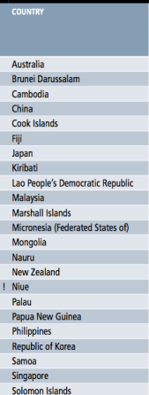
Tobacco Tax
Notes:
World Health Organization. WHO report on the global tobacco epidemic, 2008---the MPOWER package. Geneva, Switzerland: World Health Organization; 2008. Available at http://www.who.int/tobacco/mpower/mpower_report_full_2008.pdf . Accessed January 23, 2014.

Slide 20
Notes:
http://www.tobaccoatlas.org/solutions/tobacco_taxes/tax_revenue_up/

Slide 21
Notes:
http://www.tobaccoatlas.org/solutions/tobacco_taxes/tax_revenue_up/

Slide 22
Notes:
In 2002, New York City took two pioneering steps to reduce smoking: increased the tobacco tax and effectively eliminated smoking in the workplace, including restaurants and bars. These measures were followed by a dramatic decline in smoking prevalence.
http://www.nyc.gov/html/doh/html/pr2006/pr046-06.shtml

Slide 23
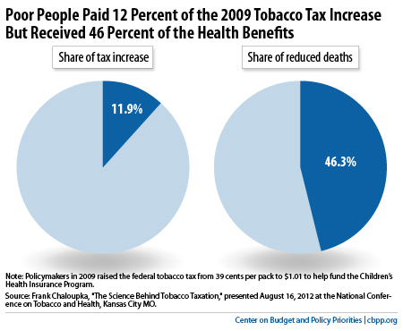

Slide 24
Cigarette Consumption Western Pacific
Notes:
http://blogs.wsj.com/chinarealtime/2013/12/11/china-eyes-smoking-ban/

Slide 25
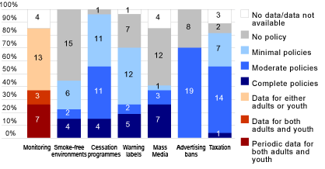
Western Pacific Region Tobacco Control Policies
Notes:
http://www.who.int/gho/tobacco/policies/region_western_pacific/en/

Slide 26
Lifetime Daily Cigarette Use (2007)
Notes:
Lifetime Daily Cigarette Use: Across surveys, the overall percentage of students who had ever smoked at least one cigarette every day for 30 days (i.e., lifetime daily cigarette use) ranged from 13.6% to 17.6% (median: 16.6%). Prevalence among female students ranged from 12.6% to 16.2% (median: 13.1%), and prevalence among male students ranged from 14.2% to 22.3% (median: 17.8%)
http://www.cdc.gov/mmwr/preview/mmwrhtml/ss5712a2.htm

Slide 27
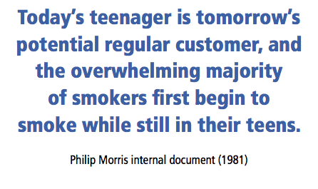
Notes:
World Health Organization. WHO report on the global tobacco epidemic, 2008---the MPOWER package. Geneva, Switzerland: World Health Organization; 2008. Available at http://www.who.int/tobacco/mpower/mpower_report_full_2008.pdf . Accessed January 24, 2014.

Slide 28
Current Cigarette Use (2007)
Notes:
Across surveys, the overall percentage of students who had smoked cigarettes on at least 1 day during the 30 days before the survey (i.e., current cigarette use) ranged from 23.1% to 37.6% (median: 31.1%). Prevalence among female students ranged from 20.4% to 31.1% (median: 25.4%), and prevalence among male students ranged from 22.9% to 44.4% (median: 31.2%)
http://www.cdc.gov/mmwr/preview/mmwrhtml/ss5712a2.htm

Slide 29
Bought cigarettes in a store or gas station (2007)
Notes:
Across surveys, among students who currently smoked cigarettes and were aged <18 years, the overall percentage of students who usually got their own cigarettes by buying them in a store (i.e., convenience store, supermarket, or discount store) or gas station during the 30 days before the survey ranged from 14.9% to 30.8% (median: 17.3%). Prevalence among female students ranged from 12.1% to 21.6% (median: 17.3%), and prevalence among male students ranged from 12.8% to 40.6% (median: 21.3%)
http://www.cdc.gov/mmwr/preview/mmwrhtml/ss5712a2.htm

Slide 30
Current cigar use (2007)
Notes:
Across surveys, the overall percentage of students who had smoked cigars, cigarillos, or little cigars on at least 1 day during the 30 days before the survey (i.e., current cigar use) ranged from 6.5% to 27.1% (median: 9.5%). Prevalence among female students ranged from 3.1% to 22.5% (median: 6.6%), and prevalence among male students ranged from 9.0% to 31.8% (median: 12.2%)
http://www.cdc.gov/mmwr/preview/mmwrhtml/ss5712a2.htm

