Slide 1

Regional Laboratory Strengthening Initiative

Slide 2
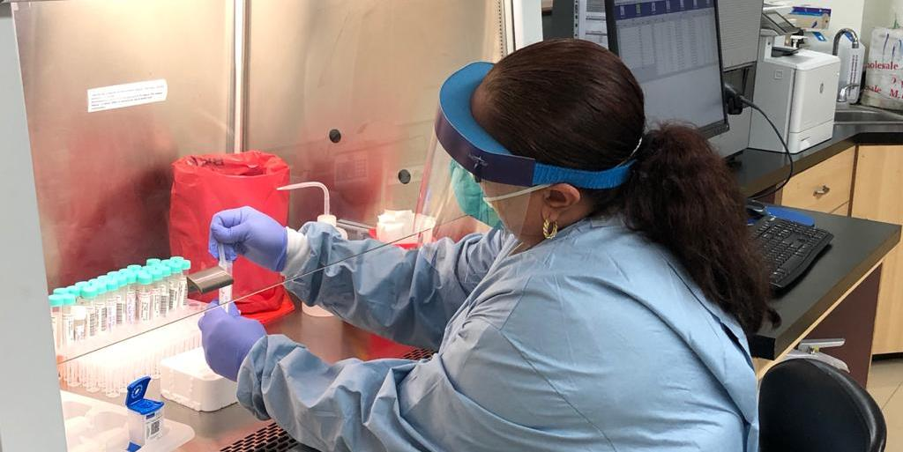
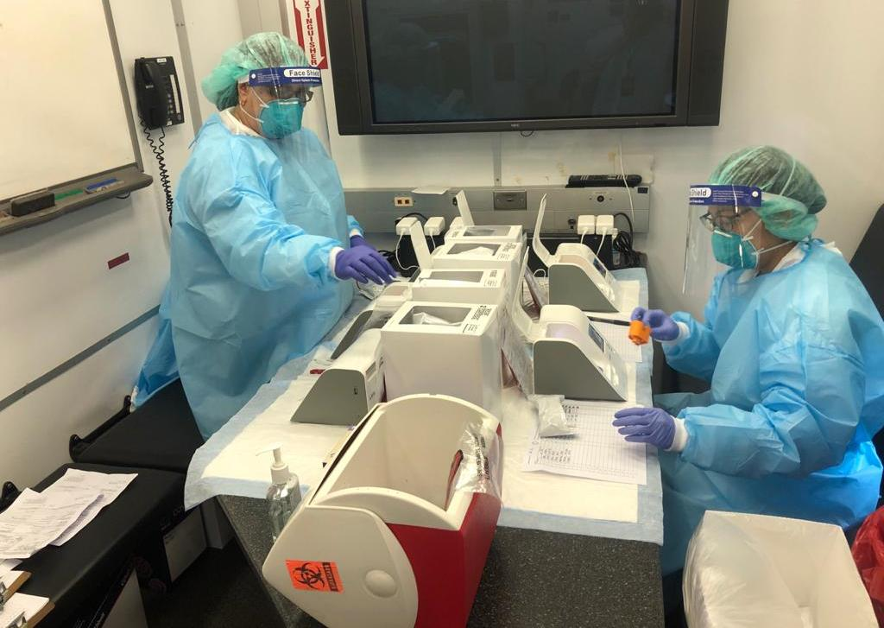
Presentation Overview
Current functional and sustainable PIHOA regional lab operations
Major updates of ongoing PIHOA regional lab strengthening activities
Commenced/planned future PIHOA regional lab activities

Slide 3
Regional Lab Initiative Team
Dr. Vasiti Uluiviti, PhD, M(ASCP)^{CM}, MMSc, Regional Lab Strengthening Coordinator
Technical Consultant – Regional Lab Program Specialist – Yet to commence work

Slide 4
Current PIHOA Regional Lab Operations
Improved accessibility to airline specimen transport
Strengthened
Lab Systems and Capacity for Preparedness and Response
Improved Laboratory Service Delivery
PIHOA Lab Shipping Mechanism (LSM)
More Effective and Timely Patient Care
Improved financial sustainability of the PIHOA LSM
PIHOA Lab Revolving Fund (LRF)
IATA Specimen Shipping Training and Certification
Continuous IATA Certified Shippers and Trainers

Slide 5

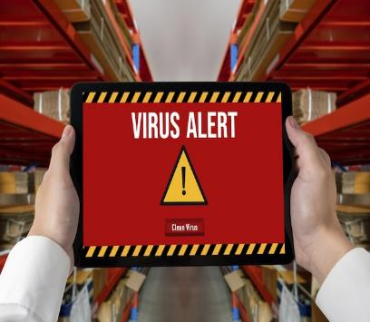

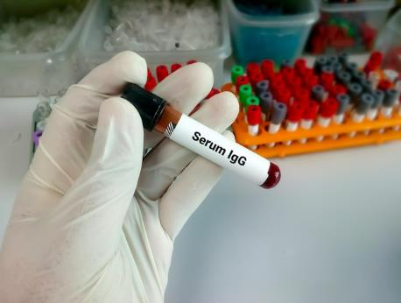





Progress Highlights 2005 – 2022: Independent Evaluation Report
Microbiology Enhancement
Training (MET)
Lab-based PH Surveillance
(CDs & NCDs)
Stepwise Lab Improvement Process Towards Accreditation (SLIPTA)
TB Lab EQA
Independent
Evaluation Report in
June 2023
Final report was endorsed by the PIHOA Board in March 2024
EVALUATION
EVALUATION
EVALUATION
PIHOA Shipping Mechanism
PIHOA Lab Revolving Fund (LRF)
IATA Shipping Training
Strengthening Lab Management Toward Accreditation (SLMTA)

Slide 6
TB Lab External Quality Assessment
Pacific Collaborative Services Integrated Lab Assessments
To assess the pre-analytical, analytical and post-analytical phases of TB lab testing in each USAPI laboratory.
  1. Lab Assessments Completed
    American Samoa DOH and LBJTMC Labs, Guam, CNMI, Palau, Kosrae - 2022
    RMI, FSM (Chuuk, Pohnpei, Yap) – 2023
  2. TB Lab Refresher Training Completed
    Majuro Hospital Lab – March 2023
To assess the lab-based testing, reporting and surveillance of the PCSI priority diseases such as TB and STIs (syphilis, chlamydia, gonorrhea, and viral hepatitis).
  1. Lab Assessments Completed
    American Samoa, Guam, CNMI, Palau, Kosrae - 2022
    RMI, FSM (Chuuk, Pohnpei, Yap) – March 2023
  2. PCSI training – April 2024
  3. PCSI lab quarterly reports – yet to begin
  4. PCSI lab quarterly meetings – yet to begin

Slide 7

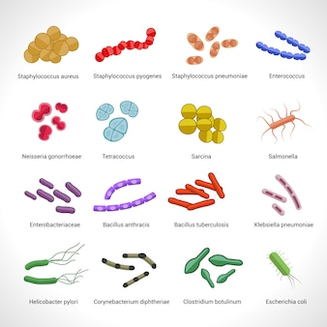


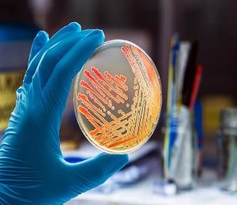
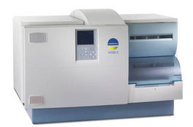
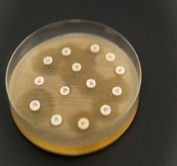
Microbiology Enhancement Training (MET)
CLIA-Regulated Lab
3-month work/training attachment
PIHOA and Palau ELC funded
Belau National Hospital Lab Microbiology Staff
Parasitology
Bacteriology
Major MET Objectives
MICROBIOLOGY SECTION
American Samoa
LBJTMC Lab
Enhance competency in diagnostic clinical microbiology testing (pre-analytical, analytical, and post-analytical phases).
Perform and report clinical and public health lab tests, including antimicrobial susceptibility testing.
Improve reporting and documentation in diagnostic clinical microbiology.
Read and interpret antibiograms.
Exposure to work ethics in a moderate complexity CLIA-regulated laboratory.
Exposure to high clinical microbiology testing workload.
Understand related elements LQMS and biosafety in microbiological and biomedical labs (BMBL).
Automated Bacterial Identification
Antibiograms
Automated Antibiotic Susceptibility Testing
High daily clinical microbiology workload

Slide 8
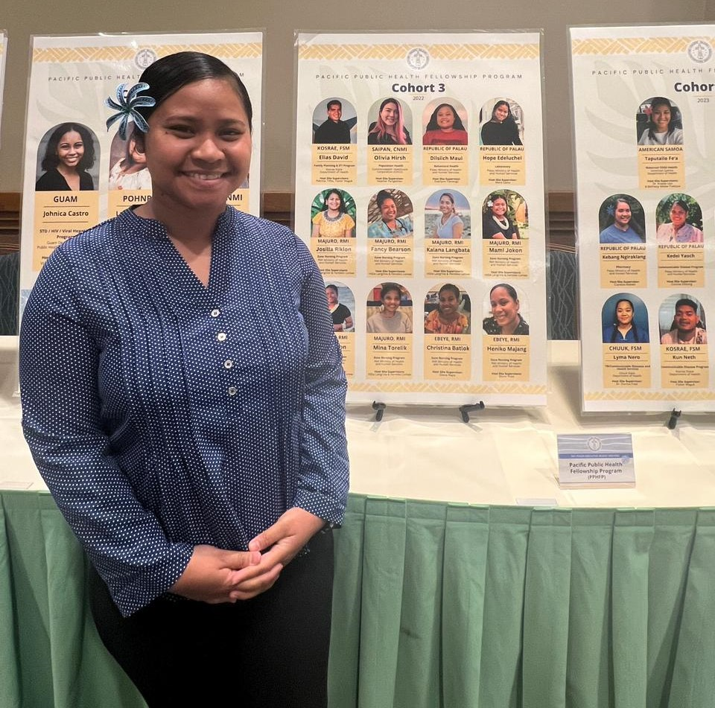
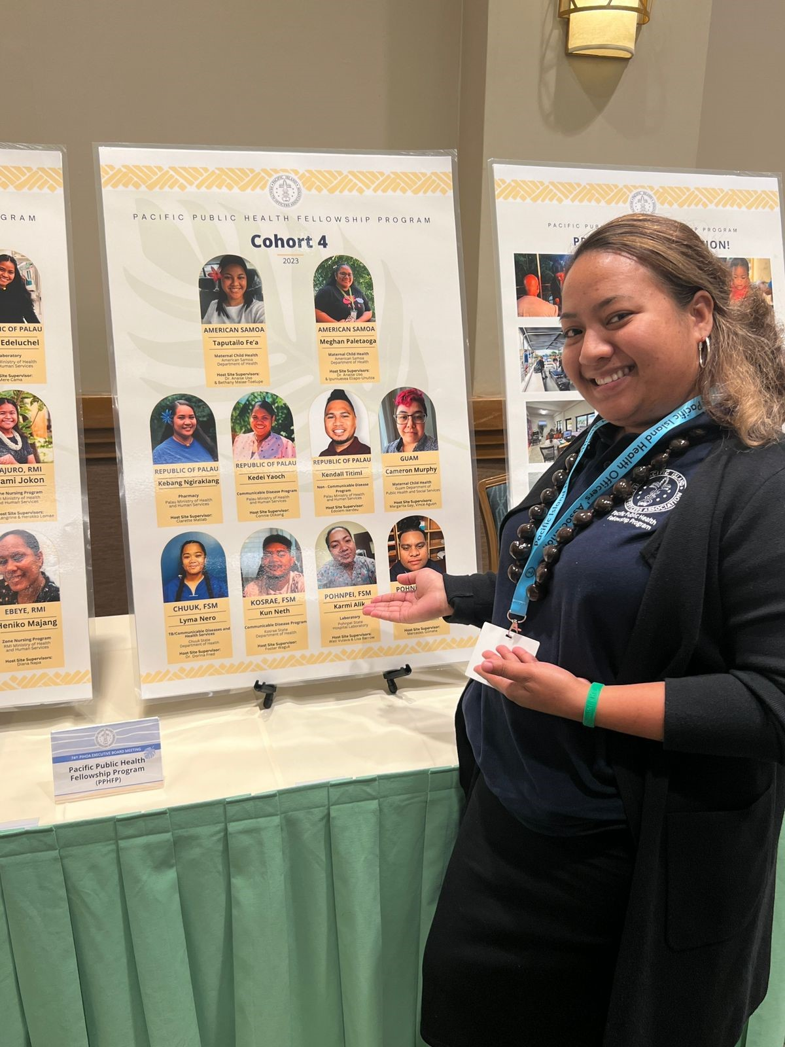
PIHOA PACIFIC PUBLIC HEALTH FELLOWSHIP PROGRAM (PPPHFP)
2- year program - Cohort 5 begins in August 2024
Purpose: Promotes public health to medical lab technologists
Pohnpei Lab Fellow 2024 - 2026
Palau Lab Fellow 2022 - 2024

Slide 9

Strengthening Health Interventions in the Pacific (SHIP) Program
Lab staff are encouraged to participate
Current students: Yap x2 lab staff
More information: SHIP Program Manager – Friday 04/19/24

Slide 10

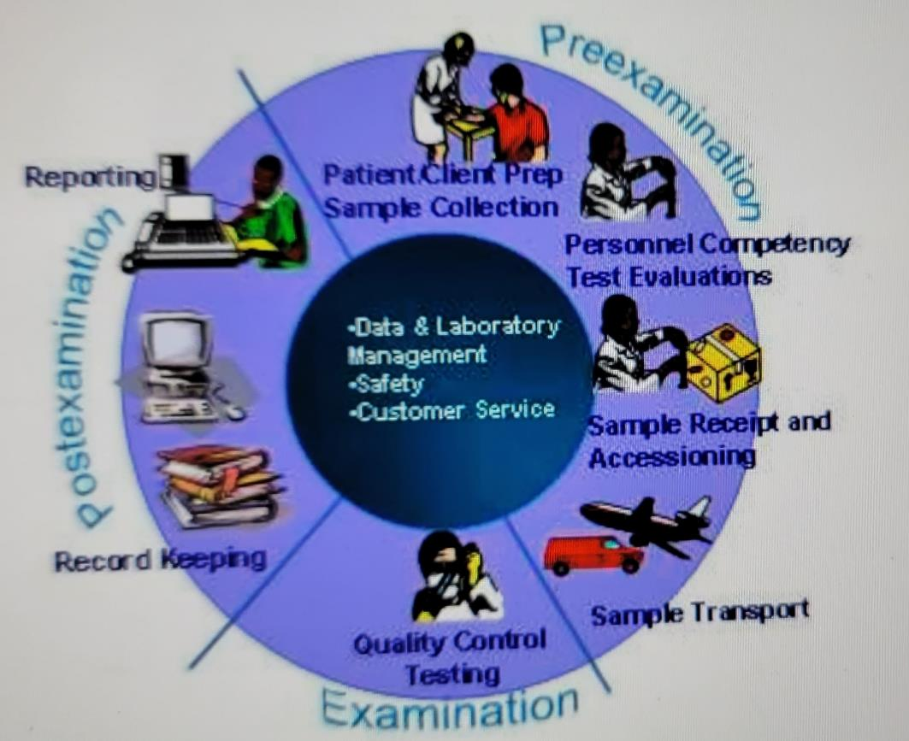
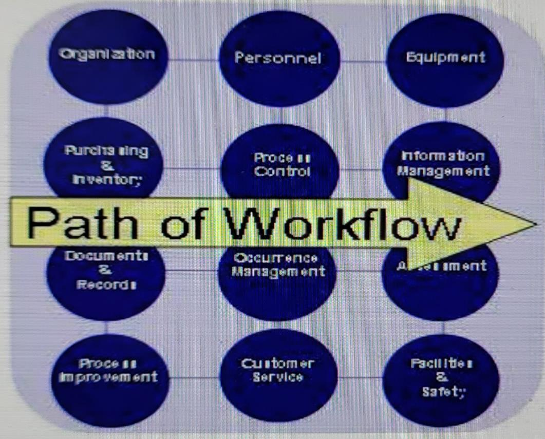


Strengthening Lab Management Toward Accreditation (SLMTA)
Lab’s complex phases of testing
Accreditation-ready
Yap, FSM
December 2016
SLMTA
Exit
SLIPTA
Audit
Score
Baseline
SLIPTA
Audit
Score
Palau
March 2019
SLIPTA Audit
SLIPTA Audit
Majuro, RMI
July 2019
Quality Improvement Projects (QIPs)
Accreditation-ready
Pohnpei, FSM
December 2019
12 Quality System Essentials (QSE)

Slide 11
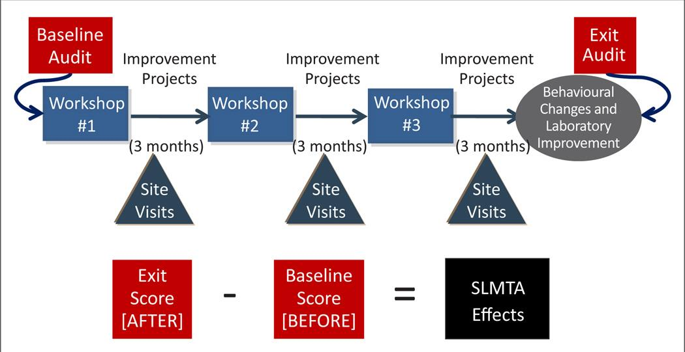
SLIPTA/SLMTA Program
Contributes to Preparation for
ISO 15189 Accreditation
ISO 15189 Accreditation Components
  SLIPTA Laboratory Baseline Audits
  Continuous SLMTA Workshops or SLMTA Category Training
  Implementation of Quality Improvement Projects (QIPs)
  Site Visits

Slide 12
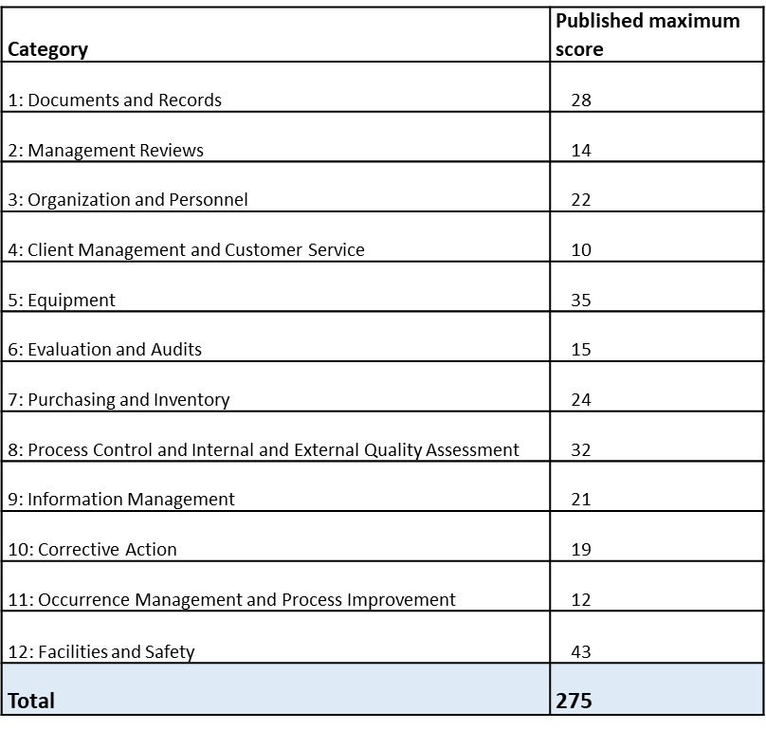
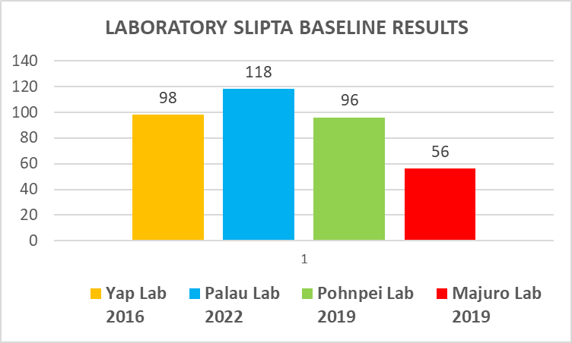
Laboratory SLIPTA Baseline Audit Scores

Slide 13
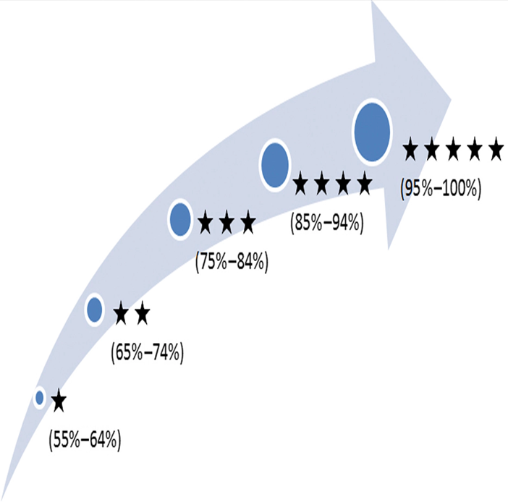
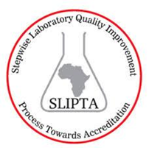
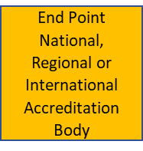
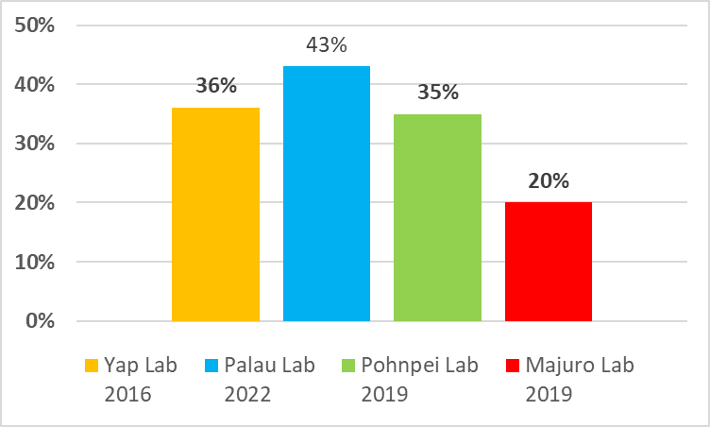
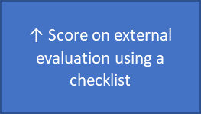
Laboratory SLIPTA Baseline Audit Scores (%)

Slide 14
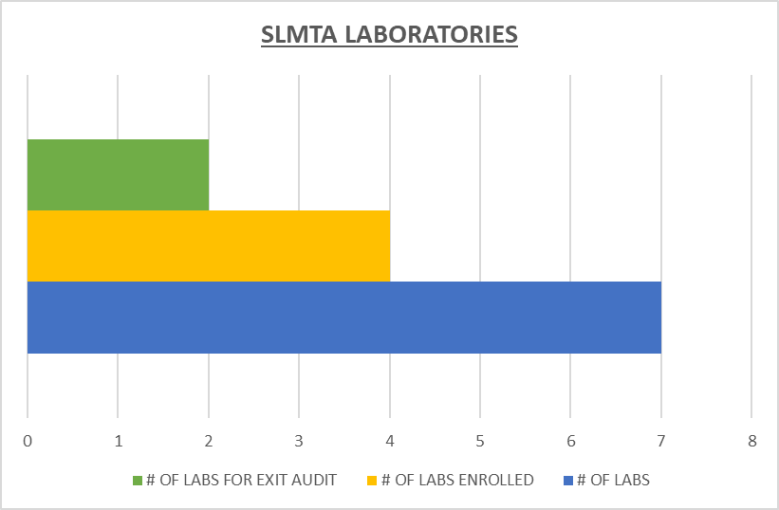
USAPI Laboratories Participating in SLMTA
CURRENT STATUS
Yap Laboratory [SLMTA Lab] ?
Majuro Laboratory [SLMTA Lab] ?
Pohnpei Laboratory [SLMTA Lab]
Palau Laboratory [SLMTA Lab]
Ebeye Laboratory [To be enrolled]
Kosrae Laboratory [To be enrolled]
Chuuk Laboratory [To be enrolled]
Ready for EXIT audit ?

Slide 15
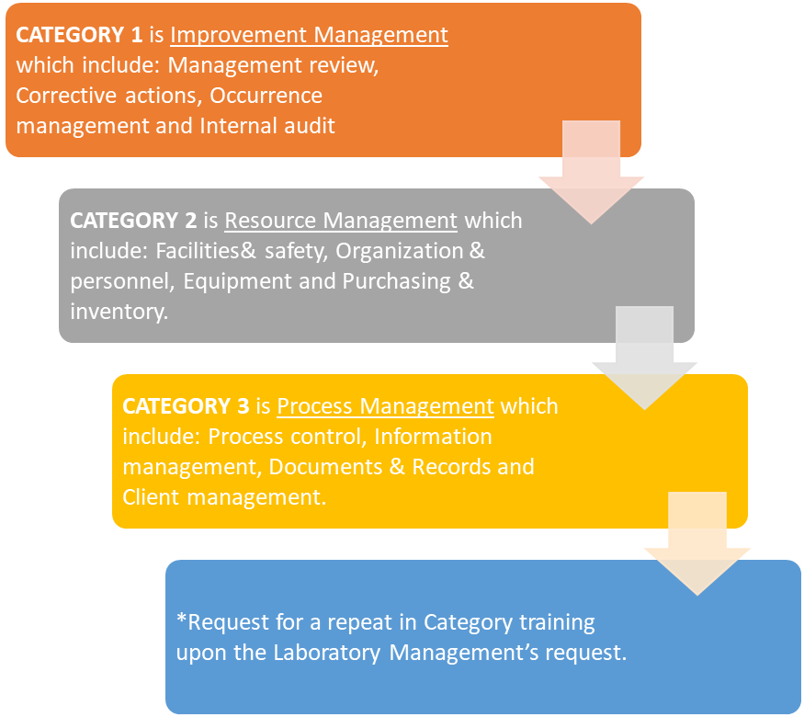
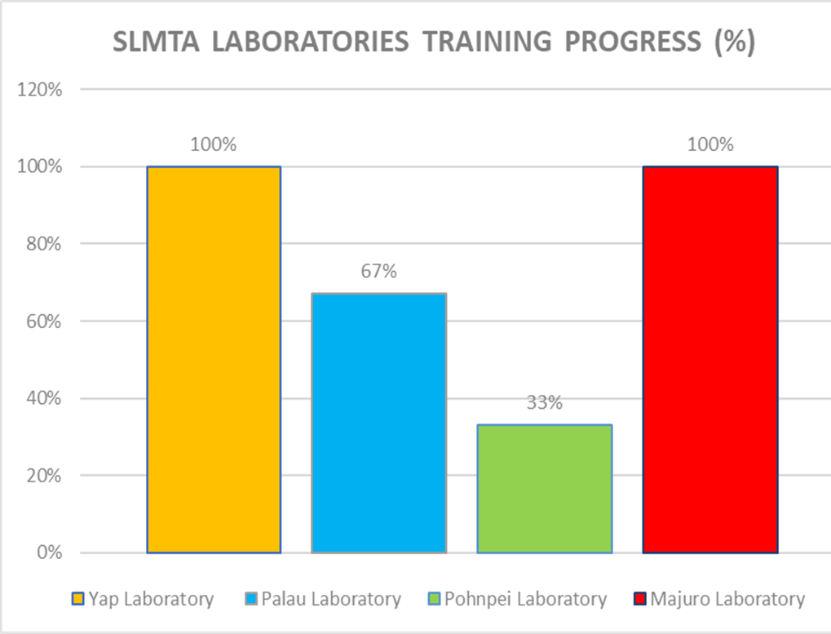
SLMTA Training Progress

Slide 16
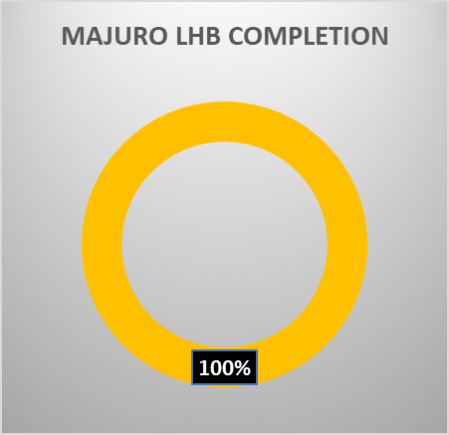
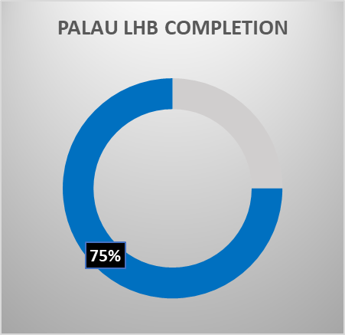
Laboratory Handbooks

Slide 17
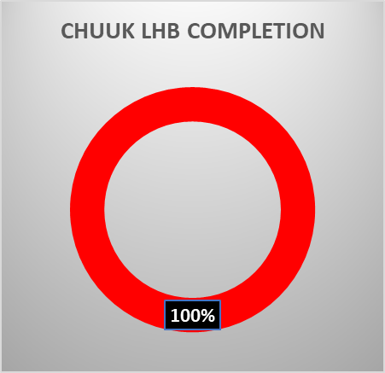
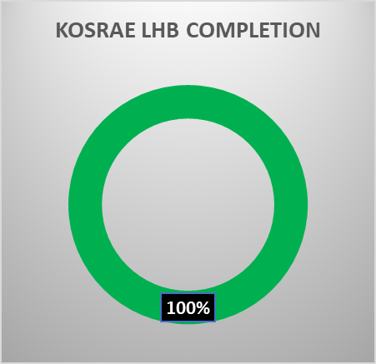
Hospital Laboratory Handbooks

Slide 18

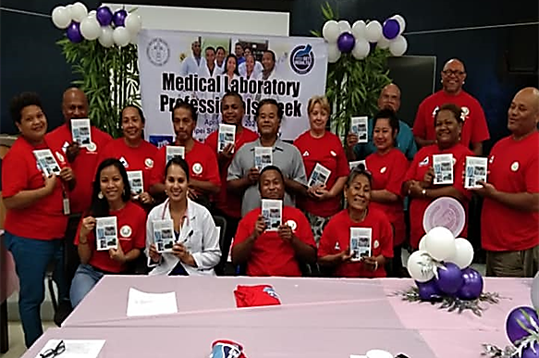
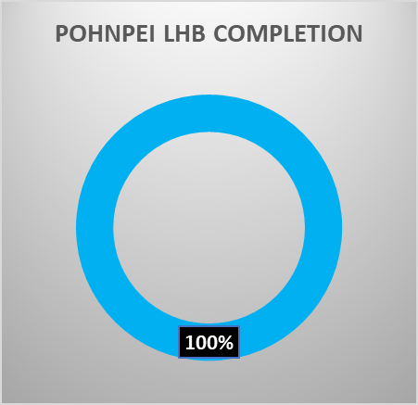
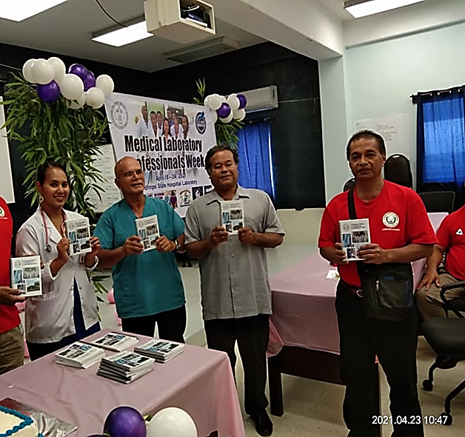
Pohnpei Hospital Laboratory Handbook 100% Completion
Completed Sections
Chemistry
Hematology
Serology
Blood Bank
Assays & Markers
Microbiology
Molecular
Send Outs
**Launched in 2020

Slide 19
Commenced and Planned Future PIHOA Regional Lab Strengthening Activities
2023 LabNet-EpiNet Joint Meeting
Honolulu, HI
  July 24 – 28, 2023
  North and South Pacific participants (~ 100)
  PIHOA partner agencies (Pacific Community, CDC, WHO, etc.)
  LabNet major agenda items:
      Lab Quality Management Systems (LQMS)
      Antimicrobial Resistance (AMR)
      Clinical/Public health Lab Workforce Development
      Lab Preparedness and Response
Trial procurement project of RMI GeneXpert cartridges
  UNDP no longer provides GeneXpert CT-NG cartridges for chlamydia and gonorrhea testing leading to local stockouts and cessation of testing in some jurisdictions that rely on UNDP’s global supply chain mechanism
  Trial procurement via PIHOA’s LRF and Shipping Mechanism is in progress
  PIHOA is now a certified agency eligible to procure directly from UNDP’s Global Supply Mechanism

Slide 20
Lab-Based AMR Surveillance Training (pending funding approval)
6. Second AMR Sub-Regional Training in Pohnpei, FSM
8. Training report
Compilation of training report - TBD
For Chuuk/Pohnpei/Kosrae, FSM - TBD
1. AMR training supplies
7. Third AMR Sub-Regional Training in Majuro, RMI
Purchased and awaiting delivery to GPHL by Dec 2019
For Majuro/Ebeye, RMI - TBD
3. Shipping
5. First AMR Sub-regional Training in Guam
Shipping of QC organisms to USAPI labs April 2024
9. AMR surveillance and monitoring
2. Processing @ Belau Hospital Lab
For Guam, CNMI, Palau and Yap - TBD
Manipulation of QC organisms
May 2022
Regional AUL training/meeting - TBD
4. Prepare for training
AMR lab surveillance training preparations - TBD

Slide 21
SLIPTA/SLMTA Challenges and Proposed Solutions Tabled with the PIHOA Board of Directors

Slide 22
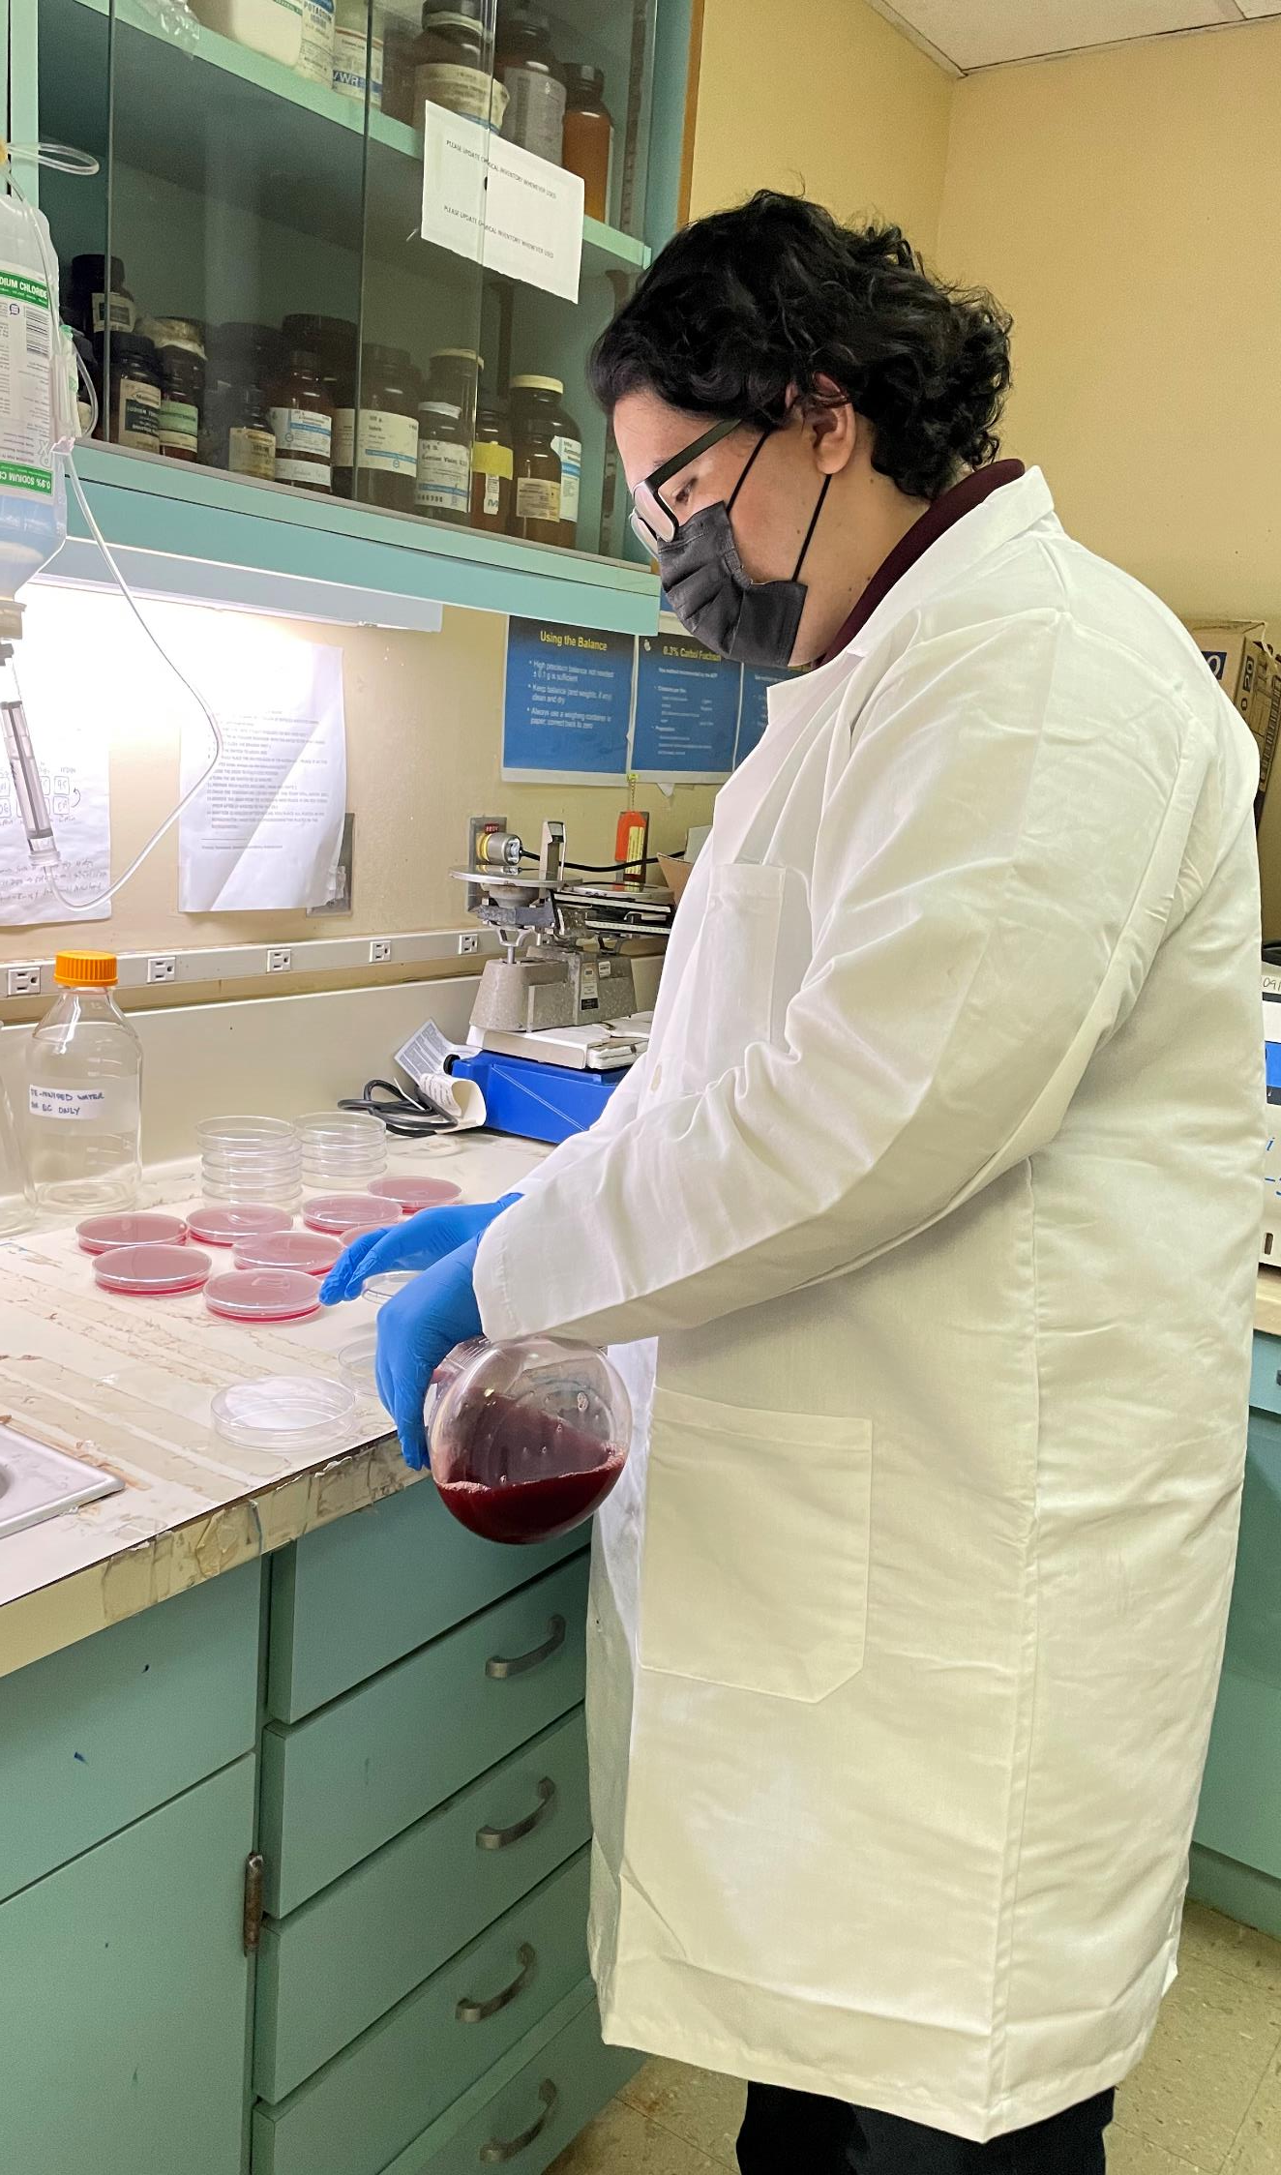





THANK YOU!

