Slide 1
FSM LABORATORY INITIATIVE
Margaret Baekalia-Santos
FSM ELC Program Manager (Acting)
FSM Dept. of Health & Social Affairs

Slide 2
Overview of the presentation
Background
Laboratory Initiatives
LQMS
Laboratory Biosafety
Challenges
Way forward

Slide 3
BACKGROUND
FSM total pop: 114,164 (2022)
FSM Path.Lab-2
FSM Food Laboratory-2
Pohnpei State Hospital laboratory -10
Chuuk State Hospital laboratory-11
Yap State Hospital laboratory -16
Kosrae State Hospital Laboratory-6
Population distribution
Chuuk: 49595 (47.3%
Pohnpei: 36,896 (35.2%)
Yap: 11,597 (12%)
Kosrae: 6,744 (6.4%)
MedLab Workforce Qualification
Yap: 9 PPTC DipMLS
Pohnpei: 5 PPTC DipMLS
Chuuk: 2 Bachelors
Kosrae: 3 Bachelors
Private labs in Pohnpei
Medpharm clinic
Genesis Hospital
Pohnpei Family Health Clinic
Berysin Community Health Center

Slide 4
FSM- Laboratory Initiatives
Human Resources: Min. requirement & registration license to practice
BSO, LQMS personnel & Trainer at each lab
Laboratory Information System (LIMS)-HCLAB interfaced with HIS
Equipment & Testing supplies
Training ( in-person, online)

Slide 5
FSM Lab initiatives-LQMS
2 LQMS managers hired by National Govt. (PSH & Path.Lab)
Baseline assessments done for Pohnpei and Chuuk State Hospital labs
Path. Lab: Telepathology, Proficiency Testing
National Food Laboratory: First ISO 17025 baseline assessment in 2018 by Cawthrone Institute, NZ. Pharmaceutical testing of substandard medicines.

Slide 6
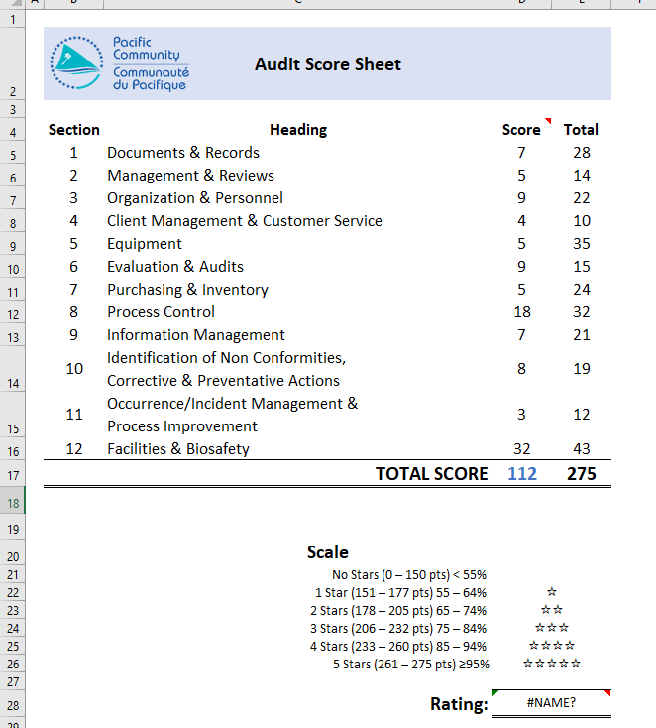
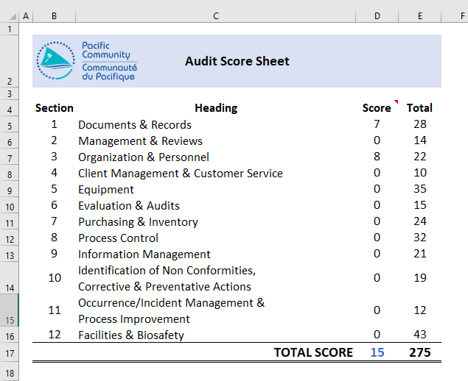
Baseline Assessment Scores 2024
POHNPEI STATE HOSPITAL LABORATORY
CHUUK STATE HOSPITAL LABORATORY
UNOFFICIAL SCORES

Slide 7
3. ORGANIZATION AND PERSONNEL
9. INFORMATION MANAGEMENT
Strengthen workforce capacity
& Capability
LIMS utilization
Documentation
5. EQUIPMENT
12. FACILITIES AND BIOSAFETY
Replace obsolete equipment
Back up analyzers
Renewal of equipment service/
maintenance contract
Biosafety Officers
Biosafety manuals
Biosafety Training
Renovation of lab spaces

Slide 8
FSM Lab Initiative- Biosafety
Each lab designates a Lab. Biosafety Officer
Each lab has own Biosafety Manual
Training provided to new lab hires (govt. & private)
Refresher training

Slide 9
Challenges
High turnover of lab staff
Non-competent lab staff
Designated roles not performed
Lab documents not reviewed and updated
Infrastructure not supporting LIMS
Not accepting change

Slide 10
Way Forward
“Implement & Strengthen Laboratory Quality Management System”

Slide 11
THANK YOU!

