Slide 1
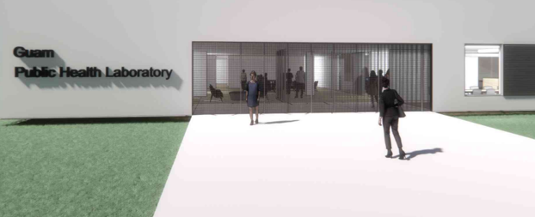
Department of Public Health and Social Services
Guam Public Health Laboratory
Update for the 7th AUL Meeting
Proposed design above shows the front of building for GPHL’s BSL2/3 facility

Slide 2
Department of Public Health and Social Services
Guam Public Health Laboratory
Department of Public Health and Social Services (DPHSS) Guam Public Health Laboratory (GPHL) - setting the stage for an integrated approach for Regional PH Biosafety Level 2/3 (BSL2/3)
Laboratory support and Center of Excellence for communicable disease control and surveillance, workforce development, research, and data integration for Guam, the United States Affiliated Pacific Islands (USAPI), and the Pacific Region

Slide 3
Department of Public Health and Social Services Guam Public Health Laboratory
Overview
Organizational Chart
Mission, Goals, Strategies, Purpose
Disadvantages of sending out specimens
Communicable/Infectious Disease Testing Equipment
Here and Now
History
SARS-CoV-2 Testing Progression
Annual Test Volume FY 2015-2023
Future Plans
Proposed Floor Plan
Regional Plans, Partnerships
Status of GPHL

Slide 4
GPHL Organizational Chart
HC-CLIA Lab Director
Remote Full-Time
(Federal- CDC ELC TAP Resource 100%)
Lab Administrator
(Federal- CDC ELC Grant 100%)
Microbiologist III
Molecular
(Federal- CDC ELC Grant 50%, STD/HIV 25%, PHEP 25%)
Medical Technologist II
Quality Assurance/ Quality Improvement Lab Technical Consultant
Microbiologist II
Bacteriology
(Federal- CDC ELC Grant 100%, LTA)
Microbiologist I
Tuberculosis
(Federal- CDC TB Grant 100%)
Medical Laboratory Technician II
Serology/Virology
(Local-General Fund)
Medical Laboratory Technician I
Microbiologist II
(Federal- CDC ELC Grant 100%, LTA)
Medical Laboratory Technician
(Federal- CDC HD Grant 100%, LTA)
Microbiologist I
(Federal- CDC ELC Grant 100%, LTA)
Chief Public Health Office (State Office)
Word Processing Secretary II
Admin Support
(Local-General Fund)
Legend
100% Local Fund
100% Federal Fund
Vacant

Slide 5
Department of Public Health and Social Services Guam Public Health Laboratory
Operate a State-of-the-Art Public Health Biosafety Containment Level 2/3 (BSL2/3) Laboratory analytical confirmatory testing capability linked to a well-functioning public health preparedness and emergency response system that will protect all of Guam, and her sister jurisdictions in the Pacific Region, from emerging and re-emerging threats to health security
GPHL Mission

Slide 6
Build a BSL2/3 facility on Guam that will meet the clinical human specimen confirmatory analytical testing needs for BSL2/3 communicable/infectious diseases for all of Guam and the neighboring jurisdictions
Ensure appropriate design and construction of the BSL2/3 facility by BSL2/3 laboratory design and construction experts
Ensure design includes consideration for the Guam environment, reducing facility maintenance costs, allowing for expansion, adequate Information Technology (IT), providing educational services, ensuring safety, and linking laboratory detection to surveillance and emergency response systems
Build
GPHL Goals
and Strategies
Develop the systems necessary to maintain sustained success and state-of-the-art BSL2/3 pathogens causing communicable/infectious disease detection at GPHL
Expand support of the lab across Government of Guam (GovGuam)
Build points of collaboration between United States Department of Defense (US DoD), United States Department of Human Health Services (HHS) and GovGuam
Create workforce development pipelines for Guam and the USAPI in collaboration with local community colleges, universities, training and education centers
Expand the funding resources beyond CDC support
Establish systems to monetize GPHL services
Consider novel approaches to address issues of procurement
Develop

Slide 7
Provide clinical human specimen confirmatory analytical testing for BSL2/BSL3 pathogens causing communicable/infectious disease, potentially lethal disease through the inhalation route of exposure, by having readily available resources
Ensure laboratory maintains CLIA compliance
Ensure appropriate/adequate ordering/inventory of lab supplies, potential resources
Ensure laboratory services to prevent, control and contain BSL2/3 pathogens causing foodborne diseases, such as E. coli, gastro-enteritis; sexually transmitted diseases, such as herpes, HIV; respiratory viruses such as Influenza, SARS-CoV-2; vector-borne diseases such as dengue, Zika; strictly BSL3 containment for risk group 3 pathogens such as anthrax, chikungunya, eastern and western equine encephalitis, hantavirus, malaria, Q fever, tuberculosis, West Nile fever, Yellow fever
Provide
GPHL
Purpose
Prepare
Prepare the public health BSL2/3 pathogens causing communicable/infectious diseases laboratory systems necessary to maintain sustained success in the emergency response to pandemic, bioterrorism, outbreaks and other public health emergencies
Strengthen continued partnerships with HHS, CDC, WHO, SPC, PIHOA, USNH, AAFB
Expand capacity to improve BSL2/3 analytical testing, surveillance, and response to outbreak prone diseases and emerging infectious diseases (EIDs)
Create work-force development in preparedness and emergency response efforts for Guam intended to support and provide BSL 2/3 anaylytical testing to the island community, USAPI and the Pacific Region

Slide 8
Turnaround Time (TAT) of clinical human specimen analytical confirmatory testing is delayed, such as reporting of results taking two (2) to four (4) months, by the reference laboratory due to:
Shipping related reasons (dry ice shortage, shipping time, cancelled flights)
Frozen shipment, availability of dry ice, scheduled only Tuesdays and Thursdays
Reference Lab testing volume priority, TAT sequencing result reported 2-3 months
Batching, packaging, coordination of clinical human specimens for shipment
Clinical human specimen rejection upon receipt due to logistical issues
Negative impact on the early detection, diagnosis, containment and treatment of infectious disease in patients
Delayed TAT
Disadvantages of sending out specimens for reference testing
Increased Cost
Cost of shipping/handling of clinical human specimen for infectious disease testing is expensive due to price of:
Logistics, such as Ambyth and/or other certified shipping companies, for dangerous goods, is a contractual service
Each shipment of Category B (Biological infectious substances) is about $650 to $750, dependent on weight
Each packing/shipping material, insulated box, in compliance with the International Air Transportation Association (IATA) regulations, is about $68

Slide 9
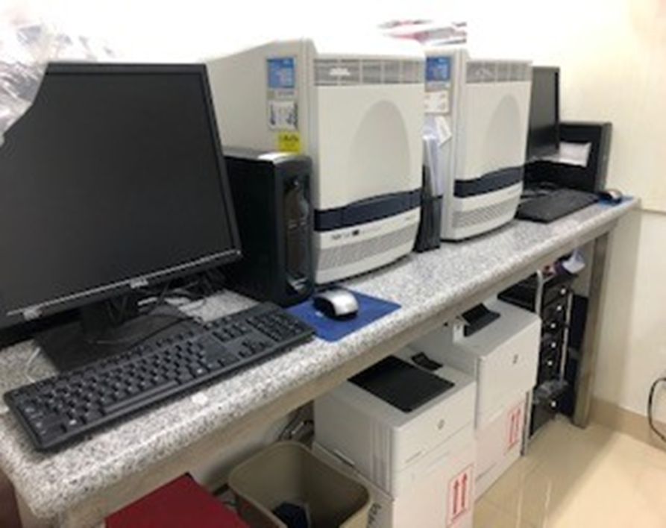
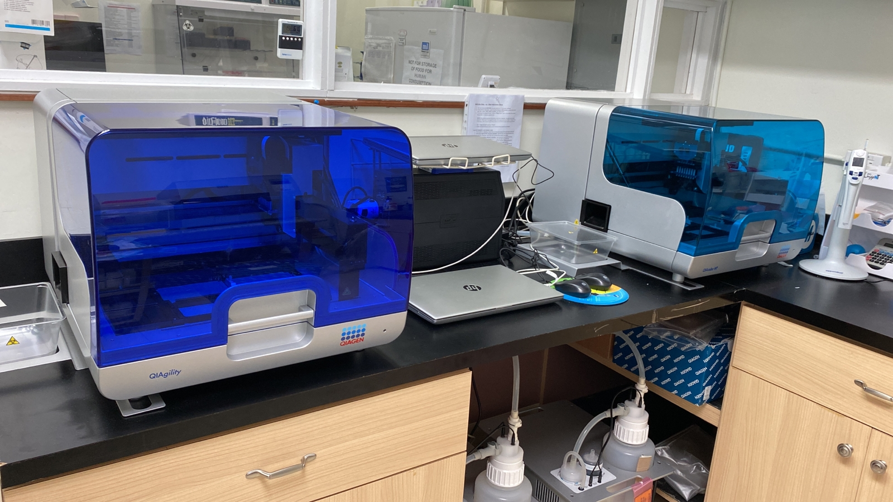
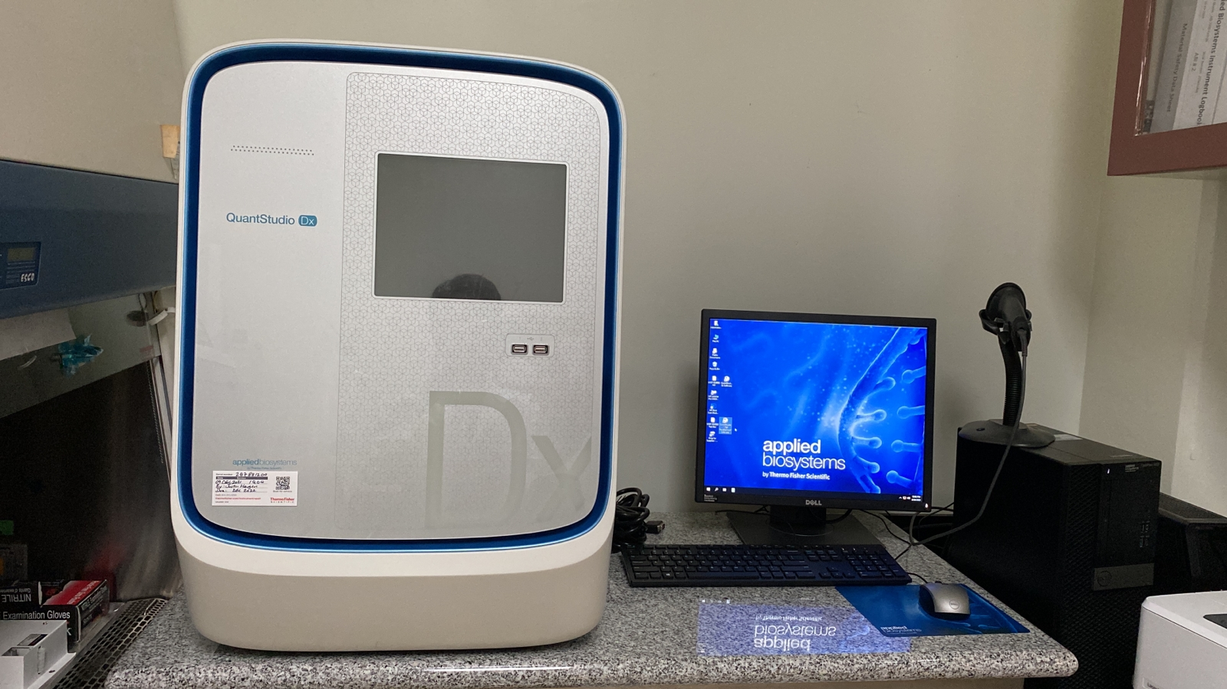
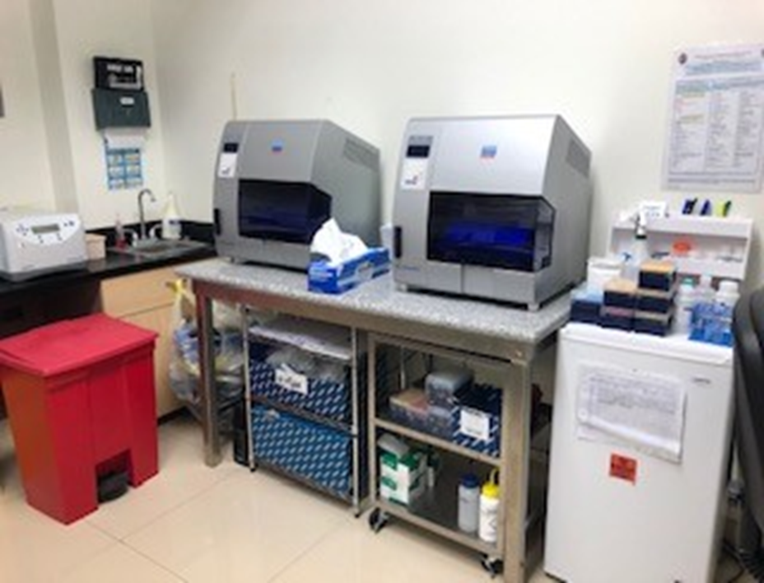
GPHL Here and Now…
Communicable/infectious disease testing equipment obtained from HHS resource allocation and CDC ELC grant funds:
2 Applied Biosystems (ABI) 7500 Fast Dx
3 EZ1 Automated RNA Extraction
2 QIAcube HT
1 QIAgility
1 Quant Studio Dx
Disease Detected | Estimate Price per Test for proposed billing | Testing Budget
Chikungunya (Trioplex) | $60.27 | 100% Federal CDC IRR-International Reagent Resource for PCR reagents 2020 PHEP/FEMA/HHS Pandemic Covid-19 Emergency Response, donations/allocations amounting to about $16M 2020 ELC- Epidemiology And Lab Capacity Pandemic Covid-19 Emergency grant funds, supply amounting to about $13M
Dengue (Trioplex) Dengue Serotyping 1-4
Zika (Trioplex)
Influenza Subtyping
SARS-CoV-2
Non-Variola Orthopox (Monkeypox; Mpox)
ABI 7500 Fast Dx
QIAGEN QIAcube HT and QIAgility
Quant Studio Dx
QIAGEN EZ1 Automated RNA Extraction

Slide 10
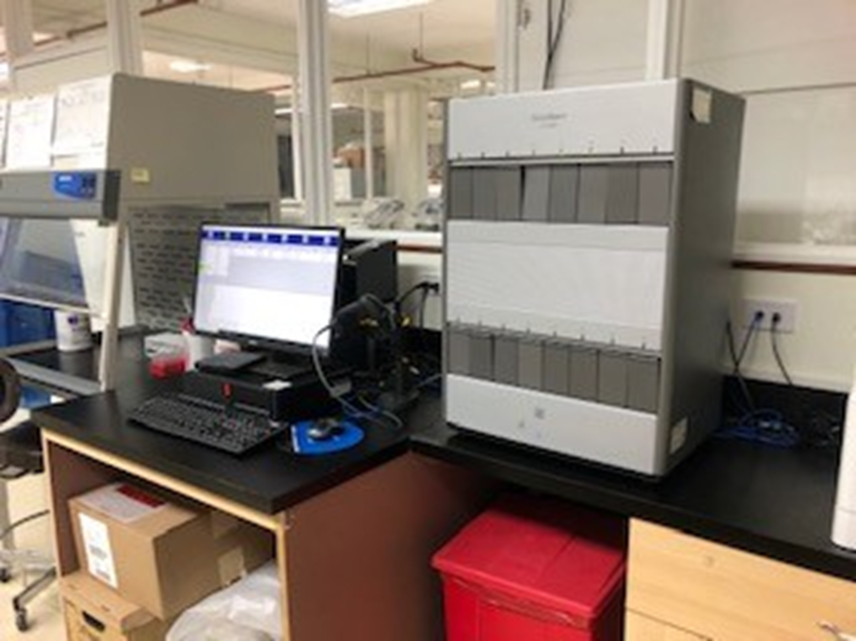
Department of Public Health and Social Services Guam Public Health Laboratory
GPHL Here and Now…
Communicable/infectious disease testing equipment obtained from CDC Division of STD/HIV resource allocation in 2007
Cepheid GeneXpert GX-XVI
Disease Detected | Estimate Price per Test for proposed billing | Testing Budget
Chlamydia | $87.77 | 100% Federal CDC IRR-International Reagent Resource for PCR reagents 2020 PHEP/FEMA/HHS Pandemic Covid-19 Emergency Response, donations/allocations amounting to about $16M 2020 ELC- Epidemiology And Lab Capacity Pandemic Covid-19 Emergency grant funds, supply amounting to about $13M
Gonorrhea
Influenza A and B
SARS-CoV-2
Respiratory syncytial virus (RSV)
M. Tuberculosis & rifampin resistance mutation | $89.50
Cepheid GeneXpert GX-XVI

Slide 11
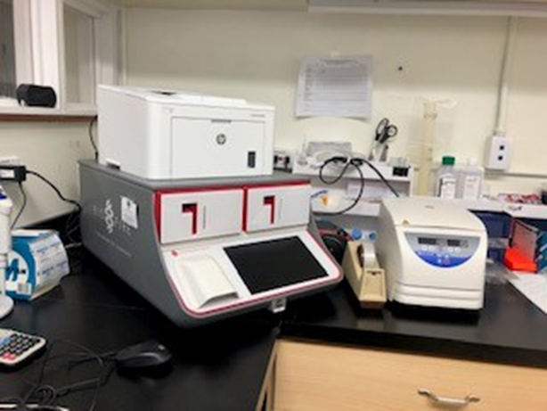
Department of Public Health and Social Services Guam Public Health Laboratory
GPHL Here and Now…
Communicable/infectious disease testing equipment obtained from CDC ELC grant funds
BioFire FilmArray
Disease Detected Respiratory Panel | Disease Detected Gastrointestinal Panel | Estimate Price per Panel for proposed billing | Testing Budget
Adenovirus Coronavirus 229E Coronavirus HKU1 Coronavirus NL63 Coronavirus OC43 SARS CoV-2 Human Metapneumovirus Human Rhinovirus/Enterovirus Influenza A (H1, H3 and H1-2009) Influenza B Parainfluenza Virus 1 Parainfluenza Virus 2 Parainfluenza Virus 3 Parainfluenza Virus 4 Respiratory Syncytial Virus | Adenovirus Astrovirus Campylobacter (jejuni, coli, and upsaliensis) Clostridium difficile (toxin A/B) Cryptosporidium Cyclospora cayetanensis Entamoeba histolytic Enteroaggregative E. Coli (EAEC) Enteroaggregative E. Coli (EAEC) Enteroaggregative E. Coli (ETEC) it/st E. coli O157 Giardia Lanlia Norovirus GI/GII Plesiomonas shigelloides Rotavirus A Salmonella Sapovirus (I, II, IV and V) Vibrio (Parahaemolyticus, vulnificus, and cholera Vibrio cholera Yersinia enterocoloticia | $158.98 | 100% Federal CDC IRR-International Reagent Resource for PCR reagents 2020 PHEP/FEMA/HHS Pandemic Covid-19 Emergency Response, donations/allocations amounting to about $16M 2020 ELC- Epidemiology And Lab Capacity Pandemic Covid-19 Emergency grant funds, supply amounting to about $13M
BioFire FilmArray

Slide 12
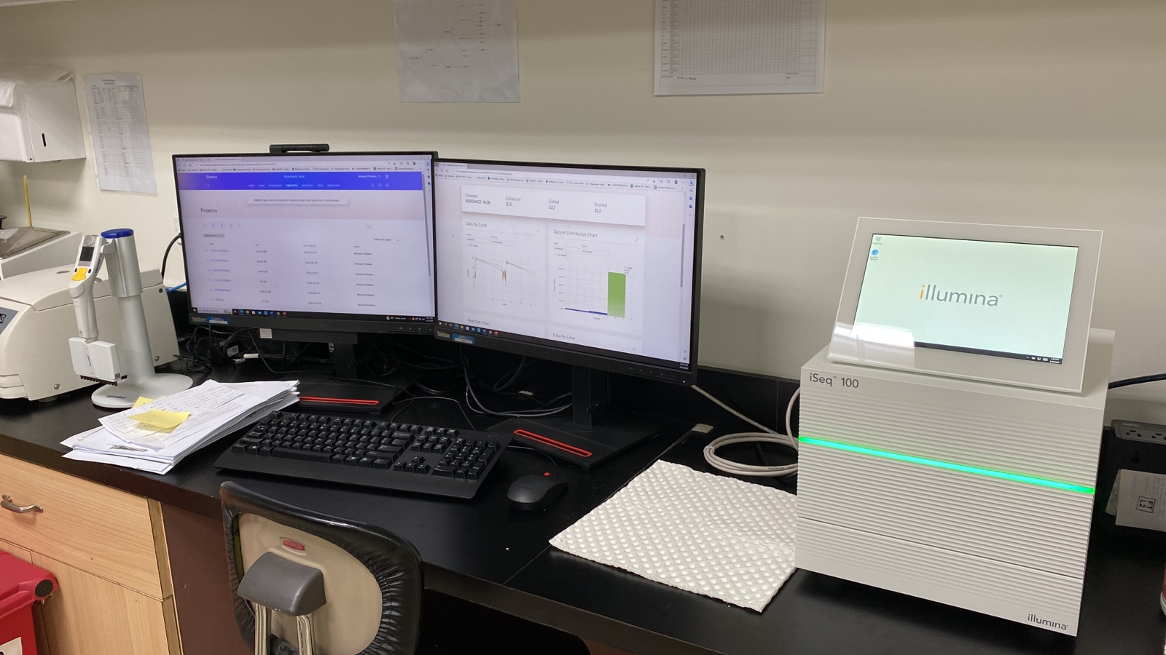
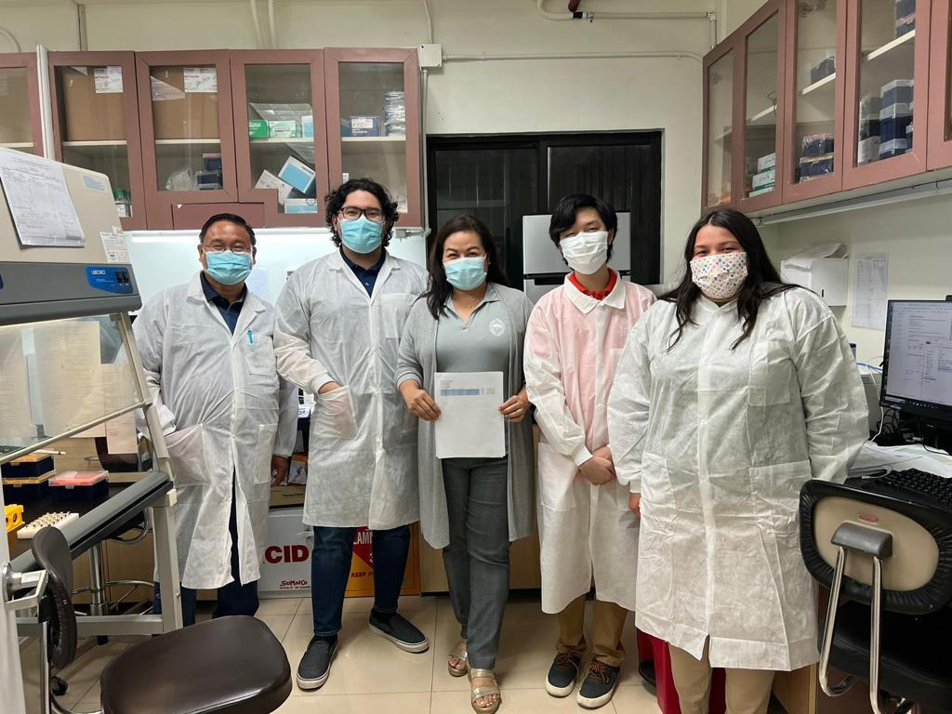
Department of Public Health and Social Services Guam Public Health Laboratory
GPHL Here and Now…
Communicable/infectious disease testing equipment obtained from CDC ELC grant funds
Illumina iSeq 100 with Illumina BaseSpace Hub DRAGEN COVID Lineage
Genome RNA Sequencing System for variant/strain analyses
(i.e., SARS-CoV-2 variants, and other emerging infectious diseases)
Completed validation February 23rd, 2023
Estimate Price per Test for proposed billing | Testing Budget
$219.25 | 100% Federal CDC IRR-International Reagent Resource for PCR reagents 2020 PHEP/FEMA/HHS Pandemic Covid-19 Emergency Response, donations/allocations amounting to about $16M 2020 ELC- Epidemiology And Lab Capacity Pandemic Covid-19 Emergency grant funds, supply amounting to about $13M

Slide 13
Department of Public Health and Social Services Guam Public Health Laboratory
GPHL Tests Performed from FY 2015 to 2023
Indicator | FY2015 | FY2016 | FY2017 | FY2018 | FY2019 | FY2020 | FY2021 | FY2022 | FY2023
Number of Total Tests performed | 10,585 | 10,036 | 9,785 | 10,814 | 9,133 | 30,921 | 87,254 | 276,155 | 23,559
Number of Genome Sequence CoV-2 performed | N/A | N/A | N/A | N/A | N/A | N/A | (CDC) | (CDC) | 105
Number of Influenza Subtyping performed | 3 | 4 | 97 | 250 | 210 | 49 | 61 | 261 | 213
Number of Leptospirosis tests performed | 2 | 8 | 5 | 19 | 5 | 0 | 39 | 34 | 26
Number of Non-Variola Orthopoxvirus (Mpox) | N/A | N/A | N/A | N/A | N/A | N/A | N/A | N/A | 1
Number of Respiratory Multiplex/Panel tests | 29 | 158 | 68 | 34 | 2 | 32 | 79 | 113,794 | 9,699
Number of SARS-CoV-2 tests performed | N/A | N/A | N/A | N/A | N/A | 27,024 | 82,962 | 156,899 | 9,060
Number of STD/HIV tests performed | 6,382 | 5,684 | 6,023 | 6,859 | 6,192 | 2,546 | 2,688 | 3,584 | 2,766
Number of Tuberculosis tests performed | 968 | 1,115 | 1,144 | 1,303 | 1,436 | 198 | 713 | 689 | 703
Number of Vector-borne tests performed | N/A | 83 | 141 | 20 | 192 | 186 | 26 | 10 | 22
Number of Vaccine Preventable Disease tests | 1,280 | 1,128 | 5,71 | 319 | 184 | 201 | 345 | 388 | 305
Number of Non-Communicable Disease tests | 1,921 | 1,856 | 1,736 | 2,010 | 912 | 685 | 341 | 496 | 659

Slide 14
Department of Public Health and Social Services Guam Public Health Laboratory
Client – AAFB, CME, CPS, DLS, DOC, DPHSS, DYA, GIAA, GCC, GCQA, GBHWC, GDOE, GFD, GMH, GPD, GRMC, GVB, JOG, MCH,
non-healthcare agencies, NRCHC, private clinics, private pharmacies, Ryan White, SRCHC, STD/HIV, TB/Leprosy, Territorial Epidemiologist office, Training centers, UOG, USAPI, USNH, VPD Immunization, WIC

Slide 15
GPHL Future Plans…
Department of Public Health and Social Services Guam Public Health Laboratory
Recruit and hire Technicians & Microbiologists (AMD, ARLN, HAI, QA/QI, WGS)
Install and train for the Laboratory Information Management System (LIMS)
Revalidate of Vitek 2 System for in-house bacterial culture and susceptibility testing
Provide Salmonella, Shigella, Vibrio culture and serotyping, other foodborne disease testing
Revalidate Bactec MGIT for in-house AFB culture and susceptibility testing
Modify and update MOU by mutual consent of authorized officials for compensation and/or replenishment of supplies, reagents, materials, and or other services (i.e. redirection, laboratory reagent and testing supplies - PPE, disinfectants, biohazard containers, and/or consumable supplies- pipette tips) in lieu of payment.
Propose supply compensation may be less than or equal to 50% of test costs for clinical human specimen testing performed by the GPHL until the capability to bill for services are operationalized.

Slide 16
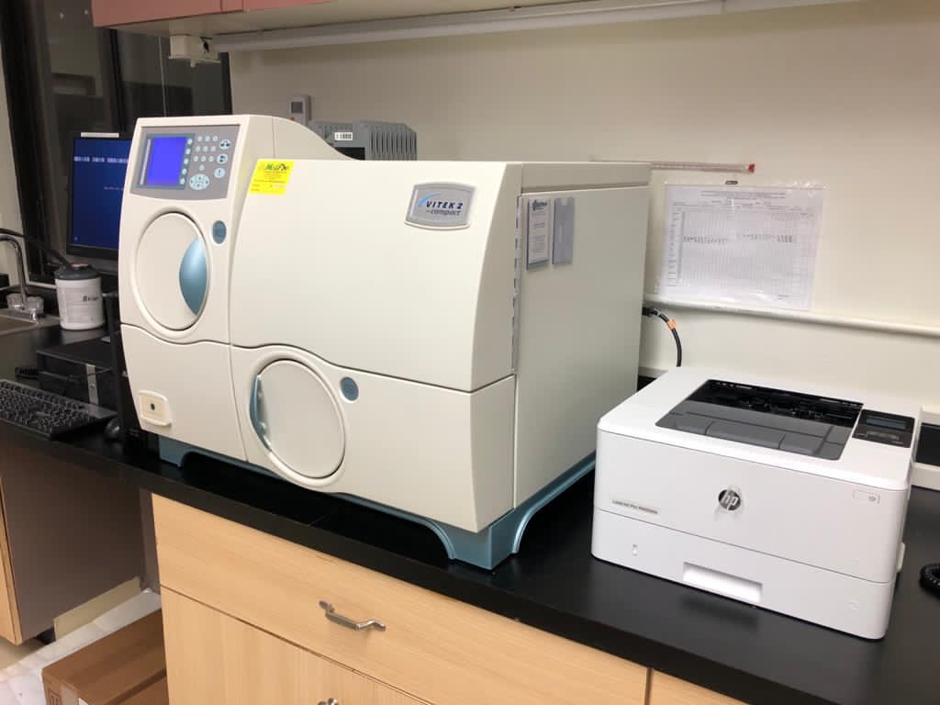
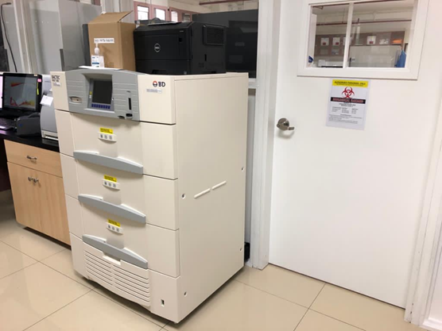
GPHL proposed validation plans
Department of Public Health and Social Services Guam Public Health Laboratory
Microbiology Culture through CDC ELC | Estimate Price per test for future billing
Vitek 2 System Gram Negative Bacilli GN - 162 organisms GN – 36 antimicrobials and ESBL test Gram Positive Cocci and Bailli GP - 124 organisms) Anaerobes and Corynebacteria ANC – 89 organisms Neisseria and Haemophilus NH – 32 organisms Yeast YST – 54 organisms YST – 3 antimicrobials Staphylococci and/ Enterococci 24 antimicrobials and ICR test Streptococcus and ICR test Streptococcus Pneumoniae 16 antimicrobials | $87.77
Vitek 2 System
Mycobacteria Culture through CDC TB | Estimate Price per test for future billing
1 BACTEC MGIT 960 (pending BSL3 room) Mycobacterium tuberculosis | $89.50
Bactec MGIT 960

Slide 17
GPHL Regional PH Laboratory Plans…
Department of Public Health and Social Services Guam Public Health Laboratory
The new GPHL will serve the DPHSS and also have the potential to provide confirmatory BSL2/3 analytical testing capability for clinical human specimens and workforce development for numerous stakeholders and partners including other USAPI laboratories.
Vision of GPHL is to serve as the Regional hub for laboratory testing, training, and research in Micronesia.

Slide 18
Strengthen GPHL collaboration with external public and private partners support for BSL2/3 lab
Department of Public Health and Social Services Guam Public Health Laboratory
Local private clinics and other Government of Guam agencies
Local universities and community colleges: University of Guam (UOG), Guam Community College (GCC)
Local clinical laboratories: Diagnostic Laboratory Services (DLS) Inc., Guam Memorial Hospital, Guam Regional Medical City, NRCHC and SRCHC for Influenza and SARS-COV-2 Surveillance
Clinical human specimens with positive Influenza A/B and SARS-CoV-2 results from Rapid testing forwarded to GPHL for subtyping
Reference public health laboratories: CDC, PIHOA, WHO, SPC, APHL, APHL Pacific Rim Consortium (Hawaii State Laboratory Division, Washington State, California, LA County, Oregon, Nevada, Alaska, USAPI)
Federal agencies: HHS, FDA, CMS, CLIA, CSTE, CDC Foundation, CDC ELC TAP

Slide 19
Status of GPHL’s New Building…
Department of Public Health and Social Services Guam Public Health Laboratory
Grant: $32M Awarded to the Office of the Governor-Community Defense Liaison Office (CDLO) – Grantee
Awarded by: Office of Local Defense Community Cooperation – Grantor
2015 Supplemental Environmental Impact Statement (SEIS) to build a new public health BSL 3 Laboratory with training room/ classroom.
Subrecipients
Association of Public Health Laboratories (APHL) - HDR is the design team - $5M
Department of Public Works (construction Agent) - $27M
Location - lot adjacent to the Guam cultural repository in Mangilao
Basis of Design development phase is in progress
End User/Client – Government of Guam & Guam Department of Public Health & Social Services

Slide 20
Department of Public Health and Social Services Guam Public Health Laboratory
Thank You!
Any Questions?

