Slide 1
6th Association of the USAPI Laboratories (AUL) Biennial Meeting
Guam
April 18th – 20th 2024
Tebuka Toatu
Pphsn labnet & laboratory surveillance coordinator
Laboratory Strengthening Programme
Public Health Division, SPC

Slide 2
Updates on Lab Initiatives in PICTs
SPC PHD PROGRAMME
(Laboratory Strengthening Programme)
April 18th 2024

Slide 3
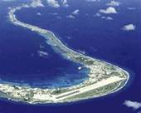
Distributions of 22 National laboratories in the Pacific
USAPI –
Guam, CNMI, RMI, FSM, Palau, American Samoa
Polynesian Islands –
Tokelau, Niue, Cook Is, Samoa, Tonga, Pitcairn Is, Tuvalu
Micronesia & Melanesia -
Nauru, Kiribati, Solomon Is, Vanuatu, Fiji, PNG
French Territories -
Wallis Is, French Polynesia, New Caledonia

Slide 4
SHIPPING OF INFECTIOUS SUBSTANCES TRAINING (SIST) IMPLEMENTATION:
YEAR | COUNTRY | STATUS
2023 | Solomon Island | 7 certified shippers
2023 | CI, FJ, KIR, PNG, Nauru, Samoa, Tonga, SI | 11 certified shippers from 10 countries +4 LSP members
2024 | FP, Niue, Tuvalu, Vanuatu | Pending

Slide 5
LQMS TRAINING:
YEAR | COUNTRY | STATUS
2023 | Nauru | Completed
2024 | Tuvalu , Solomon Islands, RMI - Ebeye | Planned
Notes:
WHO Laboratory Quality Management System Training tool kit was used for the training

Slide 6
SLIPTA AUDIT:
YEAR | COUNTRY | STATUS
2023 | Nauru | Completed
 | Vanuatu | Completed
 | Fiji | Completed
2024 | Tuvalu, Nauru, Kiribati, | Planned

Slide 7
MICROBIOLOGY & IPC TRAINING TO STRENGTHEN AMR SURVEILLANCE AND CONTROL:
YEAR | COUNTRY | STATUS
2019 | Kiribati, Samoa, Cook Islands, Fiji (CWMH), Nauru | Completed (face-to-face)
2020 | Fiji (Lautoka, Labasa) | Completed (face-to-face)
2021 | Tonga, Solomon Islands, Tuvalu | Completed (theory - virtual)
2022 | Tonga, Solomon Islands, | Completed (face-to-face microbiology practical)
2023 | Vanuatu | Completed (face-to-face)
 | Tuvalu | Completed (practical face-to-face)
2024 | Pohnpei, Yap, RMI, Palau | Planned
Notes:
With collaboration with partners – FNU, PIHOA, PPTC, SPC & WHO

Slide 8
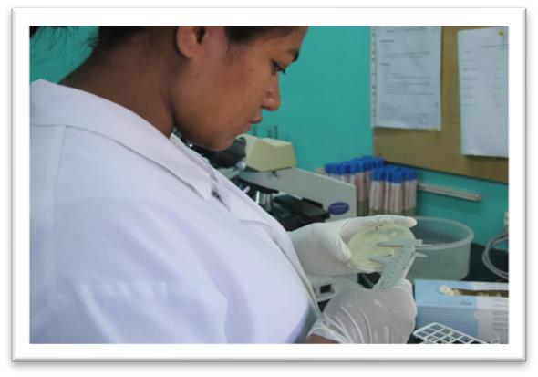
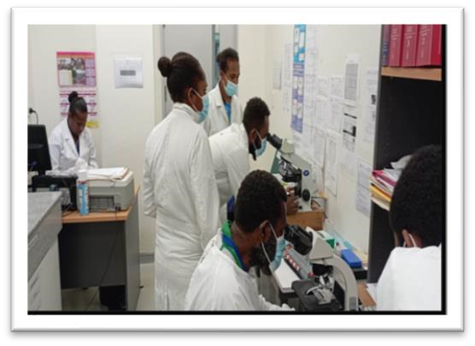
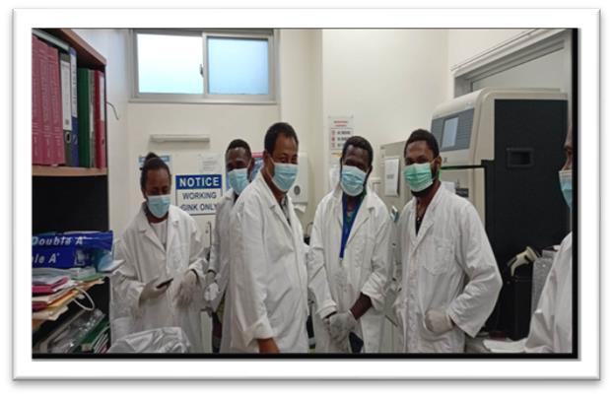
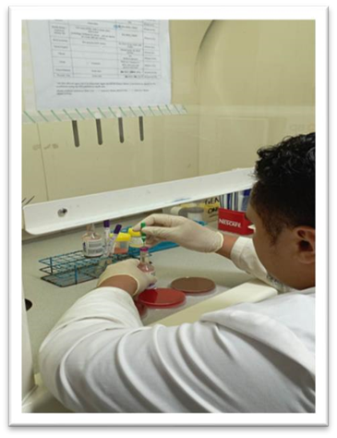
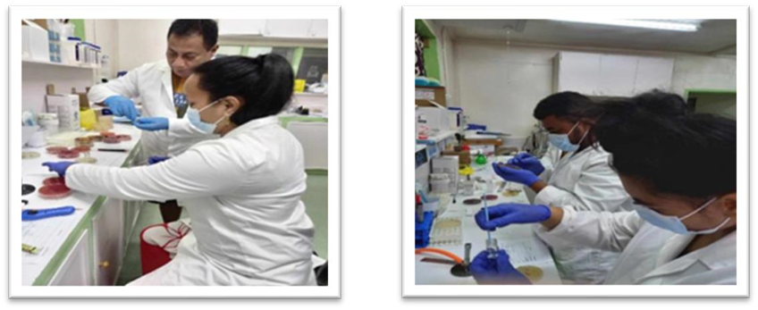
Microbiology Strengthening in PICTs
Kiribati
Vanuatu
Tuvalu Microbiology Strengthening
Samoa

Slide 9
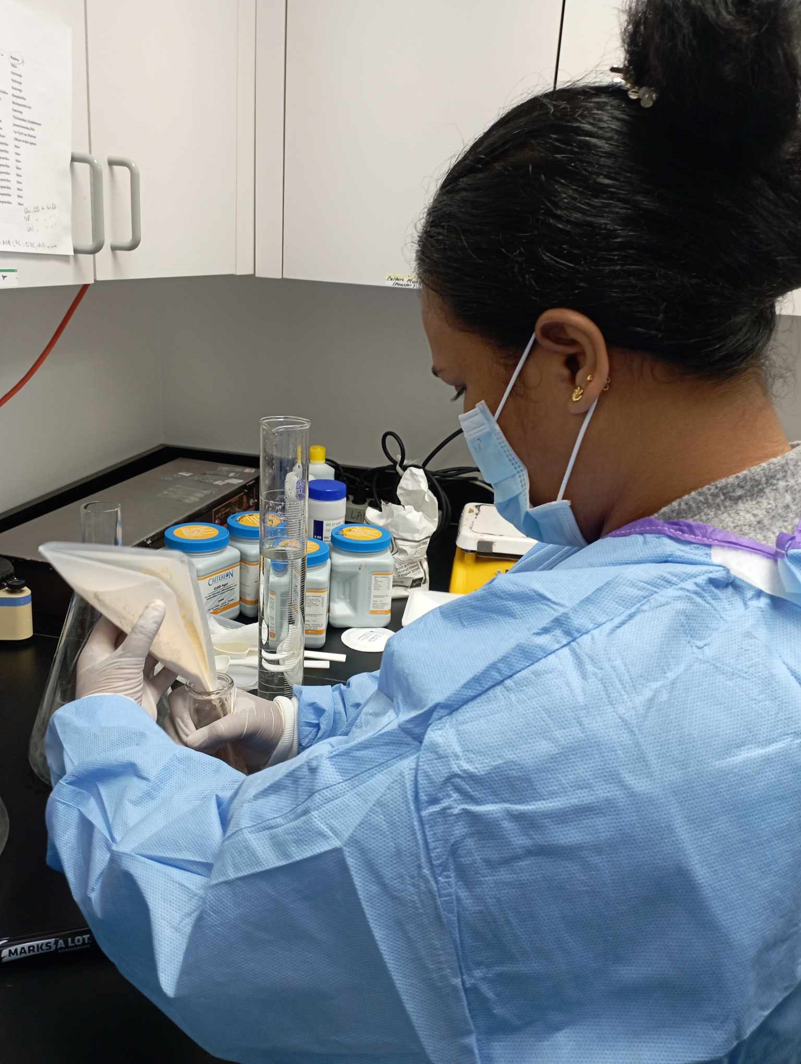
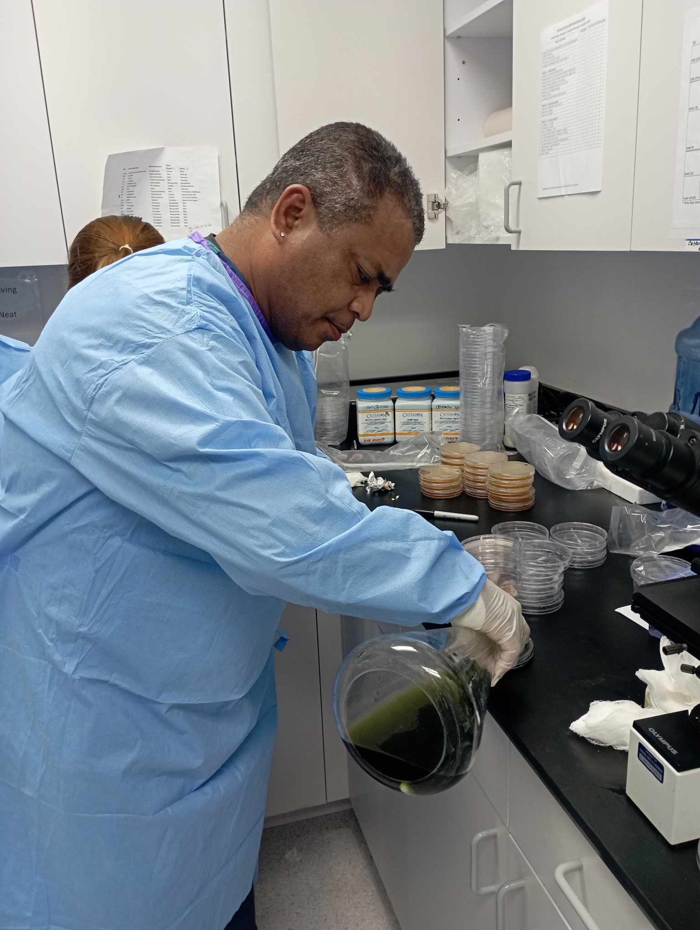
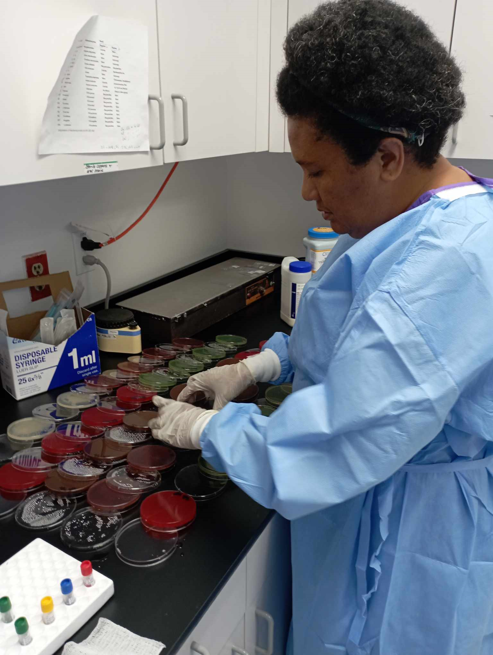
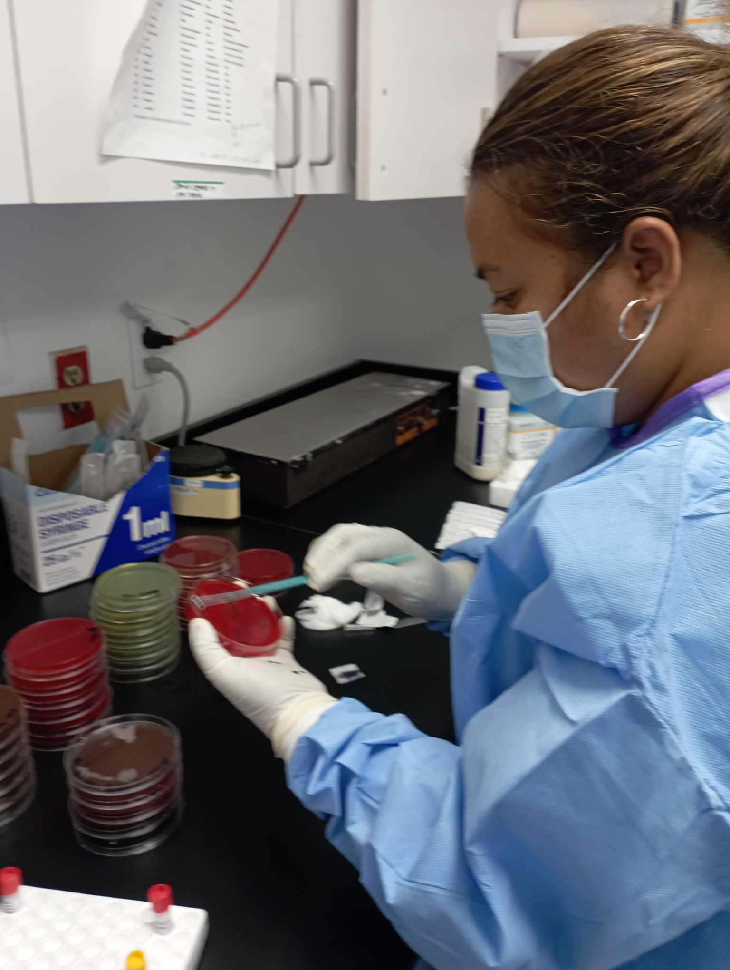
Pohnpei State Hospital Pathology Laboratory

Slide 10
AMR M&E AND ROLL OUT OF SPC PHD ANTIBIOGRAM DATABASE:
YEAR | COUNTRY | STATUS
2022 | Kiribati, Cook Islands, Vanuatu | Completed
2023 | Samoa, Solomon Islands, Nauru, Tuvalu | Completed
2024 | Pohnpei | Completed
 | Yap, Palau, RMI | Planned

Slide 11
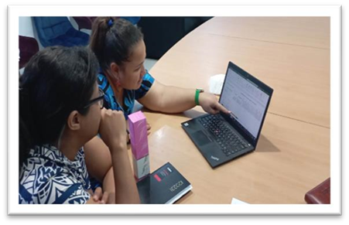
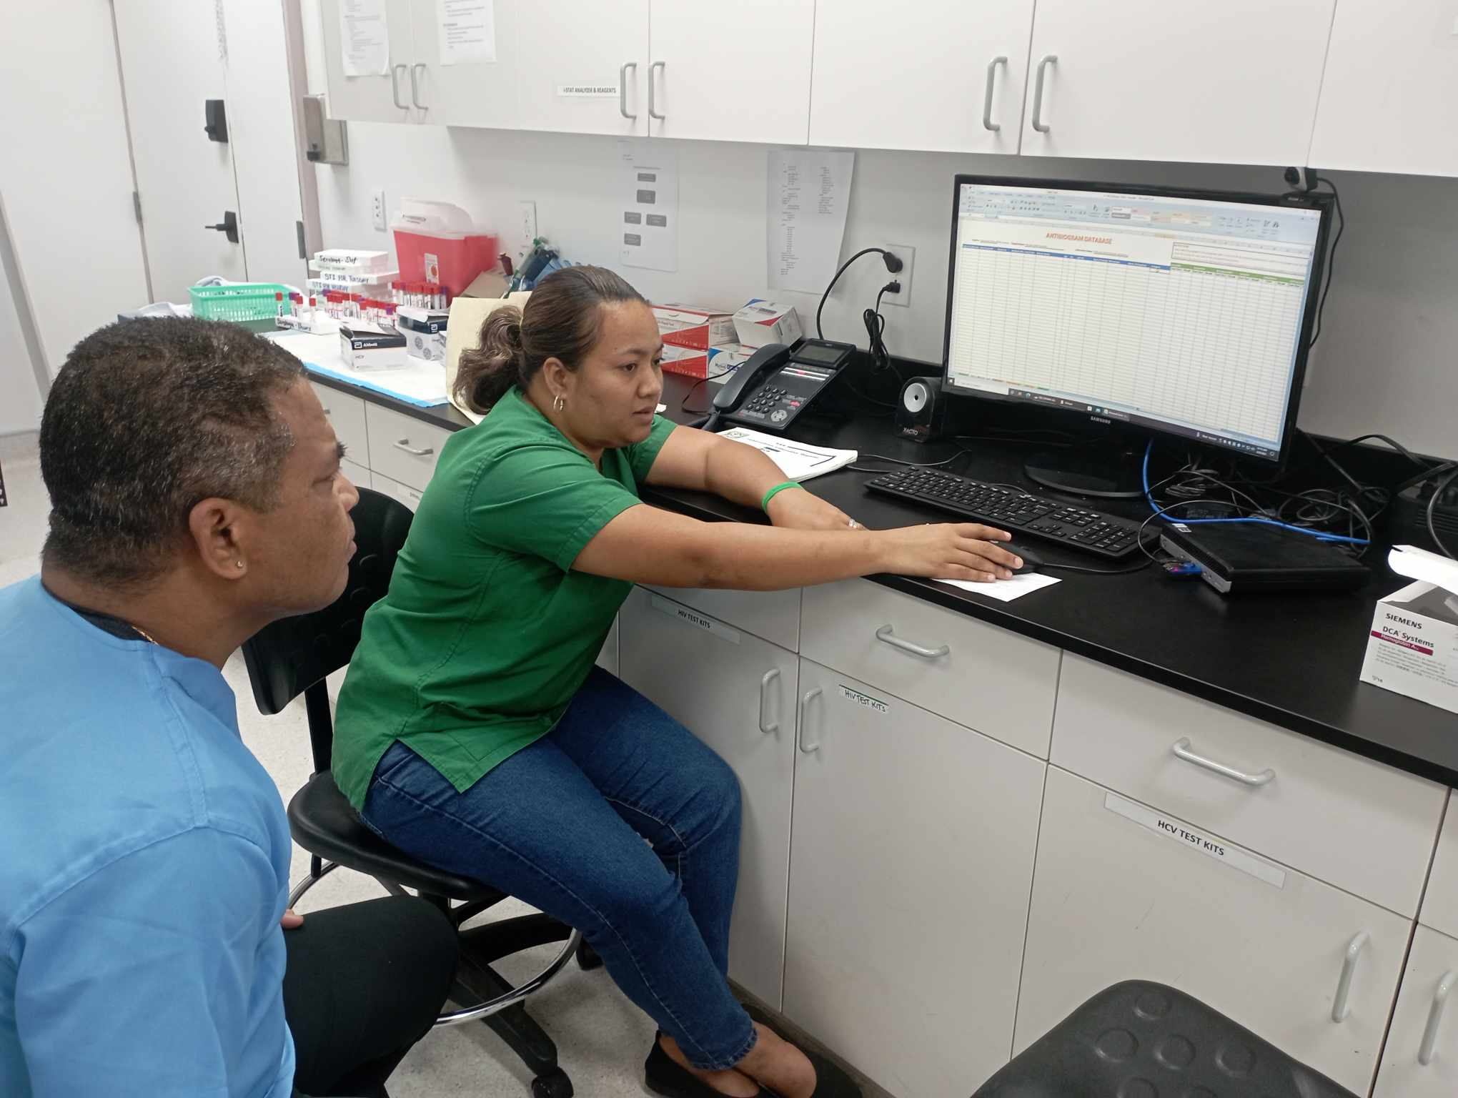
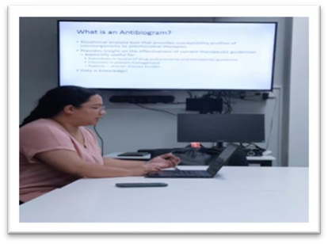
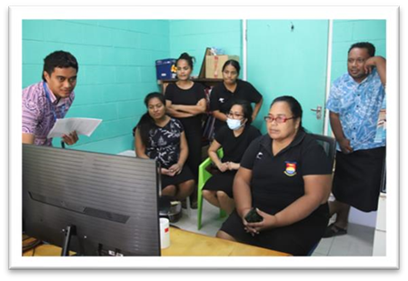
Samoa
FSM – Pohnpei State Hospital Laboratory
Nauru
Kiribati

Slide 12
COLLABORATION WITH PRIDA & PPTC IN THE ROLL OUT OF A DIPLOMA IN MICROBIOLOGY COURSE:
YEAR | COUNTRY | STATUS
2024 | Fiji, Kiribati, Nauru, Timor Les, Tonga, Vanuatu, PNG | Ongoing
Notes:
PRIDA – Pacific Regional Infectious Disease Association. 13 students currently enrolled for this years course

Slide 13
CANCER SCREENING – HPV SCREENING
YEAR | COUNTRY | STATUS
2024 | Tonga, Kiribati | Ongoing

Slide 14
PCR MENTORSHIP PROGRAM:
YEAR | COUNTRY | STATUS
2023 | Cook Island to ESR | Completed
 | Tonga to ESR | Completed
 | SI & Vanuatu to VIDRL | Completed
2024 | VIDRL to Kiribati | May

Slide 15
STRENGTHENING PCR TESTING CAPABILITIES :
YEAR | COUNTRY | STATUS
2023 | Cook Island, Fiji, Kiribati, Tonga, SI, Vanuatu | Provided trioplex (DENV, CHKV, ZKV) and Leptospira reagents Training on testing implementation provided
2024 | Fiji CDC & SI | Trioplex & Leptospira, DENV serotyping reagents –in process
 | Fiji (Labasa Molecular Lab) | Trioplex & Leptospira reagents)

Slide 16
Lab-based Surveillance support during Mass Gathering Events:
YEAR | COUNTRY | STATUS
2023 | Micronesian Games (RMI) | completed
 | Pacific Games (Solomon Islands) | completed
2024 | Pacific Festival of Arts (Hawaii) | ongoing

Slide 17
Other activities:
Updating of LabNet Catalogue
Updating of Regional AMR Dashboard
Updating of Regional Lab Workforce

Slide 18
Thank you

