Slide 1
LEAP
e-QMS :Cloud Quality Management System
BASIC QMS
©2022 CGI KK, ALL RIGHTS RESERVED
Notes:
Objective of this slide:
Tell people what we are going to talk about.
Example script:
LEAP is a unique cloud-based e-QMS software program that guides your laboratory through the entire QMS process.
LEAP assures that all lab staff are appropriately, consistently and inclusively involved.
LEAP sets up and manages your lab’s adherence to the standards.
LEAP supports your lab’s ever-evolving quality journey.
With LEAP, your facility remains in compliance 24/7/365.

Slide 2
Agenda
Quality Management System (QMS)
Components
Objectives
Challenges
LEAP (e-QMS)
3min Video
How LEAP works
How LEAP helps your lab
Message from the Author: Common Sense Implementation of QMS in the Clinical Laboratory, A Software Guided Approach.
Notes:
Objective of this slide:
Review the agenda
Example script:
Today we are covering three overarching topics.
Firstly, we will talk about the Components, Objectives, and Challenges of adopting QMS.
Secondly, we will show you how LEAP e-QMS supports you throughout your QMS journey.
And finally, we will be seeing a short message from the LEAP founder.

Slide 3
Quality Management Systems
QMS
Objectives and Challenges
BASIC QMS
©2022 CGI KK, ALL RIGHTS RESERVED
Notes:
Objective of this slide:
Transition to Quality Management discussion
Example script:
Now, let’s talk about the objectives and challenges of Quality Management Systems in general.

Slide 4
QC
Doc
LIS
Notes:
Objective of this slide:
Highlight common misconceptions of Quality Management Systems (QMS)
Example script:
Many people think QMS tools primarily consists of managing…
Quality Control (QC),
Lab Information System(LIS), and
Document Management Systems
But in fact, it is much, much more

Slide 5
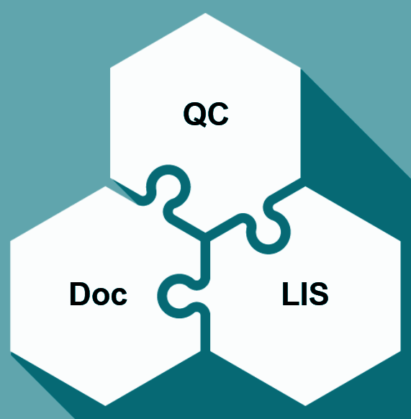
True QMS goes
deeper
Notes:
Objective of the slide:
Emphasize the depth of Quality Management Systems (QMS)
Example script:
In fact, QC, LIS and Document Management is only the tip of the iceberg.
QMS sets policies and procedures for all aspects of clinical testing, beginning with pre-analytical to analytical and finally post-analytical processes.
This quality can only be achieved through real people performing real actions.
QMS is an interlinked end-to-end process. Failure in any link can lead to decreased economic productivity, safety lapses and even catastrophic failures.

Slide 6
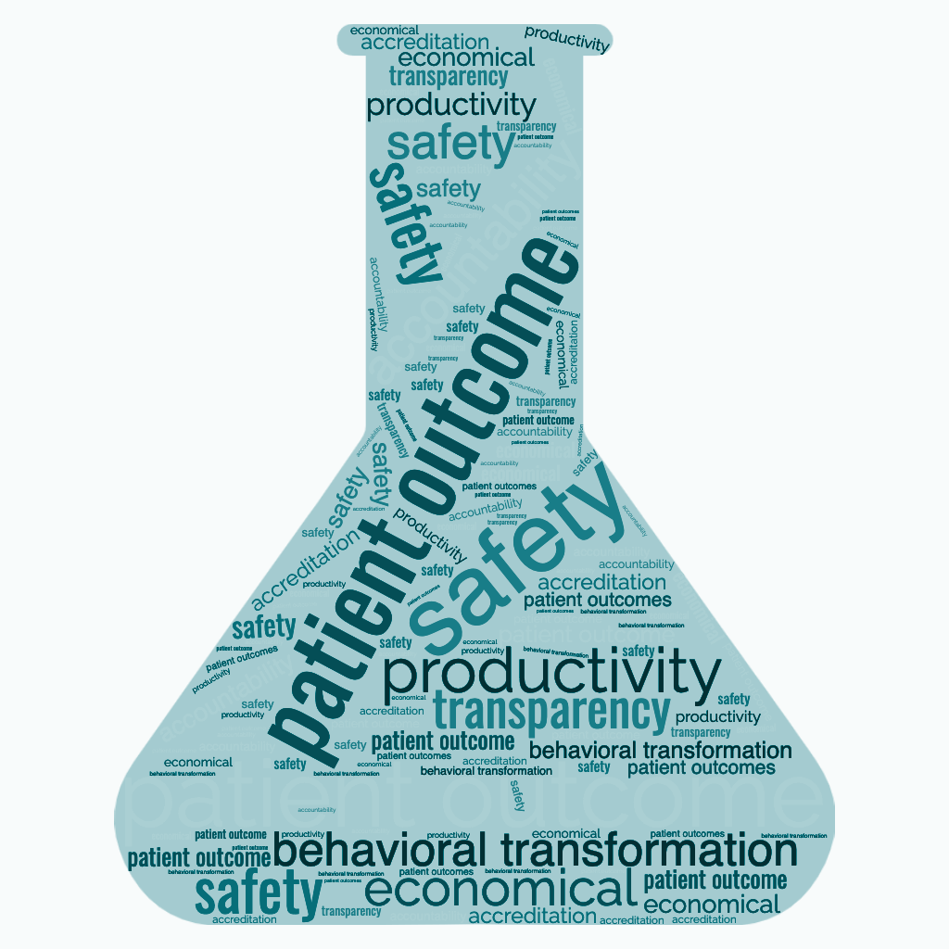
QMS has many objectives and benefits.
But ultimately, effective QMS should be about advancing patient outcomes.
Notes:
Objective of the slide:
Emphasize that QMS’s ultimate objective is about “advancing patient outcomes”
Example script:
While there are many objectives, the primary QMS objective is advancing patient outcomes. Period.
Virtually every standard can be linked back to supporting patient outcomes, assuming, of course, all laboratory staff are also potential patients.

Slide 7
High standards
High benefits
Higher challenges
BASIC QMS
Notes:
Objective of the slide:
Explain CAP and ISO 15189 standards
Example script:
Accreditation demonstrates that you are operating a safe, effective and patient centric laboratory.
There are two primary clinical laboratory standards. These are the College of the American Pathologist (CAP) and the The International Organization for Standardization (ISO) 15189.
Your choice of standards will depend on your circumstances, objectives, and geography.
The ISO standards tend to be more flexible, allowing you to create your own vision of quality. ISO tends to be more local, considering local economic, infrastructure, culture and educational systems.
The CAP standards are much more rule-based and encompass over 2,000 standards and specific to each technical speciality. These standards are constantly being upgraded based on technical advancements.
Both CAP and ISO have its benefits, and both are challenging if done right.
In all likelihood, if you are going to support global clinical trials or entertain global collaborations, CAP should be considered highly.

Slide 8
Large Volume
Documentation
Educating Personnel
Progress Management
What to do next?
Inspection
CAPA
QMS is a never ending
process
Notes:
Objective of the slide:
Remind listeners that building and maintaining a high level of QMS requires the commitment of the whole laboratory and driven and supported by management. Discuss the transition from paper to digital paper management to e-QMS.
Example script:
Quality is a journey with no end.
Realizing your objectives can only be had by building quality processes, driving education, attention to detail, and keen organizational management.
These objectives were particularly challenging with analog, paper based systems. Things became marginally better with digital document management systems. e-QMS brings things to an entirely new level, enabling quality processes though staff accountability and organizational transparency.

Slide 9
“QMS is NOT a mysterious.”
“QMS is NOT Documentation”
“QMS is a set of rules to be followed and processes monitored.”
“QMS rules are basically Common Sense.”
“The challenge of QMS is to manage a large number of processes.”

Slide 10
Introducing LEAP
QMS
e-QMS Empowered
BASIC QMS
©2022 CGI KK, ALL RIGHTS RESERVED
Notes:
Example script:
Now talk about e-QMS focusing on LEAP Software.

Slide 11
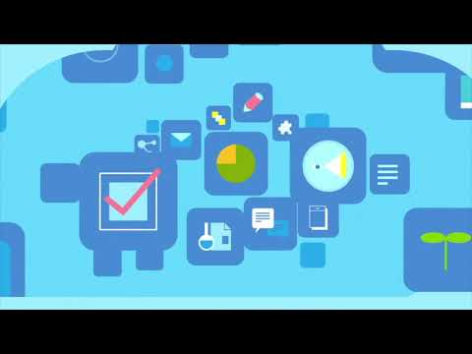
Notes:
Example script:
To provide a base for this discussion let’s take a look at a short 3 minute video describing how LEAP works.

Slide 12
LEAP is Your Quality Manual
Project Manager
Resource Library
Process Monitor
CAPA Manager
Document Manager
Performance Monitor
Notes:
Objective of the slide:
Introduce LEAP as the solution to the problems that clinical laboratories encounter when tackling QMS.
Remind listeners that LEAP is approved and audited by CAP
Example script:
Building QMS requires successfully completing many projects. This can be accomplished by LEAP’s project management system,’
Of course, these processes can only become functional if everyone is educated on how these systems work and what their role is.
Ultimately, success is had by providing system transparency and individual and organizational accountability. LEAP supports this through a cascade of intuitive dashboards clearly flowing from your overall QMS status of your entire laboratory, from there to each department and finally to each individual.
LEAP will help your laboratory achieve all of this by making QMS become a shared habit.
Effective utilization of LEAP will not only assure you meet your QMS objectives, it will also make your lab Inspection ready 24/7.

Slide 13
LEAP VERSIONS
LEAP – CAP
LEAP – ISO15189 (2022)
LEAP – BASIC CAP
LEAP – BASIC ISO

Slide 14
Fundamental LEAP Concepts
Project Logic Flow
Family of Standards (FOS)
5 Tasks process for each FOS
Actionable Content Library
My Tasks
My Maintenance Tasks

Slide 15
LEAP Underlying Logic Flow
Evidence of Compliance
EVIDENCE & GUIDANCE
Procedures
HOW
TO IMPLEMENT
Policies
INTERNALISE
Standards
THE RULE
Notes:
Objective of the slide:
Explain the underlying logic of LEAP flow.
Example script:
LEAP’s underlying logic is based on simple principles.
Firstly, understand the rule which is set by the Accreditation Body.
Secondly, create a policy that states that your lab will comply with that specific standard.
Thirdly, create and implement a system based on your policy to ensure the lab continuously stay in compliant to standards.
Lastly, review and document all evidence.

Slide 16
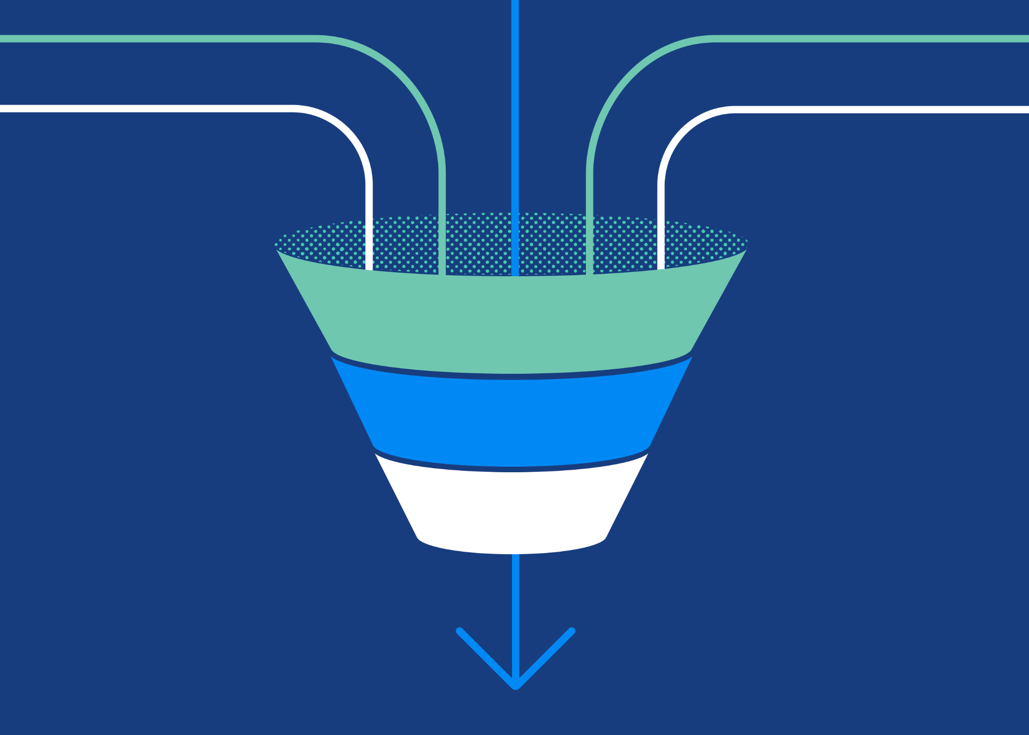
Project Management
Education Reference
Transparency Accountability
Build QMS
Habit
Be Inspection
Ready
LEAP mimics the PDCA cycle for continuous improvement
Extensive standards converted to logical bite-sized projects
Family of Standard
Notes:
Objective of the slide:
LEAP helps streamline QMS building and maintaining by making the projects bite-sized, manageable and effective.
Sample Script:
Managing a single standard like managing temperature is, to be sure easy and is common sense. The risk of not maintaining temperature is obvious as are the benefits of doing it properly. I would argue that all published standards are common sense when looking at risks and benefits. I would also say that creating a policy and procedure is equally simple.
The challenge comes from two fronts. First is the fact that there are so many standards and the second is the interlinking nature of these standards.
This is where modern computing comes into play. In fact, LEAP manages most of the organizational stuff for you leaving you and your staff to focus on thinking, learning and effectively implementing.
To further help you, LEAP incorporates unique concepts developed through decades of trial and error by QMS consultants and software designers.
One example is the concept of Family of Standards (FOS), whereby ISO or CAP standards are grouped in bite-sized, manageable pieces.
Each FOS becomes a project supported by all the tools you will need for the creation and maintenance of effective QMS processes.
All documentation is automatically categorized and filed for easy management and retrieval.

Slide 17
Project Management
Education Reference
Transparency Accountability
Build QMS
Habit
Be Inspection
Ready
The 5 Task Process for Effective QMS Building
for a consistent and streamlined approach
Master Evidence Consolidation
5
Setting up Maintenance
4
Budget
3
2
Customization
1
Education
Notes:
[MAC: I really don’t like the graphics on this slide. We can do better.]
Objective of the slide:
Demonstrate another example of LEAP’s unique design is the 5-tasks process, which drives effective implementation for each standard.
Sample script:
Another part of LEAP’s ‘secret sauce’ is its standardised task-based approach for each project. Each group of standards, or FOS follows this 5-task process:
Task 1) Create and Approve Materials and customise processes to your laboratory
Task 2) Assign and review materials by all stakeholders
Task 3) Create and review budget requirements
Task 4) Create maintenance teams and intervals
Task 5) Consolidate Inspection-Ready Master Evidence Folder (MEF)
Going through this 5-task process insures your QMS is built to meet your specific needs, allows all stakeholders to understand the objectives of each standard and their role in making it work. This process also ensures resources are considered for effective implementation and long-term maintenance.
Most of all, the LEAP 5-tasks process helps assure that knowledge is shared and churned both within individual stakeholder’ minds and among all participants within the organization.

Slide 18
Each FOS Contains a Content Library
An overview of all Standards and helpful hints
Templates of all required materials
Samples of all completed templates for customization
Education materials where applicable

Slide 19
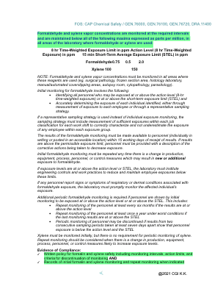
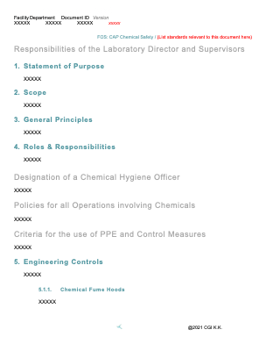
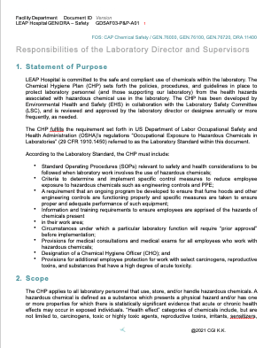
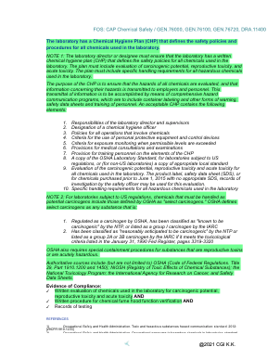
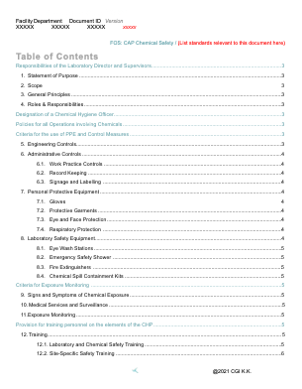
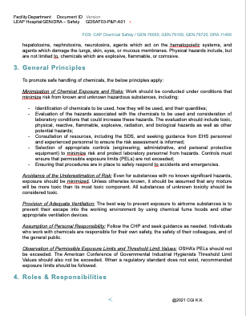
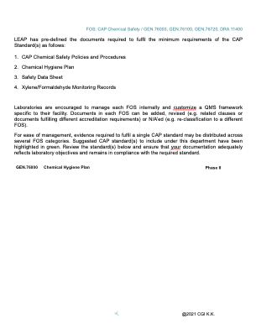
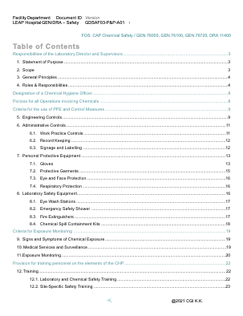
Project
Management
Education & Reference
Transparency Accountability
Build QMS
Habit
Be Inspection
Ready
Over 1,700 Resources and Growing…
Overview
of Standard
Templates
of all documentation
Samples
of all documentation
Notes:
Objective of the slide:
Show how LEAP is full of comprehensive content available for use and customization.
Sample Script:
LEAP is full of useful and efficiently curated information from CAP and ISO 15189 standards as well as the QMS community.
Each family of standard contains an Overview which explain the standards.
It also comes with Templates and Samples of necessary documentation and compliance evidence.
The content serves as a guideline to compliance.
There is over 1,700 files that are organised systematically for easy reference, as well as a catalogue of education materials. LEAP continues to update this information based on new standards and feedback from QMS professionals

Slide 20
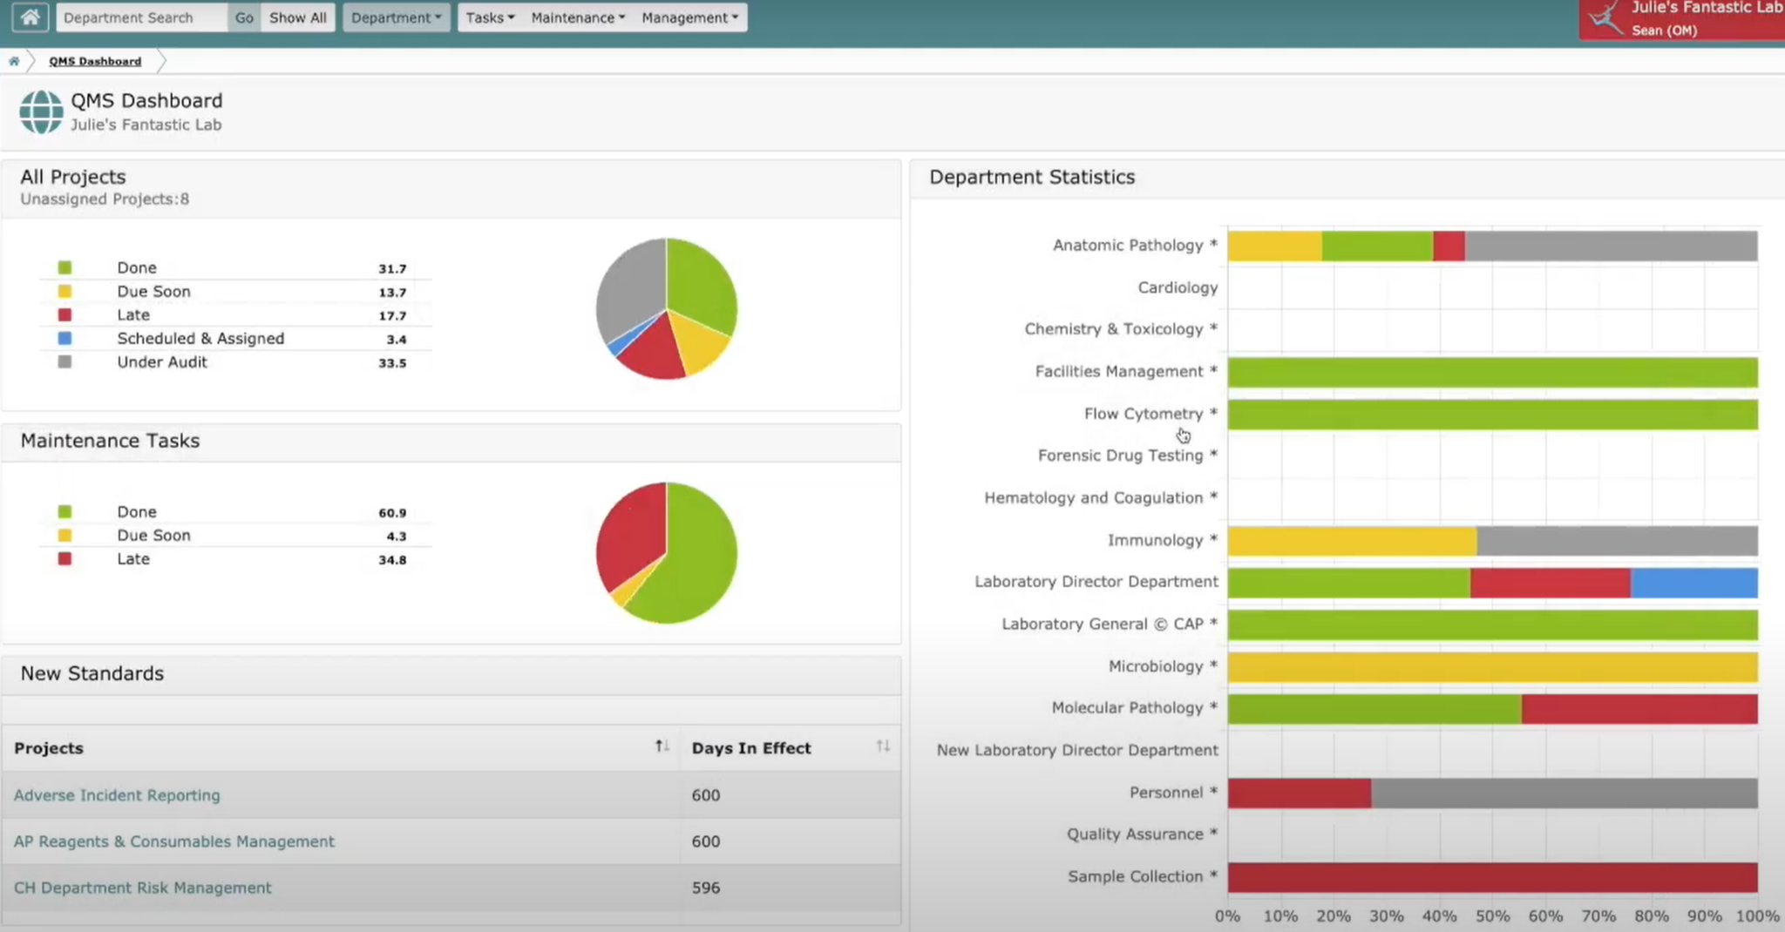
Project
Management
Education Reference
Transparency Accountability
Build QMS
Habit
Be Inspection
Ready
Monitor QMS building
by department, person and standard grouping
Notes:
Objective of the slide:
Show how LEAP creates transparency and drives accountability.
Sample script:
LEAP contains a cascade of intuitive dashboards. The main dashboard depicts the QMS status of your entire laboratory.
With a single click you can dive into each laboratory department.
With another click you can see the status of each project and the role and status of each individual stakeholder.
LEAP even has one-click accessibility to each person’s individual “to-do-list” by clicking the MY TASK button.
LEAP is easy to use and effective.

Slide 21
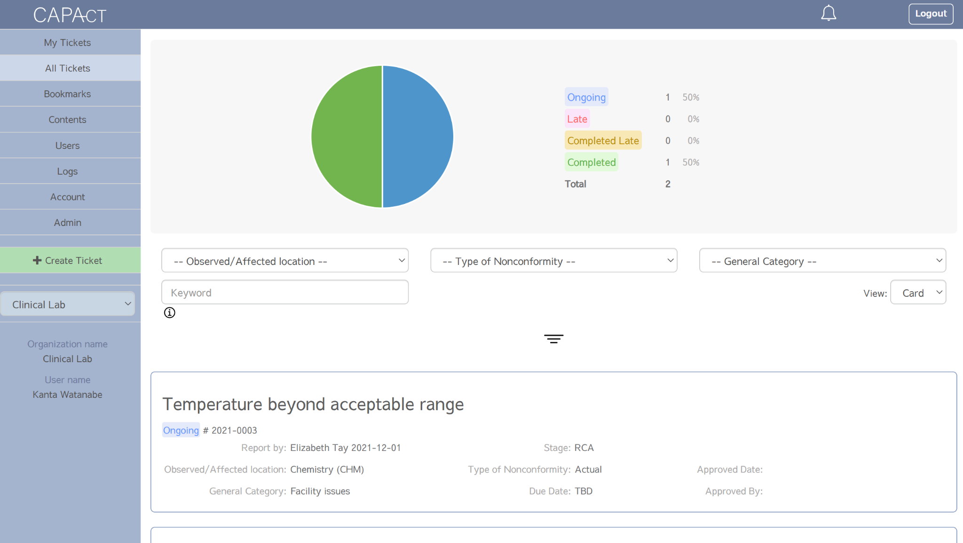
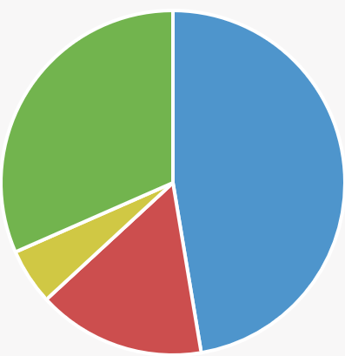
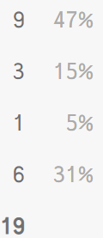
Project
Management
Education Reference
Transparency Accountability
Build QMS
Habit
Be Inspection
Ready
Tracking system for non-conformities
Notes:
Objective of the slide:
LEAP helps manage and monitor non-conformities.
Sample script:
LEAP has a Non-conformity or CAPA management application.
You can register, catalogue, assign and track each CAPA project, specific to each department, and each member’s assigned duties.
This can be used to track and resolve non-conformities, inspection deficiencies and even to manage quality indicators.

Slide 22
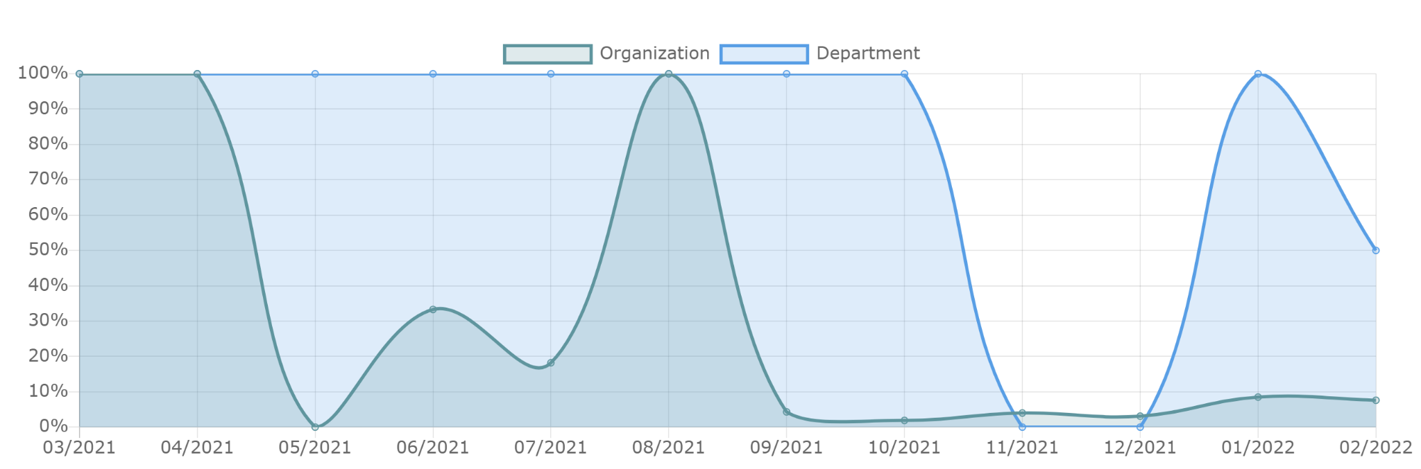
Project
Management
Education Reference
Transparency Accountability
Build QMS
Habit
Be Inspection
Ready
Encourage regular QMS habits through prompts,progress monitoring, and integration of tasks to daily workflow
Notes:
Objective of the slide:
LEAP lets the lab track the results of QMS compliance, retrospectively, over time.
Sample script:
Each department has an associated QMS maintenance dashboard.
Here we can not only see the current status of QMS compliance, but also your historic compliance.
This is an outstanding way to build good habits for each member of your laboratory, driving accountability.
Remember, the benefits of QMS only come true when standards become ingrained habits. In some ways this dashboard should be called the “Good Habit Builder Dashboard”!

Slide 23
Project
Management
Education Reference
Transparency Accountability
Build QMS
Habit
Be Inspection Ready
Expedited Inspections Management Oversight
For onsite, virtual and hybrid QMS Monotering
Notes:
Objective of the slide:
Emphasize how LEAP is uniquely suited to various inspection types and has been endorsed by CAP
Example Script:
LEAP has been designed for onsite, virtual and hybrid inspections.
LEAP was successfully used for CAP’s first-ever fully virtual inspection.
It has lead to the reduction of inspection time and costs.
Example1- Speedy Inspection
A reference laboratory which performs a single molecular test took two day to finish an onsite inspection.
A lab with the same size took less than half a day to complete the inspection using LEAP.**
** ensure that you do not promise this but state it as an example. A speedy inspection is not necessarily a good one but it does indicate that the lab is well-prepared. For example, when asked, a lab should be able to quickly pull out any documentation or evidence within a minute. This is how LEAP can help.**
Example 2- Smoother Virtual/Hybrid Inspection
A laboratories who uses paper based QMS faced issues during CAP inspections.
Paper-based means that the lab staffs had to hold the paper up to the camera, or had to have a separate device that projects the paper documents. In both cases, paper-based encountered issues of:
1. Inspectors are unable to see the document clearly
2. Using separate device cause other technical issues (e.g., cameras showing faces was disabled in one lab)
Etc.
Where laboratories who used LEAP for a virtual CAP inspection had easy time showing electronic document through share screen.

Slide 24
LEAP Implementation
CGI will create a custom LEAP instance just for your lab.
Each member login and password
All staff to complete on-line tutorial (1-2 hours)
LEAP Academy
Set up projects for all FOS’s
On-line support
Complete all Projects
Maintain all Processes
LEAP Basic Certificate of Accomplishment

Slide 25
LEAP Roles and Permission Levels
System Administrator (CGI Only)
Organization Manager
Consultant
Department Manager
Task Manager

Slide 26
Join the LEAP with…
Notes:
Objective of the slide:
Show the track record of LEAP and how it is already being used in prestigious institutions
Sample scripts:
LEAP is being used in various labs across the globe.
In particular…(select examples from what is pertinent to your client)
National Cancer Center Hospital East (Japan)
Saint Luke Hospital (Japan)
Jichi Medical University Hospital (Japan)
Nagasaki University Hospital(Japan)
Aomori Prefectural Central Hospital (Japan)
Ehime Prefectural Central Hospital (Japan)
Iwate University Hospital(Japan)
Nigata University Hospital(Japan)
SRL&Shizuoka Cancer Center Collaborative Laboratories(Japan)
LSI Medhience Kawasaki(Japan)
Denka Kew Genomics (Japan)
Guardant Health Japan (Japan)
ACTmed(Japan)
Gene Research(Japan)
MiRTeL(Japan)
GeneTech(Japan)
Konica Minolta(Japan)
Takara Bio(Japan)
G&G Science (Japan)
King Salman Armed Forces Hospital (Saudi Arabia)
Dammam Medical Complex (Saudi Arabia)
Assiut University Hospital (Egypt)
Agency for Science, Technology and Research(Singapore)

