Slide 1
Strengthening Health Interventions in the Pacific (SHIP) Program The Pacific’s Field Epidemiology Training Program (FETP) Building epidemiology and surveillance capacity in the USAPIs
7th Association of the USAPI Laboratories (AUL) Meeting
April 19, 2024
Tamuning, Guam
Hélène Le Mouëllic
SHIP Program Manager
helenel@pihoa.org

Slide 2
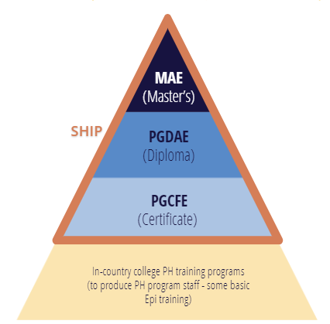
Strengthening Health Interventions in the Pacific
What is SHIP?
Field Epidemiology Training Program (FETP) adapted for the Pacific region
Improve health agencies’ HIS and surveillance, and develop staff capacity
Partnership between PIHOA Secretariat and the Departments and Ministries of Health
Integrates training with capacity development:
“From work, at work, for work”
Accredited by Fiji National University (FNU)
Accredited by

Slide 3
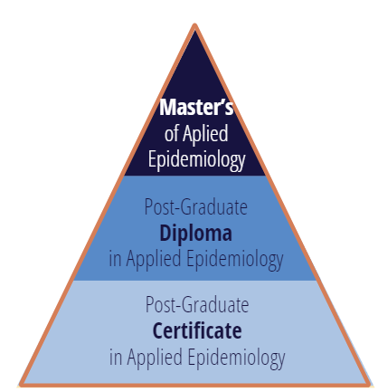
SHIP Courses
Analytical Epidemiology Project
Evaluation of a Health System or Program
Health Emergency Preparedness and Response
Teaching
SHIP courses
In-country residency, knowledge transfer, active engagement
EPI 834
Biostatistics, Data Management and Analysis
EPI 835
Operational Research
1- Protocol Writing
EPI 835
Operational Research
2- Data Cleaning & Analysis
EPI 835
Operational Research
3- Paper Writing
4 one-week training modules delivered on site
EPI 826-01
Introduction to Epidemiology and Field Epi
EPI 826-02
Introduction to Health Information Systems
EPI 826-03
Investigation and Management of Disease Outbreaks
EPI 826-04
Management and Analysis of HIS Data
EPI 826-05
Field Epidemiology Project
5 one-week training modules delivered on site

Slide 4
SHIP Data
Since 2013
5 Diploma courses delivered
RMI: ongoing cohort. 8 Diploma candidates
Plans for regional cohort following online biostatistics course
5
141 Certificate Graduates
79 Certificate courses delivered
13 Certificate cohorts completed
American Samoa: 1, CNMI: 1,
FSM: 4 (1 in each State), Guam: 2, Palau: 1, RMI: 4
2 Certificate cohorts on-going: FSM-Yap, and Palau
28 Certificate Candidates
as of March 2024

Slide 5
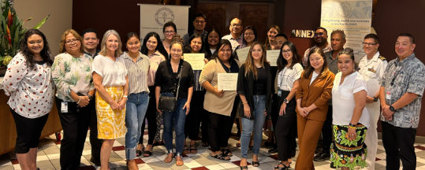
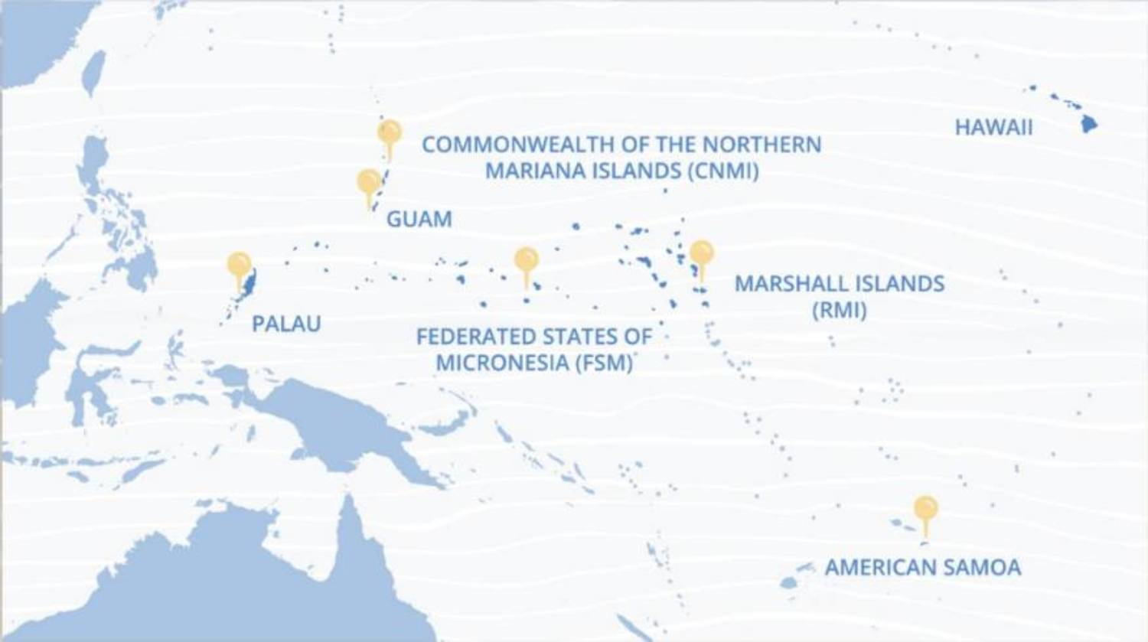
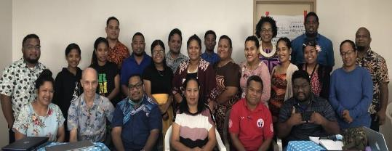
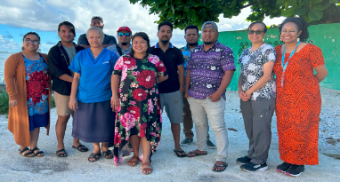
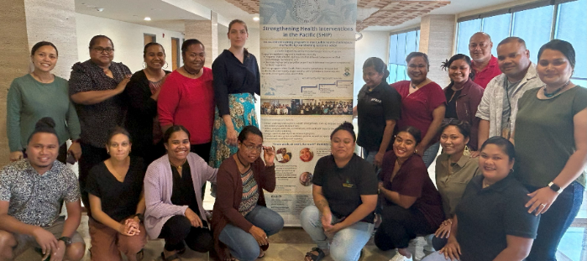
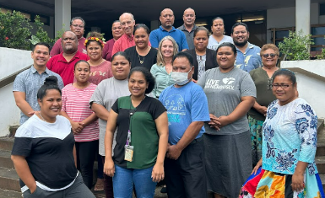
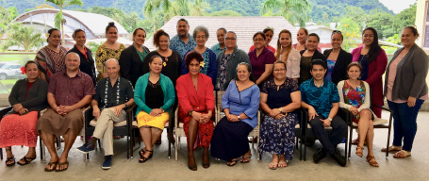
Certificate Cohorts in the USAPIs
CNMI Certificate Cohort, 2023
Guam Certificate Cohort, 2023
Majuro Certificate Cohort, 2023
Ebeye Certificate Cohort, 2023
Palau Certificate Cohort, 2024
FSM - Yap Certificate
Cohort, 2024
American Samoa Certificate Cohort 2019

Slide 6
Partnership and Agreement
PIHOA
MoH/DoH
SHIP Candidates
Deliver courses
Delegate local focal point to work with instructors
Share participants and projects’ progress and receive guidance from MoH/DoH
Do projects in partnership with PIHOA instructors & MoH/DoH leadership and supervisor
Continuous communication with instructors & supervisors on projects and courses
Allow local Epi or previous SHIP graduates (if available) to assist with teaching
Provide a training room for teaching and food
Nominate eligible staff
Select Field Epi Projects
Provide Feedback about EpiTech projects
Formally assess students according to FNU guidelines for course credits
Consult to develop Surveillance & HIS systems project and work with EpiTech to put projects in place
Register participants with FNU
Work with local focal points to organize logistics for courses
Give protected time and space to candidates
Cover tuition costs
Solicit supervisors and team’s input for project improvement
Take courses for credit

Slide 7
Epi Technicians at the Certificate level
Operate existing, well-designed data systems
Assure good quality data inputs
Use Excel and/or EpiInfo
Produce standard, high-quality reports
Understand and can explain reports
Not for designing health information systems or analyzing complex data

Slide 8
Staff to consider for Epi Technicians
EpiNet team data person
Hospital statistics officer
PH statistics officer
MCH data officer
SAMH data officer
NCD surveillance person
Vital Stats officer
QA/other data officer
IT officer
Administrators & Managers
EpiNet Team members:
Physician
Lab
Public Info Officer
Administrator on EpiNet team
Environmental Health Officer
Hosp Infection Control Officer

Slide 9
Epi Technicians Candidates Must Have
Good level of English language and math skills
(e.g., no problem with division/multiplication, fractions, percentages)
(not every data entry technician can handle this material)
Interest and motivation to take all 5 face-to-face courses
Willing to do required pre-work in preparation for each course
Willingness to put other work aside during each week-long course
Willing to take courses seriously, work hard, take all required exams and complete each project
FNU eligibility requirements
Eligibility:
a bachelor’s degree, or three years’ experience
working in the health sector
a supportive reference from a workplace supervisor
endorsement/nomination by the MoH/DOH
applicants without an undergraduate health degree or with less than the required professional experience may be considered for enrollment on a case-by-case basis.

Slide 10
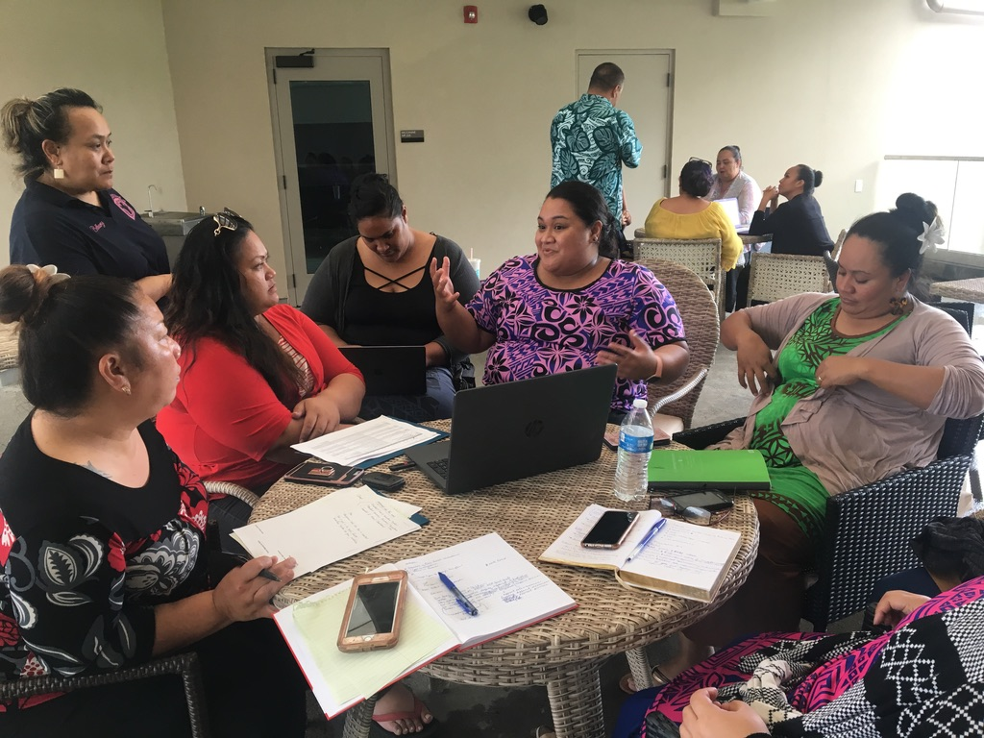
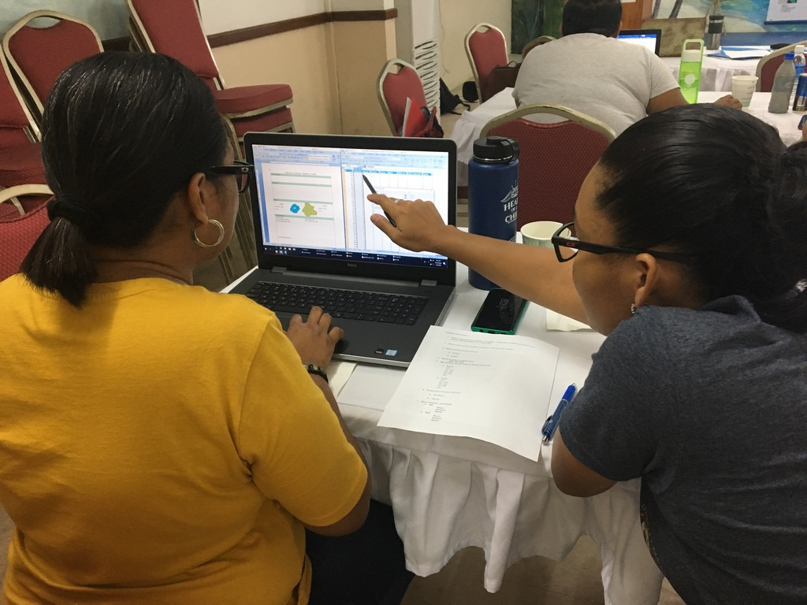
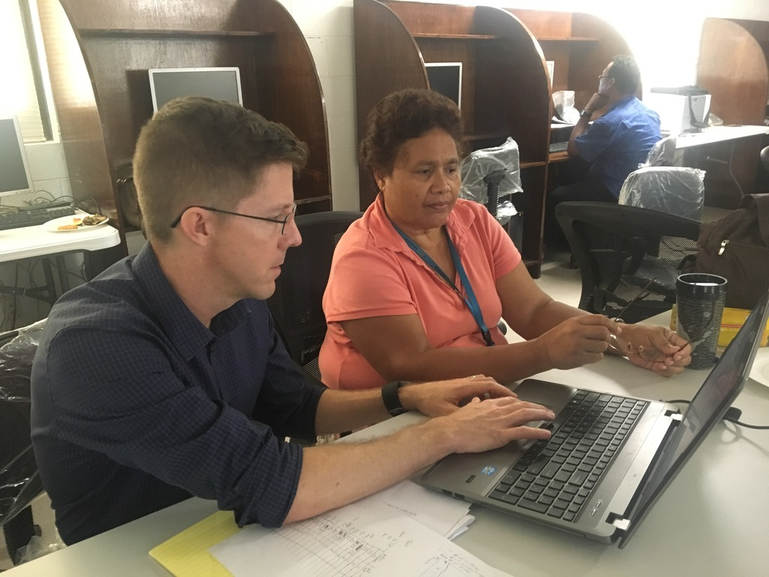
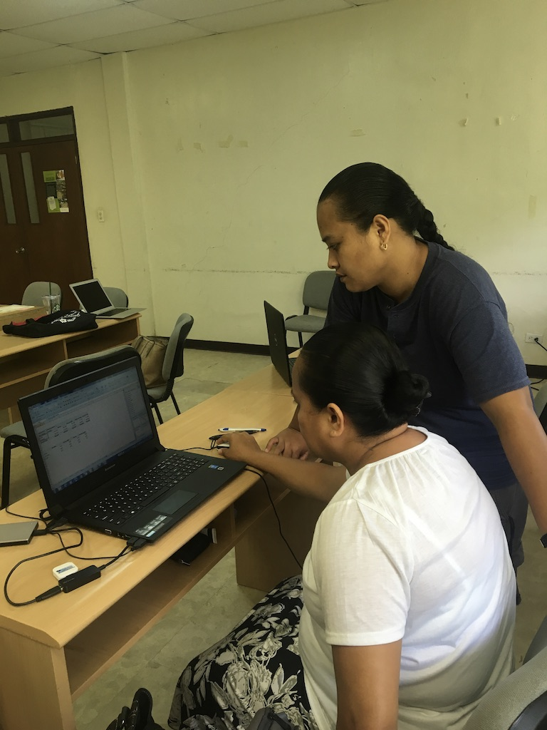
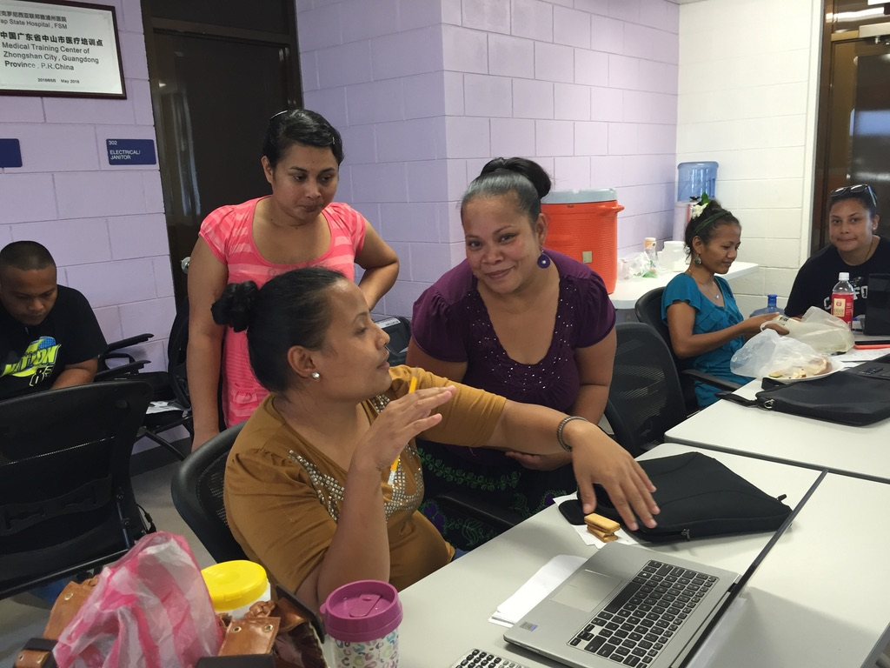
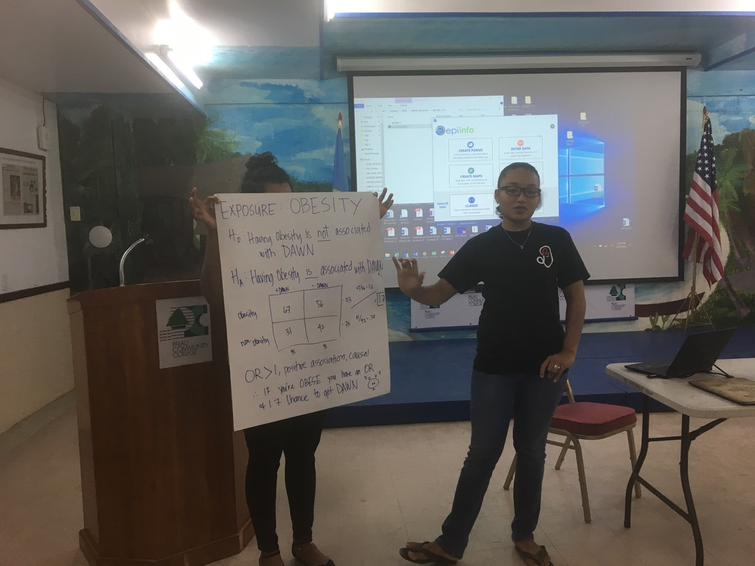
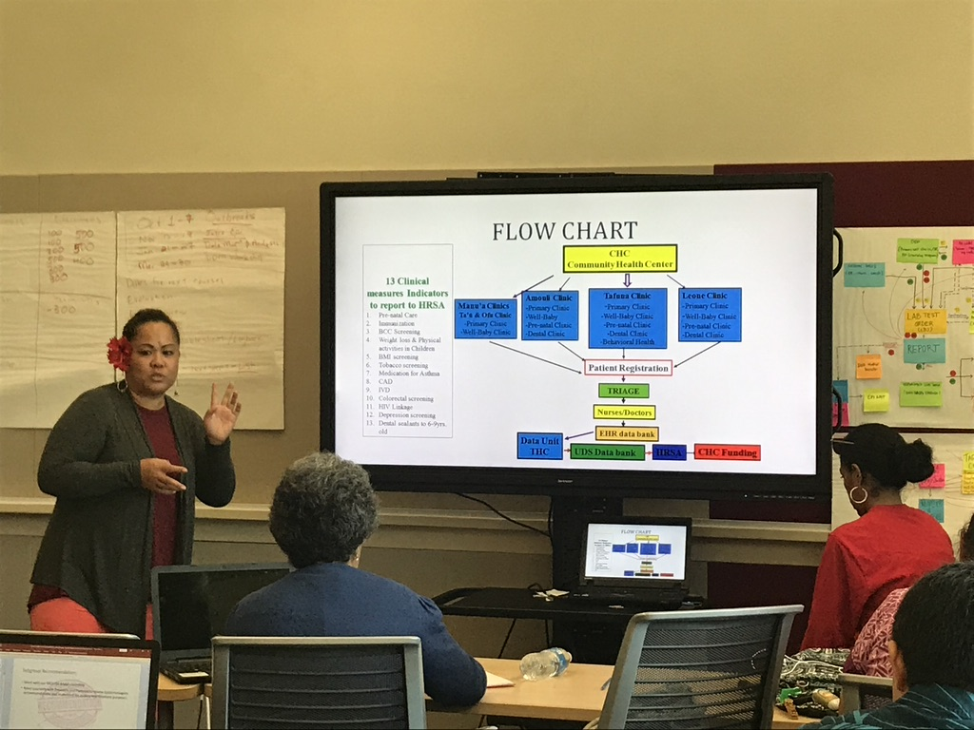
Course Delivery
Online coursework and face-to-face session

Slide 11
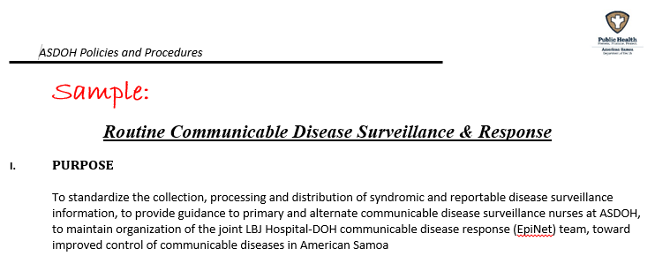
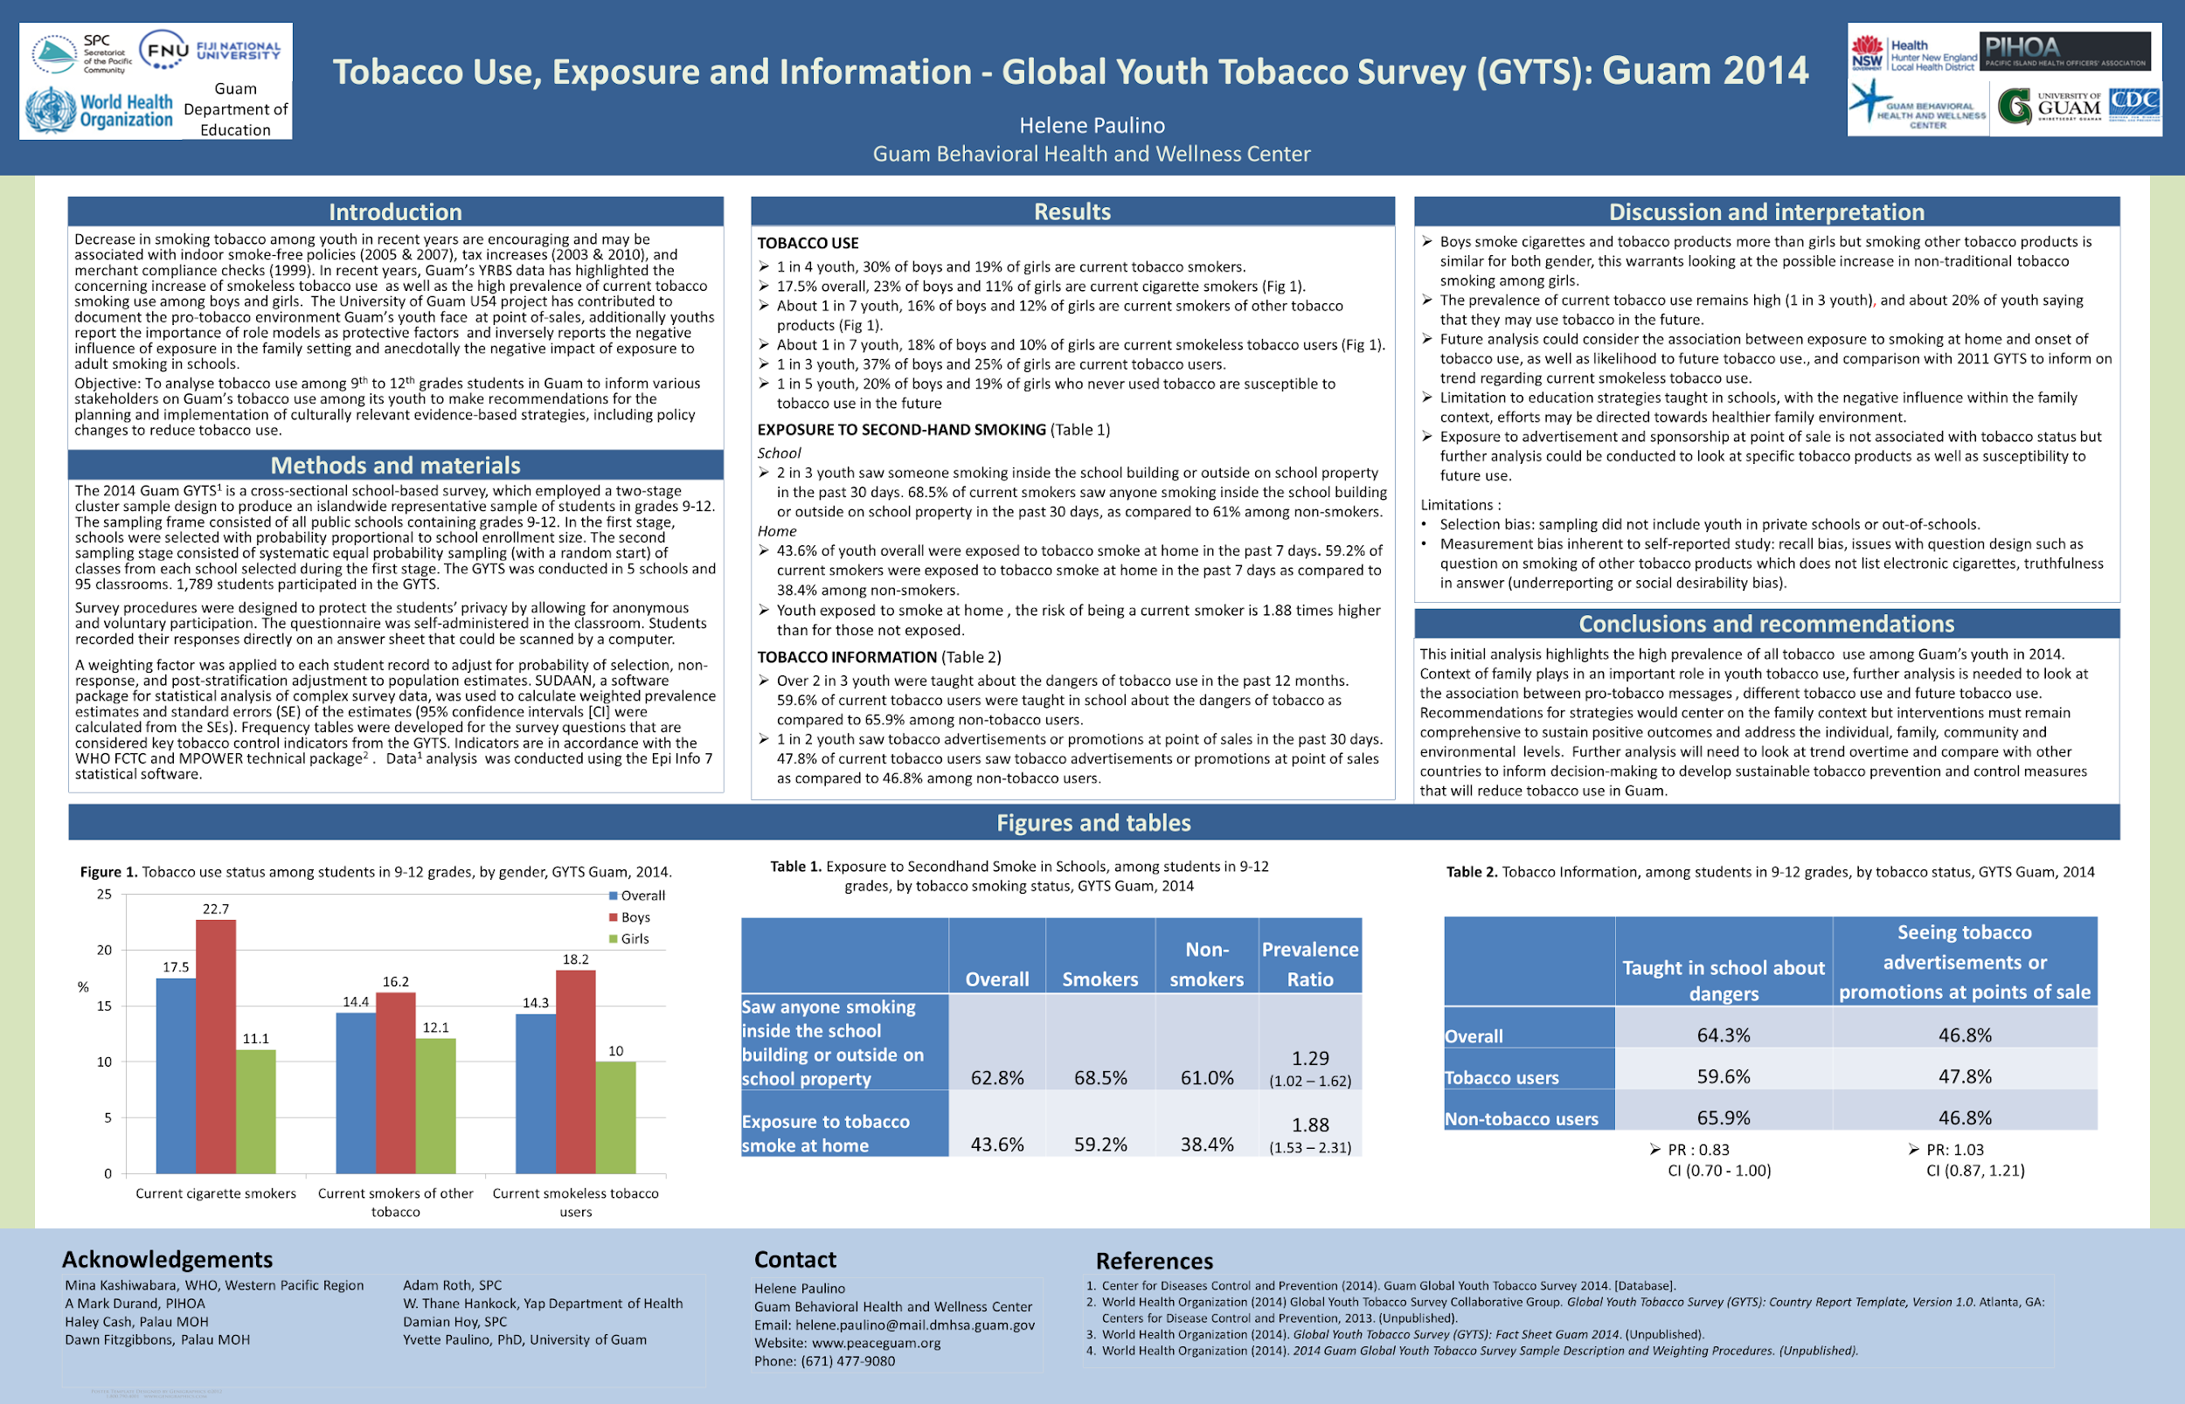
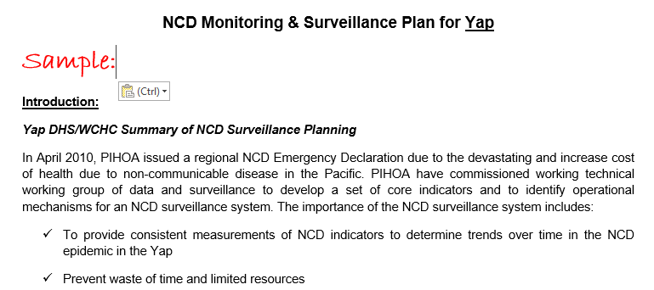
“From Work, At Work, For Work”
Training delivered to build both systems and skills

Slide 12
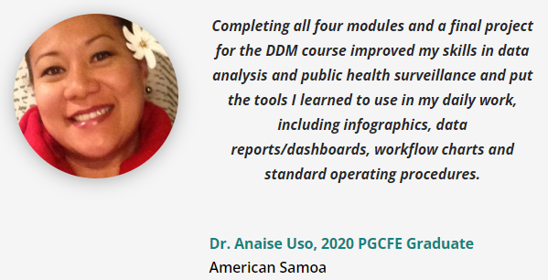
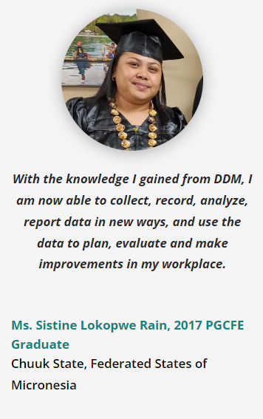
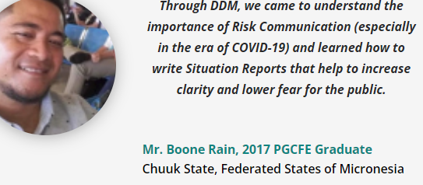
Learning by Doing, Voices of PGCFE Graduates

Slide 13
CONTACT US
Strengthening Health Interventions in the Pacific
PIHOA Guam Office
Pacific Island Health Officers Association
GCIC Building
414 W Soledad Avenue, Suite 906
Hagåtña, GU 96910
PHONE: (671) 735-3337
Hélène Le Mouëllic
SHIP Program Manager
Elua mori
SHIP Program Administrator
helenel@pihoa.org
eluam@pihoa.org
PIHOA.ORG

Slide 14
Thank You
REGIONAL EPI UNIT
Dr. Mark Durand, SHIP Faculty Lead
Dr. Haley Cash, NCD Regional Epidemiologist
Dr. Thane Hancock, CDC Preparedness Epidemiologist
Hélène Le Mouëllic, SHIP Program Manager
Stephanie Kern-Allely, CD Regional Epidemiologist
Dr. Yvette Paulino, PPHF Program Manager
PIHOA.ORG

