Slide 1
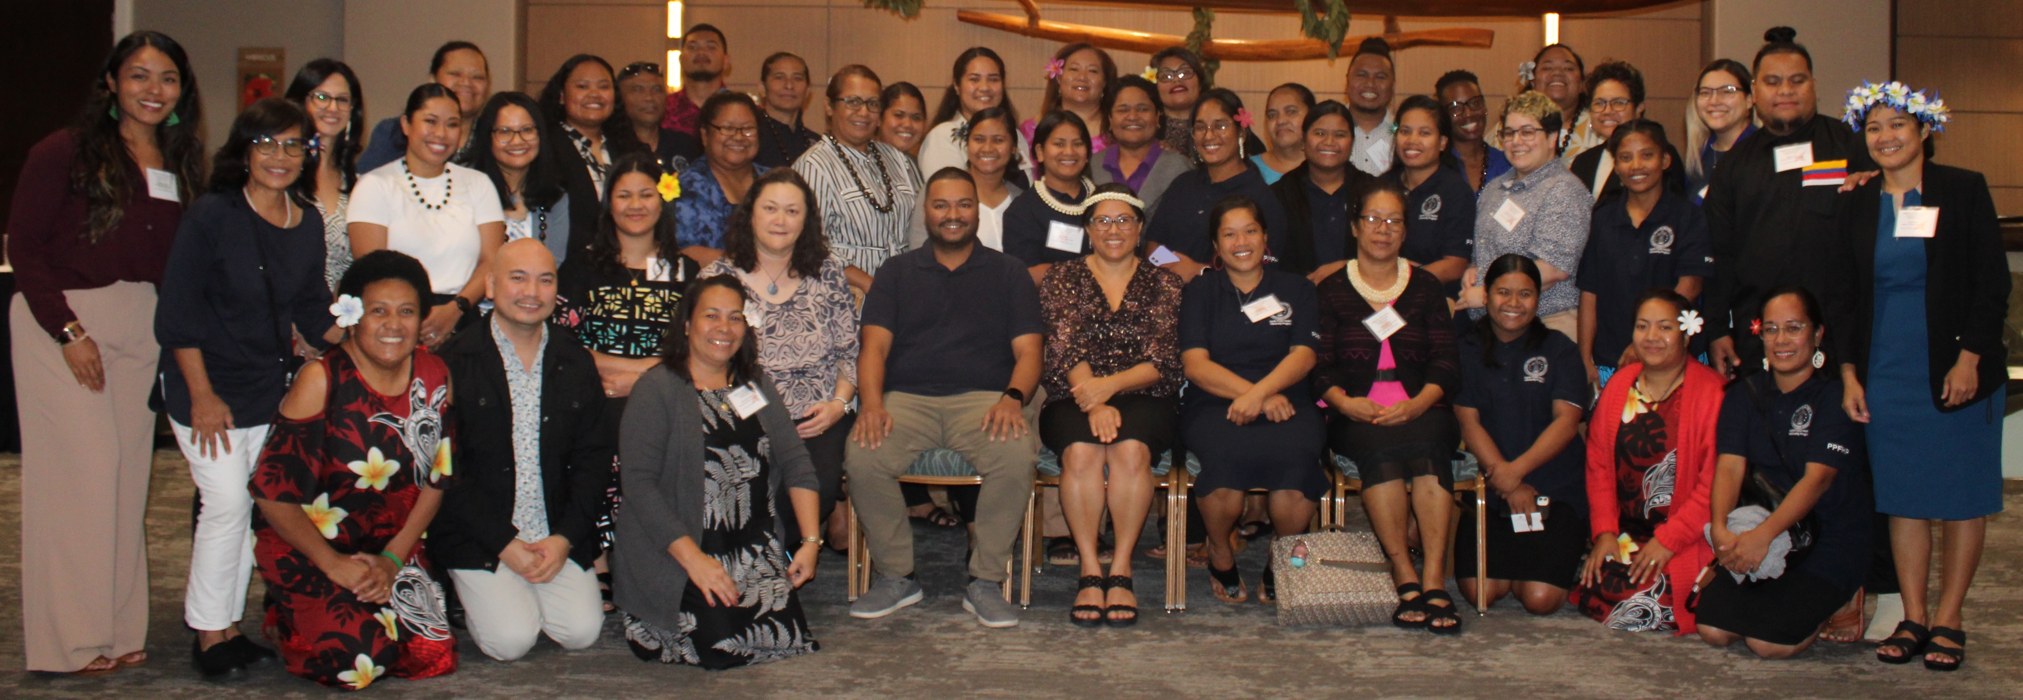
Pacific Public Health Fellowship Program
(PPHFP)

Slide 2




Pacific Public Health Fellowship Program
What
IS THE PPHFP?
Why
DO WE HAVE THE PPHFP?
How
DO WE DELIVER THE PPHFP?
The PPHFP is a 2-Year training program that upskills new college graduates in practical hands-on Public Health training, to strongly enter the Public Health workforce.
To raise the next generation of Public Health champions and leaders across the U.S. Affiliated Pacific Islands.
Learning Pathway
1. Curriculum
2. Practical hands-on
training in a Host Site

Slide 3

Learning Pathway
8 Public Health Domains
    Meet 40 Competencies
Online Learning Modules on each Domain
Monthly Online Interactive Forums
    CDC TRAIN Course
    (Public Health 101 Series)
    FEMA Emergency Preparedness Course
    Weekly ELSC Course
    DDM Course (Certificate in Field Epidemiology)
    Monthly ‘Meet the Experts’
    Monthly Conversation Hour
    Additional Jurisdiction / Field Specific Training
Health Equity
Health Policy & Program Planning
Partnership
Public Health Science
Analytics and Assessment
Health Communication
Health Management & Finance
Leadership & Systems Thinking
CURRICULUM

Slide 4

Learning Pathway
Host Site Supervisor
Develop a Workplan based on priority
health need in Jurisdiction
    Daily field work
    Participation in Conferences
    (E.g., APHA, AMCHP, etc)
    Participation in PIHOA Executive Board Meetings
PRACTICE

Slide 5
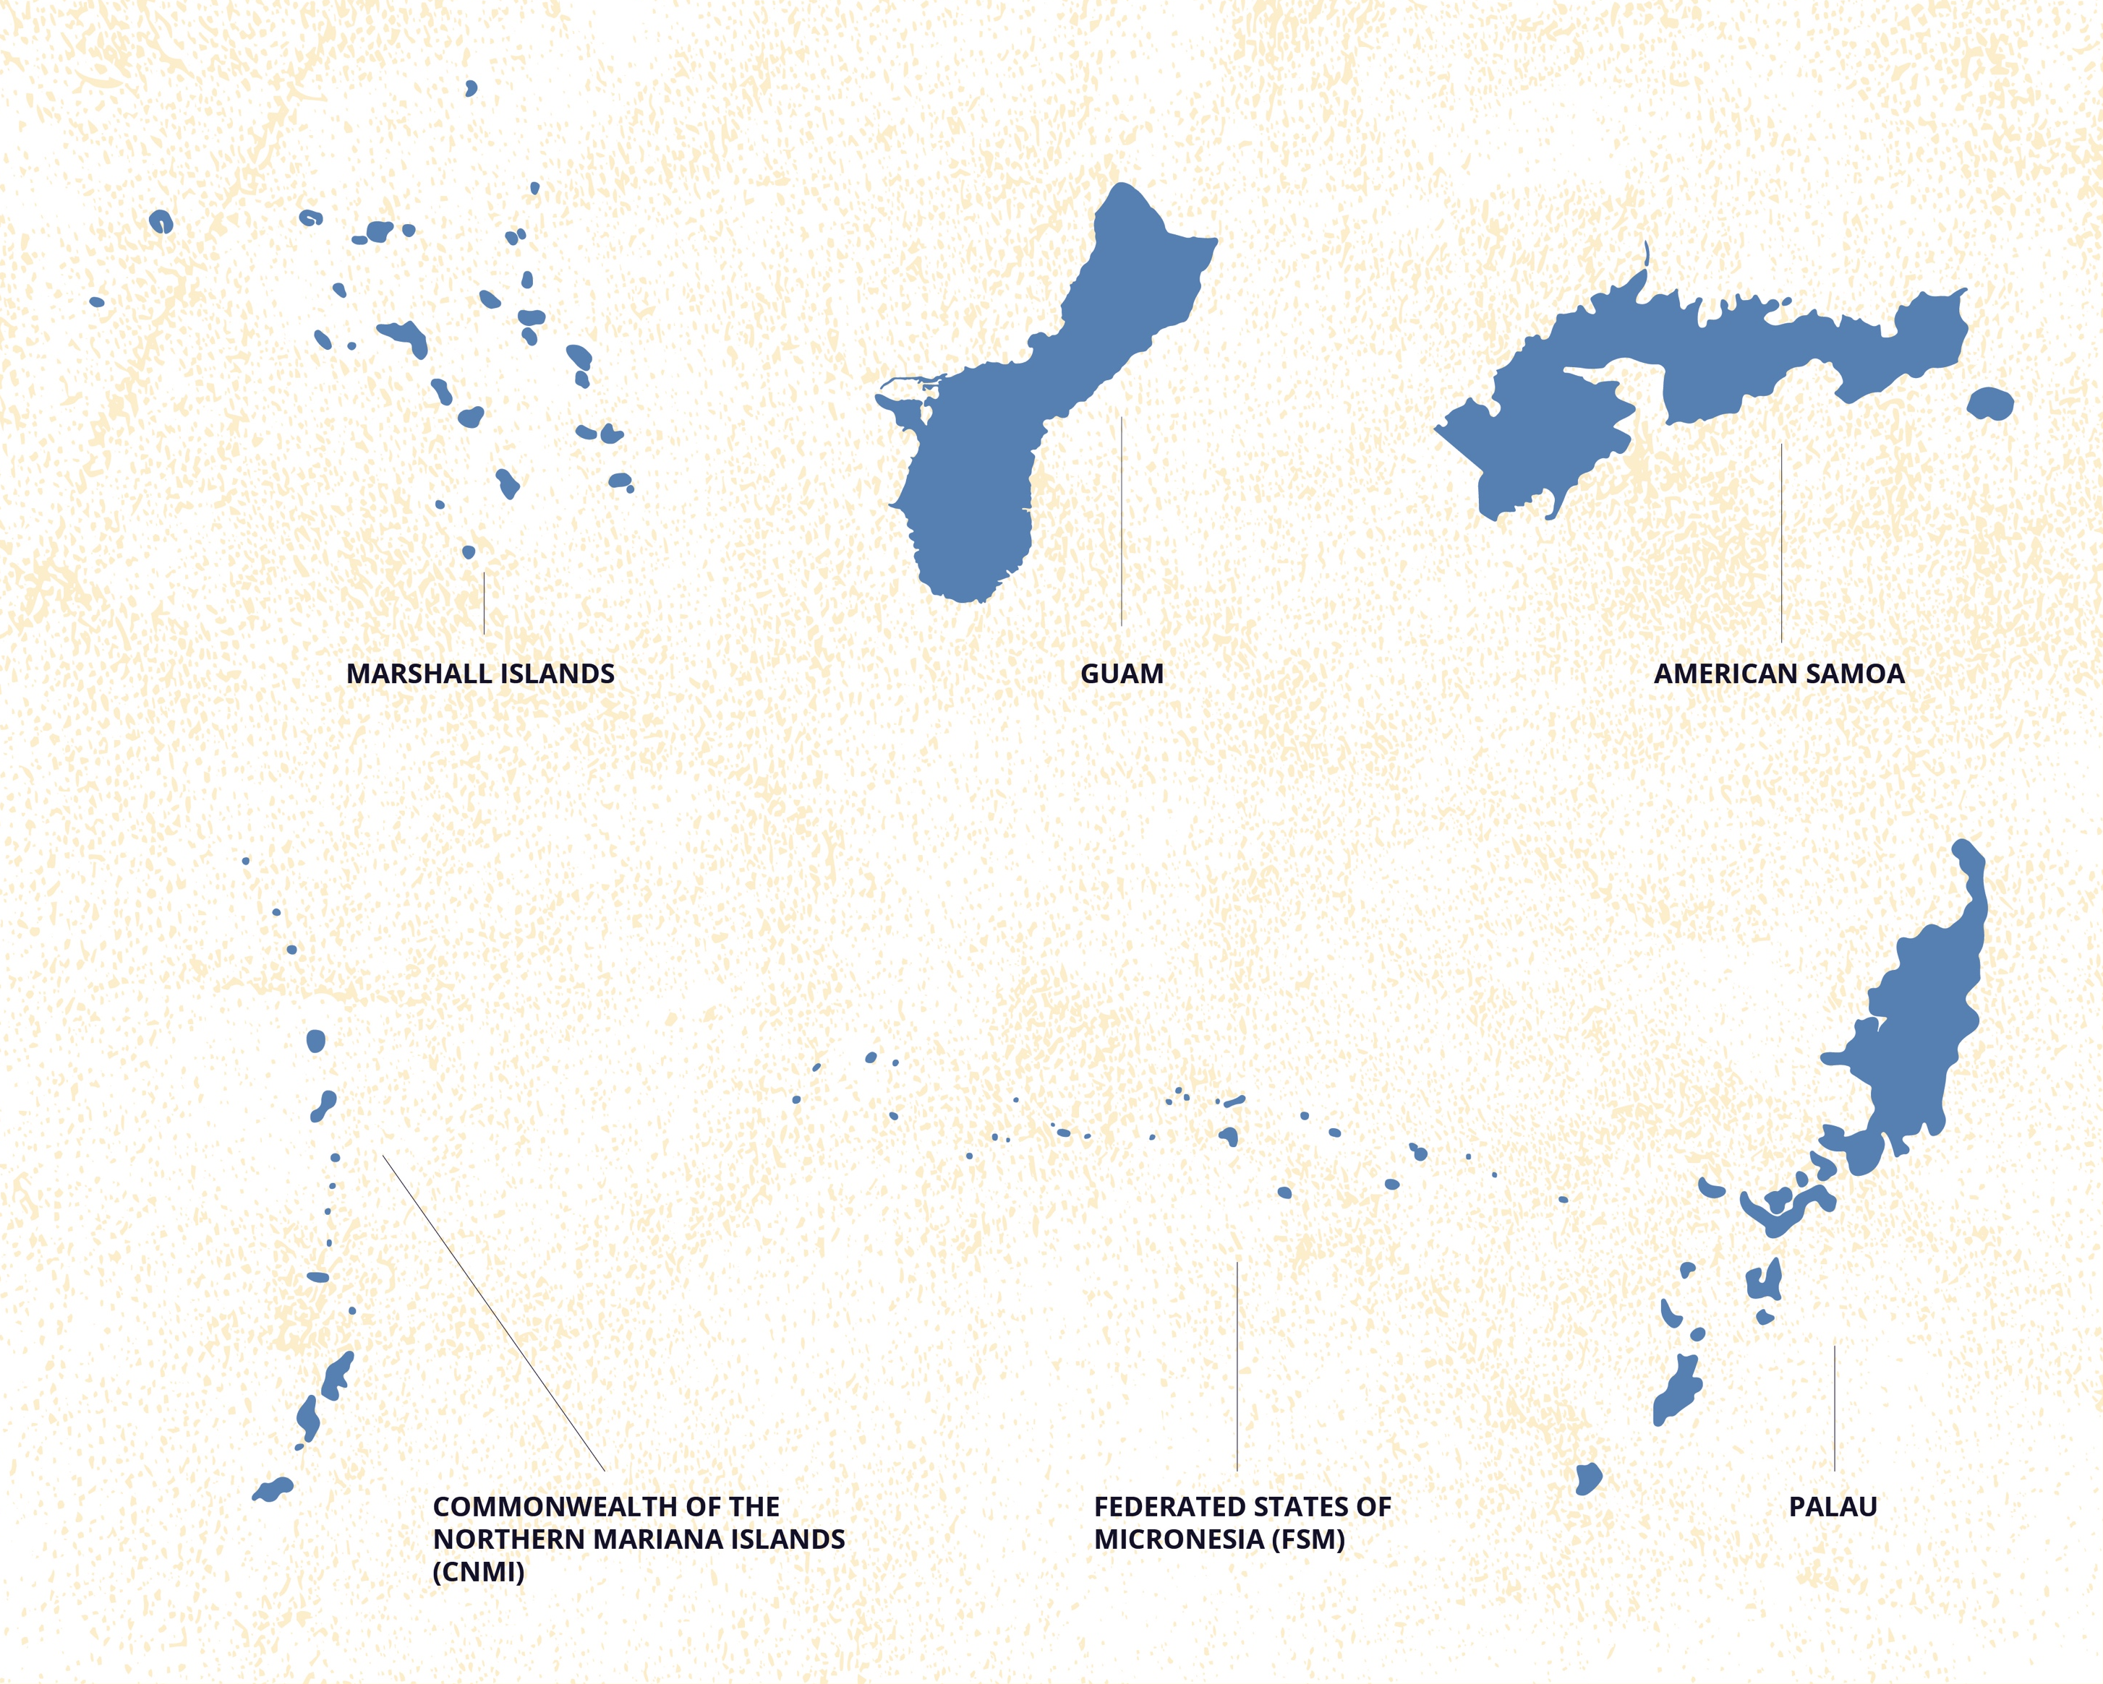
Where are the PPHFP Fellows?
2
6
8
1
2
22
Fellows
9
Host Sites
1
2
2
1
5
5
5
Graduates
Notes:
- PPHFP started in 2020, with 2 Fellows.
- 25 Fellows, across 8 sites.
- All USAPIs represented except for YAP.
- 81% female

Slide 6
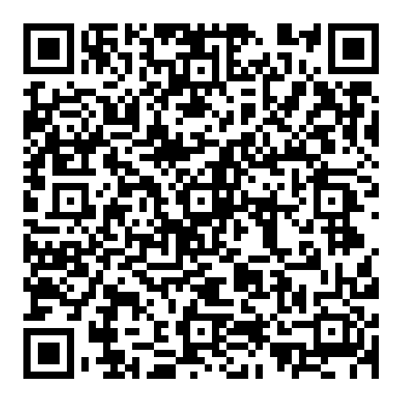

PPHFP Applications
ELEGIBILITY
Strong interest in pursuing a Public Health career
Associates or Bachelor Degree in a field that is applicable to Public Health
Early career graduates recently graduated within the past 2 years
Aspire to serve the USAPIs upon completion of the program
LIVING ALLOWANCE
APPLICATION PERIOD (Cohort 5)
April – June 2024
PROGRAM COMMENCEMENT
August 1, 2024 – July 31st 2026
Scan QR Code
for more PPHFP information

Slide 7
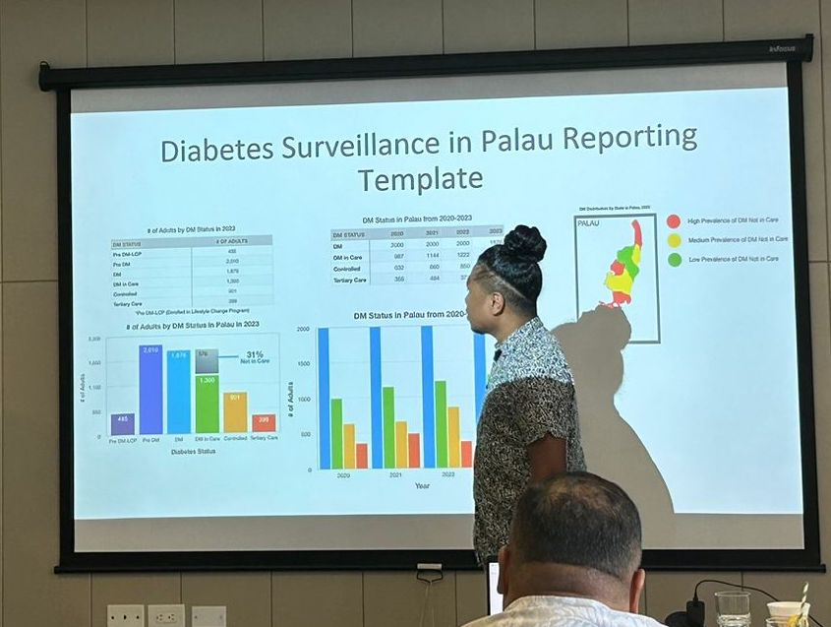
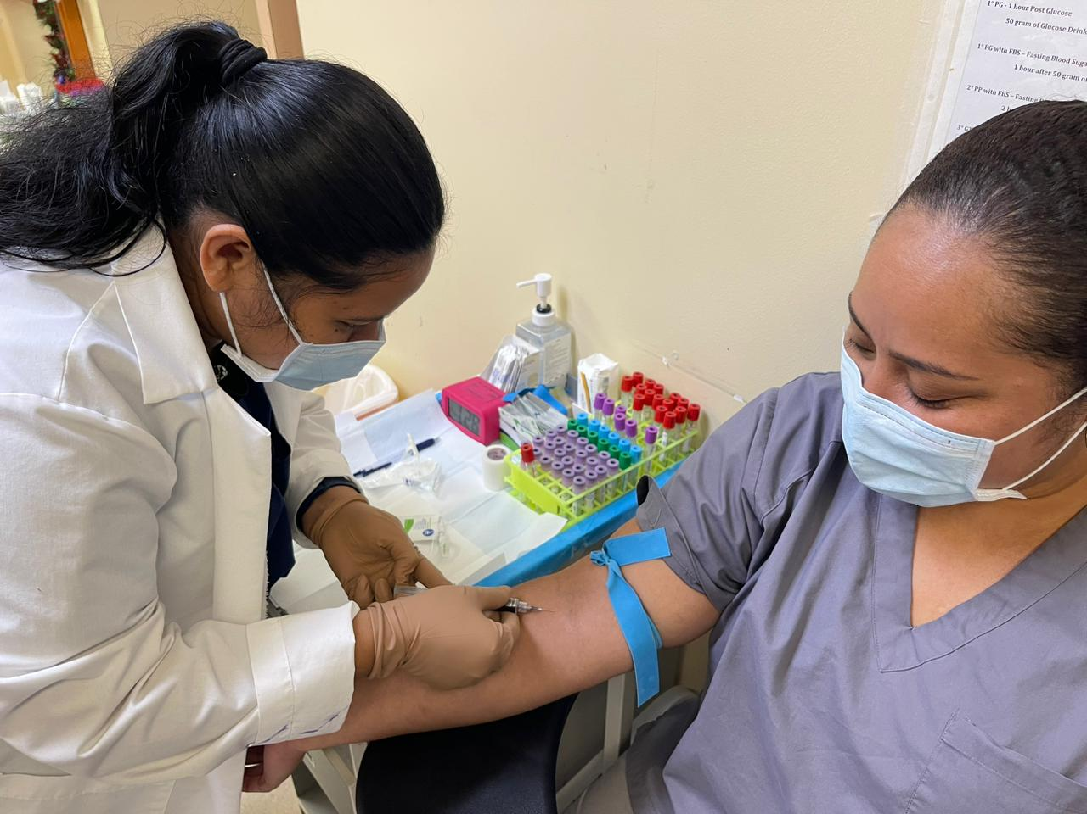
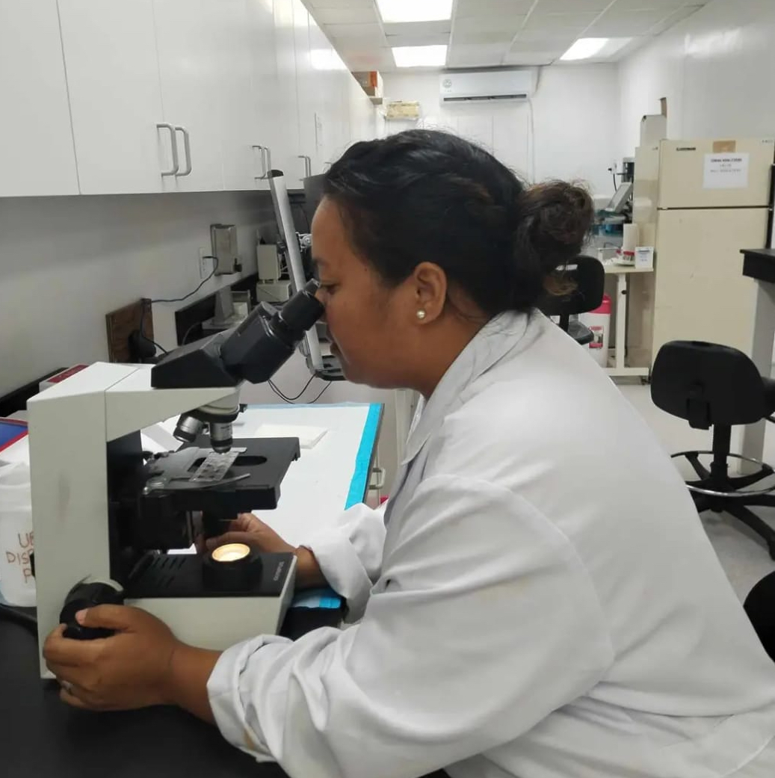
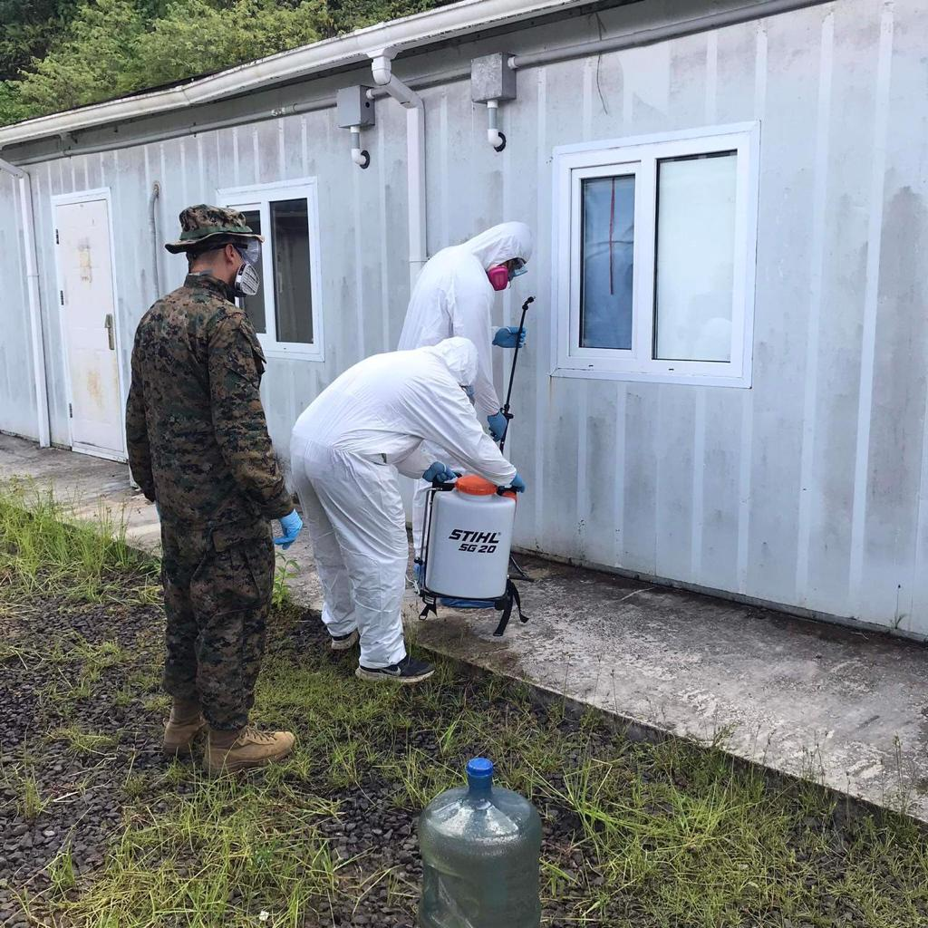
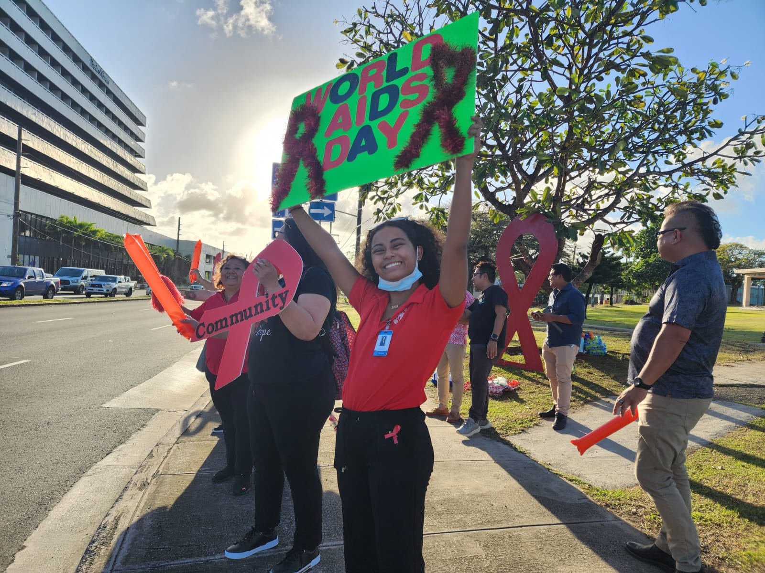
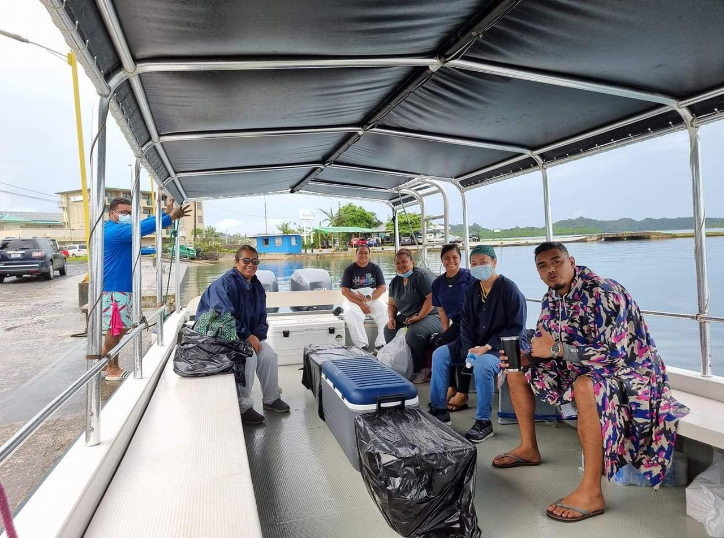
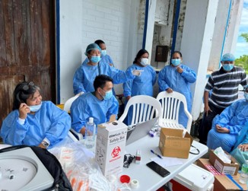
Fellows in the Field

Slide 8
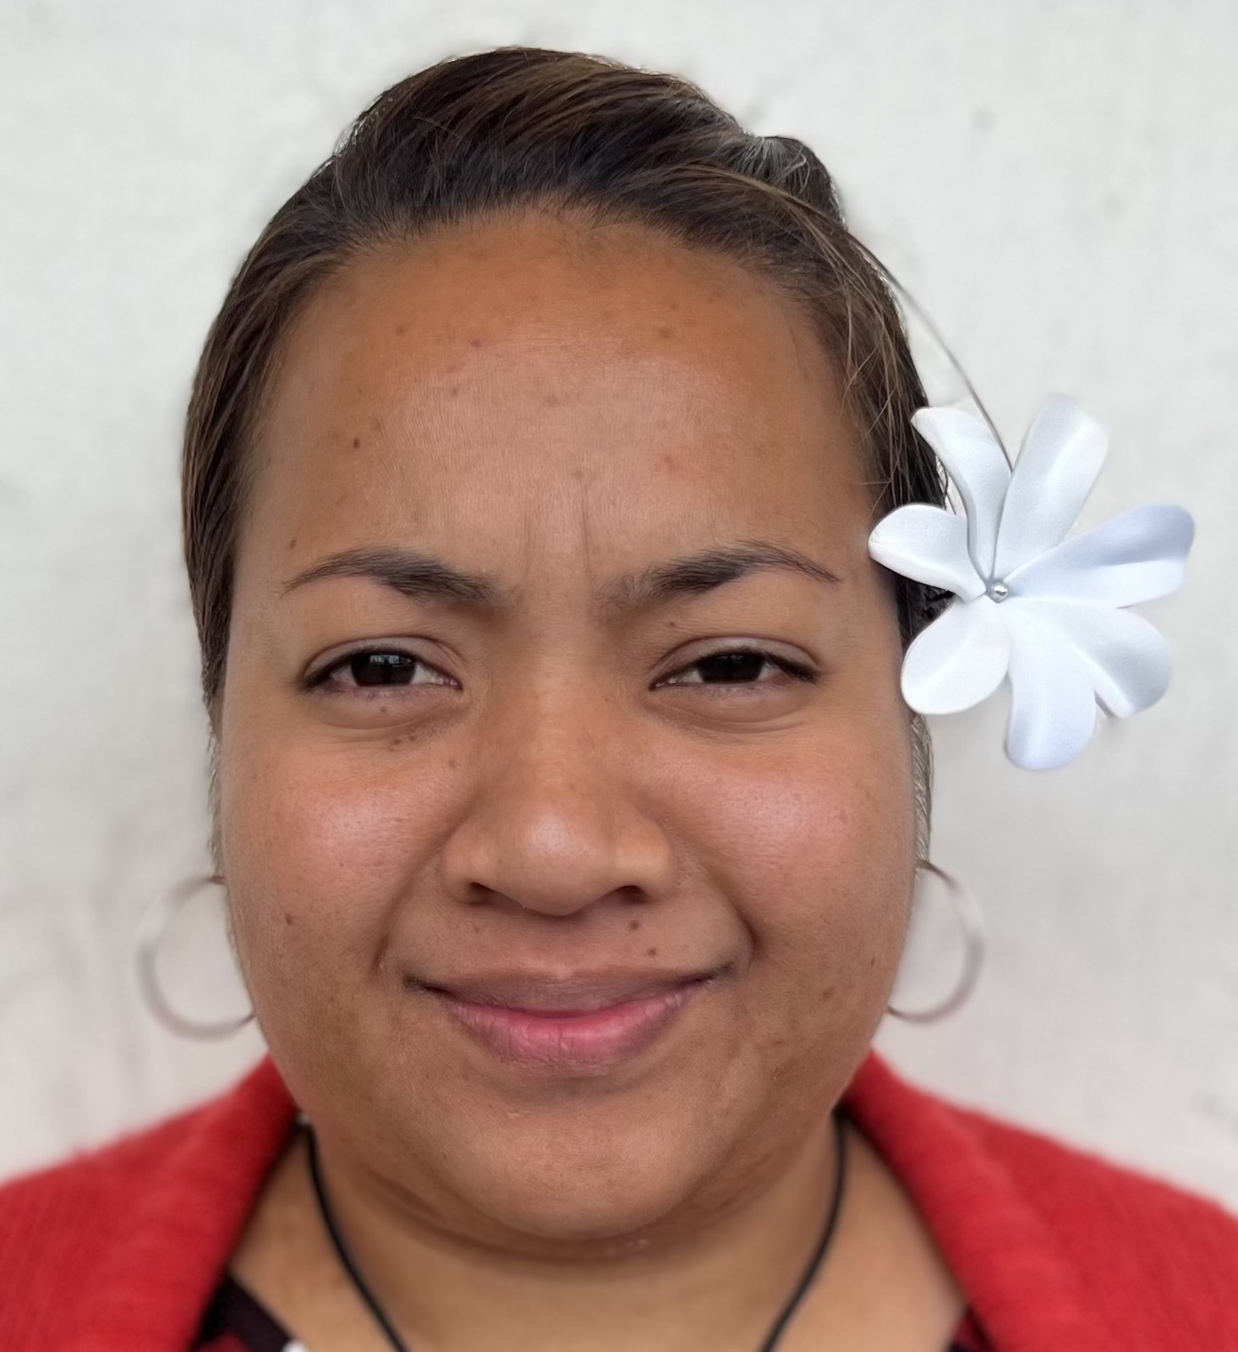
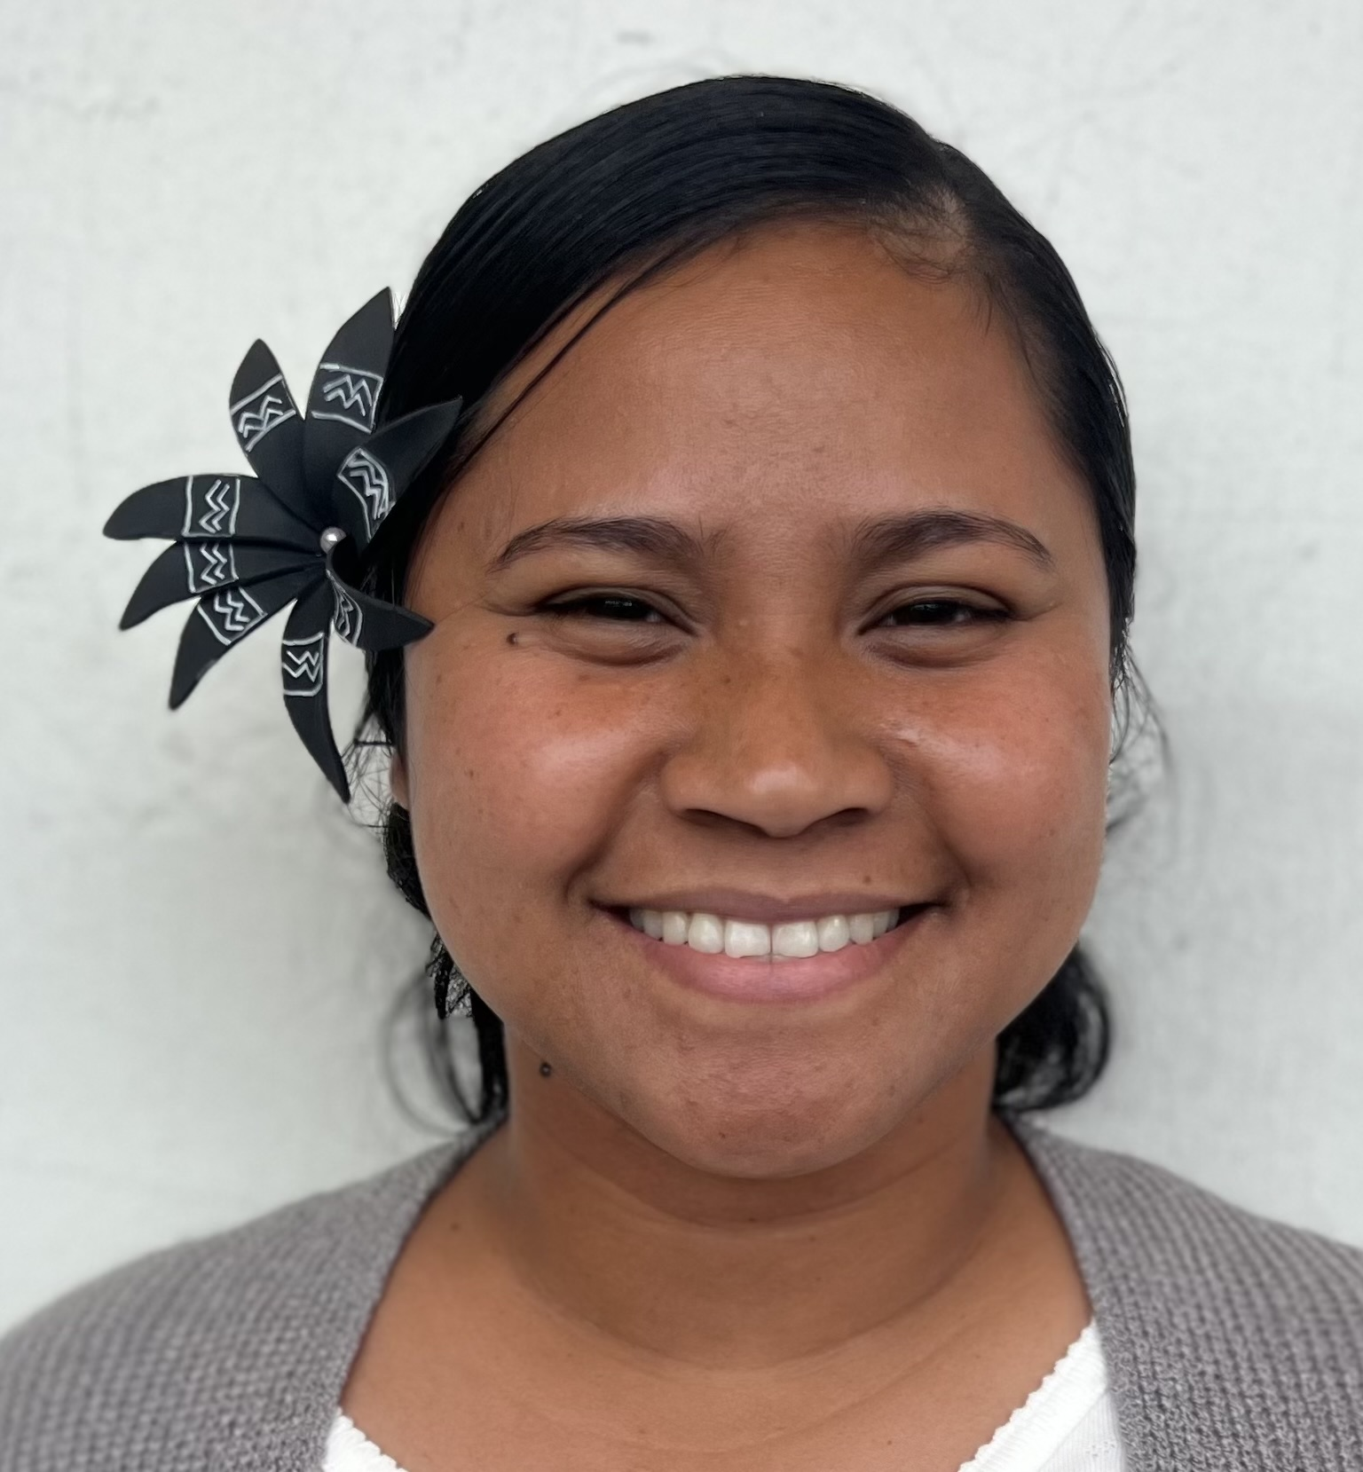
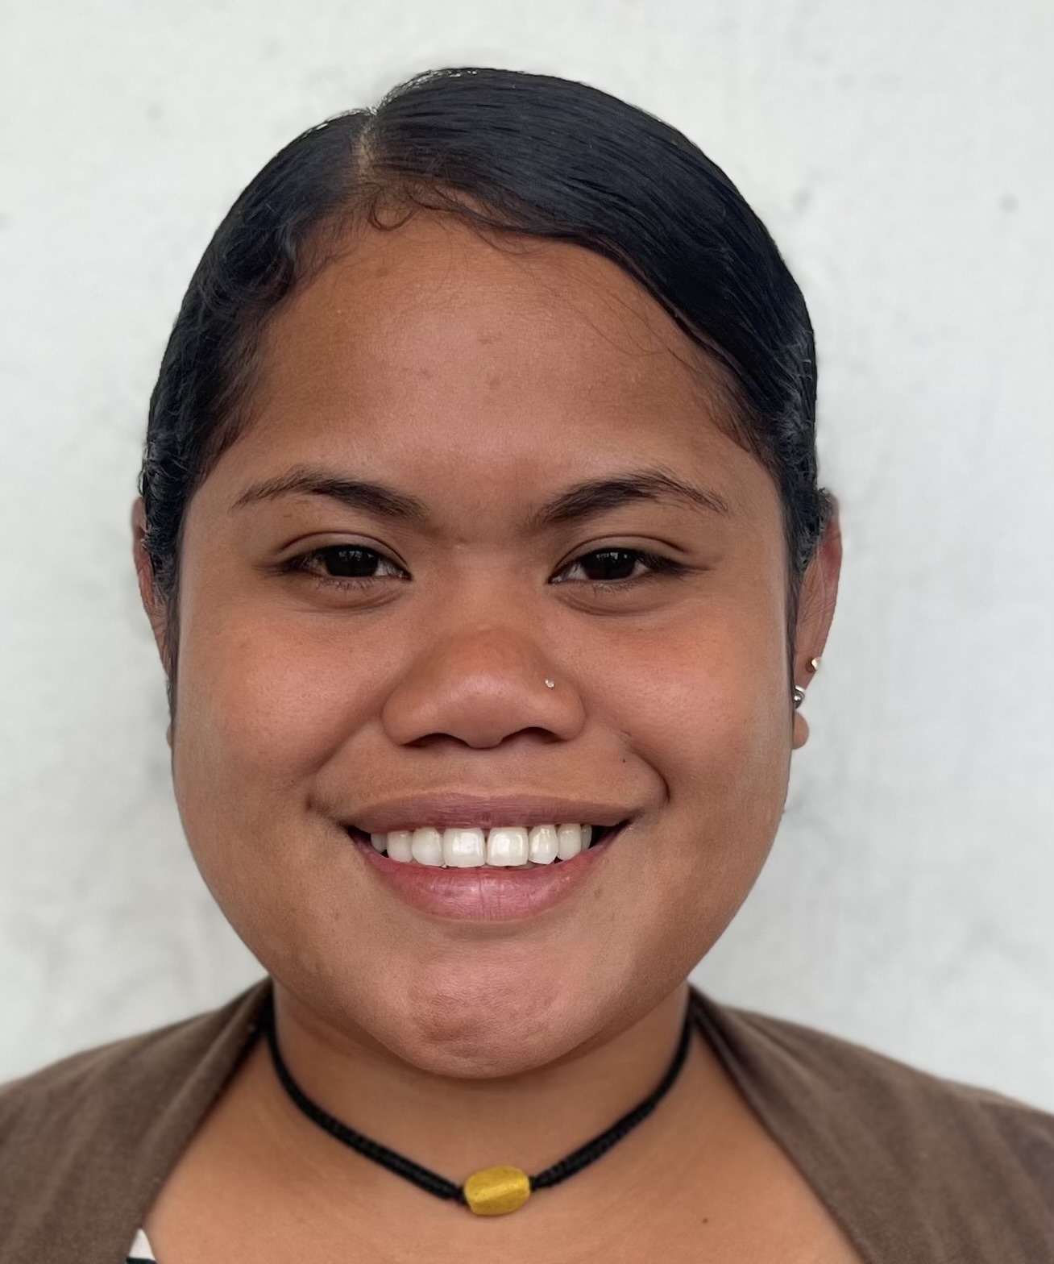
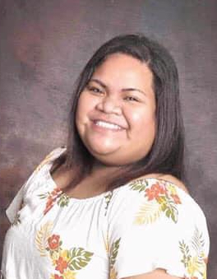
Examples of Lab / STI Fellows
Karmi Alik
Pohnpei
Pohnpei State Hospital Laboratory
Laboratory
Supervisor: Wati Vulava
Hope Edeluchel
Palau
Palau Ministry of Health
and Human Services
Laboratory
Supervisor: Mere Cama
Kedei Yaoch
Palau
Palau Ministry of Health
and Human Services
Communicable Disease Program
Supervisor: Connie Olikong
Lu-Ann Edward
Pohnpei
Pohnpei Community Health Centre
STDs & Diabetes Services
Supervisors:
Dr. Josephine Saimon & Dr. Fruston Likiaksa

Slide 9

On behalf of the PIHOA Pacific Public Health Fellowship Program
We want to express our sincerest appreciation to our Lab partners
Soulmaz Rostami
Program Manager
Pacific Public Health Fellowship Program
PIHOA | Pacific Island Health Officers Association
e | soulmaz@pihoa.org
w | www.pihoa.org

